Slide 1



Upper Columbia conservation commission (UC³)
Kate Wilson
Montana Dept. of Natural Resources & Conservation
CRB June 7, 2018

Slide 2

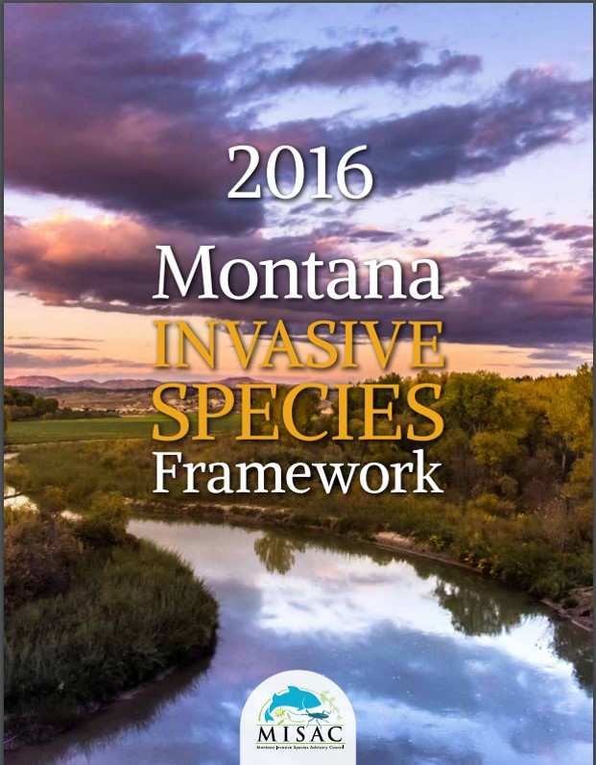
BAckground
Montana
  Population 1,033,000
  56 counties/624 cities & towns/7 Indian Nations
  10 million visitors annually
  Fishing, boating & recreation destination
Roles & Responsibilities for AIS in Montana
  Fish, Wildlife & Parks
    Lead for AIS Program & Operations
  Dept. of Natural Resources & Conservation
    Montana Invasive Species Council (MISC)
    Upper Columbia Conservation Commission (UC3)
    AIS Grants
    Facilitate interagency coordination
  House Bill 622: 2017 Montana Legislative session

Slide 3
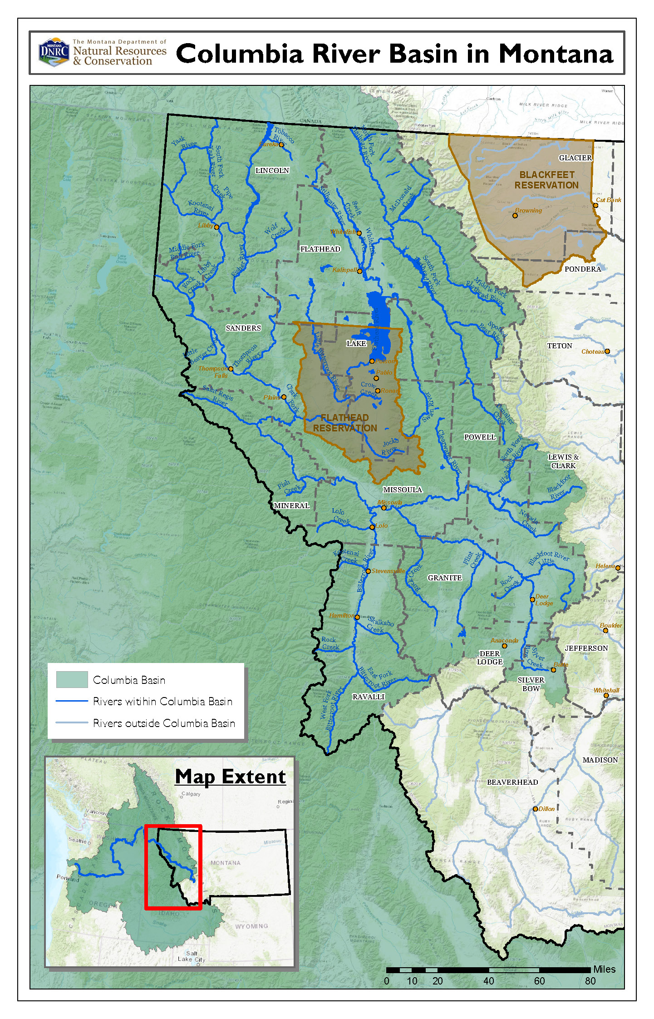
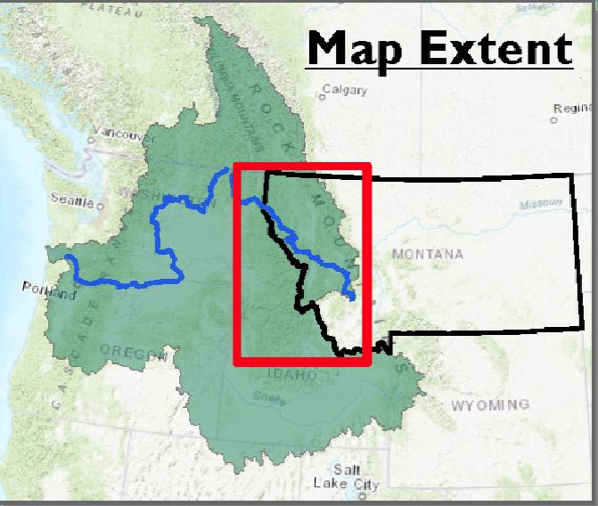
Montana Tributaries within Columbia River Basin:
  Blackfoot River
  Bitterroot River
  Swan River
  St Regis River
  Thompson River
  Stillwater River
  Tobacco River
  Yaak River
  Flathead River/Lake
  Clark Fork River
Southern portion: Bitterroot Valley/Deer Lodge
Northern portion: Eureka

Slide 4

Purpose & Duties
Monitor condition of aquatic resources
Coordinate development of annual monitoring plan
Encourage close cooperation between federal, state, regional, tribal and local water resource managers
Encourage international coordination between Montana and BC
Develop and implement education and outreach strategy
Encourage economic development by reducing and controlling invasive species
Provide annual report
Make recommendations to Governor, federal/state/Tribal/local agencies for reducing threats of AIS

Slide 5
APPOINTED/VOTING Members
UC3 Representation
Montana Invasive Species Council | Private Industry
Conservation District | Private Landowner
Confederated Salish & Kootenai Tribe | Member at Large
Recreation Organization | Ex-Officio: Representatives (House, Senate)
Electric Cooperative | Ex-Officio: NWPPC, NRCS, BLM, NPS
Hydropwer | Ex-Officio: USFS, USFWS, BOR, USACE

Slide 6
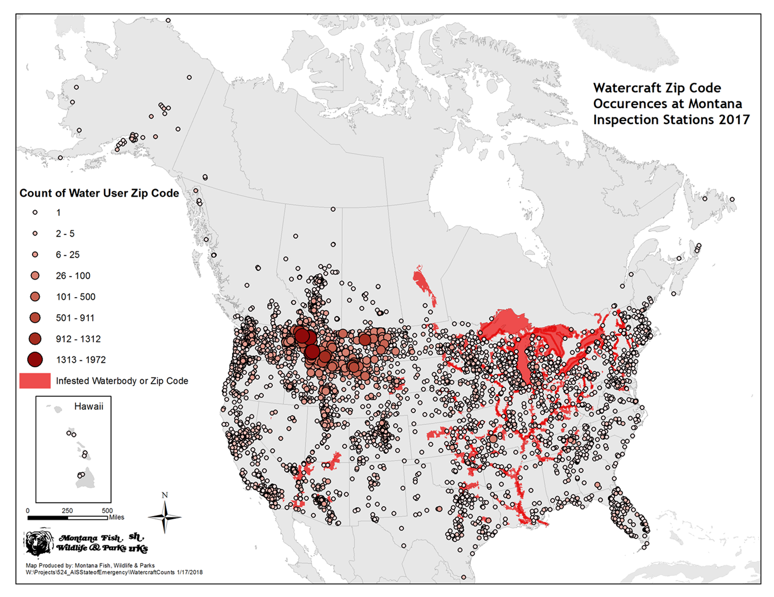

Slide 7
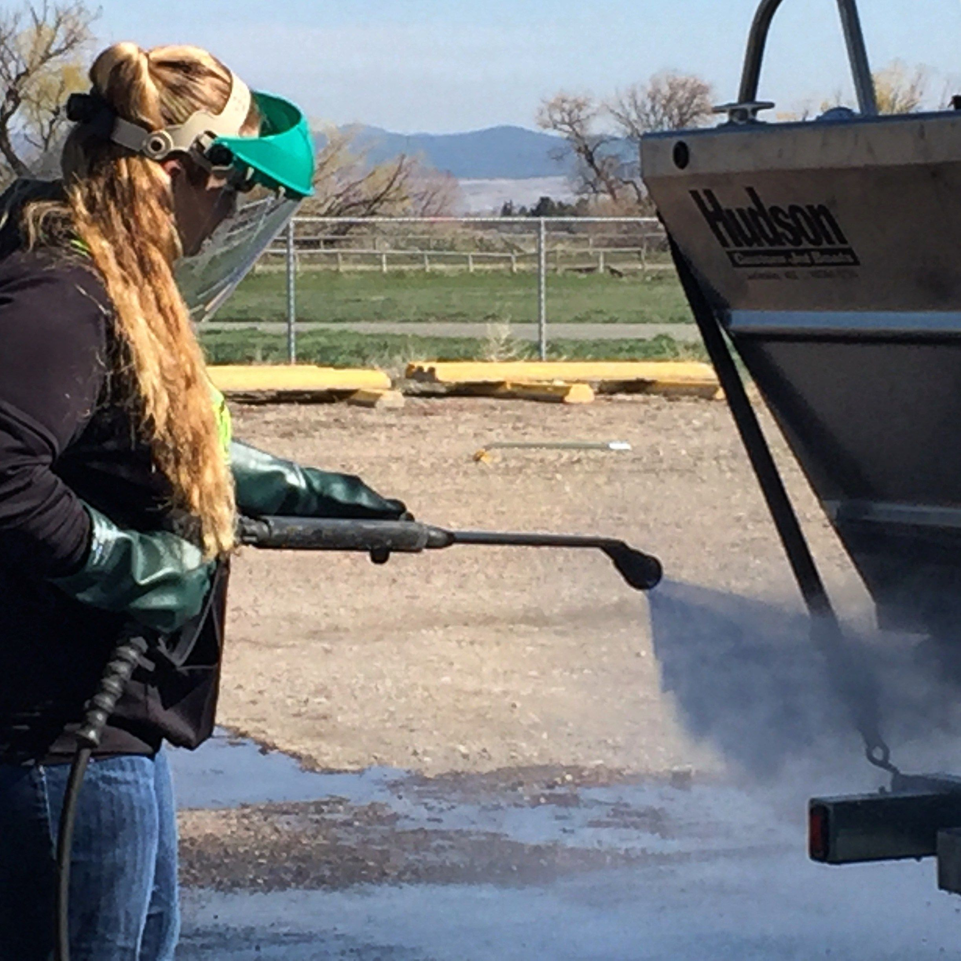
UC³ Highlights
Workshop on Watercraft Inspections & Monitoring
  Dec 11-12: Inspections & Monitoring
  Objective: Share information & enhance cooperation among partners in the basin
Quarterly meetings
Sub-committees
  Education & Outreach
  Response Preparedness
  Early Detection/monitoring
  Watercraft Inspections
Flathead Basin Rule: mandatory inspection

Slide 8
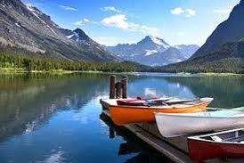
UC³ Highlights
BOR Funding
  E&O: Training, website, materials
  Monitoring network expansion
  Marina pilot project
Containment Recommendations
  Close access points at Tiber that cannot be staffed
  No ‘local boaters’ that reside west of the divide
Tiber status (current)
  Compromise
Next: June 13th meeting
  State funding mechanism
    Sticker, gas tax, angler pass, hydro???
    2019 Legislative Session: magic solution

Slide 9
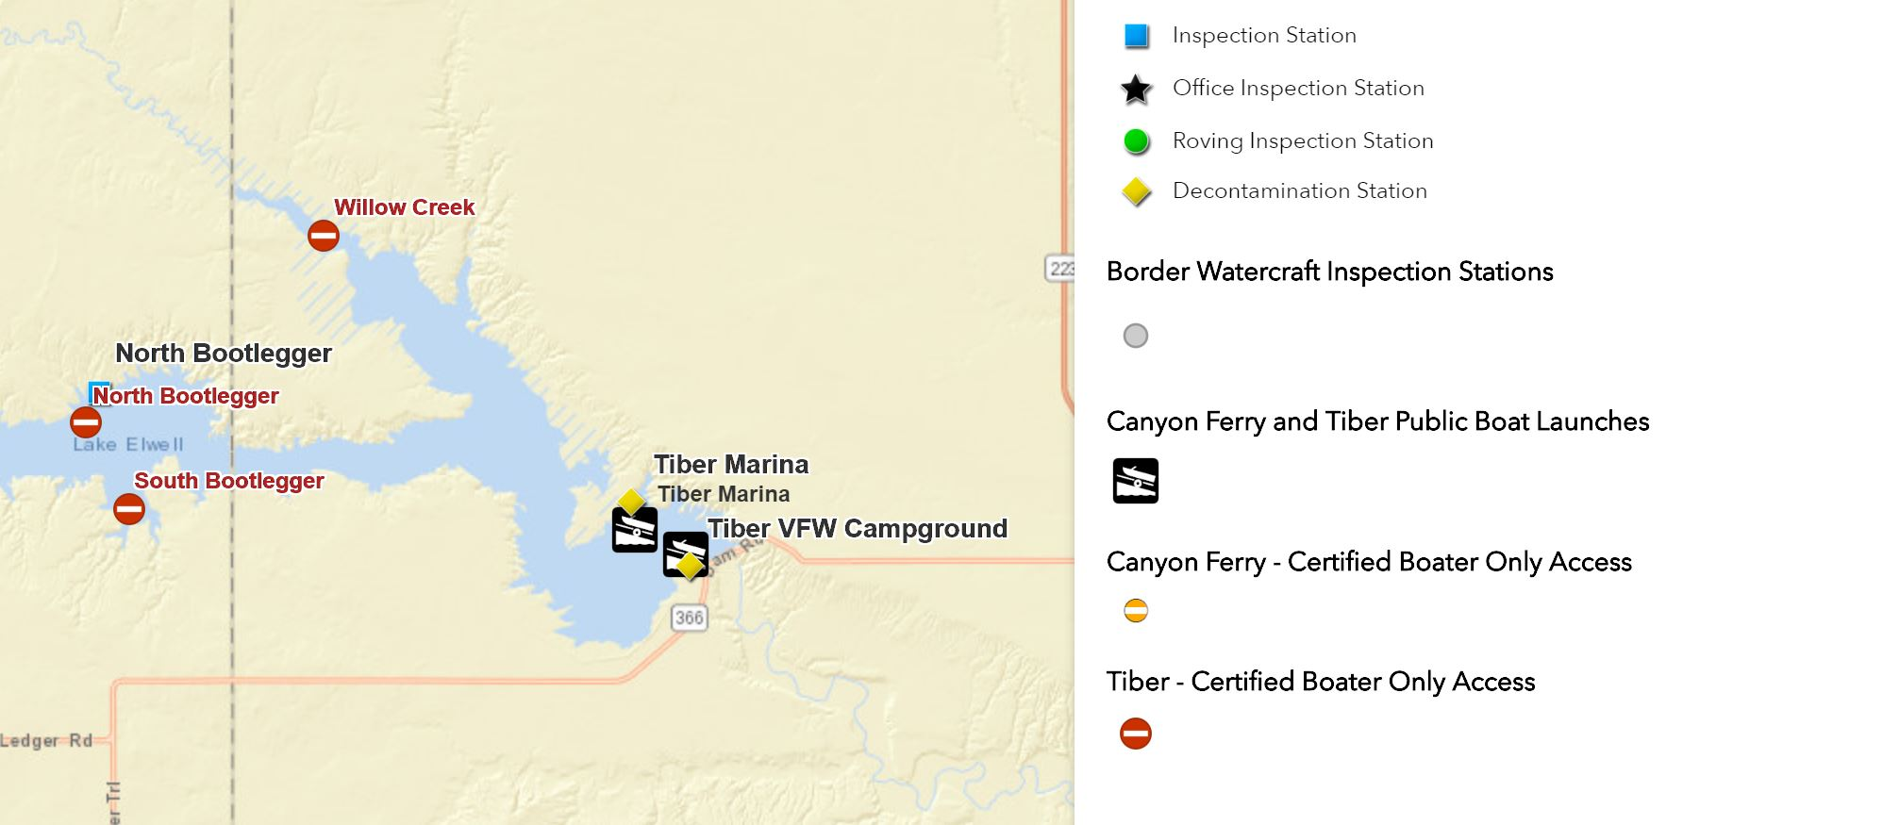

TIBER UPDATE
Tiber: May 11th (7 days/daylight hours)
  Tiber Marina
  VFW West Campground
  N. Bootlegger
Tiber Certified Boater Access (gate code):
  S. Bootlegger
  Willow Creek
Certified Boater Program: East of Divide residents only

Slide 10
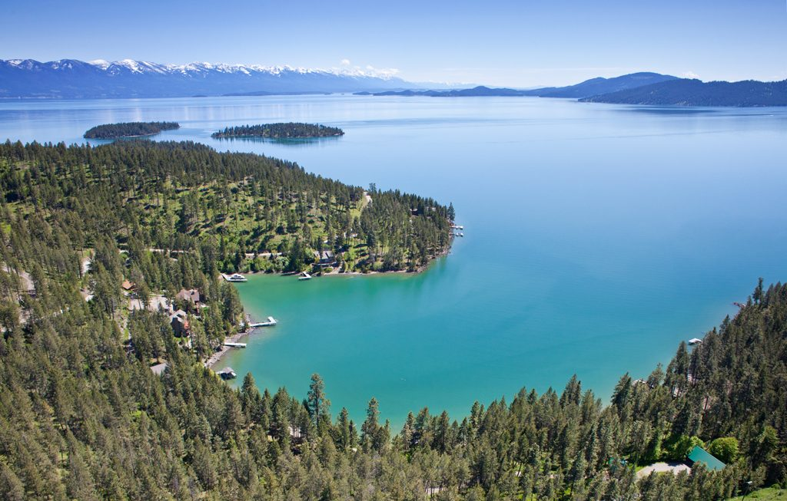
Next crb rapid response exercise: flathead lake
Flathead Lake: shared management
  BIG
  Headwaters
  Destination/high risk
  CSKT/state management
  2 counties
September 2018
Learn from lessons in 2016
Scenario development
Incident Command
Treatment option?

Slide 11
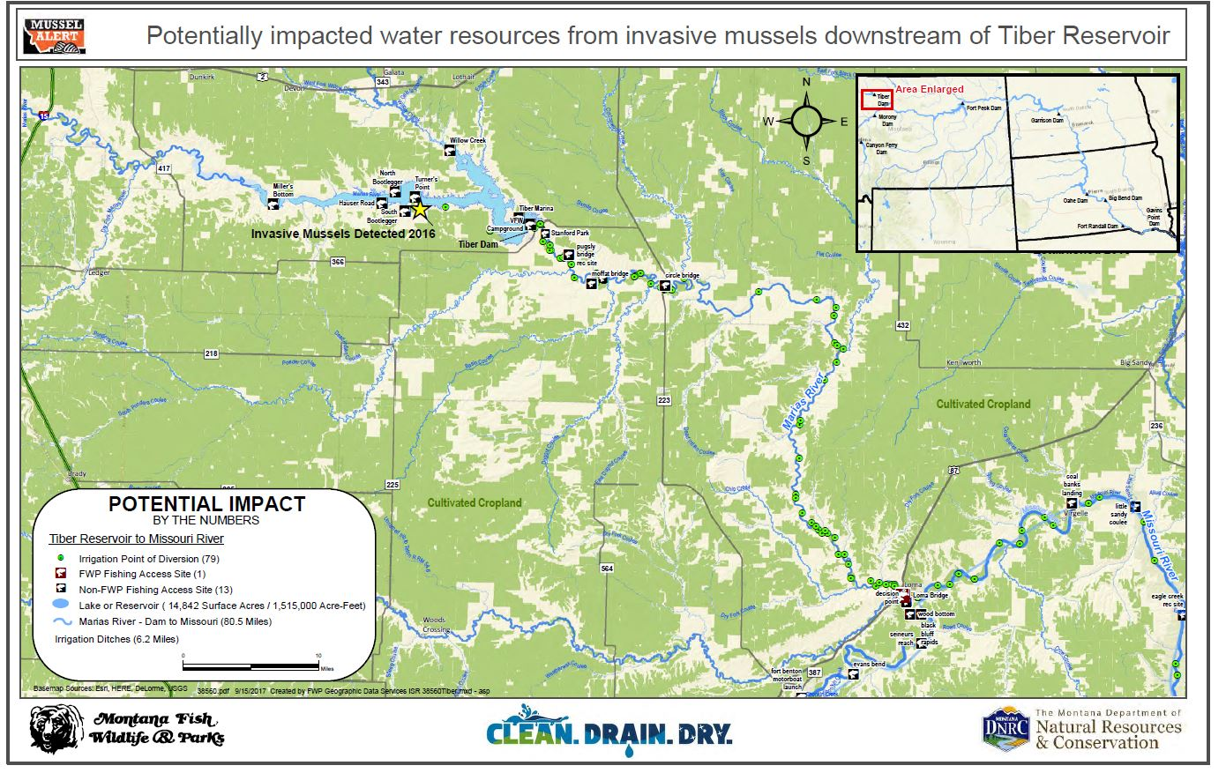
Geographic response planning
Geographic Response Plan concept & potential partnerships

Slide 12
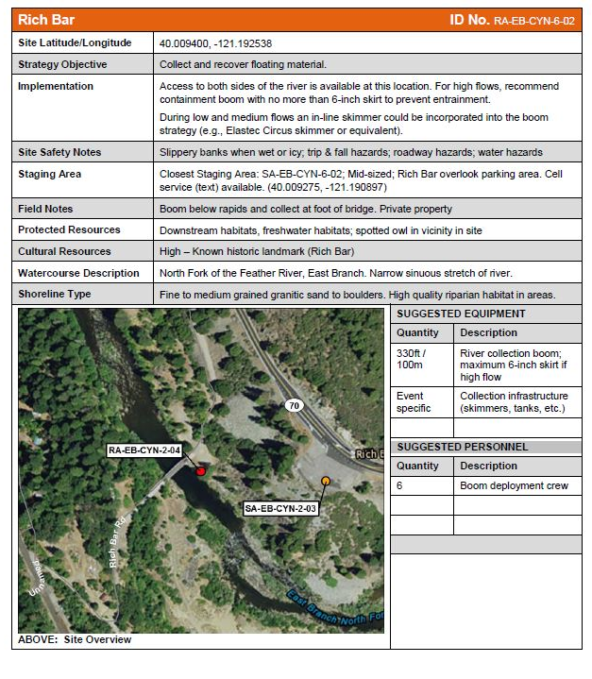
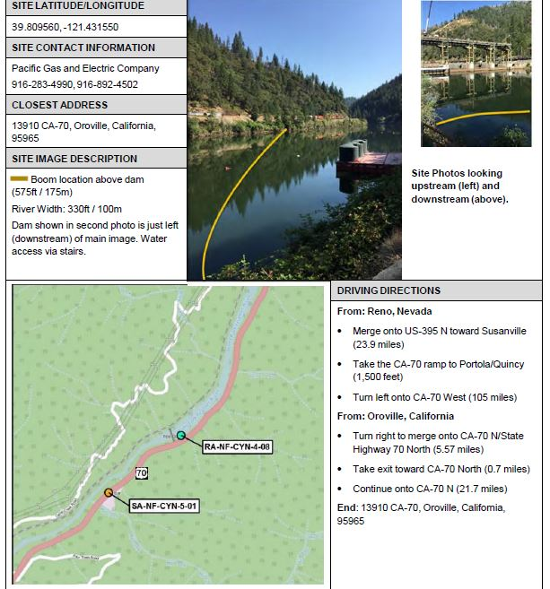
Rethinking Response
Look to industry for potential partnerships on
map-based geographic response planning tools
Same approach/concept
  Infrastructure & water users
  Endangered/threatened species
  Deployment of response resources
  Incident Command System

Slide 13

Northern Rockies coordination group (NRCG) mandatory protocols
NWCG Guide to Preventing AIS Transport by Wildland Fire Operations (PMS 444) provides excellent science-based BMPs
Issues last season in region:
  Confusion about which parts of Guide to apply
  Lack of consistency
  Voluntary (‘encouraged’ vs. ‘mandatory’ language)
  Uncertainty with products and potential damage to equipment
NRCG Aviation and Equipment Committee: supplemental directive
  Columbia River Basin
  Focus on invasive mussels
  Aviation and ground based equipment

Slide 14
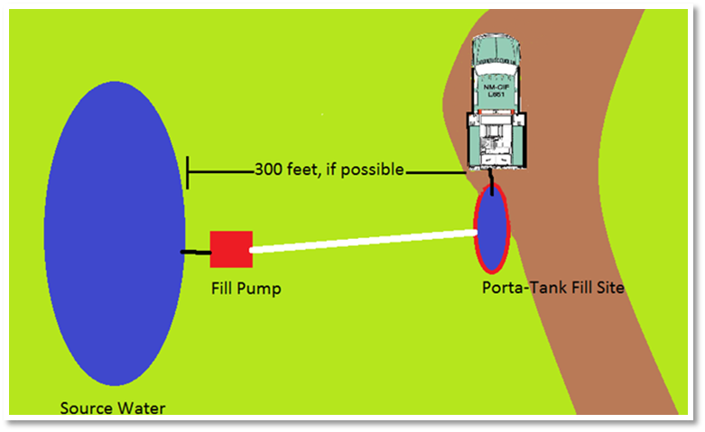
HOW TO GUIDE: Ground OPs
Focus on drafting techniques (not internal tanks)
ALWAYS prime water from drafting source (not engine tank)
Do not leave draft hose full with foot valve engaged and submerged
Any apparatus with a tank must have a foot valve for drafting
Avoid drafting from untreated (raw water) – use municipal sources or port-a-tanks as central drafting source
  300’ from waterway
Bring extra (clean) foot valves
Chemical decontamination station
(chlorine solution)
  Easy to use
  Existing equipment
  Comfort level with product

Slide 15
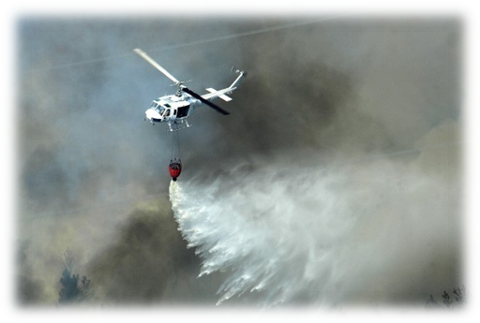
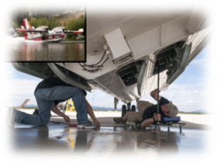
Aviation
Avoid:
  Dipping/scooping from multiple sources
  Mud/plants
Use deepest water possible
Switch out used bucket for new bucket (between water sources, when hot water or dry time not an option)
Visually inspect equipment
Use hot water to decontaminate exposed surfaces (140 F, 5-10 seconds)
  Do not use Quat or bleach products on fire equipment
  For buckets with rubber valve seals: avoid prolonged exposure to hot water
When hot water not available:
  Municipal treated water
  Dry time (varies by equipment type)

Slide 16
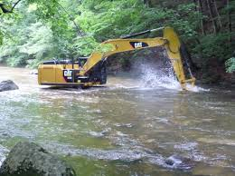
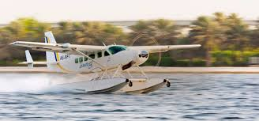
Other vectors
310/Joint Application – water-based equipment
  ‘Equipment’ definition (wholly or partially submerged) = subject to same rules as watercraft
  Any in-stream work requires application, approval from local Conservation District
  Add language to permit/instructions: CLEAN DRAIN DRY; inspection required in certain circumstances
Seaplanes
  WRP Committee – regional approach?
  Can also be considered ‘equipment’ in Montana
  Self-certification as possible way to manage
  Evaluating current protocols
  Partner state potential?

Slide 17
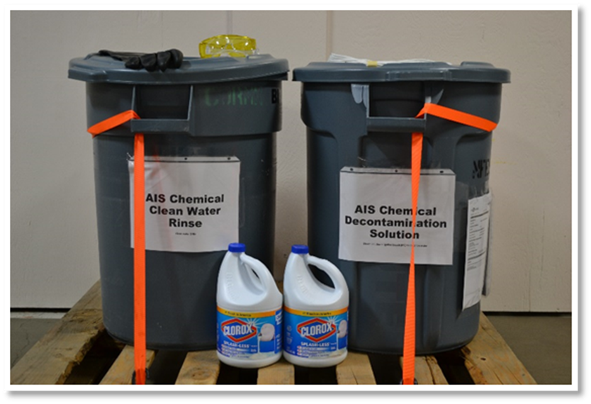
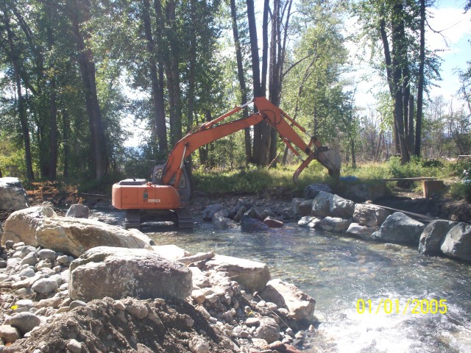
Philosophy: Cultural & organizational change
Cultural shift required!
Any BMP needed, we (GOV) should do it ourselves (not rely on others)
CLEAN DRAIN DRY: get it tattooed on your body people
Keep it simple
We got this!!!

Slide 18

Related updates
Economic Analysis
  Mussel impacts to statewide resources
  Cost/Benefit Analysis
  Statewide but able to be split into major basins
Missouri River Pilot Project
  Enhance coordination with local partners
  ‘Central & Eastern Montana Mussel Response Team’
  Fork Peck Invasive Mussel Tabletop Exercise Aug 28
November 14 Western Governor’s Association Initiative
November 15-16 Montana Invasive Species Council Summit (law review focus)

Slide 19
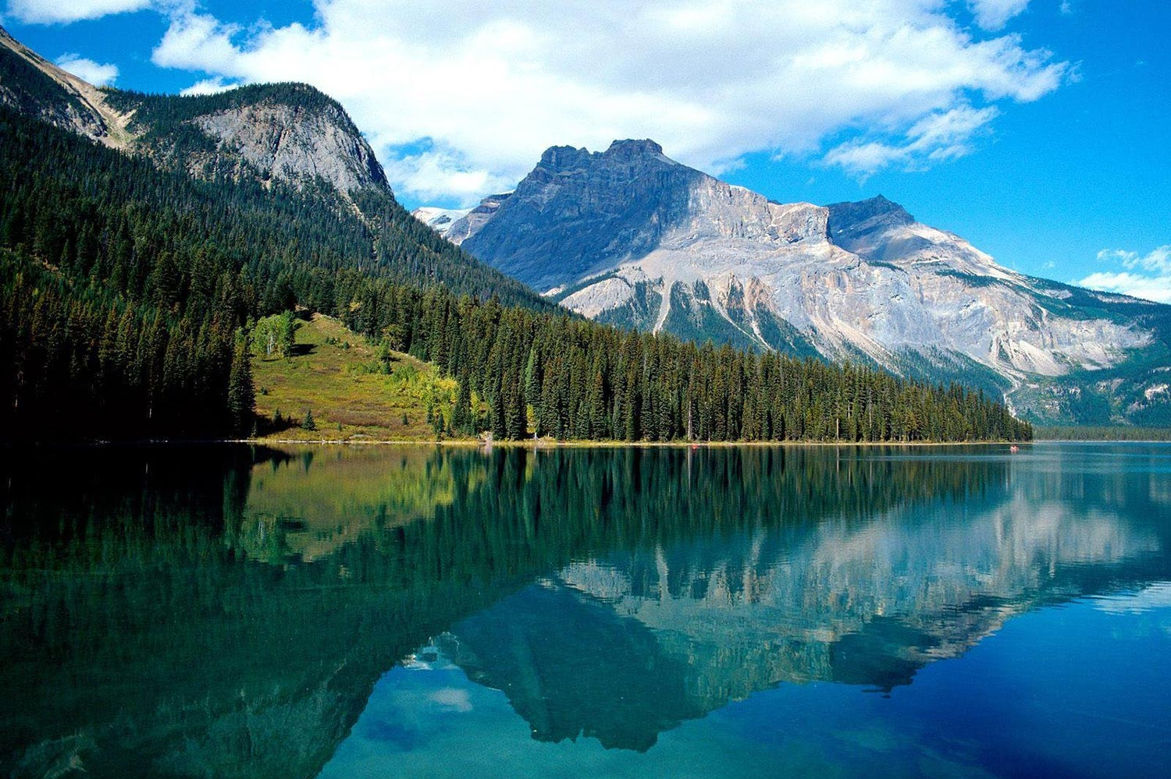
Kate Wilson
Commission Administrator
Montana Dept. of Natural Resources & Conservation
kate.wilson@mt.gov
406-542-4282

