Slide 1

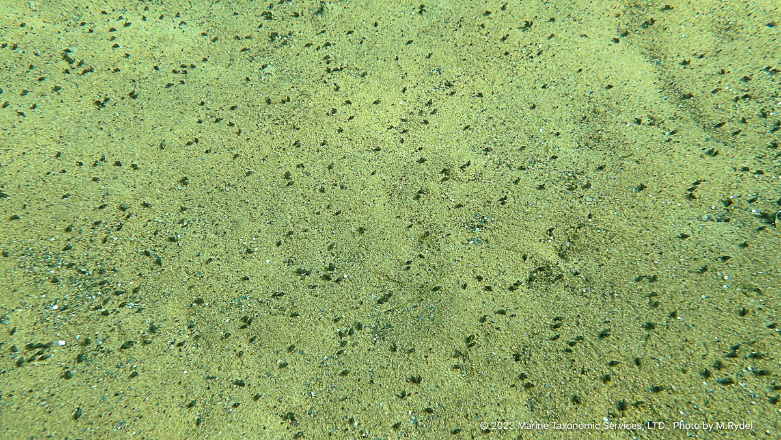

New Zealand Mudsnail Discovery in Lake Tahoe
Columbia River Basin AIS Team Meeting
December 10, 2024
Dennis M. Zabaglo, AIS Program Manager
Tahoe Regional Planning Agency

Slide 2
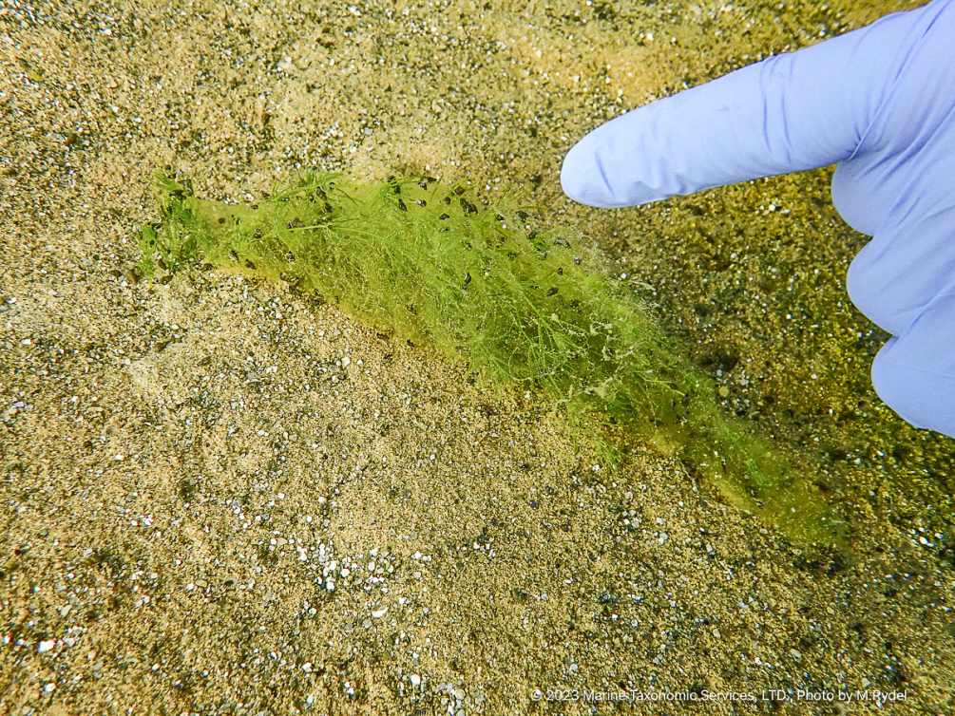
NZMS Update
Introduction
NZMS Discovery
Rapid Response
Science engagement
Actions
Takeaways

Slide 3


Introduction
TRPA
Compact Agency
Create and enforce rules
Environmental Improvement Program
Environmental Thresholds
AIS Program Lead

Slide 4
NZMS Discovery
Discovery September 6, 2023
  Discovered by program contract divers (Marine Taxonomic Services) during plant surveys, approximately 900m NE of the mouth of the Upper Truckee River
  Samples collected for identification
  Rapid Response Plan initiated
    TRPA and Tahoe Resource Conservation District form Incident Team
    Concentrated survey around the point of discovery
  NZMS Confirmed through physical observation (9/11) and DNA (9/15)
  Grid Survey developed
  Lake-wide transects modified

Slide 5
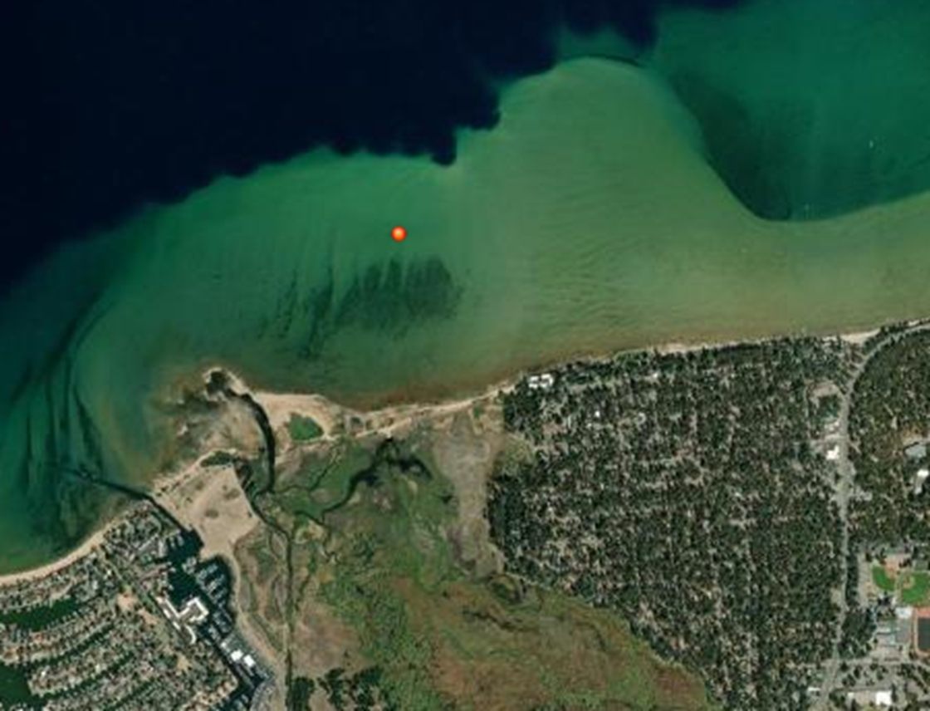
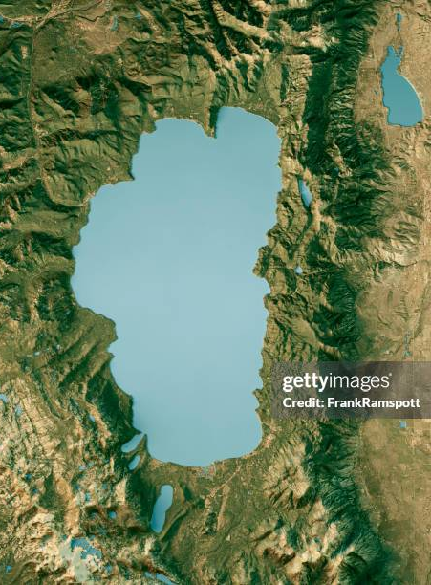
NZMS Update

Slide 6
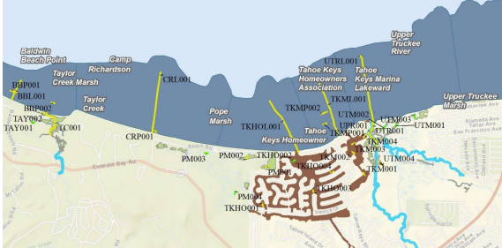
Rapid Response
Subsequent Actions
  Review existing monitoring data
  Enhanced monitoring
    Modified plant transects
    Deep water dives
    Grid survey
      Emerald Point to Edgewood
    Tahoe Keys Surveys

Slide 7
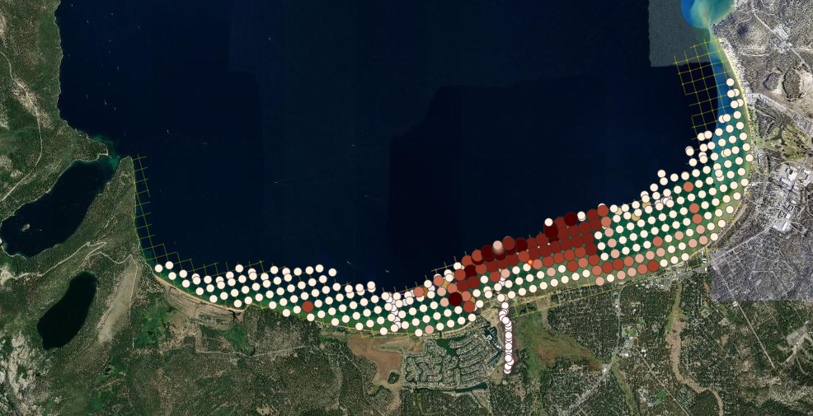
NZMS Update

Slide 8
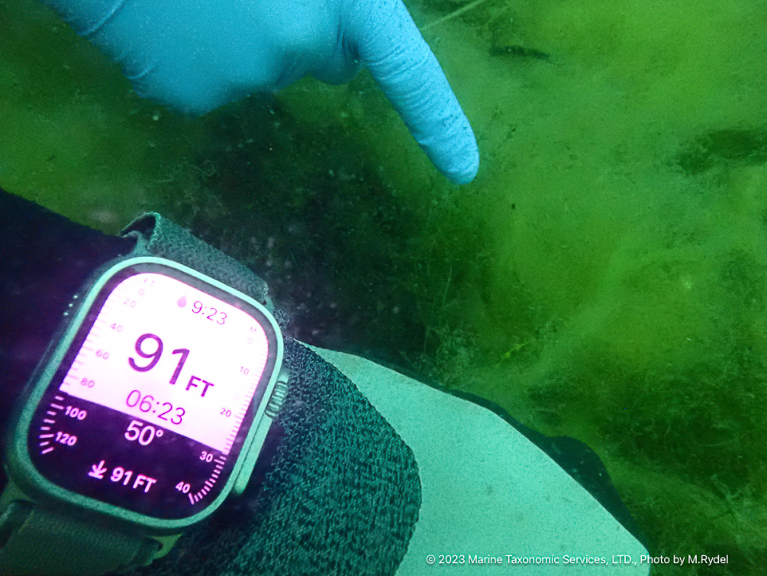
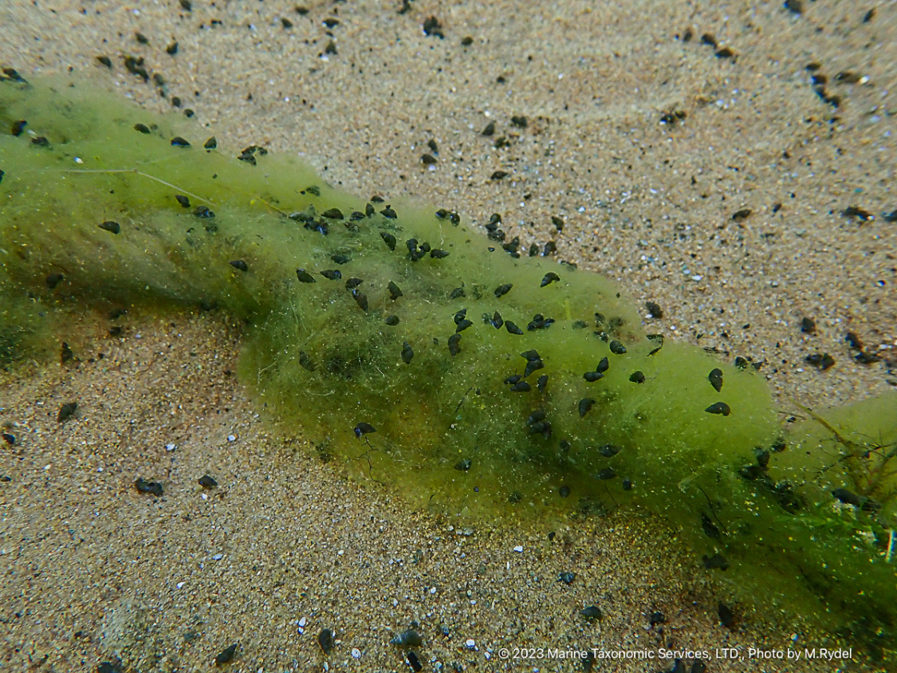

Slide 9
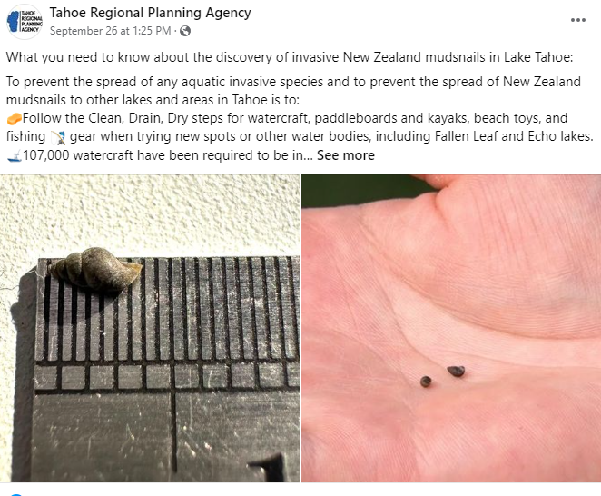
Rapid Response
Subsequent Actions
  Outreach
    Initial notifications to CDFW, NDOW, and USFWS
    Notify local partners
    Press Release
    Social Media
    Targeted messaging

Slide 10
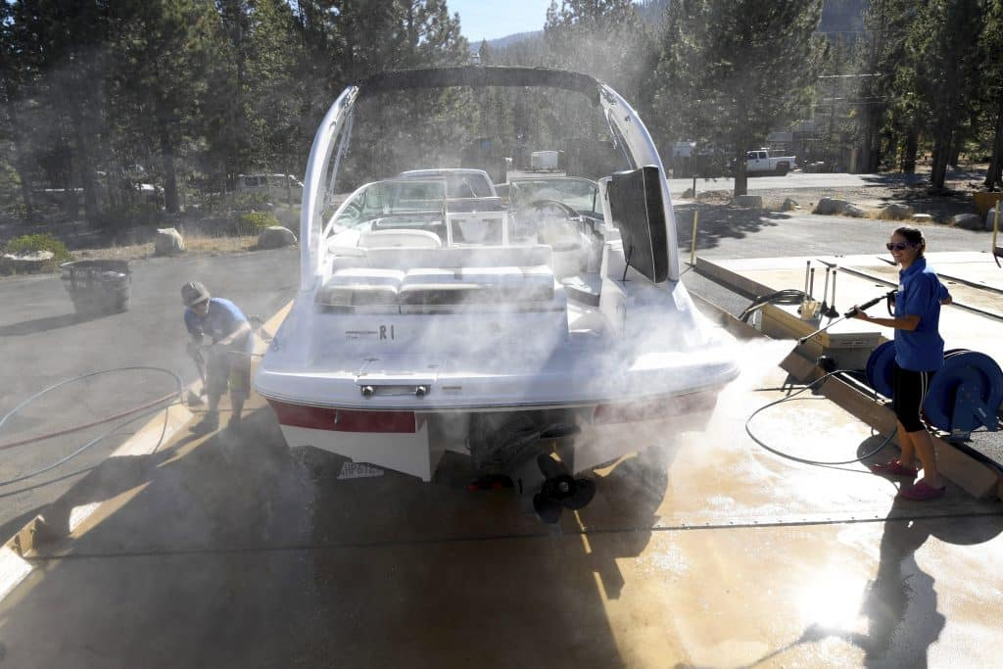
Rapid Response
Subsequent Actions
  Management actions
    Decontamination protocols
    Alert western partners
    Reinforce “pull your plug” requirements
    Clean, Drain, Dry
    Tahoe Keys sample collection protocols

Slide 11
Science Engagement
Tahoe Science Advisory Council Engagement
  Technical Advisory Committee met 10/6 – 10/7/23
    Dr. Michael P. Marchetti (St. Mary’s College of California)
    Dr. Lars Anderson (USDA-retired)
    Dr. Sudeep Chandra (Global Water Center, University of Nevada and Tahoe Science Advisory Council Scientist)
    Dr. Christopher Jerde (University of California, Santa Barbara)
    Kelly Stockton-Fiti (KASF Consulting)
    Dr. Adam Sepulveda (USGS)

Slide 12
Science Engagement
Tahoe Science Advisory Council Engagement 10/6/2023
    Charge
      How would you approach assessment of the extent and severity of the infestation?
      What options are available to eradicate, contain, control, or manage the infestation?
      What is the likely impact of the infestation and how could you assess the impacts (if any) from snails to the ecosystems in the Lake Tahoe basin?
    Met with Incident Team to discuss report on 10/16/23
    Report is global; not all actions will be appropriate or feasible for Lake Tahoe
    Use science to inform priorities and policy
    https://www.tahoesciencecouncil.org/_files/ugd/c115bf_a0f61adc5a0c4dd58240512e8652e6f8.pdf

Slide 13
Science Engagement
Tahoe Science Advisory Council Engagement
  Recommended highest priority actions
      Better understanding of distribution
        eDNA, grid survey, lake-wide transects, deep water, Tahoe Keys
      Coordinated baseline data
      Focus on containment options vs control
        HACCP
        Imbedded in Prevention
      Impact analysis
        Further coordination with the Council, funding is needed
      Prevention protocol options
        CD3, signage, Tahoe Keepers outreach, protocols at ramps
      Risk assessments for other invasives
        In progress

Slide 14
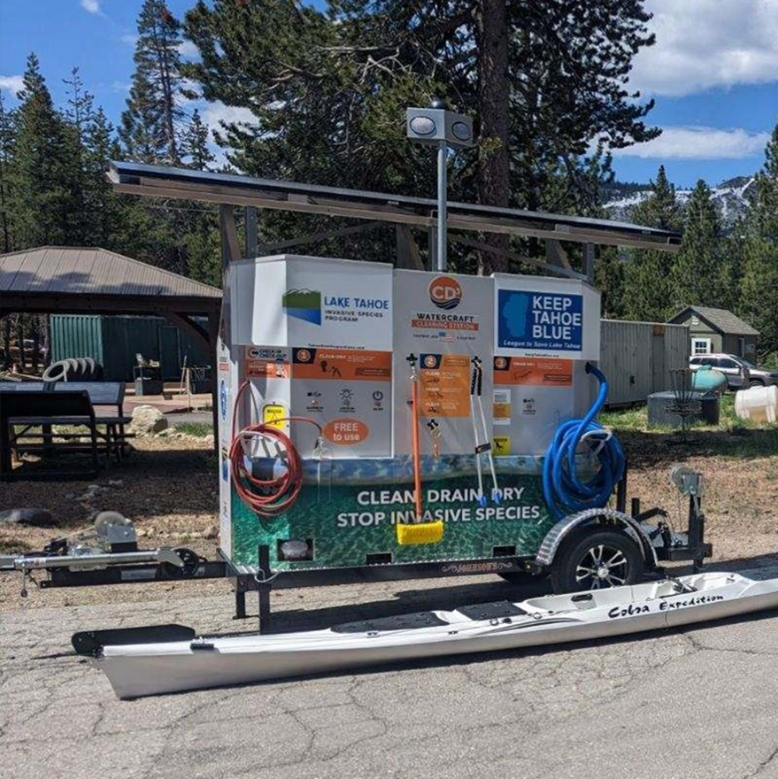
New Zealand Mudsnail
2024 Activities
  Prevention & Containment
    Roving inspectors
    Cleaning stations (CD3)
    Protocols
  Monitoring
    Grid
    eDNA
    Tahoe Keys surveys
    Site assessments
  Education & Outreach
    Tahoe Keepers
    Eyes on the Lake
    Marina and contractor trainings
    Signage
    Tahoe Boating app
  Risk assessments
Notes:
Containment- protocols at ramps, drain assessments
Leverage overall program needs
Science- impacts

Slide 15

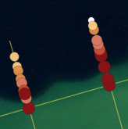
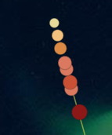
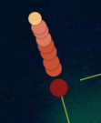
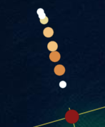
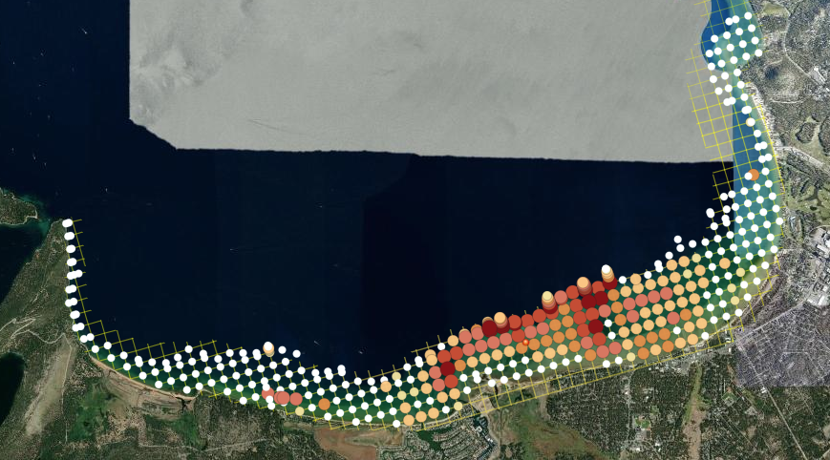
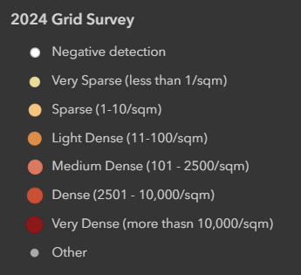


Grid Survey
Repeat of 2023 effort, plus:
  Expanded northeast to Round Hill
  3 additional Deep Dive transects (65-150’)
Some spread to the East
  Furthest East = Nevada Beach
“Sparse” down to 150’ at half of deep dive transects
Notes:
2023 – NV beach

Slide 16
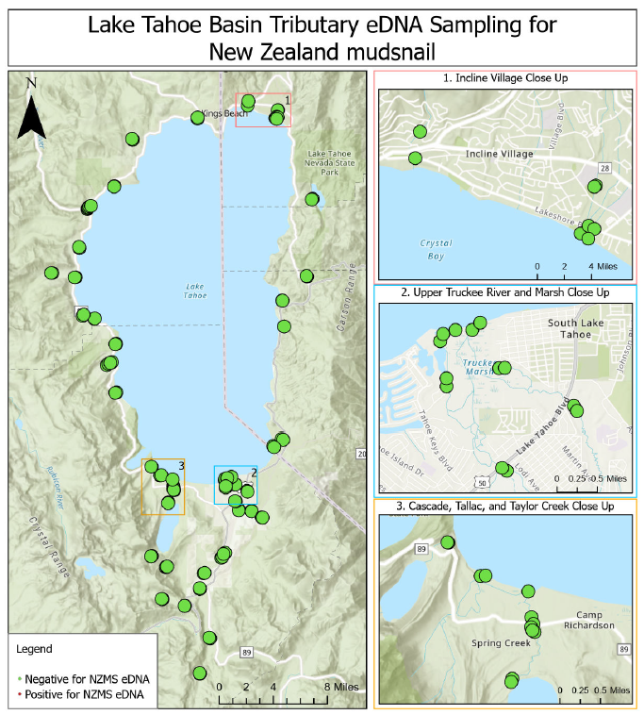
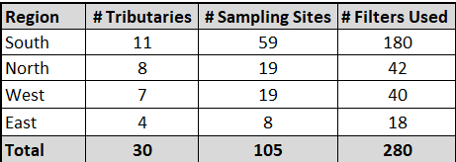
eDNA
No Positive Detections
Site Selection Prioritization
Near known NZMS infestations
High traffic recreation areas
Areas with sensitive species (Sierra Nevada yellow-legged frog, Western pearlshell mussel, Great Basin ramshorn) or target habitat for Lahontan cutthroat trout recovery
Culturally and/or socially important sites
Areas likely to have greater environmental or economic impact
Repeatability of long-term monitoring efforts
Existing sampling effort already established
Safety/accessibility
Basin-wide representation

Slide 17
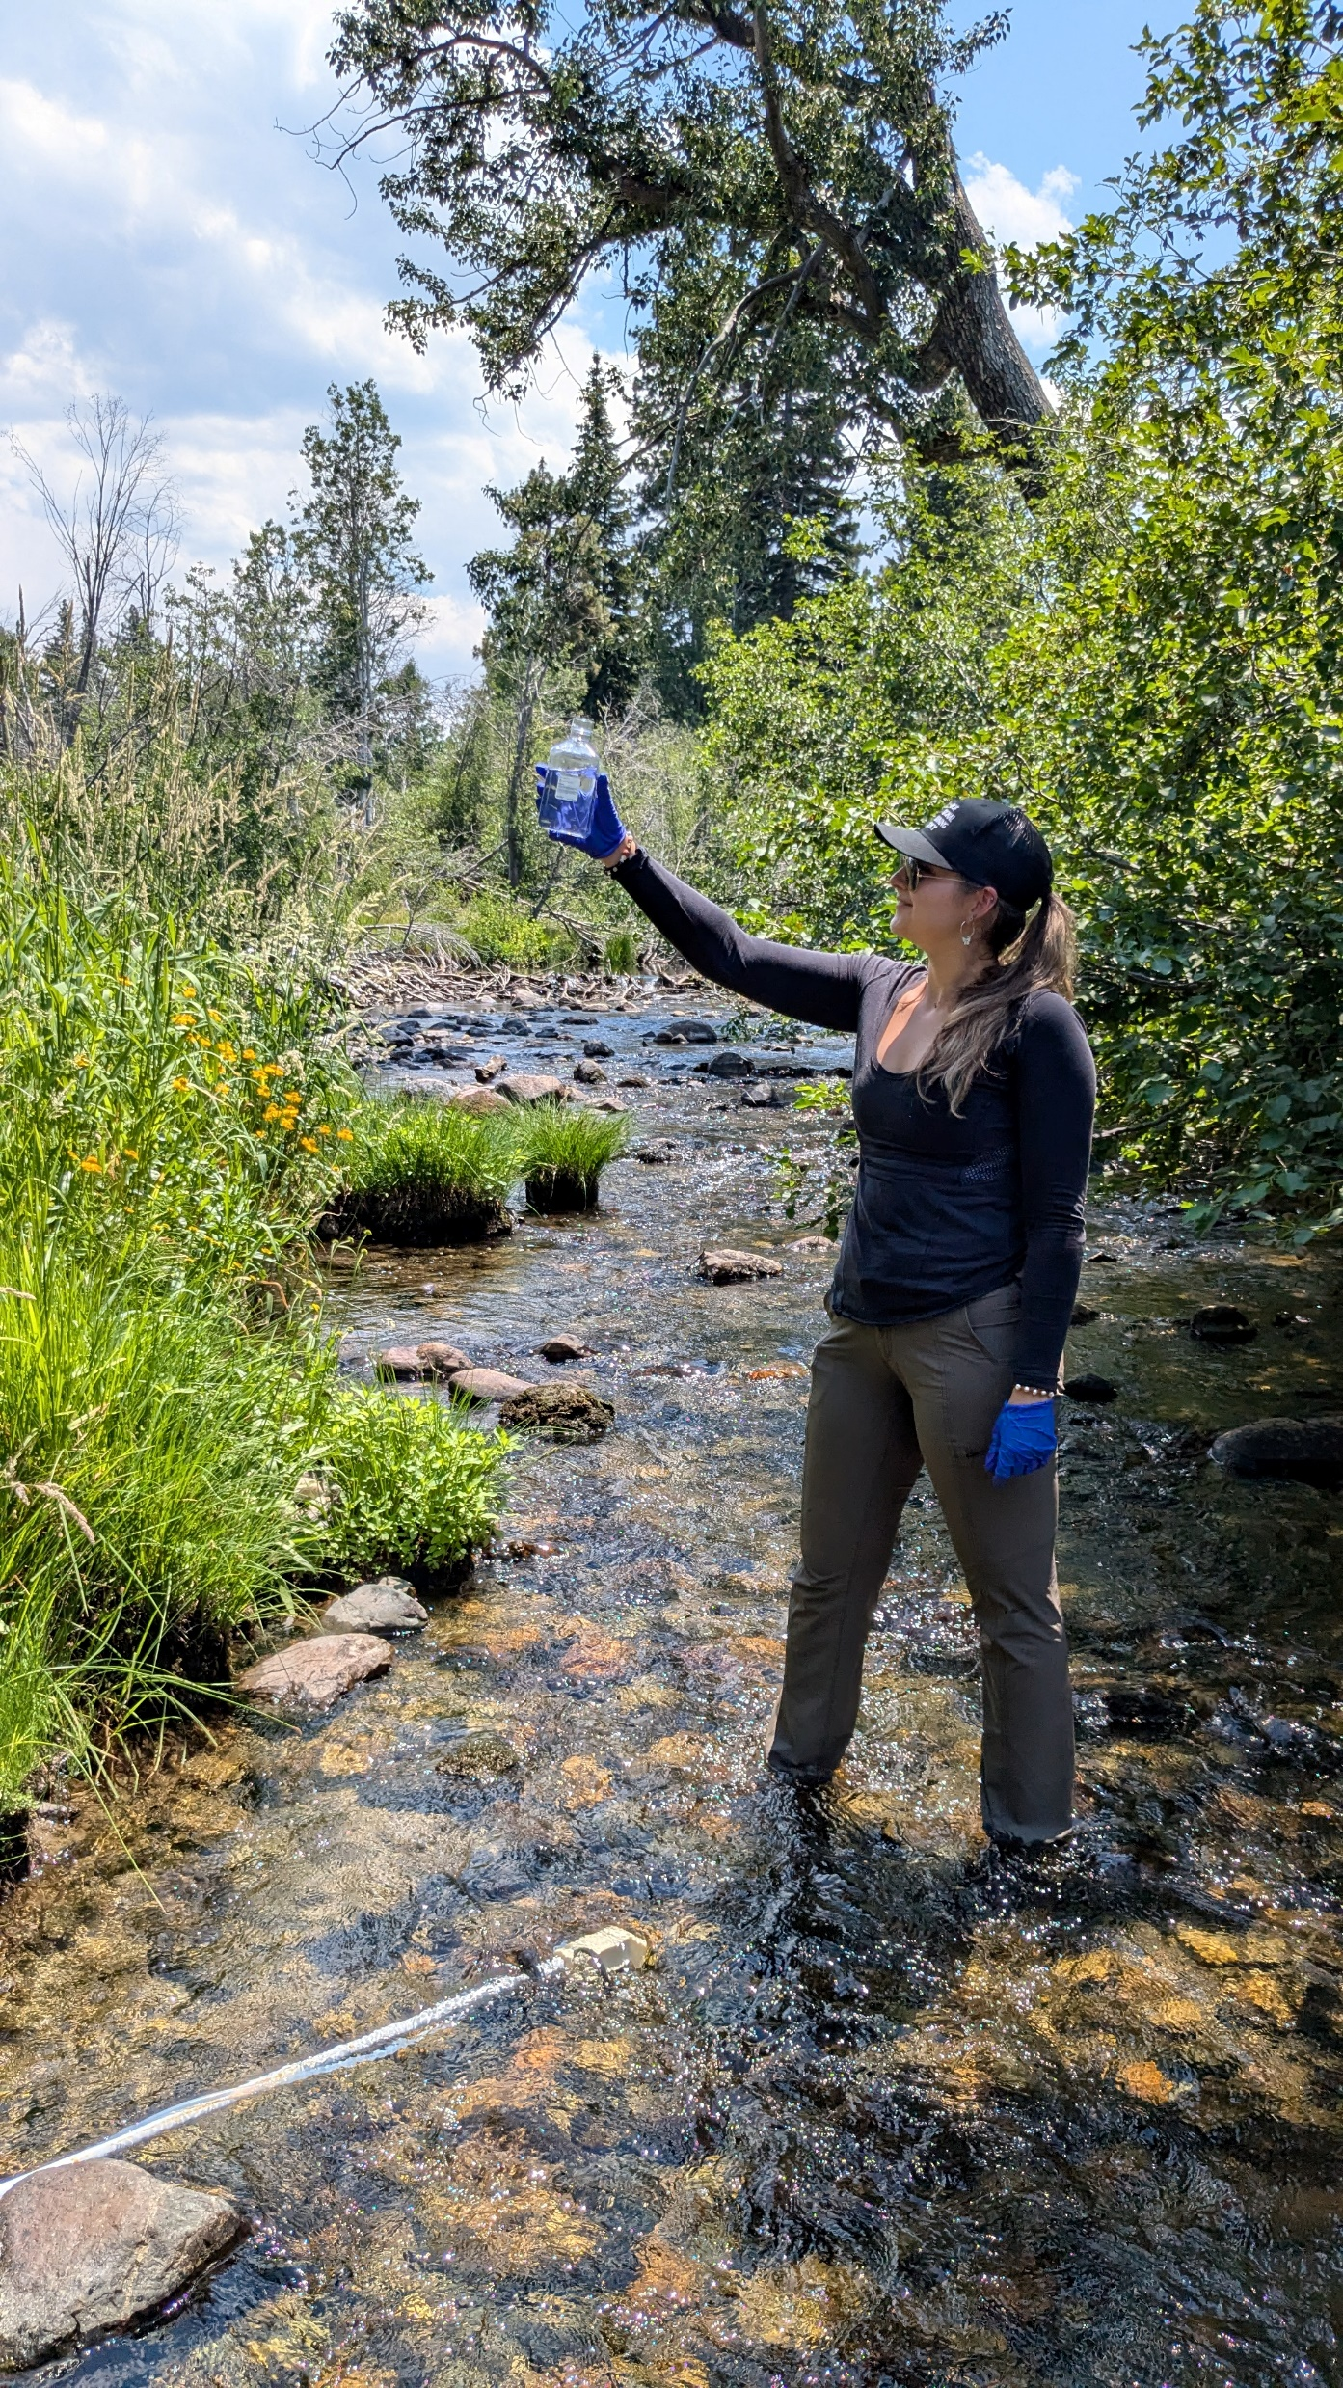
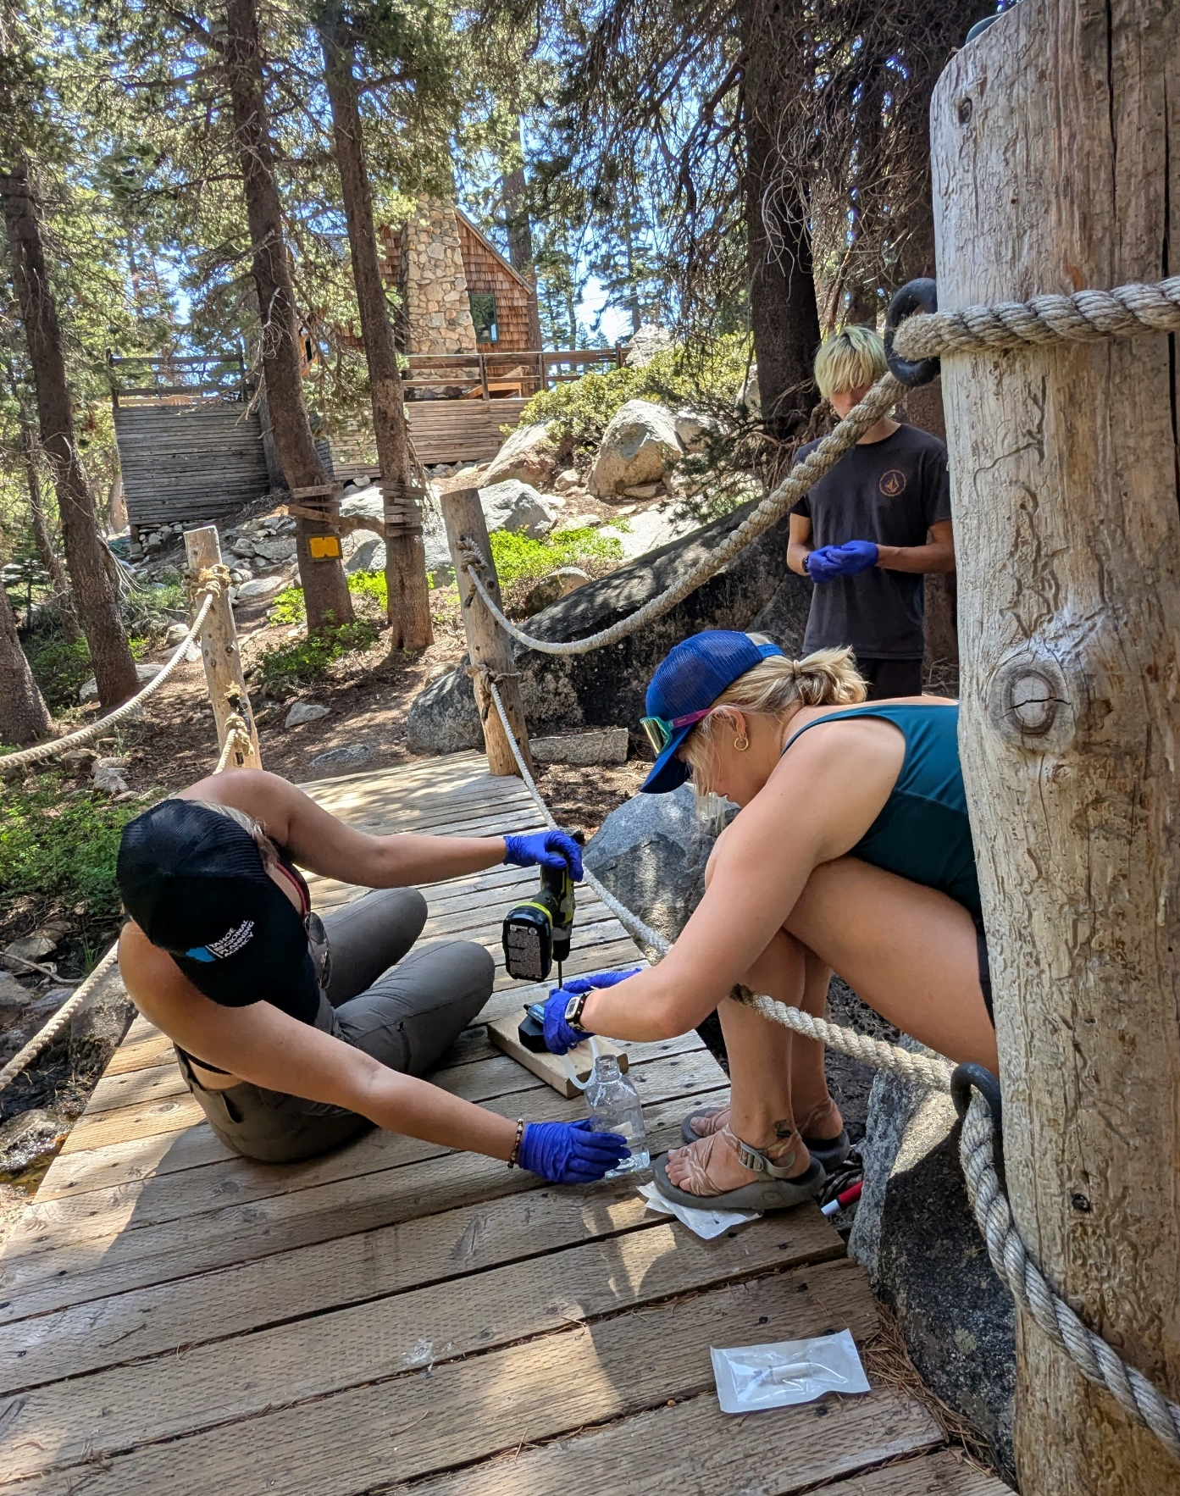






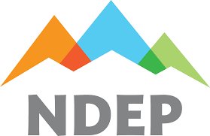
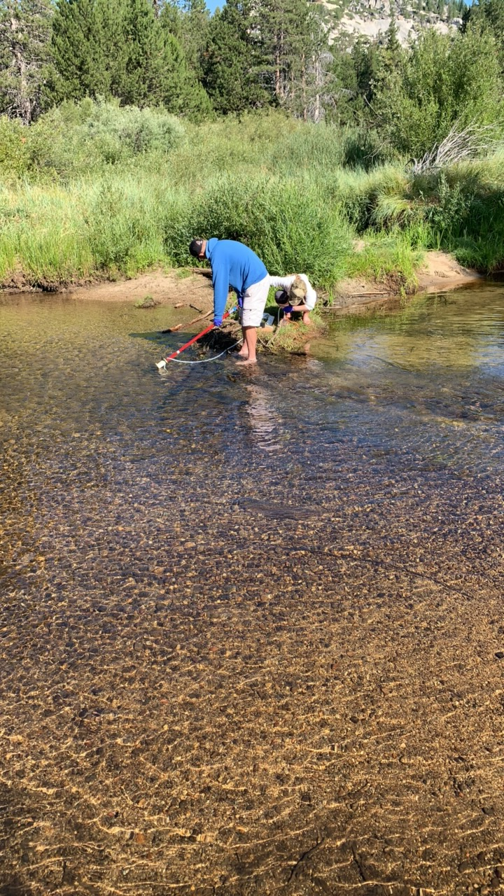
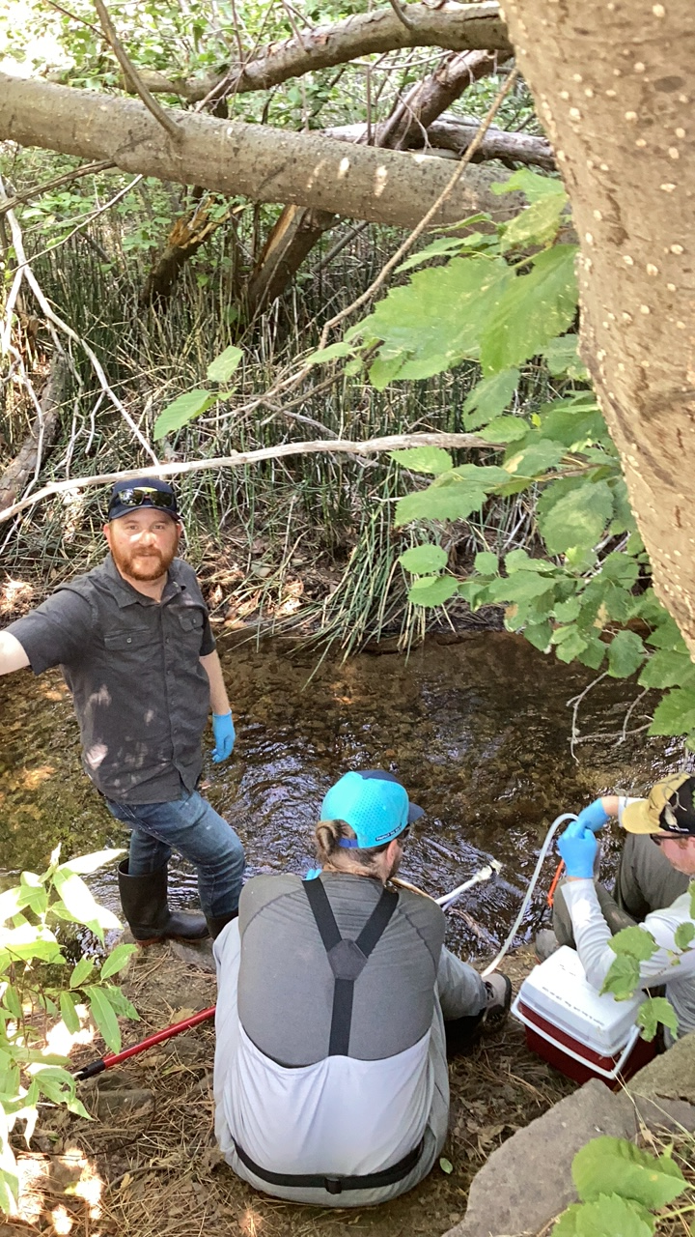
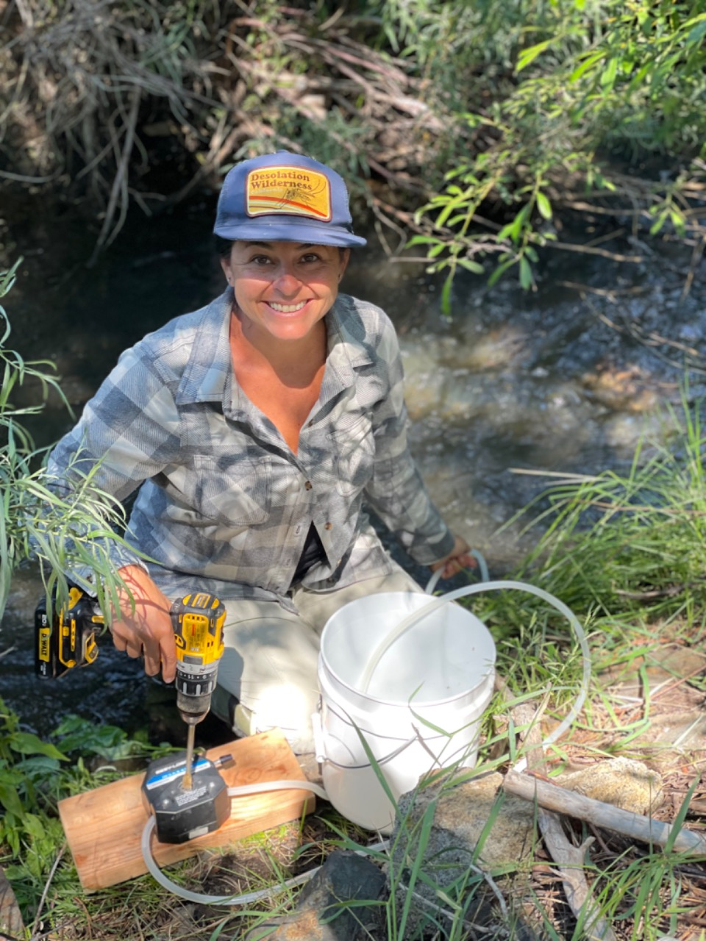
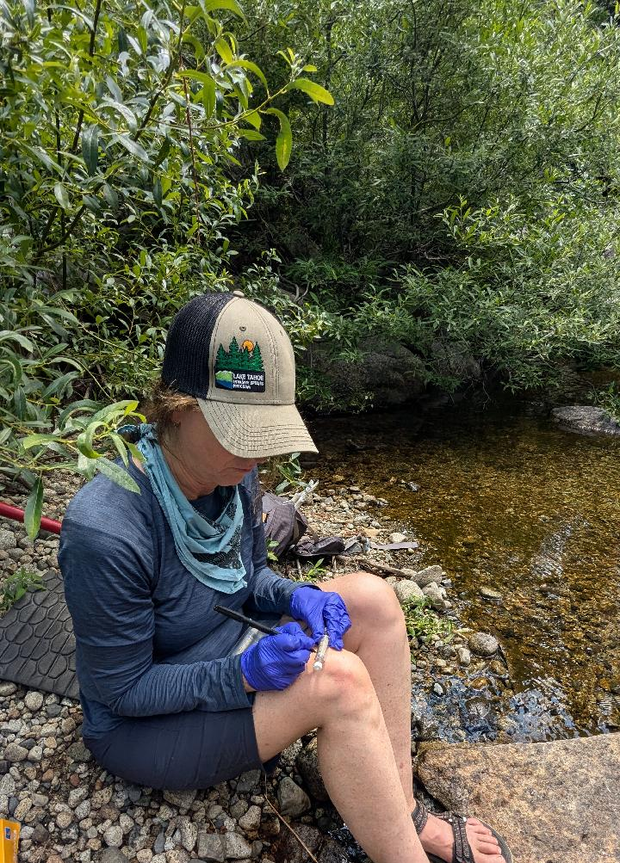
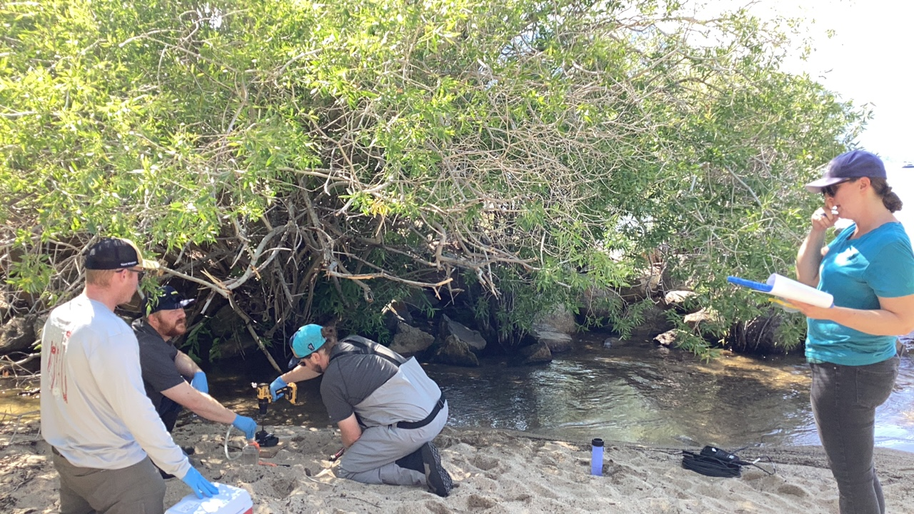
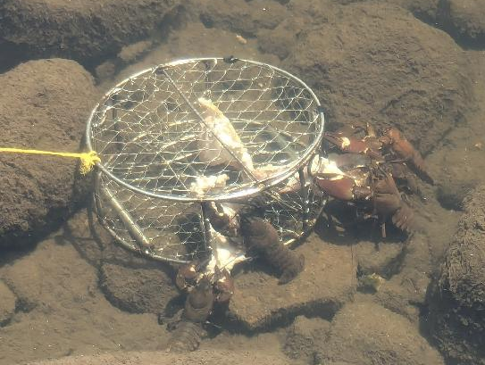

Slide 18

Notes:
Containment- protocols at ramps, drain assessments
Leverage overall program needs
Science- impacts

Slide 19
NZMS Takeaways
  Power of partnerships
  Timing was fortuitous
  Refocus non-motorized prevention efforts
  Continue roving inspectors
  No real treatment options
  eDNA experience
  Efforts that will address all AIS
  EDRR- mussel focus
  Routine EDRR exercises
  Prioritize species for control
  Movement but increase/decrease undetermined
  Funding for future work
Notes:
Containment- protocols at ramps, drain assessments
Leverage overall program needs
Science- impacts

Slide 20
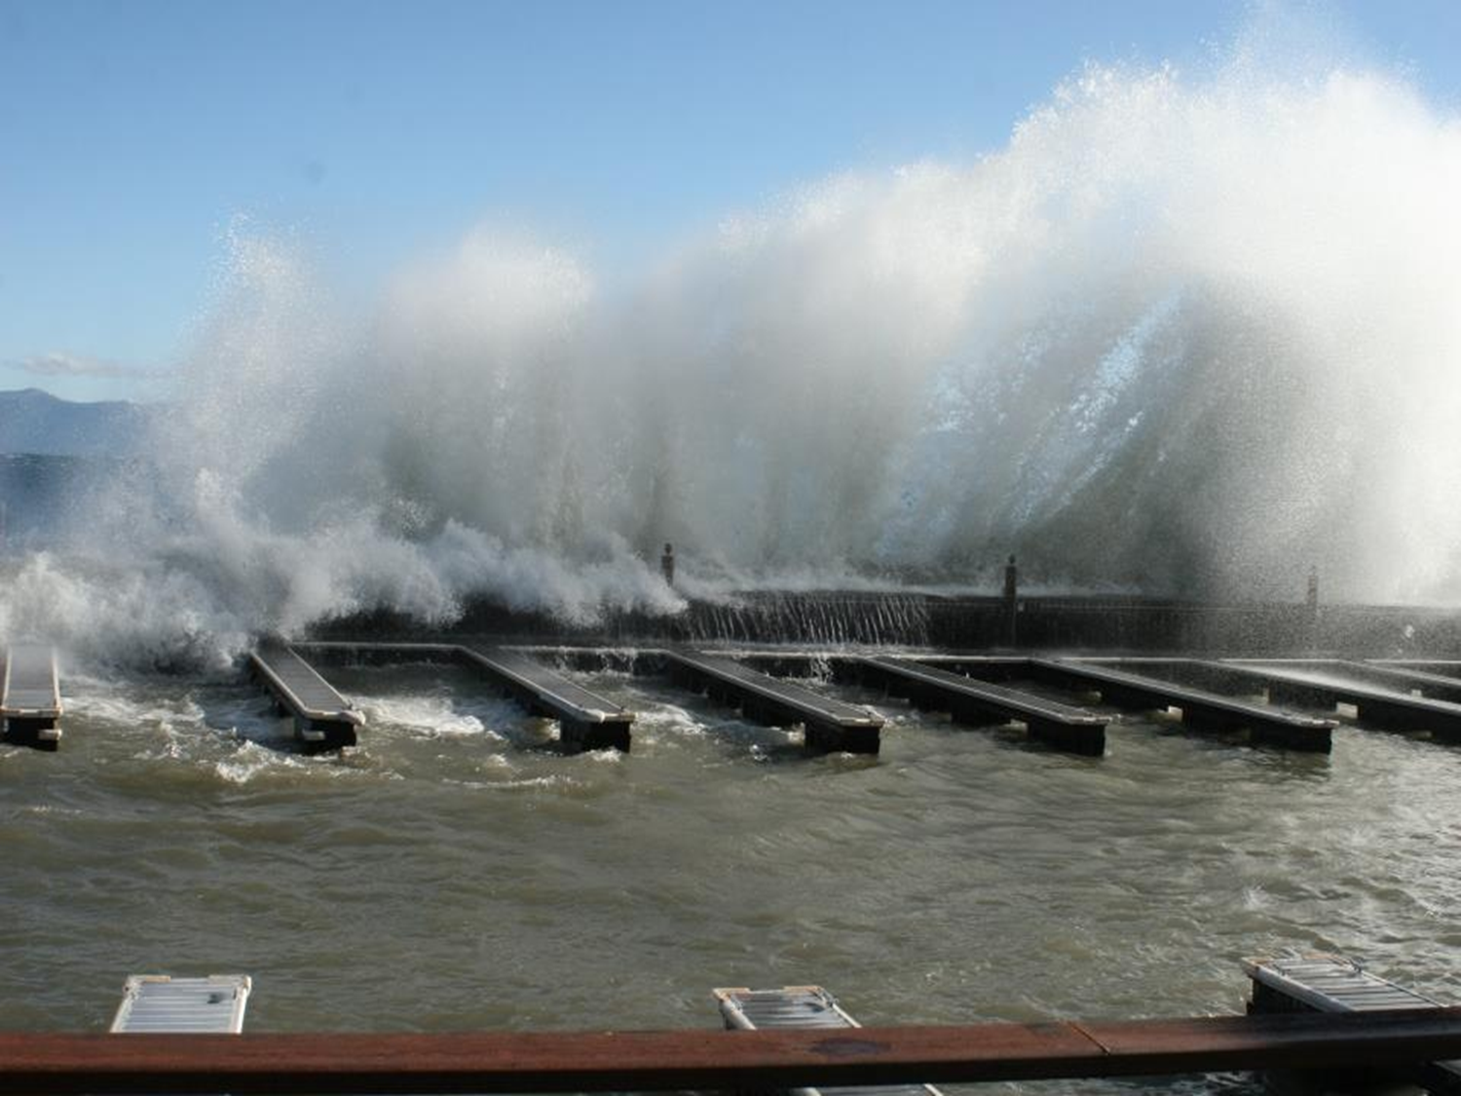
Thank you!
”…those who learned to collaborate and improvise most effectively, have prevailed”
- Darwin
dzabaglo@trpa.gov

