Slide 1
U.S. Fish and Wildlife Service Fish and aquatic conservation
Aquatic Invasive Species Program Update
Columbia River Basin 100th Meridian Working Group Coordination Meeting - December 10-11, 2024

Slide 2
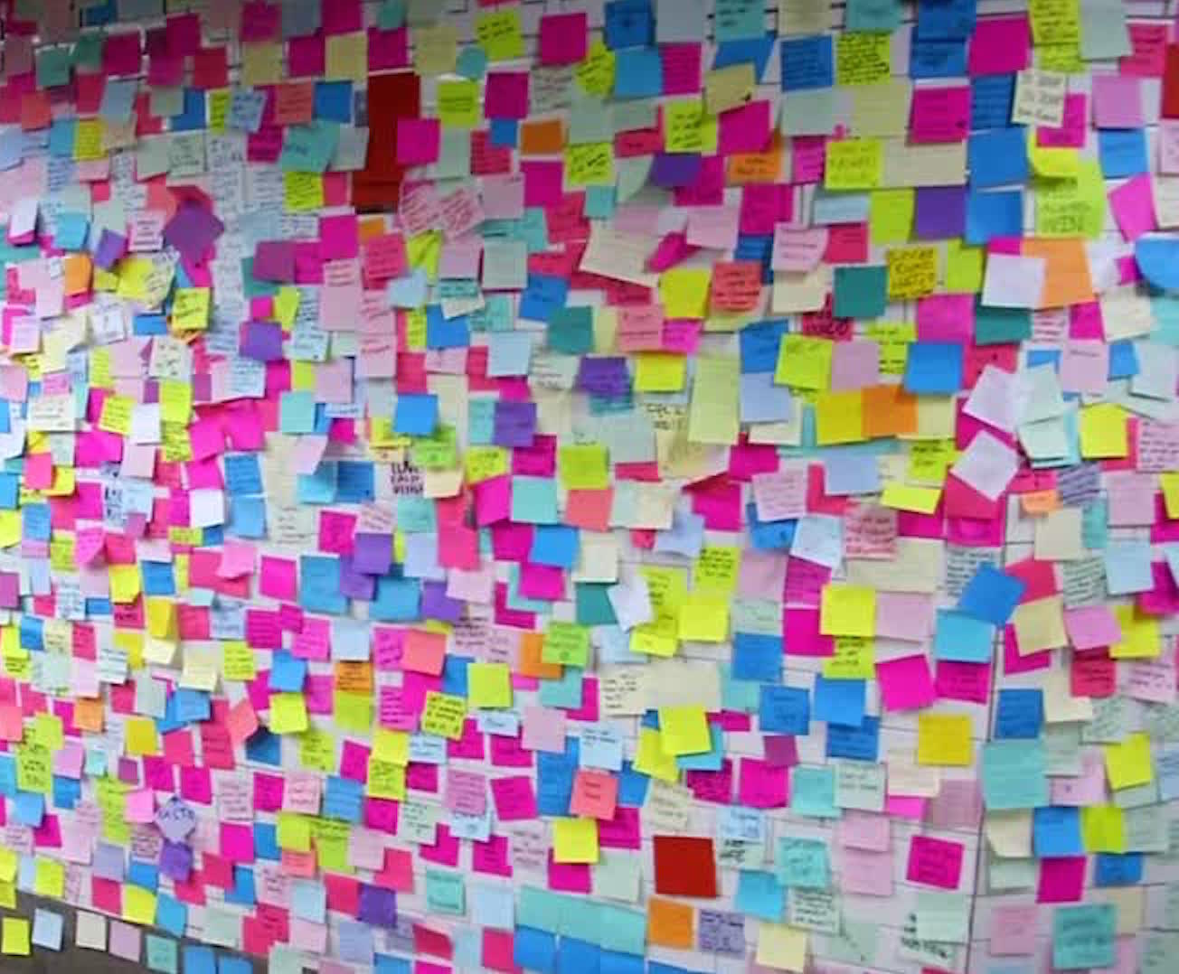
Program Priorities

Slide 3
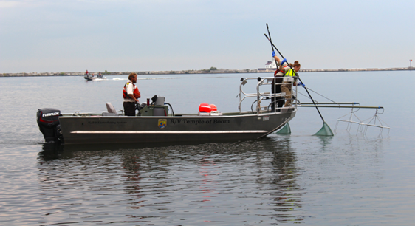
Prevention
Horizon Scanning
Risk Assessments (species), HACCP (activities)
Early Detection
Broad Spectrum Monitoring
Targeted Species Monitoring
Rapid Response
Control / Management
YY male fish (brook trout) pilot project
Coordination / Communication
Notes:
HACCP is Hazard Analysis Critical Control Point risk assessment planning
Coordination and communication includes outreach and education internally to our staff, our leadership, our partners, and the public

Slide 4
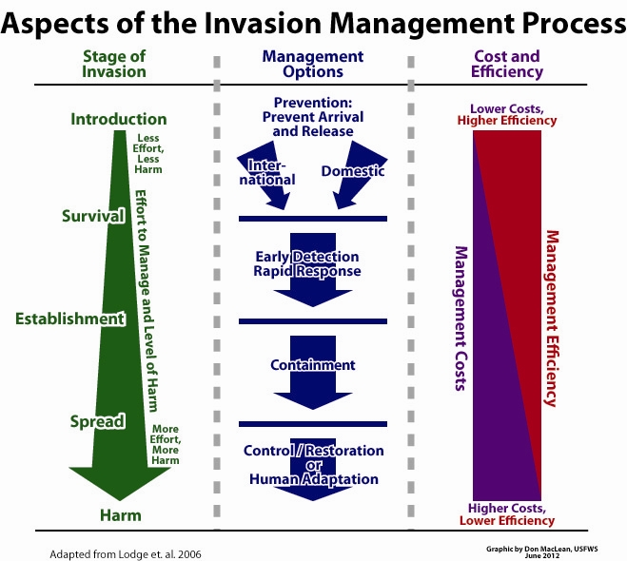
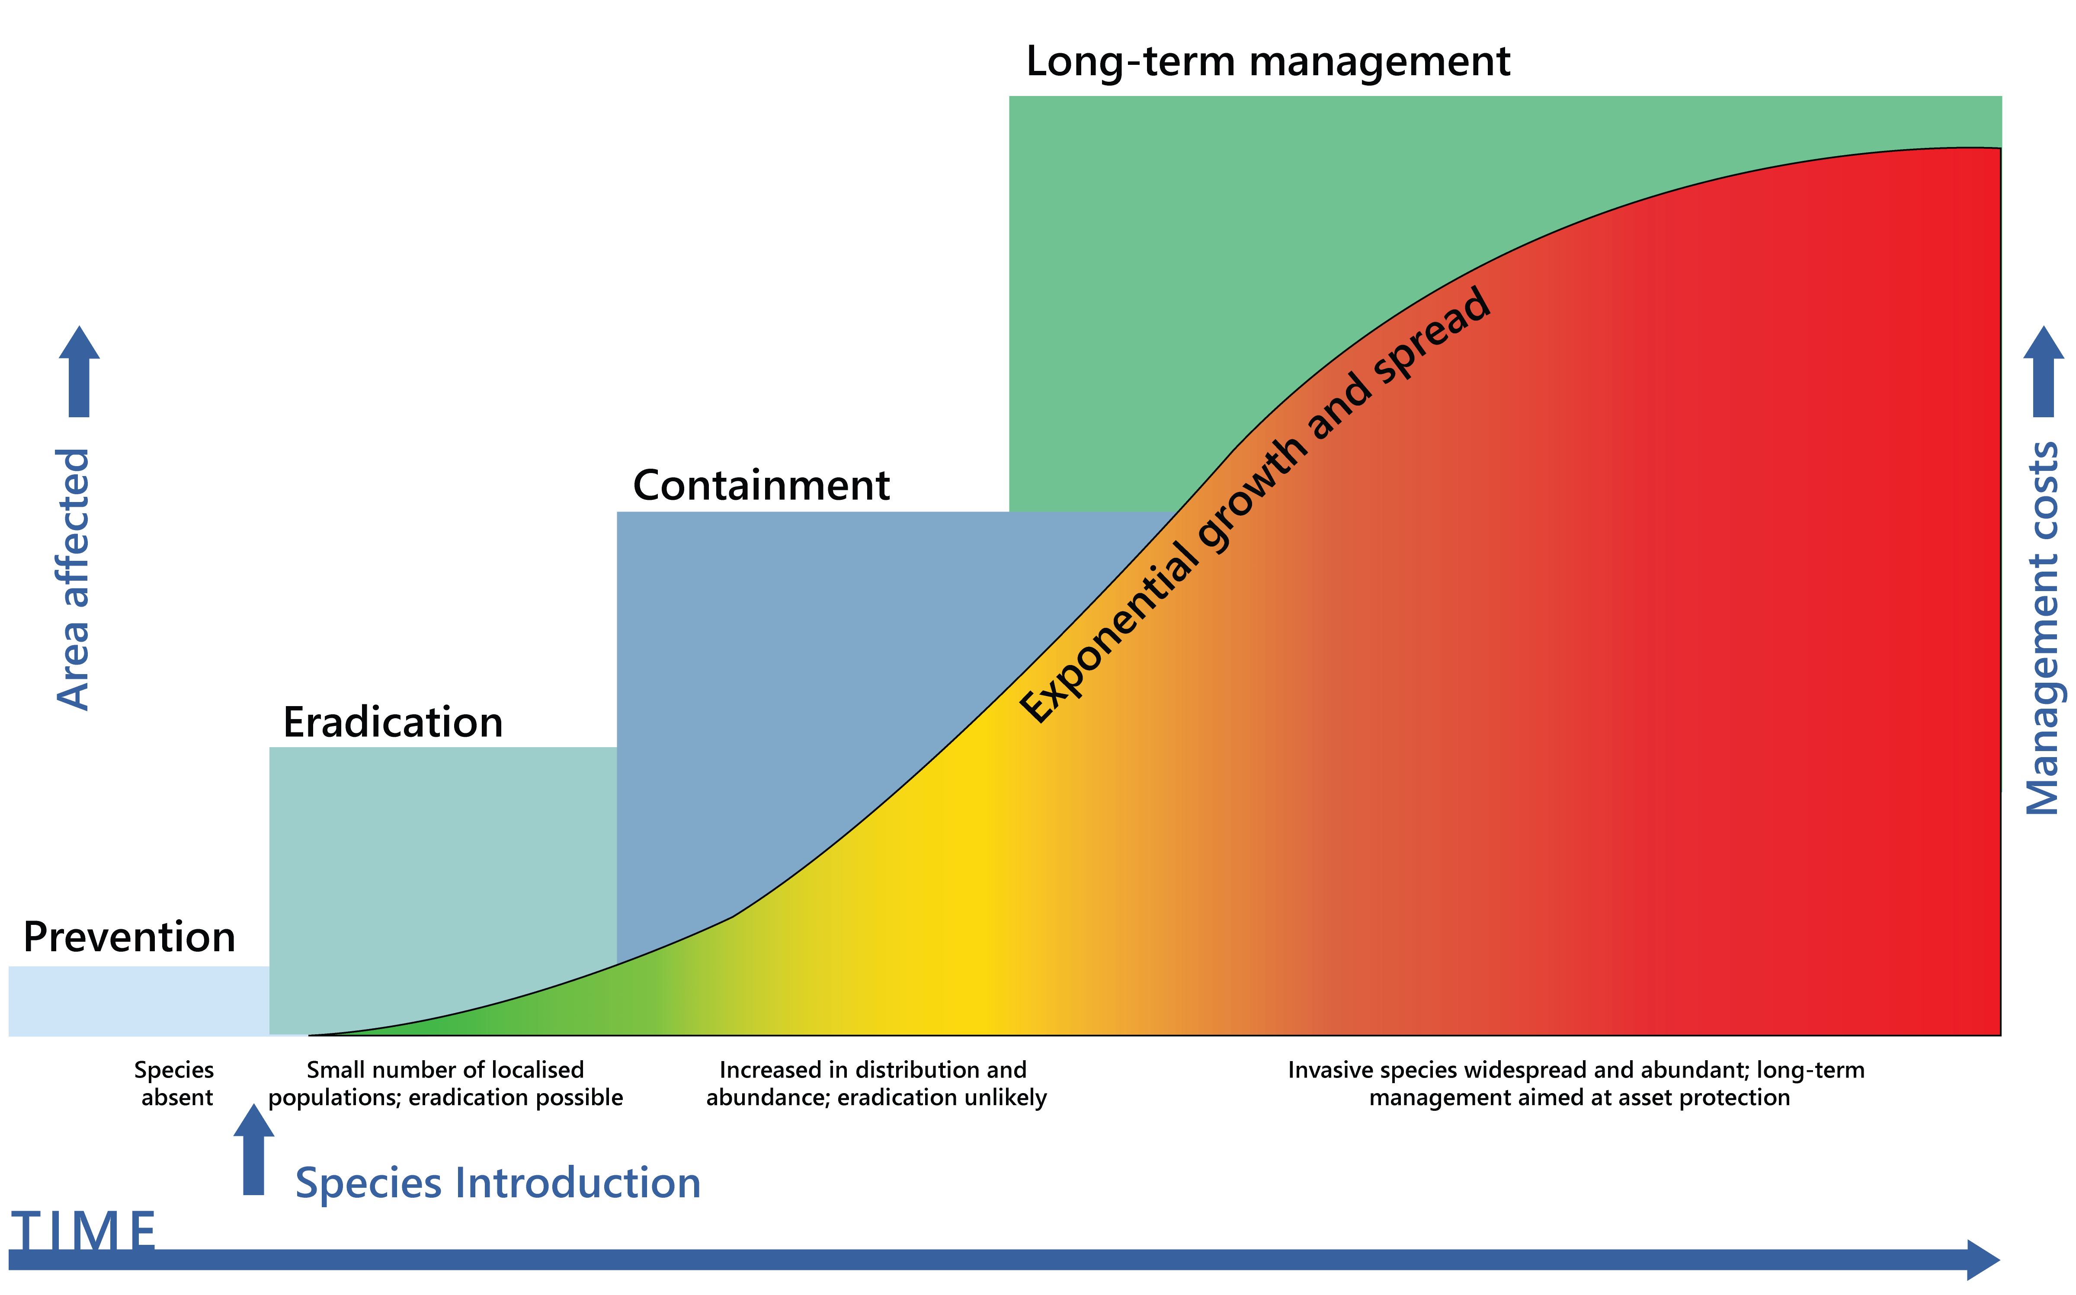
Notes:
You are all very familiar with the invasive species invasion curve, that helps visualize the importance of prevention.
Invasive Species Invasion Curve – (from Invasive Species Council accessed 2021); adapted from Lodge et al 2006
Prevention can be at two levels – international and domestic – we all experienced this with moss balls earlier this year.

Slide 5
PREVENTION
Horizon Scanning Northwest Science, 97(1-2):26-36 (2024). https://doi.org/10.3955/046.097.0104
Risk Assessment Screening https://www.fws.gov/story/ecological-risk-screening-summaries
Hazard Analysis Critical Control Point (HACCP) planning
2-day certification classes (hosted in March and Sept. 2024)
3-day Train-the-Trainer workshop (Jan. 2025)
Multiple classes scheduled in 2025
Notes:
Horizon scanning work was completed focused on watercraft, (pathway) and aquatic plants
Risk assessments - We evaluate risk based on similarity of climate and history of invasiveness. FOR MORE THAN 1700 species

Slide 6
EARLY DETECTION
Monitoring (targeted species & multi-species)
Expanding laboratory capacity
Molecular Laboratory Expansion
Validated genetic marker development
Classroom learning
eDNA: study design, implementation & application
Class FWS-CSP2010
March 24-28, 2025 in San Marcos, TX
Notes:
Monitoring – talk more about that tomorrow in the monitoring discussion

Slide 7
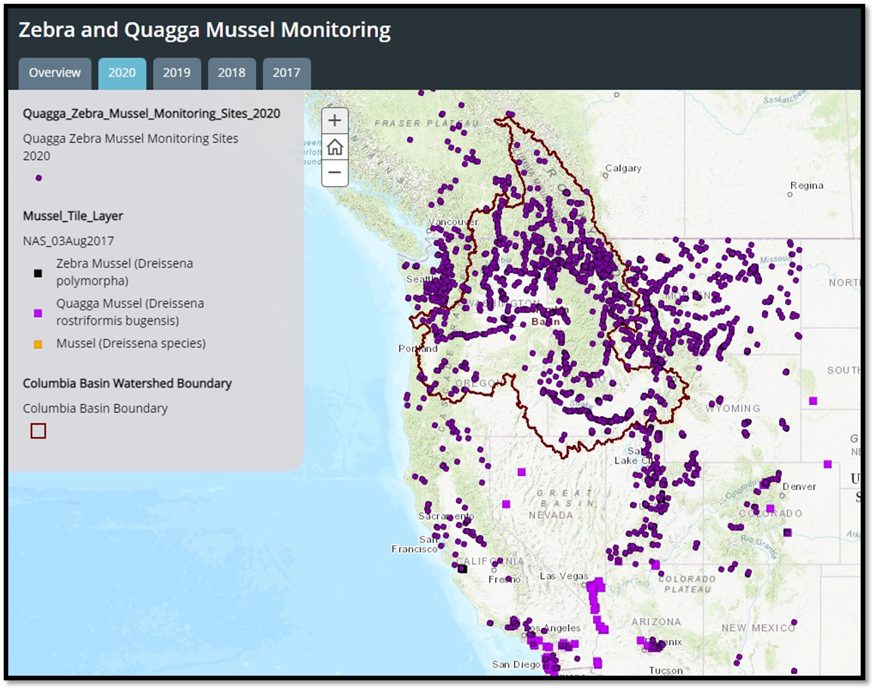
EARLY DETECTION
Visual inspection surveys
eDNA monitoring
Zebra & Quagga mussel
Northern pike
New Zealand mudsnail
Carp species
FY24 – testing different eDNA protocols for high priority AIS for surveillance at NFH
Notes:
eDNA surveys at Carson, Willard, Little White Salmon, Spring Creek, Eagle Creek and Warm Springs NFHs.
eDNA to test for NZMS at all of the facilities from 2015-Present.
eDNA for QZM in 2017 and 2018.
FY21 - tested the above facilities for NZMS, QZM, northern pike and common carp.
FWS approved funding for a pilot study to test the performance of the Biomeme portable PCR unit for real-time eDNA sample processing at National Fish Hatcheries.
Jen - NZMS surveys and eDNA sampling at our lower Columbia Basin NFHs and up to five reference locations; Testing for five species again in FY22 including: New Zealand mudsnail, zebra mussels, quagga mussels, northern pike and common carp.
pre-proposal to purchase a Biomeme mobile qPCR thermocycler for real-time eDNA sample processing at our National Fish Hatcheries. The objectives of the study would be to 1) sample 3-5 locations with known NZMS presence to evaluate the performance and detection probability of the Biomeme unit, and 2) compare Biomeme sample results and logistics (e.g., processing time, cost, results turnaround timeframe) with those from WSUs eDNA lab. I will be using the Biomeme thermocycler to test for NZMS, but you can also purchase test kits for zebra/quagga mussels and northern pike.

Slide 8
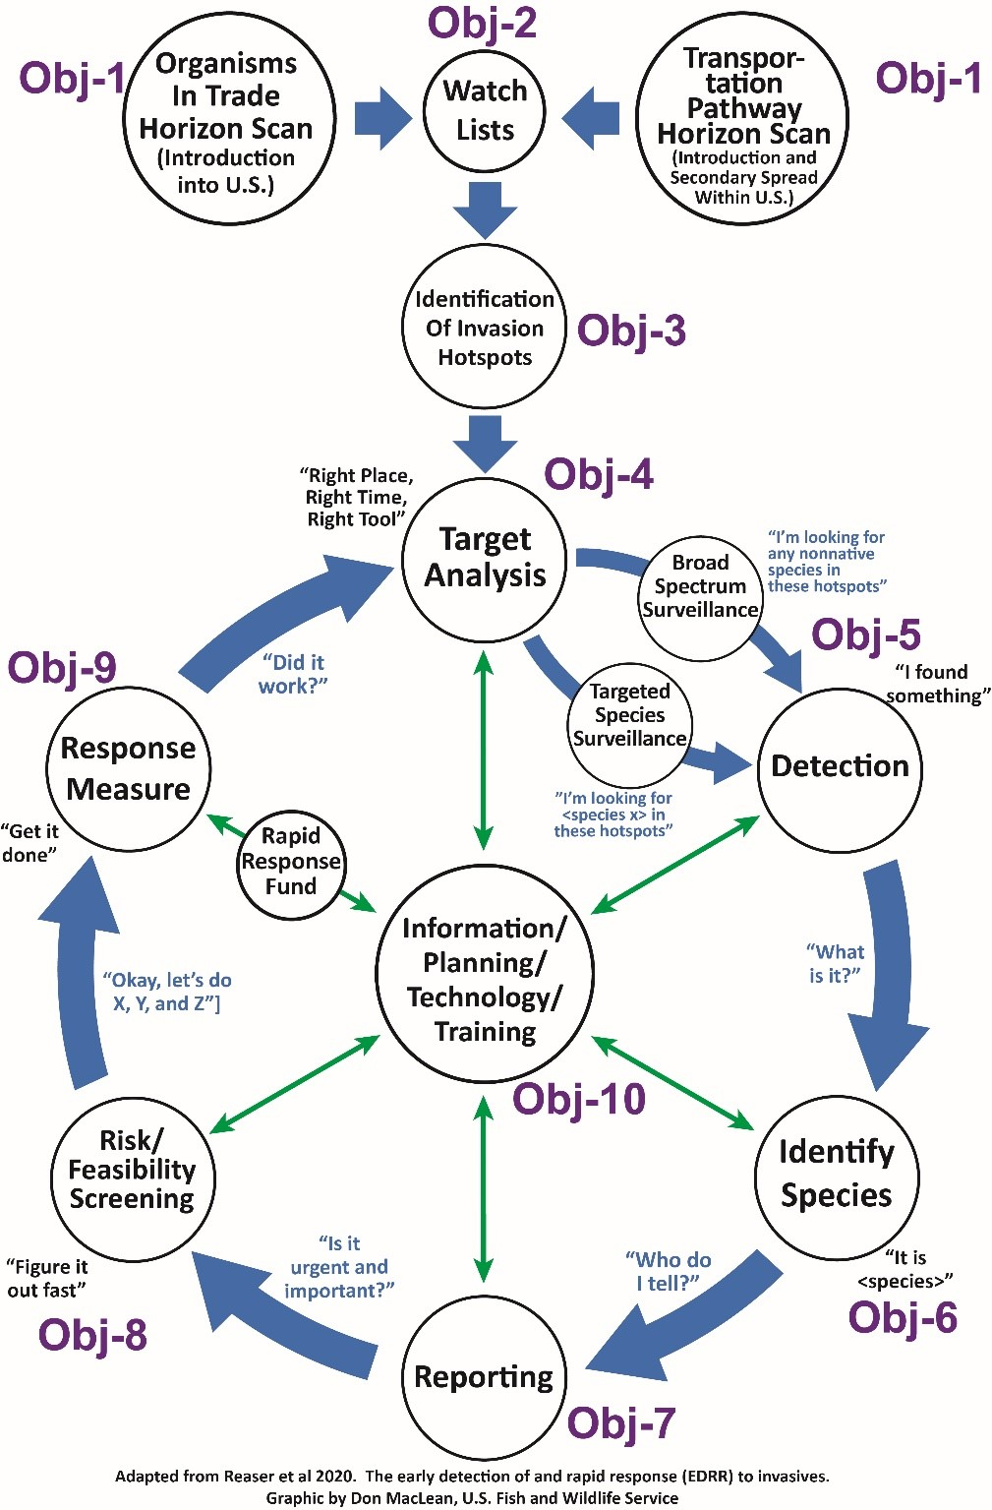
Nationally Coordinated Early Detection Rapid Response Program
Notes:
Multi-agency MOU for Rapid Response was finalized in November 2020; between US Army Corps of Engineers, Department of the Interior, and USDA Forest Service.
https://www.doi.gov/sites/doi.gov/files/usace-usfs-doi-mou-2020.pdf

Slide 9
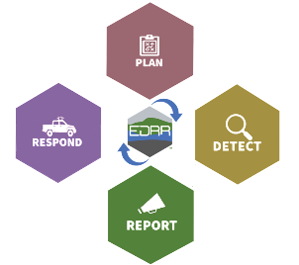
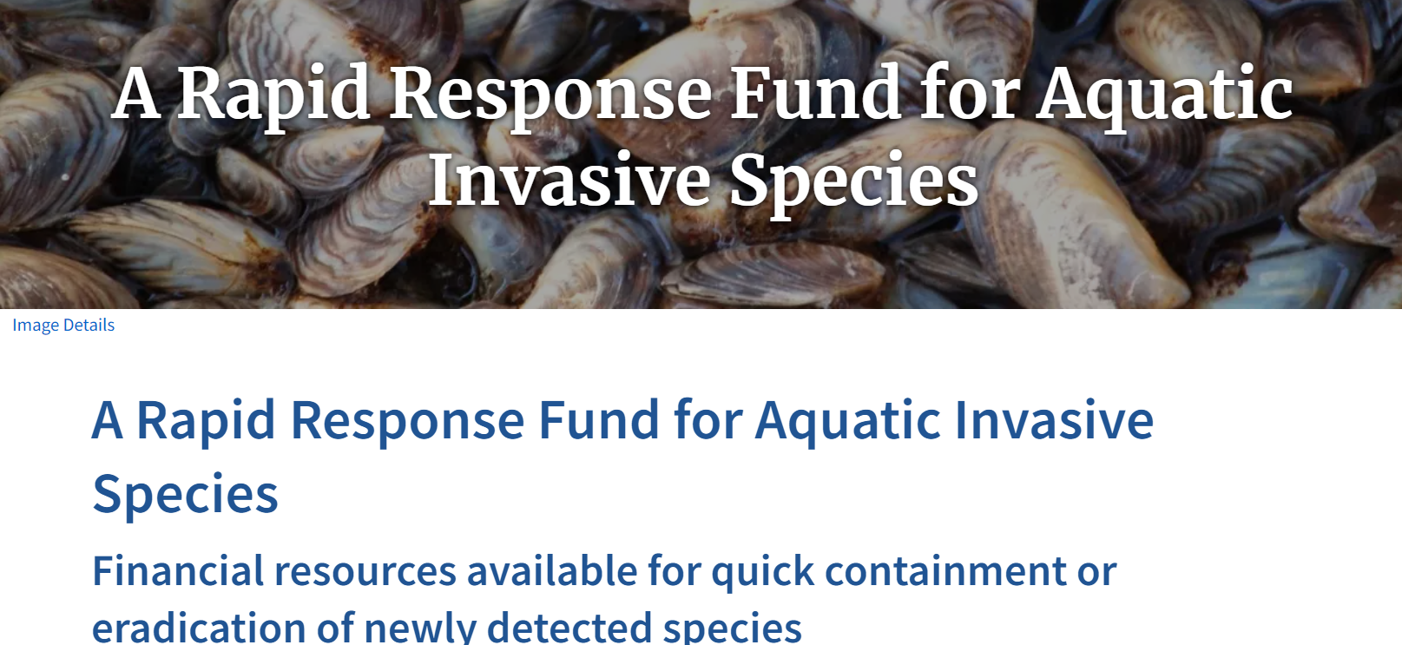
Implementation Highlights: Augmenting rapid response funding and capacity
DOI Interjurisdictional Invasive Species
Rapid Response Team (IInSRRT)
Established in 2023!
Coming soon!
Notes:
Rapid Response Funding: Implement Rapid Response Fund for Aquatic Invasive Species Pilot Program to expedite rapid response led by states, tribes, territories, and federal land management agencies.
Rapid Response Capacity: Strengthen response capacity (Interjurisdictional Invasive Species Rapid Response Teams (IInSRRT), and other response capacity and capabilities, including funding) to rapidly respond to new detections and achieve rapid response outcomes (e.g., containment, eradication).

Slide 10
Priority Aquatic Invasive Species
New Zealand Mudsnail
Zebra & Quagga mussels
Golden mussels
Mystery snail(s)
Rusty crayfish
Marbled crayfish
Eurasian watermilfoil
Hydrilla
American bullfrog
Spiny waterflea
Northern pike
Largemouth bass
Smallmouth bass
walleye
Brook trout
Invasive carp species
Large scale loach
Round goby

Slide 11
YY Brook Trout Stocking
Tyee Springs / Wind River
Stocking YY Brook Trout
Annual Brook Trout removal
PIT array to monitor movement and survival of YY brook trout
Notes:
In any case, we (the CRFWCO) will be continuing our YY brook trout stocking project out at Carson NFH. Activities will include coordinating the installation of a screen on the bypass channel to eliminate the egress of brook trout into the Wind River, performing annual brook trout removals, installing a PIT array to monitor movement (and potentially survival) of YY brook trout in Tyee, and finally stocking a new batch of YY fish into Tyee.
Region 1 Proposal for HQ 2018 Prevention Funding: Abernathy Fish Technology Center (FTC), Columbia River Fish and Wildlife Conservation Office (FWCO), and Carson NFH submitted a proposal for $150,000 for a proof-of-concept eradication of brook trout in Tyee Springs (above ATC) using the YY male approach. The proof-of-concept evaluation of the YY male methodology can help the Service and its partners determine if and how this approach could control nuisance brook trout populations in other locations, and for other nuisance AIS, like common carp. A feasibility study for control of common carp at Malheur using the YY male approach has been proposed. The results of this brook trout eradication project will provide science to inform that effort.

Slide 12
Funding
State ANS Plan Grants
Quagga / Zebra Mussel Action Plan Funds
Inter-Agency Agreement
Watercraft Inspection database
Watercraft Inspection & Decontamination training
Rapid Response Preparedness
Notes:
FY24 $4.08M ANS Mgt. Plans (apprx. $95K per state)
FY24 $2.25M QZAP
FY24 interagency agreement $250K
FY24 provide funding to PSMFC to maintain the efforts on CRB work, rapid response exercises

Slide 13
Notes:
You are all very familiar with the invasive species invasion curve, that helps visualize the importance of prevention.
Invasive Species Invasion Curve – (from Invasive Species Council accessed 2021); adapted from Lodge et al 2006
Prevention can be at two levels – international and domestic – we all experienced this with moss balls earlier this year.

Slide 14
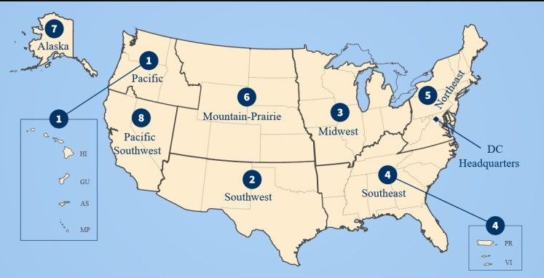
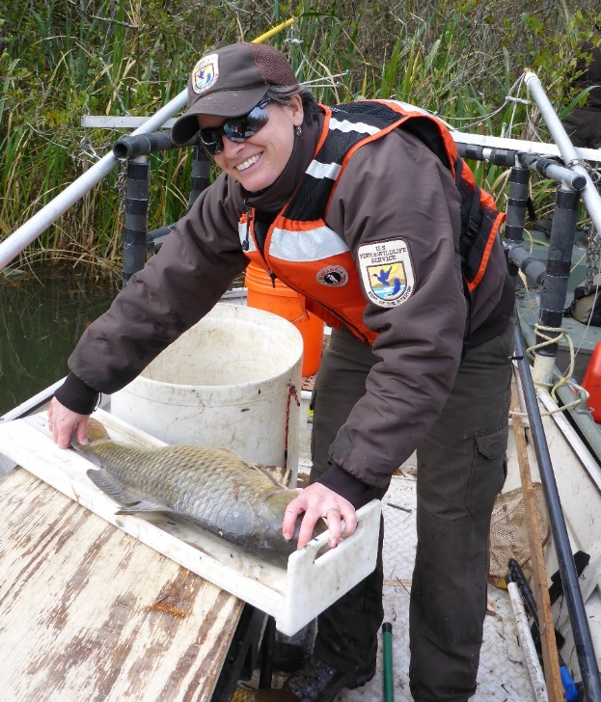
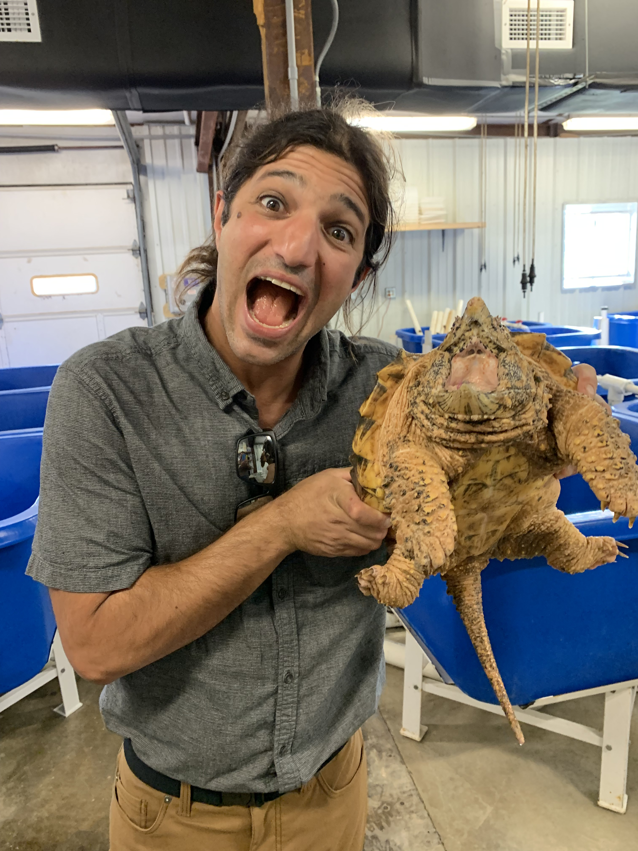
Please contact us!
https://www.fws.gov/program/aquatic-invasive-species/contact-us
Cesar Blanco
FWS – Region 8
Pacific Southwest
916-335-7817 (office/cell)
cesar_blanco@fws.gov
Kim Holzer
FWS – Region 7
Alaska Region
907-213-9792 (office/cell)
kim_holzer@fws.gov
Theresa Thom
FWS – Region 1
Pacific Region
971-278-8029 (cell)
theresa_thom@fws.gov
Barak Shemai
FWS – Region 2
Southwest Region
505-366-9565 (office/cell)
barak_shemai@fws.gov
Liz Sunshine
FWS – Region 6
Mountain Prairie Region
720-450-6601(office/cell)
elizabeth_sunshine@fws.gov
Notes:
Schedule your HACCP training with us, or contact us with any questions you might have!

