Slide 1
WSU’s 2021 Dreissenid Mussel Early Detection Monitoring in the Columbia River
Steve Bollens
Gretchen Rollwagen-Bollens
Julie Zimmerman
School of the Environment and School of Biological Sciences
Washington State University

Slide 2
Location and number of samples collected in 2021 (Bi-weekly, May through October)
Sampling Location | Number of Net Samples | Number of eDNA Samples
Lake Celilo, WA | 41 | 12
Rowland Lake | 41 | 12
Bingen Harbor | 41 | 12
White Salmon | 41 | 12
White Salmon River at Underwood CUR | 41 | 12
Drano Lake | 41 | 12
Wind River | 40 | 12
Stevenson | 40 | 12
Near Bonneville Lock, Hamilton Recreation area | 40 | 12
Beacon Rock SP | 40 | 12
Washougal Marina | 40 | 12
Vancouver, near Kaiser Memorial Park | 40 | 12
Total | 486 | 144

Slide 3
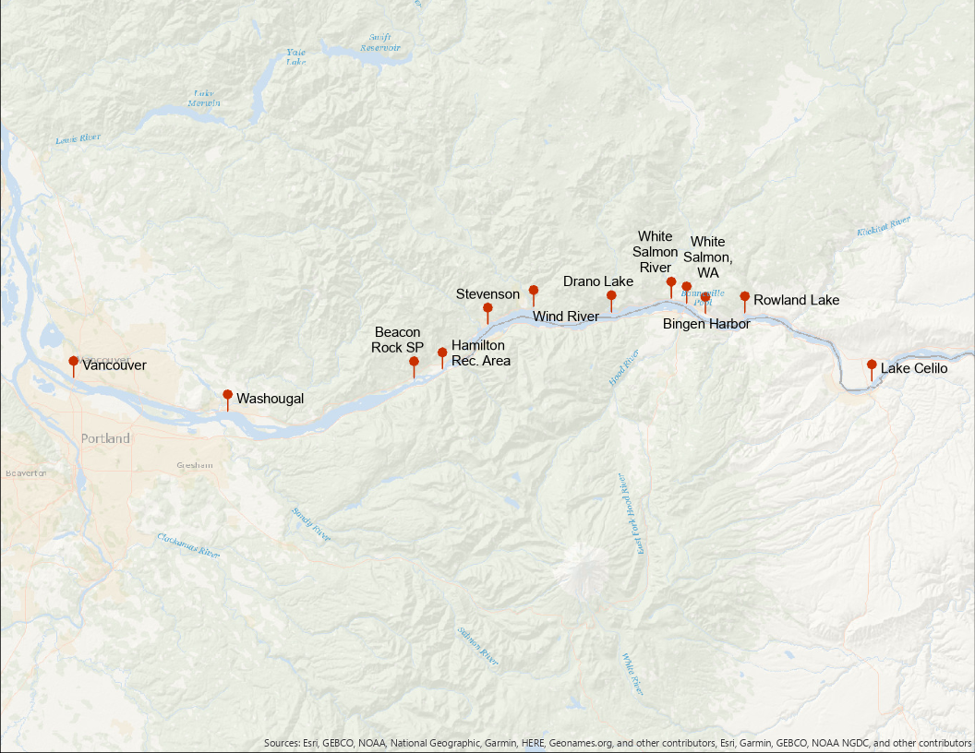
Location of samples collected in 2021

Slide 4
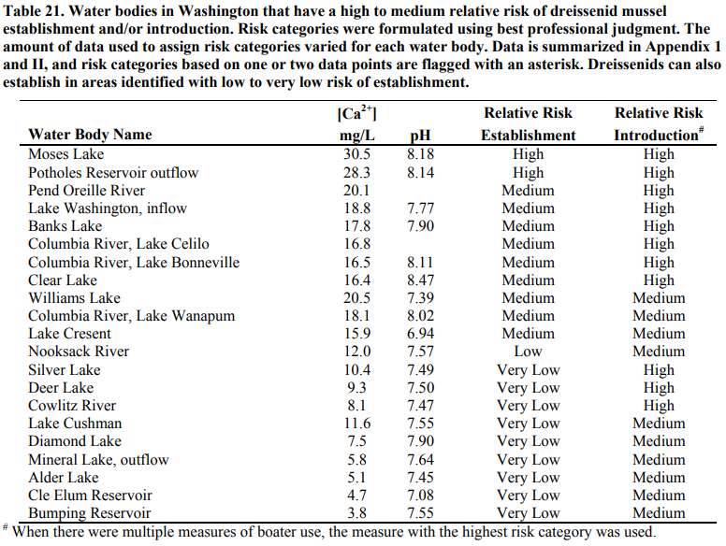
Risk assessment data used to direct sampling
Wells et al. (2011)

Slide 7
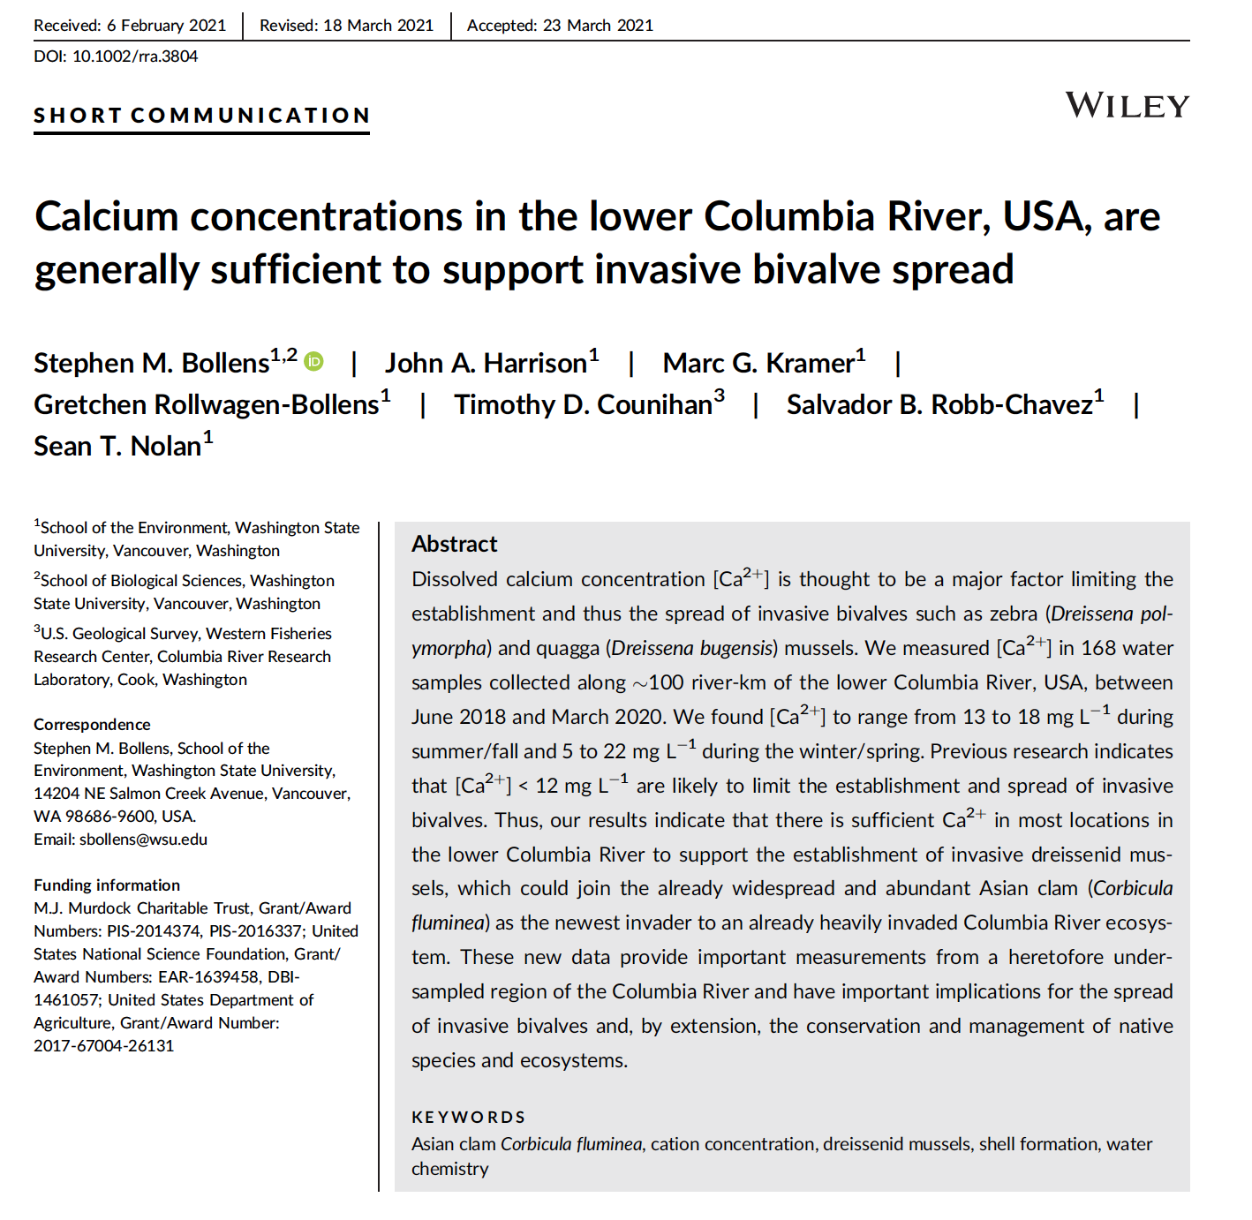

Slide 8
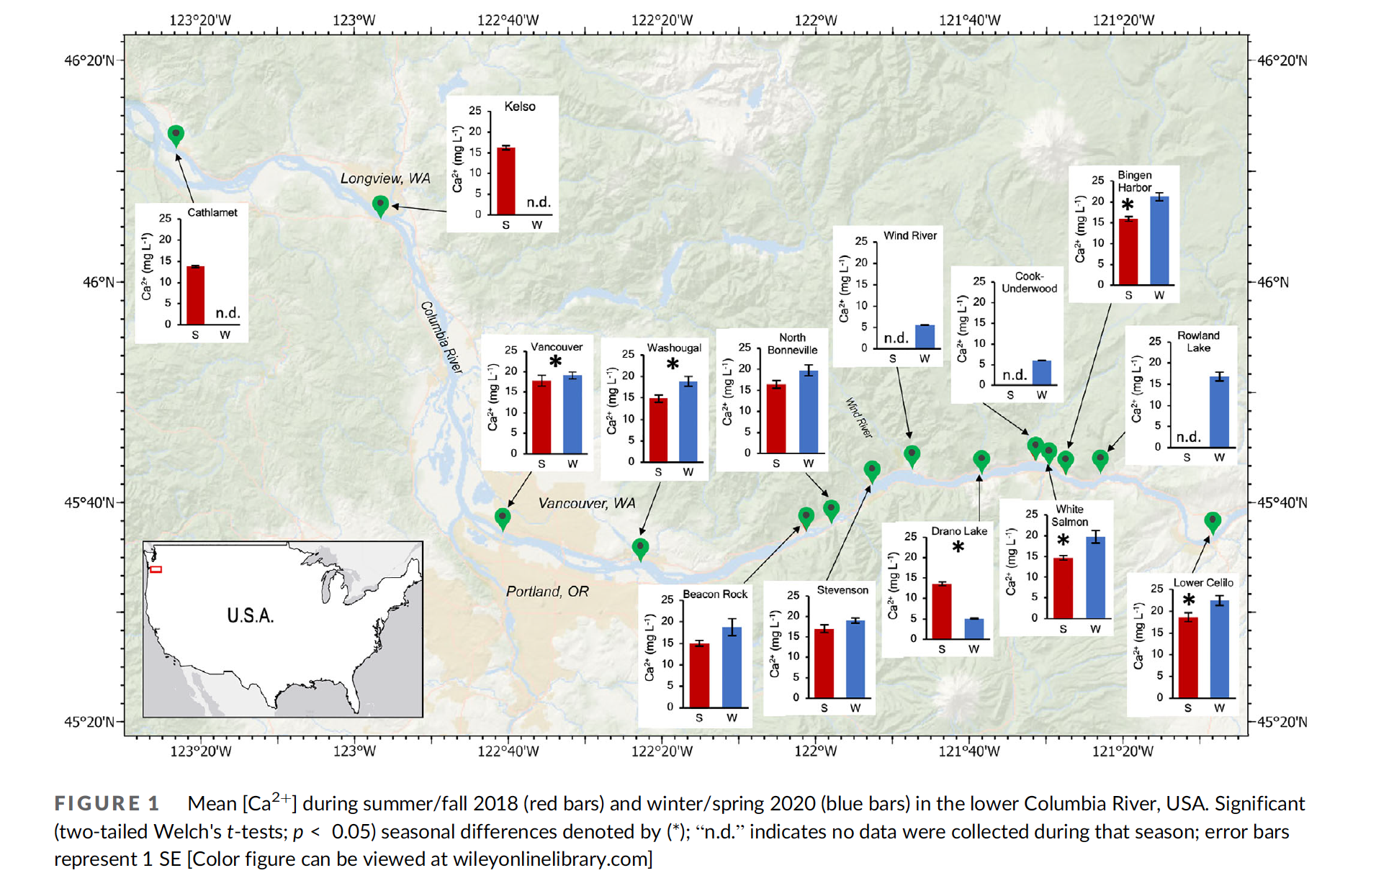
WSU Calcium Data from 2018-2020
From Bollens et al., 2021, River Res. Appl., https://doi.org/10.1002/rra.3804

Slide 9
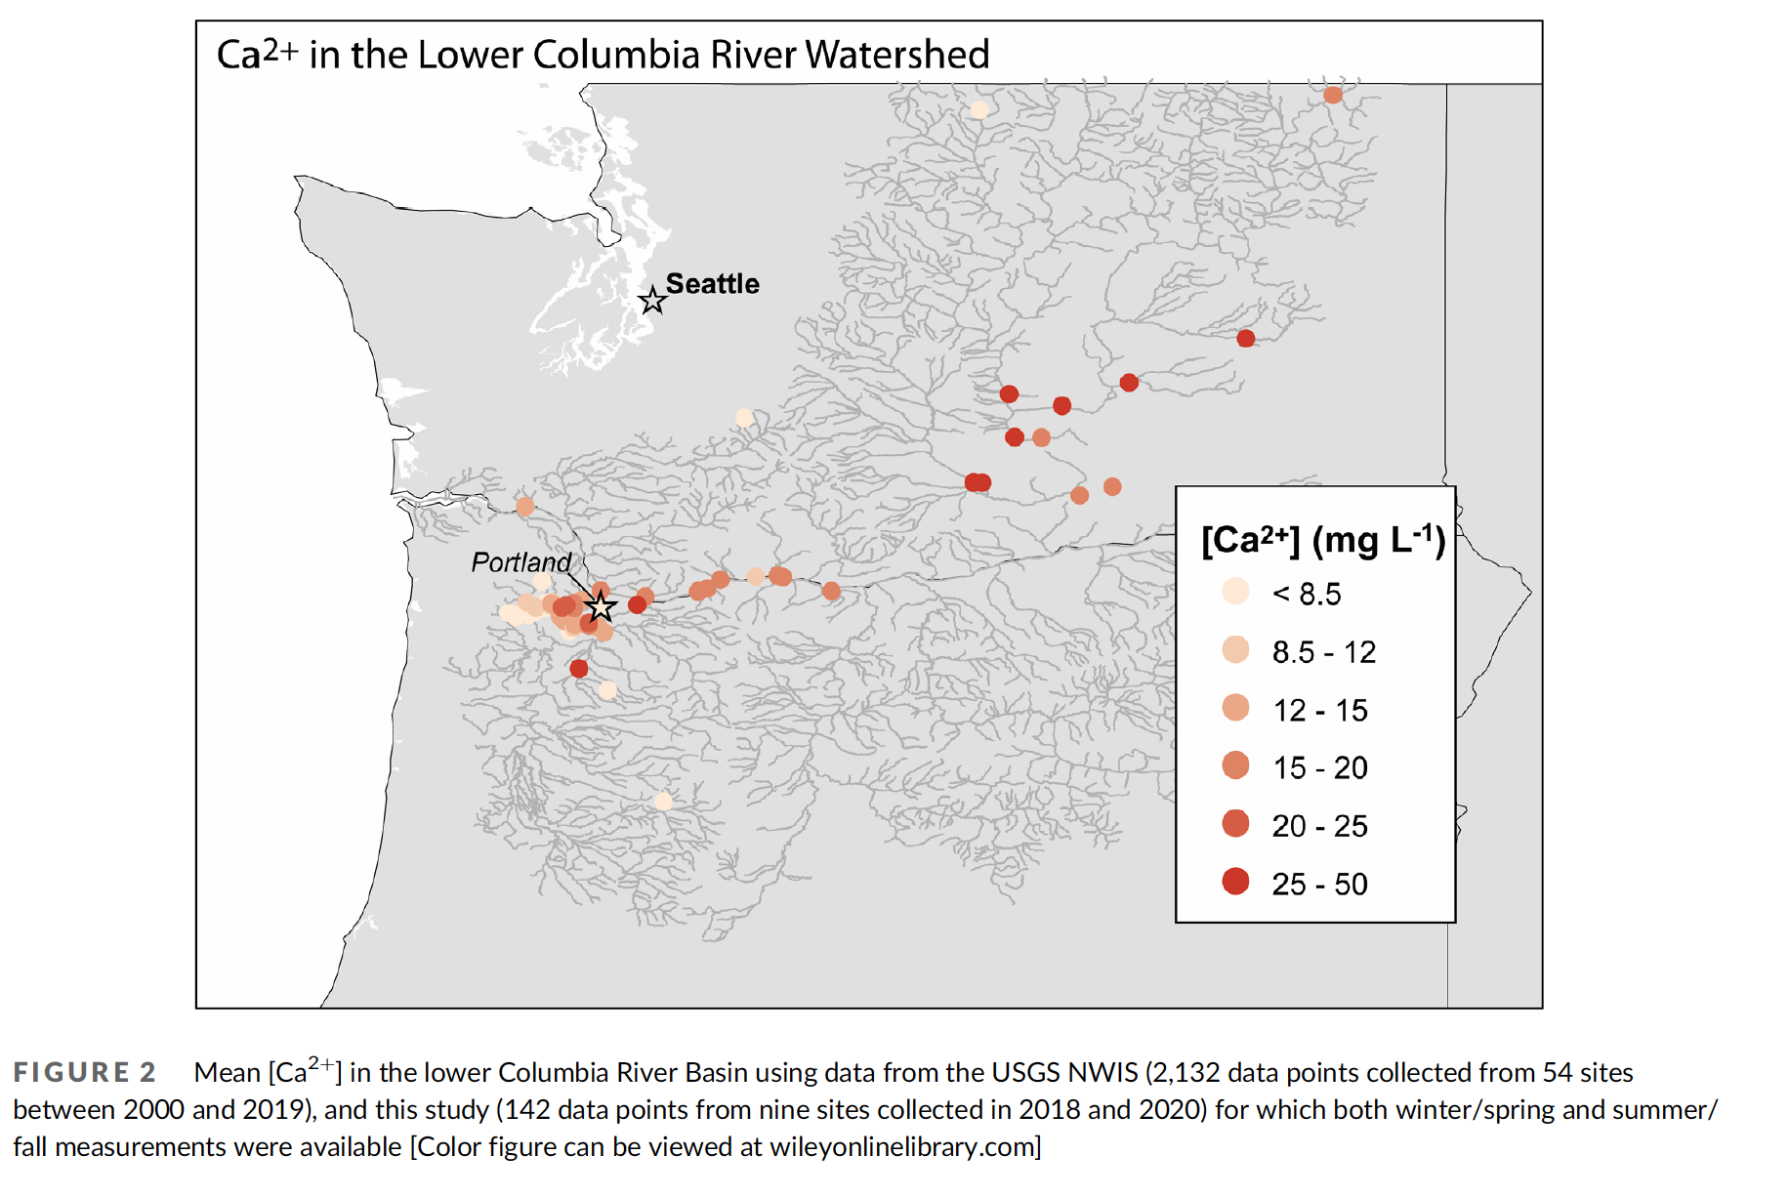
From Bollens et al., 2021, River Res. Appl., https://doi.org/10.1002/rra.3804

Slide 10
Given our (WSU’s) sampling locations, which range from Lake Celilo (most upstream) to Vancouver (most downstream), our risk assessment is as follows:

Slide 11
Given our (WSU’s) sampling locations, which range from Lake Celilo (most upstream) to Vancouver (most downstream), our risk assessment is as follows:
Risk of Introduction
High

Slide 12
Given our (WSU’s) sampling locations, which range from Lake Celilo (most upstream) to Vancouver (most downstream), our risk assessment is as follows:
Risk of Introduction | Risk of Establishment
High | Medium

Slide 13
Given our (WSU’s) sampling locations, which range from Lake Celilo (most upstream) to Vancouver (most downstream), our risk assessment is as follows:
Risk of Introduction | Risk of Establishment | Potential Economic Impacts
High | Medium | Extremely High

Slide 14
Given our (WSU’s) sampling locations, which range from Lake Celilo (most upstream) to Vancouver (most downstream), our risk assessment is as follows:
Risk of Introduction | Risk of Establishment | Potential Economic Impacts | Potential Ecological Impacts
High | Medium | Extremely High | Extremely High

Slide 15
Allocation of samples by sampling method
 |  | WATER BODY
FIELD COLLECTION METHOD | LABORATORY ANALYSIS METHOD | THE DALLES RESERVOIR | BONNEVILLE RESERVOIR | “LOWER” COLUMBIA | TOTAL
Plankton tow | CPLM Microscopy | 41 | 285 | 160 | 486
Water sample | eDNA | 12 | 84 | 48 | 144
Plankton tow | FlowCam | 9 | 21 | 18 | 48

Slide 16
Results of 2021 Surveys: Dreissenid Veligers The Good News!
 |  | WATER BODY
FIELD COLLECTION METHOD | LABORATORY ANALYSIS METHOD | THE DALLES RESERVOIR | BONNEVILLE RESERVOIR | “LOWER” COLUMBIA | TOTAL
Plankton tow | CPLM Microscopy | 0 | 0 | 0 | 0
Water sample | eDNA | 0 | 0 | 0 | 0
Plankton tow | FlowCam | 0 | 0 | 0 | 0

Slide 17
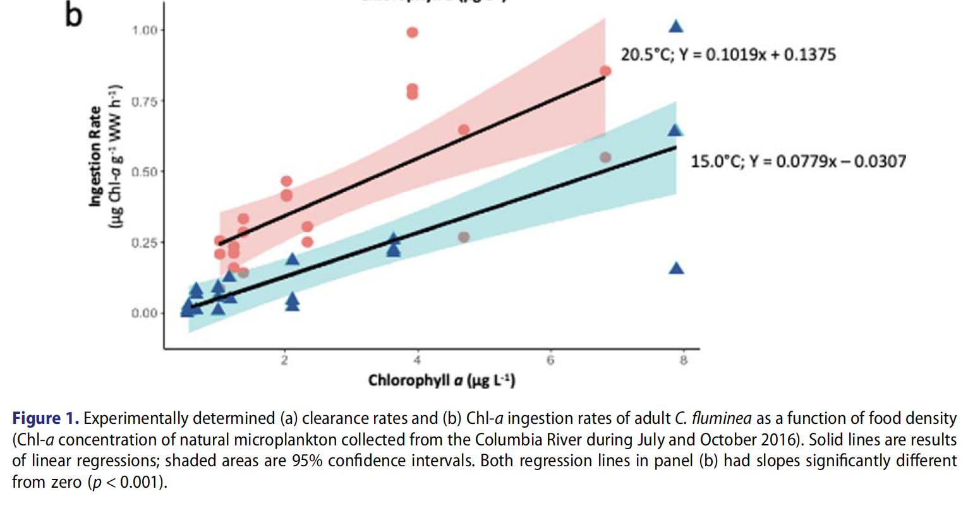
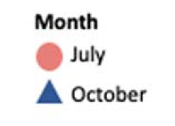
Ingestion rate of the Asian clam, Corbicula fluminea,
as a function of food concentration
From Rollwagen-Bollens et al., 2021, Inland Waters, https://doi.org/10.1080/20442041.2020.1843933

Slide 18
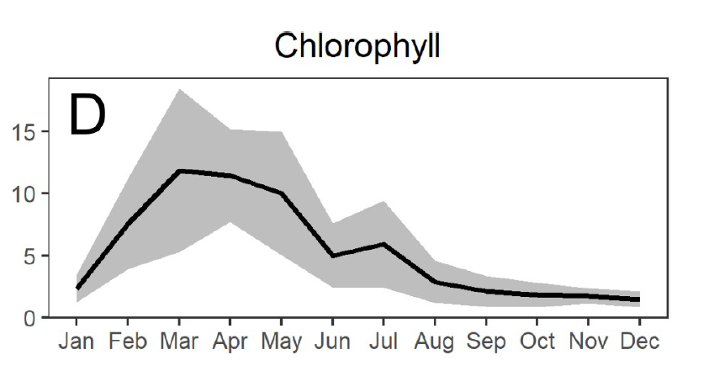
Chlorophyll a concentration (ug/L) in the lower Columbia River
(Vancouver Dock, 2005-2016)
From Dexter et al., 2020, PLoS ONE 15(12): e0243002
https://doi.org/10.1371/journal.pone.0243002

Slide 19
Ingestion rate of the Asian clam, Corbicula fluminea,
as a function of food concentration
From Rollwagen-Bollens et al., 2021, Inland Waters, https://doi.org/10.1080/20442041.2020.1843933

Slide 20
What went well and what posed difficulties?
Everything continues to go “as smooth as silk” – WSU has been doing this for many years now, so we are a “well-oiled machine.”
COVID slowed down the processing of the 2020 samples by several weeks, but did not significantly affect our work in 2021 nor should it going forward.

