Slide 1
AIS Cost-share program under §104 of the Rivers and Harbors act of 1958, as amended
Prepared by Jonas Grundman
National APC Program Technical Lead
U.S. Army Corps of Engineers

Slide 2
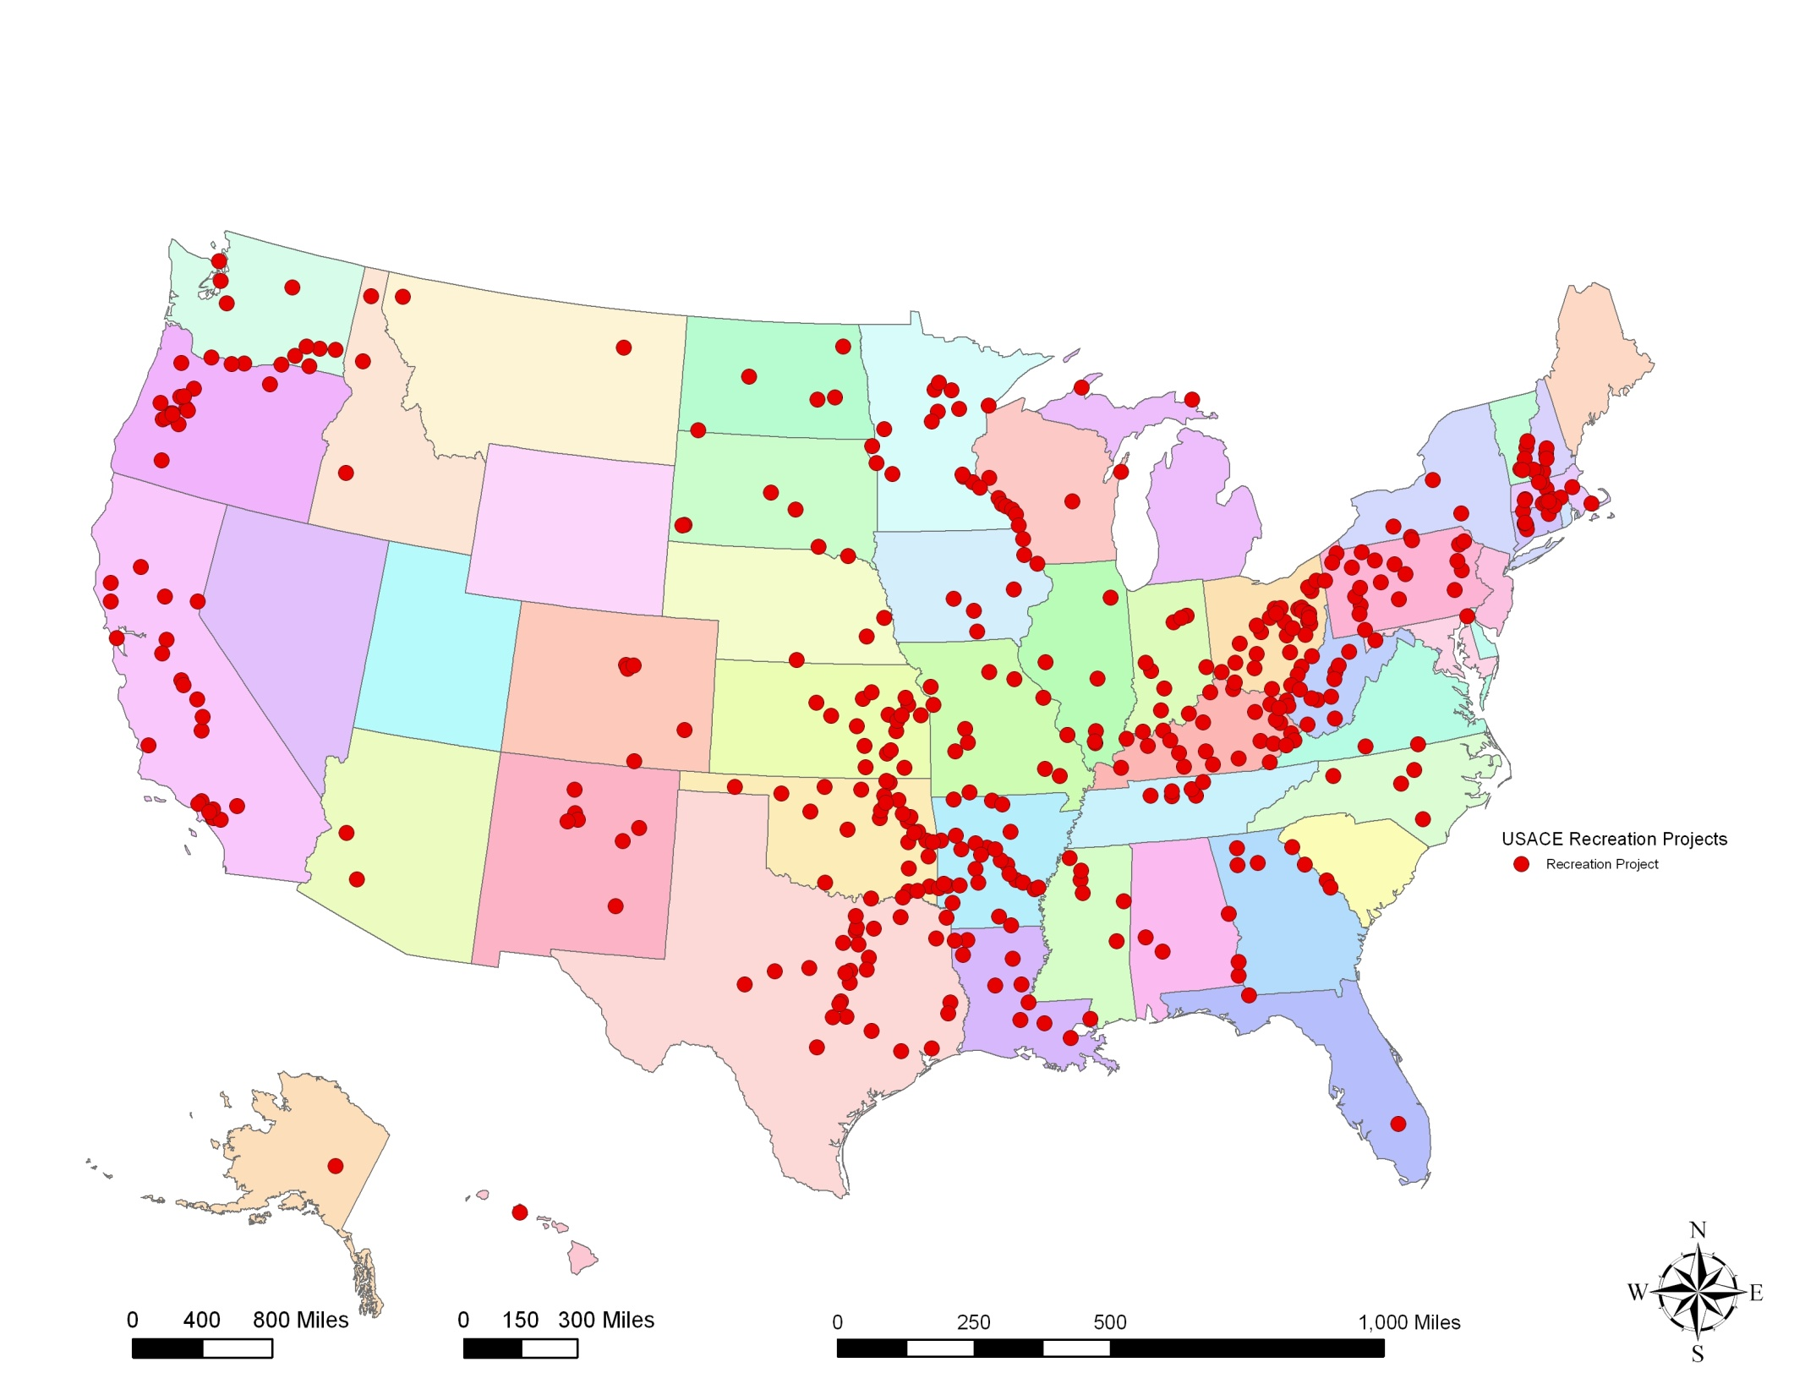
USACE Background:
Projects:
700 Civil Works Projects
12.5 Million acres federal lands
25,000 miles of Navigation Channels
90% within 1 hour of a metropolitan area
Ecosystem restoration projects
Challenges:
Demand to use our lands & waters
Recreation, Navigation, Water Supply, Hydropower Generation
Fun filled fact we’ve been killing weeds since 1898

Slide 3
Presentation overview
Intro and BLUFs
What is the APC-CS Program
How does this impact Operations Division
Program Implementation
Brief History of the Aquatic Plant Control Program
Legislation from 1958 to 2020 (2022?)
Funding history
Current Status of Geographic Expansion under WRDA(s)
Upper Missouri River Basin
Open Forum: how might this program integrate into traditional Operations Div. Programs…

Slide 4
Water Resources Development Act (WRDA)
Public laws enacted by Congress to deal with various aspects of water resources: environmental, structural, navigational, flood protection, hydrology, etc. Typically, the United Sates Army Corps of Engineers administers the bulk of the Act's requirements.
America’s Water Infrastructure Act of 2018 (WRDA 18) contained nearly 300 authorities or amendments.
Prior to ‘76: Flood Control Act of 19__
Rivers and Harbors Act of 19__
Generally, every 2 years. (eg. WRDA 14, WRDA 16)

Slide 5
BLUF
AIS like Zebra and Quagga Mussels are significant issues for national water resource infrastructure, ecosystems, and public recreation (all USACE missions).
ZM and QM spread via recreational boat traffic
Watercraft inspections at key locations is a critical prevention tactic
Prior to 2014, USACE had little to no authority to support prevention efforts off USACE property
Needed to ‘Get in the Game’
Big Picture: Rapidly expanding program experiencing growing pains. ~18 States within ~10 Districts (3 MSCs). Need consistency, communication, and coordination to be successful.

Slide 6
We are gathered here today to…
Aquatic Plant Control – Cost Share Program
50:50 Cost-share w/ Non-Federal Sponsor
Support current or expanded watercraft inspection stations
Prevent the spread of Aquatic Invasive Species into, or out of, waters of the United States.
What is Operations Role in the Program?
Not a USACE Funding Mechanism
Educational Role & Advocate
With State / Local Partners – build into regional efforts

Slide 7
How does usace manage the national program?
Funding
Pres. Budget Submission = $0
Congressional add each FY
Implementation Lead (NWW)
NWD via Walla Walla District (CRB Exp)
Provides QA over Letter Report and PEA
NWW: Signs PPA, Approves AWPs and SOW
Manages Labor and Processes Invoices
Lead District(s) by Basin
Draft Env. Compliance Docs (LR/PEA)
Primary POC within Basin w/ NFS & internal agency
QA/QC on PPA and AWPs

Slide 8
Aquatic Plant Control Program: 1958 - 2021
Rivers and Harbors Act of 1958
Specific aquatic plant species
8 southern U.S. states
70:30 Cost-share
Amendments through 1999
Research and planning at full federal expense
Authorization increase from 1.3M to 15M
Geographic scope added all U.S.
Species updated to include all aquatic plants

Slide 9
Aquatic Plant Control Program: 1958 - 2021
WRDA 2014 (PL 113-121)
Created Watercraft Inspection Station Program (WISP) within Columbia River Basin (CRB)*
50:50 Cost-share with Non-Fed Sponsors
Authority focused on protecting USACE CW projects
Amend. covered species to include all Aquatic Invasive Species (AIS), e.g. Zebra & Quagga Mussels
USACE authority for Risk Assessments, AIS Monitoring, RR Planning, and WQ Monitoring
Authorization of 40M (20M WISP, 20M APC)
Notes:
* Limited to specific states (ID, MT, OR, WA) & only within the drainage of the CRB. Did not include WY or NV.

Slide 10
cost-share basins under §104 of the RHA WRDA 2014

Slide 11
Aquatic Plant Control Program: 1958 - 2021
WRDA 2016 (PL 114-322)
Amended CRB WISP to include entire political boundary of CRB states* vs. CRB drainage area
Authority to assist States w/ Rapid Response Actions
Authorization of 40M (20M WISP, 20M APC)
WRDA 2018 (PL 115-270)
Significant geographic and $$ expansion;
(i) Columbia River Basin (30M)
(ii) Upper Missouri River Basin (30M)
(iii) Upper Colorado, South Platte, and Arkansas Basins (30M)
Notes:
* Limited to specific states (ID, MT, OR, WA). Does not include WY or NV.

Slide 12
cost-share basins under §104 of the RHA WRDA 2018

Slide 13
Aquatic Plant Control Program: 1958 - 2021
WRDA 2020 (PL 116-260)
Expanded geographic area;
(iv) Russian River Basin (30M)
(v) US – Canada Border Region (10M)*
Modified ‘Location’ criteria for inspection stations
WRDA 2014: justification based on ability to protect USACE projects.
WRDA 2020: Amends to those with the “highest likelihood of preventing the spread of AIS into and out of waters of the United States”.
Potential impacts to how each basin is justified within the letter report.
Notes:
* Need clarifying guidance on intent of US-CA Border Region.

Slide 14
cost-share basins under §104 of the RHA WRDA 2020

Slide 15
WRDA 2020

Slide 16
Aquatic Plant Control Program: Funding
Congressional Authorizations by Basin (WISP)
WRDA Year | Program Authorization
2014 | Total – $20M | CRB - $20M
2016 | Total - $20M | CRB - $20M
2018 | Total - $90M | CRB - $30M UMRB - $30M UCRB, SPRB, ARP - $30M
2020 | Total - $130M | CRB - $30M UMRB - $30M UCRB, SPRB, ARP - $30M RRB - $30M US-CA Border – $10M
Notes:
* Need clarifying guidance on intent of US-CA Border Region.

Slide 17
Aquatic Plant Control Program: Funding
Watercraft Inspection Stations
AIS Monitoring
Fiscal year | obligations | Expenditures
2017 | $3,700,000.00 | $3,242,901.13
2018 | $ 4,122,489.00 | $4,045,096.61
2019 | $496,581.00 | $3,470,806.58
2020 | $5,003,924.00 | $4,107,012.04
2021 | $5,205,613.00 | In progress.
Fiscal year | obligations | Expenditures
2017 | n/a | n/a
2018 | $691,957 | $32,182.42
2019 | $702,587.00 | $687,784.95
2020 | $700,592.00 | $470,899.89
2021 | $869,658.00 | In progress.
Notes:
* Need clarifying guidance on intent of US-CA Border Region.

Slide 18
Watercraft Inspection Station Program – Current Status and Efforts
Columbia River Basin
Active cost-share for WA, OR, MT, ID
Amended Letter Report adding WY & NV with MSC & HQ for approval/finalization. Includes WID, RR, and Monitoring
Once approved, USACE and Non-Fed will amend cost-share agreement.
Upper Missouri, South Platte, Upper Colorado Basins
Letter Reports in MSC Policy Review – ~Feb22
Finalization in Q2 FY22
PPA(s) Executed, AWP(s) Approved, SOW(s) Executed

Slide 19
Watercraft Inspection Station Program – Current Status and Efforts
Arkansas River Basin
Identifying a lead District to begin Letter Report and Compliance.
Delay due to error in WRDA language.
Russian River Basin
Letter Report in early stages
Estimated completion Q4 FY22
U.S – Canada Border Region
Will be requesting clarification on congressional intent
Question on authority for international cost-share

Slide 20
Watercraft Inspection Station Program – Current Status and Efforts
Roles and Responsibilities MOU
Clarifies roles of NWW and lead Districts
Impacted Districts have agreed/signed
Plan to route to NWD and SPD Q2 FY22
Will amend/update as new basins are incorporated

Slide 21
Watercraft Inspection Station Program – Current Status and Efforts
Rapid Response Cost-share
Assist with purchase of equipment, training exercises, or eradication efforts
Working to incorporate into Project Partnership Agreements
NEPA: Completed for cost-sharing of equipment*.
ESA: Programmatic consultation in progress
NMFS: status unclear, working to resolve
FWS: no progress (emergency consult.)
Final Approvals received on PPA (CRB)
Allows cost sharing purchases of equipment, training, exercises and drills
Working with States to develop their SOW.

Slide 22
Watercraft Inspection station Cost-share program scope: Ok, so what can we (USACE) do with it?
What it is…
What it isn’t…
Cost-share Program w/ Non-federal Sponsors (NFS)
NFS can place inspection stations on USACE (and other Fed) property.
Can be operated by the NFS or their contractors
Reimbursable
NFS develops an annual work plan, approved by the USACE
NFS Invoices for up to 50% of costs incurred under the approved work plan
USACE pays for completed work
NOT a funding mechanism for USACE operating projects
Stations on USACE lands MAY require a RE Instrument
USACE shall not operate the station or provide volunteers
NOT a grant program
NFS does not receive funds prior to completing work

Slide 23
Water Resources Reform and Development Act (WRDA) (2014, 2016, 2018, 2020)
(Public Law 113–121—June 10, 2014 , Sec. 1039. Invasive species)
‘‘(1) IN GENERAL
—In carrying out this section, the Secretary may establish watercraft inspection stations in the Columbia River Basin to be located in the States of Idaho, Montana, Oregon, and Washington at locations, as determined by the Secretary, with the highest likelihood of preventing the spread of aquatic invasive species at reservoirs operated and maintained by the Secretary.
December 2015: FY 2016 Omnibus passes - $4 million to establish watercraft inspections
January 2016: USACE begins drafting implementation guidance
March 2016 : IG completed
March 2017: Letter Report completed

Slide 24
Water Resources Reform and Development Act (WRDA) (2014, 2016, 2018, 2020)
April 5 2017: Watercraft Inspection Program Begins; PSMFC signs agreement to administer the $3.7 million with the USACE (Walla Walla) on behalf of OR, ID, MT and WA. Reimbursement 50%
May 2017 The FY 17 federal budget included $ 5 million for the CRB WRDA project -- It included “monitoring” ($ 1 million) as an allowable expense.
July 2017: Monitoring Cost Share Program Begins ($373,000)

Slide 25
Water Resources Reform and Development Act (WRDA) (2014, 2016, 2018, 2020)
January 2021: CRB
Watercraft Inspection program agreement ($5 M)
Febuary 2021: CRB
Monitoring agreement ($789k)

Slide 26
CRB Expansion: NV & WY
Amending 2017 Letter Report / EA
Covers WID, Monitoring, and Rapid Response
That protect the CRB.
In final Approval with NWD
Once approved, PSMFC & NWW sign amendment to cost share agreement for upcoming FYs

Slide 27
Implementation
Corps Established an Agreement with PSMFC.
Annual Statements of Work (SOW) identify the expected work and budgets.
50% / 50% cost share* on a reimbursement basis.
WID and Monitoring as separate SOW.
Monthly Reimbursements.
*Of total costs (Federal + State costs), not a 50% reimbursement of the state’s costs. Only implementation is cost shared. Letter Reports/ Environmental Compliance 100% Federal.

Slide 28
Geographic expansion
Letter Report for each basin.
Upper Colorado: Albuquerque District
Upper Missouri: Omaha District
South Platte: Omaha District
Russian River: San Francisco District
Arkansas River: ? (Tulsa District)
Includes WID, monitoring, and Rapid Response
Overall report summarizing the Letter Reports, discussing common elements, work processes, coordination among the states and basins.
Expected Completion Oct 2021 for UC, UM, SP
FY2021 Appropriation $15M an 3M Monitoring.

Slide 29
Geographic expansion

Slide 30
Flowering Rush
Aquatic Plant Control Program established in Rivers and Harbors Act of 1958
Cost share largely unfunded since 1996 - ?
Letter Report approved by NW Division.
Federal Interest
Cost Effective
Cost Efficient
Roles of Parties
Local Cooperative Agreement with PSMFC
Annual Agreements (Walla Walla Commander)

Slide 31
Flowering Rush
Letter Report/EA reviews complete.
Final approval by NW Division Commander-Spring 21
State participating: 1M total allowed
Montana, Washington, Idaho, Oregon
Sign Cost Share Agreement
Receive Annual Work Plan
ESA/NEPA compliance-done
Finalize Annual Work Plans / obligate funds
Annual Agreements

Slide 32
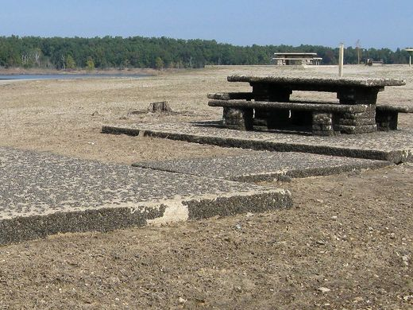
Questions, Comments, concerns, etc

Slide 33
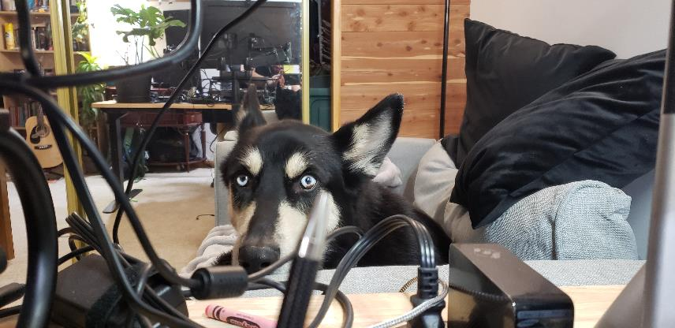
Open forum

