Slide 1
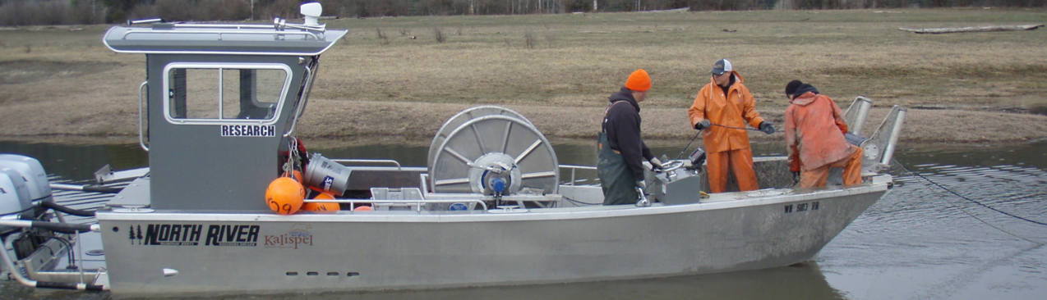


Pushing Back Against Invasive Northern Pike:
Application of a Large-scale Suppression Program
Photo: Kalispel Tribe
Nicholas J. Bean¹, Shane J. Harvey¹, Jason M. Connor¹, Jason A. Olson¹, William P. Baker²
Kalispel Tribe of Indians Natural Resources Department¹
Washington Department of Fish and Wildlife²
Columbia River Basin AIS Team Meeting, Spokane, WA – December 6-7, 2022

Slide 2
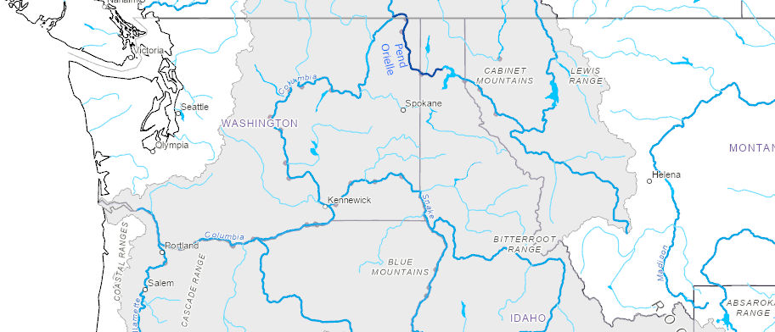

Project Location
Pend Oreille River, Washington
Notes:
The project is located on the Washington portion of the Pend Oreille River which is the terminal river of the Pend Oreille/Clark Fork watershed that originates in Montana.
The Pend Oreille River flows from the outlet of Lake Pend Oreille Idaho and turns due north after crossing into Washington and terminates at its confluence with the upper Columbia River in BC Canada.
There are three major hydroelectric dams on the mainstem Pend Oreille River: Albeni Falls in Idaho owned by the US Army Corp of Engineers, Box Canyon Dam in Washington owned by the Pend Oreille PUD, and Boundary Dam near the US/Canada Border, which is owned by Seattle City Light.

Slide 3
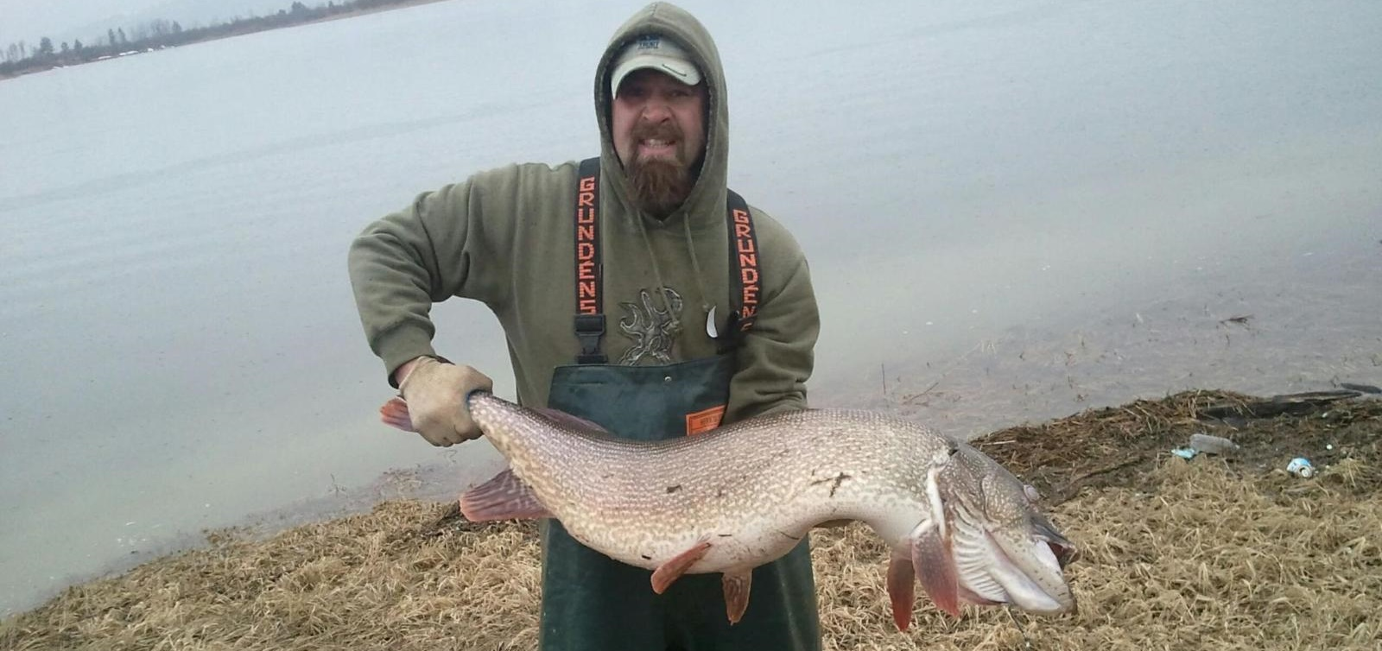
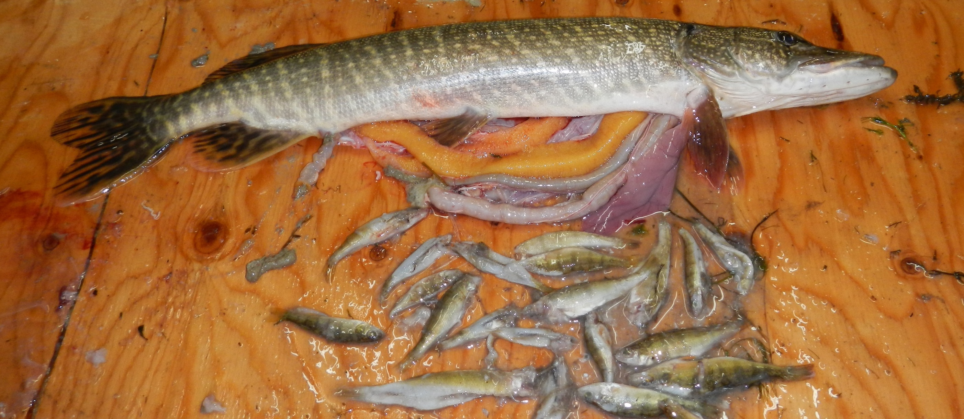
Photo: Kalispel Tribe
Photo: Kalispel Tribe
Not native to the Northwestern U.S.
Highly invasive and popular (angler)
High reproductive and growth potential
Large and efficient apex predator
Capable of restructuring fisheries
Disrupted ecosystems in MT, AK, ID, WA, CO, UT, CA
Northern Pike
Esox lucius
Notes:
Within North America, Northern pike (pike hereafter) are native to the mid-west, and large parts of Canada and Alaska.
Numerous introductions over the past 50 years have increased their distribution throughout the United States, including the Pacific Northwest
Pike are a highly fecund species capable of producing hundreds of thousands of eggs and can attain large sixes, capable of consuming fish 75% of their body length.
As a top-level predator, pike are capable of disrupting fisheries and ecosystems, which has occurred in MT, AK, ID, WA, CO, UT, and CA.

Slide 4
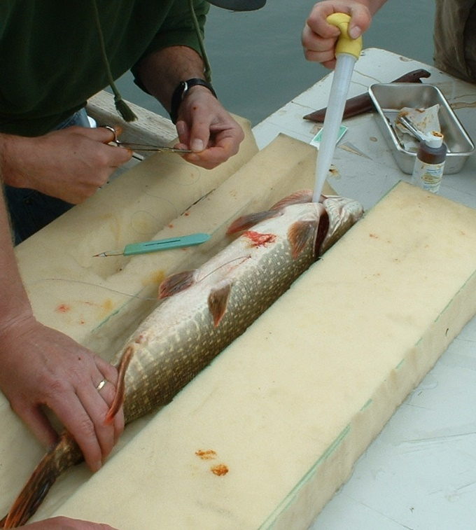
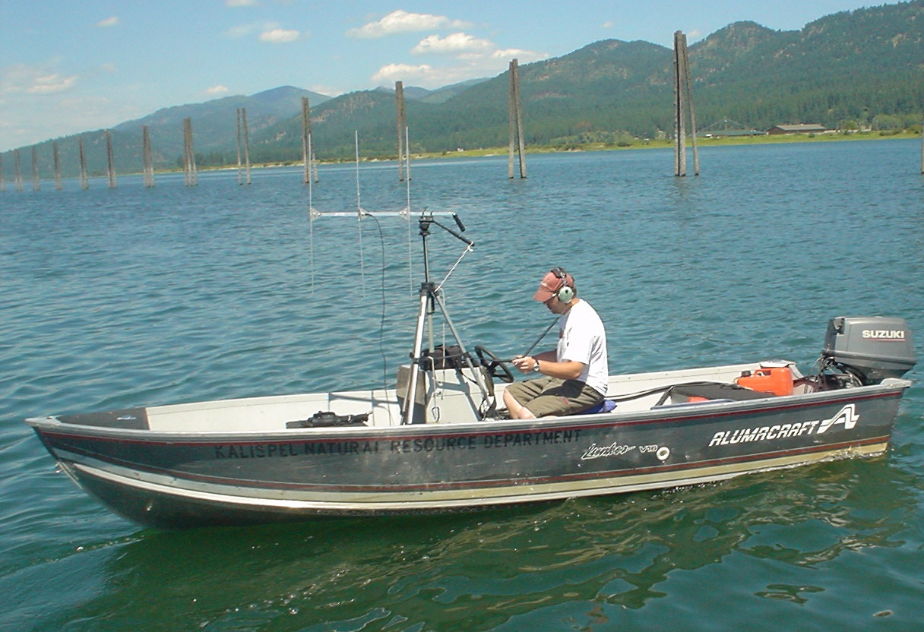
2004
Pike First Detected
2010
Spring Pike Index Netting Survey (SPIN) Developed/Initiated
2011
Suppression Pilot
2005
Studies and Evaluations Initiated
Management Objectives Developed
Public Outreach and Regulation Changes
Photo: Kalispel Tribe
Photo: Kalispel Tribe
Pend Oreille River Pike:
Invasion, Evaluation, Action
Notes:
Pike were first detected in the Pend Oreille River in a survey of Box Canyon Dam in 2004. During that survey less than 30 were captured.
We immediately initiated studies such as diet, growth, dispersal, telemetry, bioenergetics, and population estimates to better understand this new species.
In 2010 we developed a Spring Pike Index Netting survey which would provide us a tool to monitor the relative abundance of the population.
In 2011 we conducted a successful pilot suppression effort to determine if we could achieve site level reduction in catch .
The same year we conducted extensive public outreach.
Immediately following, we developed specific management goals and objectives for the population.

Slide 5
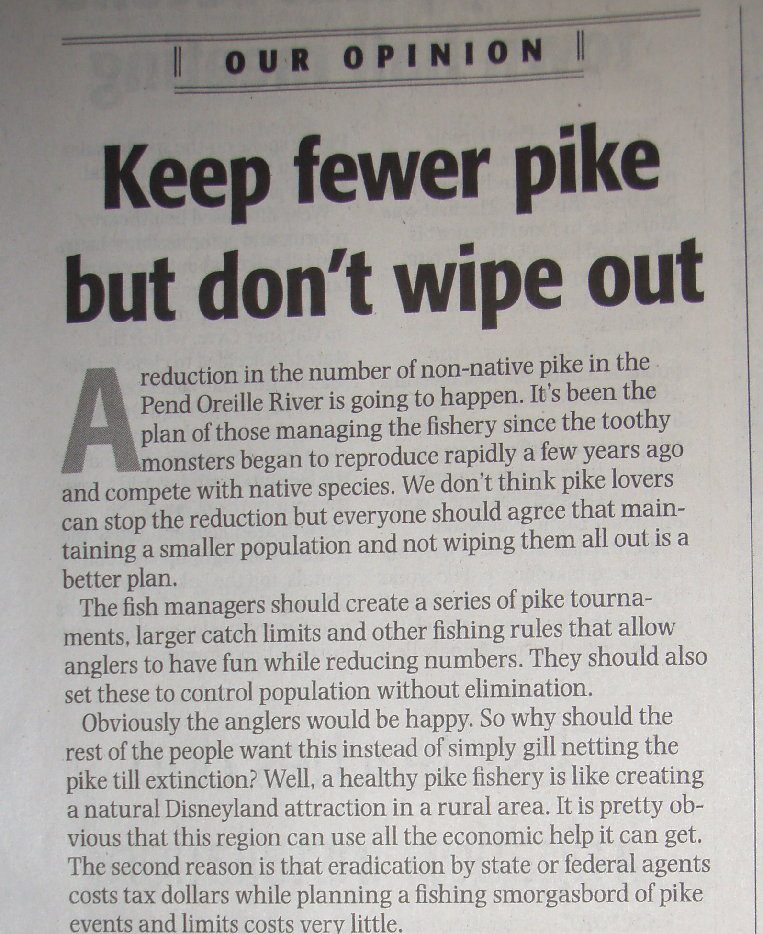
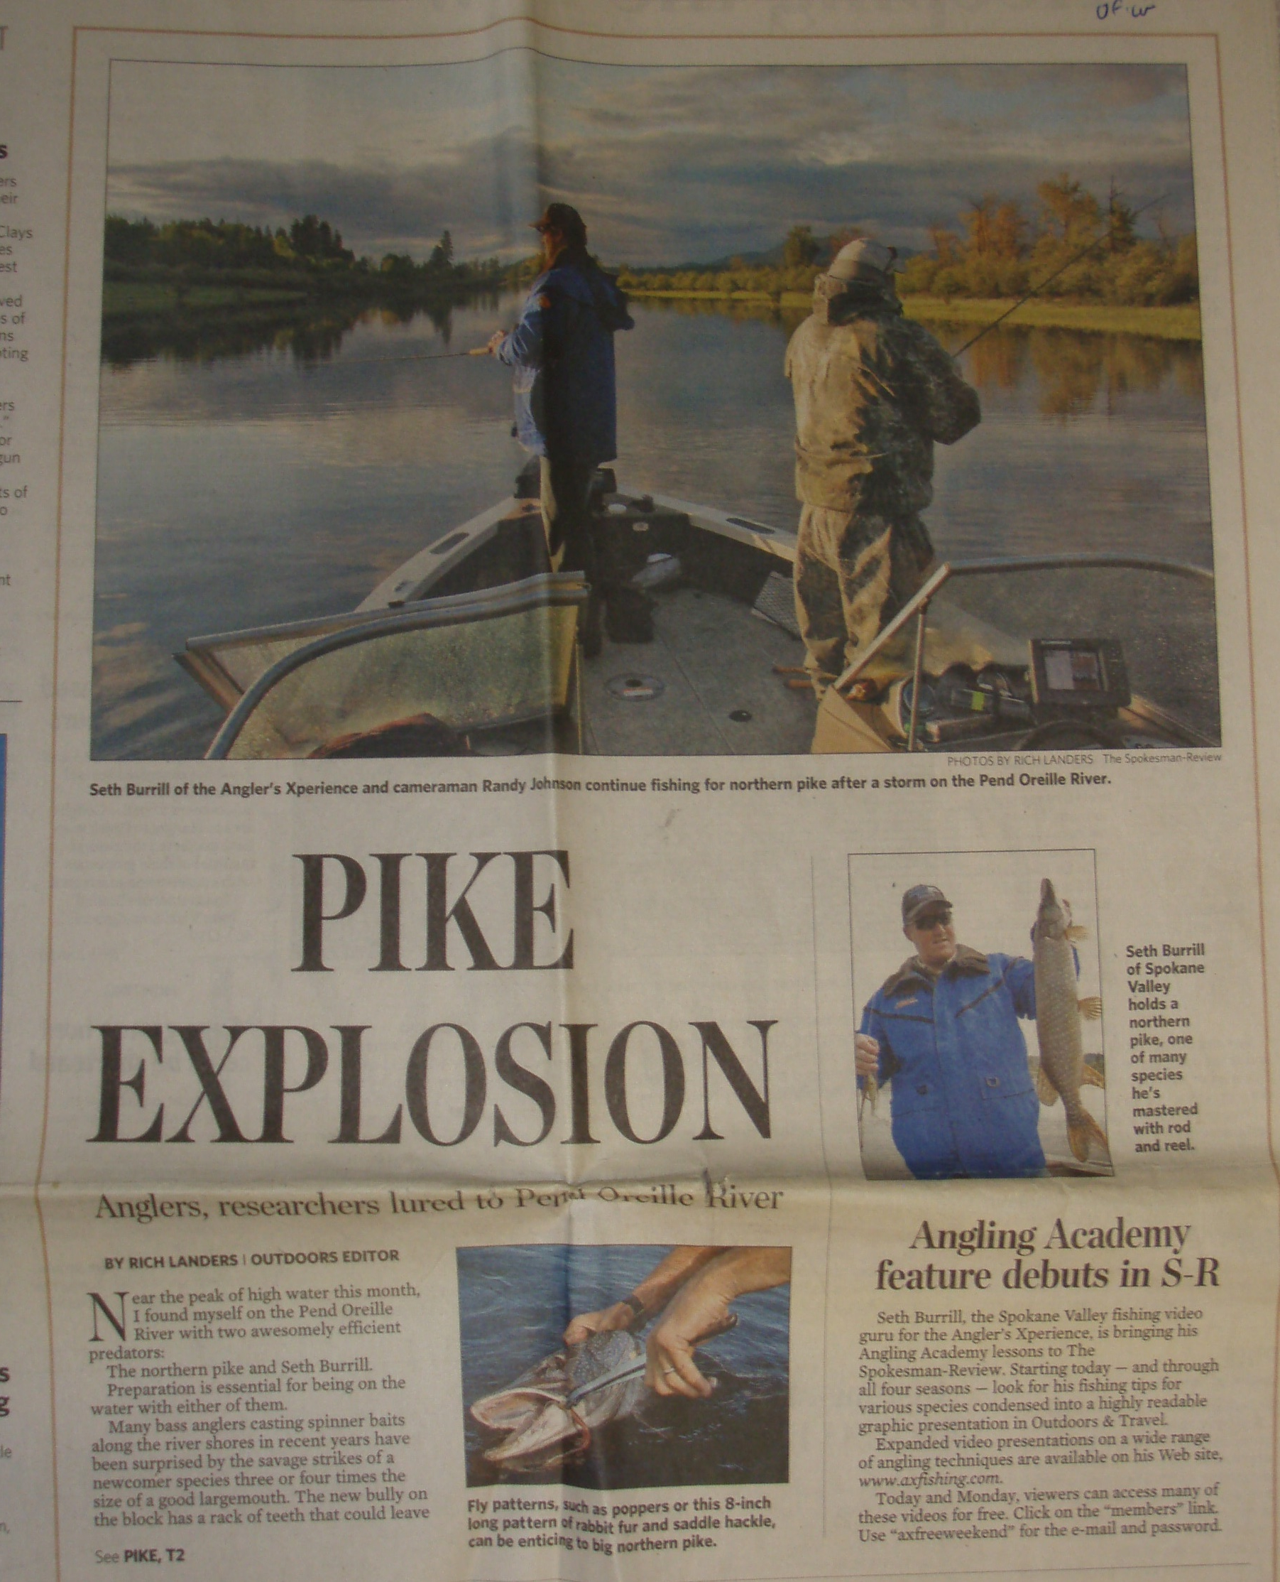
Population grew from <400 (2006) to >10,000 (2011) pike
Occupied most of Box Canyon by 2011 (Boundary by 2016)
Most other species declined from 2004 to 2009
Fishery publicized and popular
Left unchecked – impacts to resident and anadromous Columbia River fisheries imminent
Article Newport Miner; Photo: Kalispel Tribe
Article Spokesman Review; Photo: Kalispel Tribe
Pend Oreille River Pike:
Expansion & Impacts
Notes:
The studies we conducted revealed several key issues:
The population had exponential grew from 400 individuals in 2006 to more than 10,000 in 2011
Pike now occupied the entire extent of the Box Canyon reservoir
During standardized warmwater surveys conducted by WDFW and KNRD, most species showed dramatic declines in abundance from 2004 to 2009, which was also reflected in the 2011 survey.
The fishery was gaining tremendous momentum in the angling community which created challenges from a management perspective.
All the data clearly showed pike were here in force and having significant impacts and left unchecked would continue to decimate the local fisheries and spread to and harm the resident and anadromous fisheries of the Columbia.

Slide 6
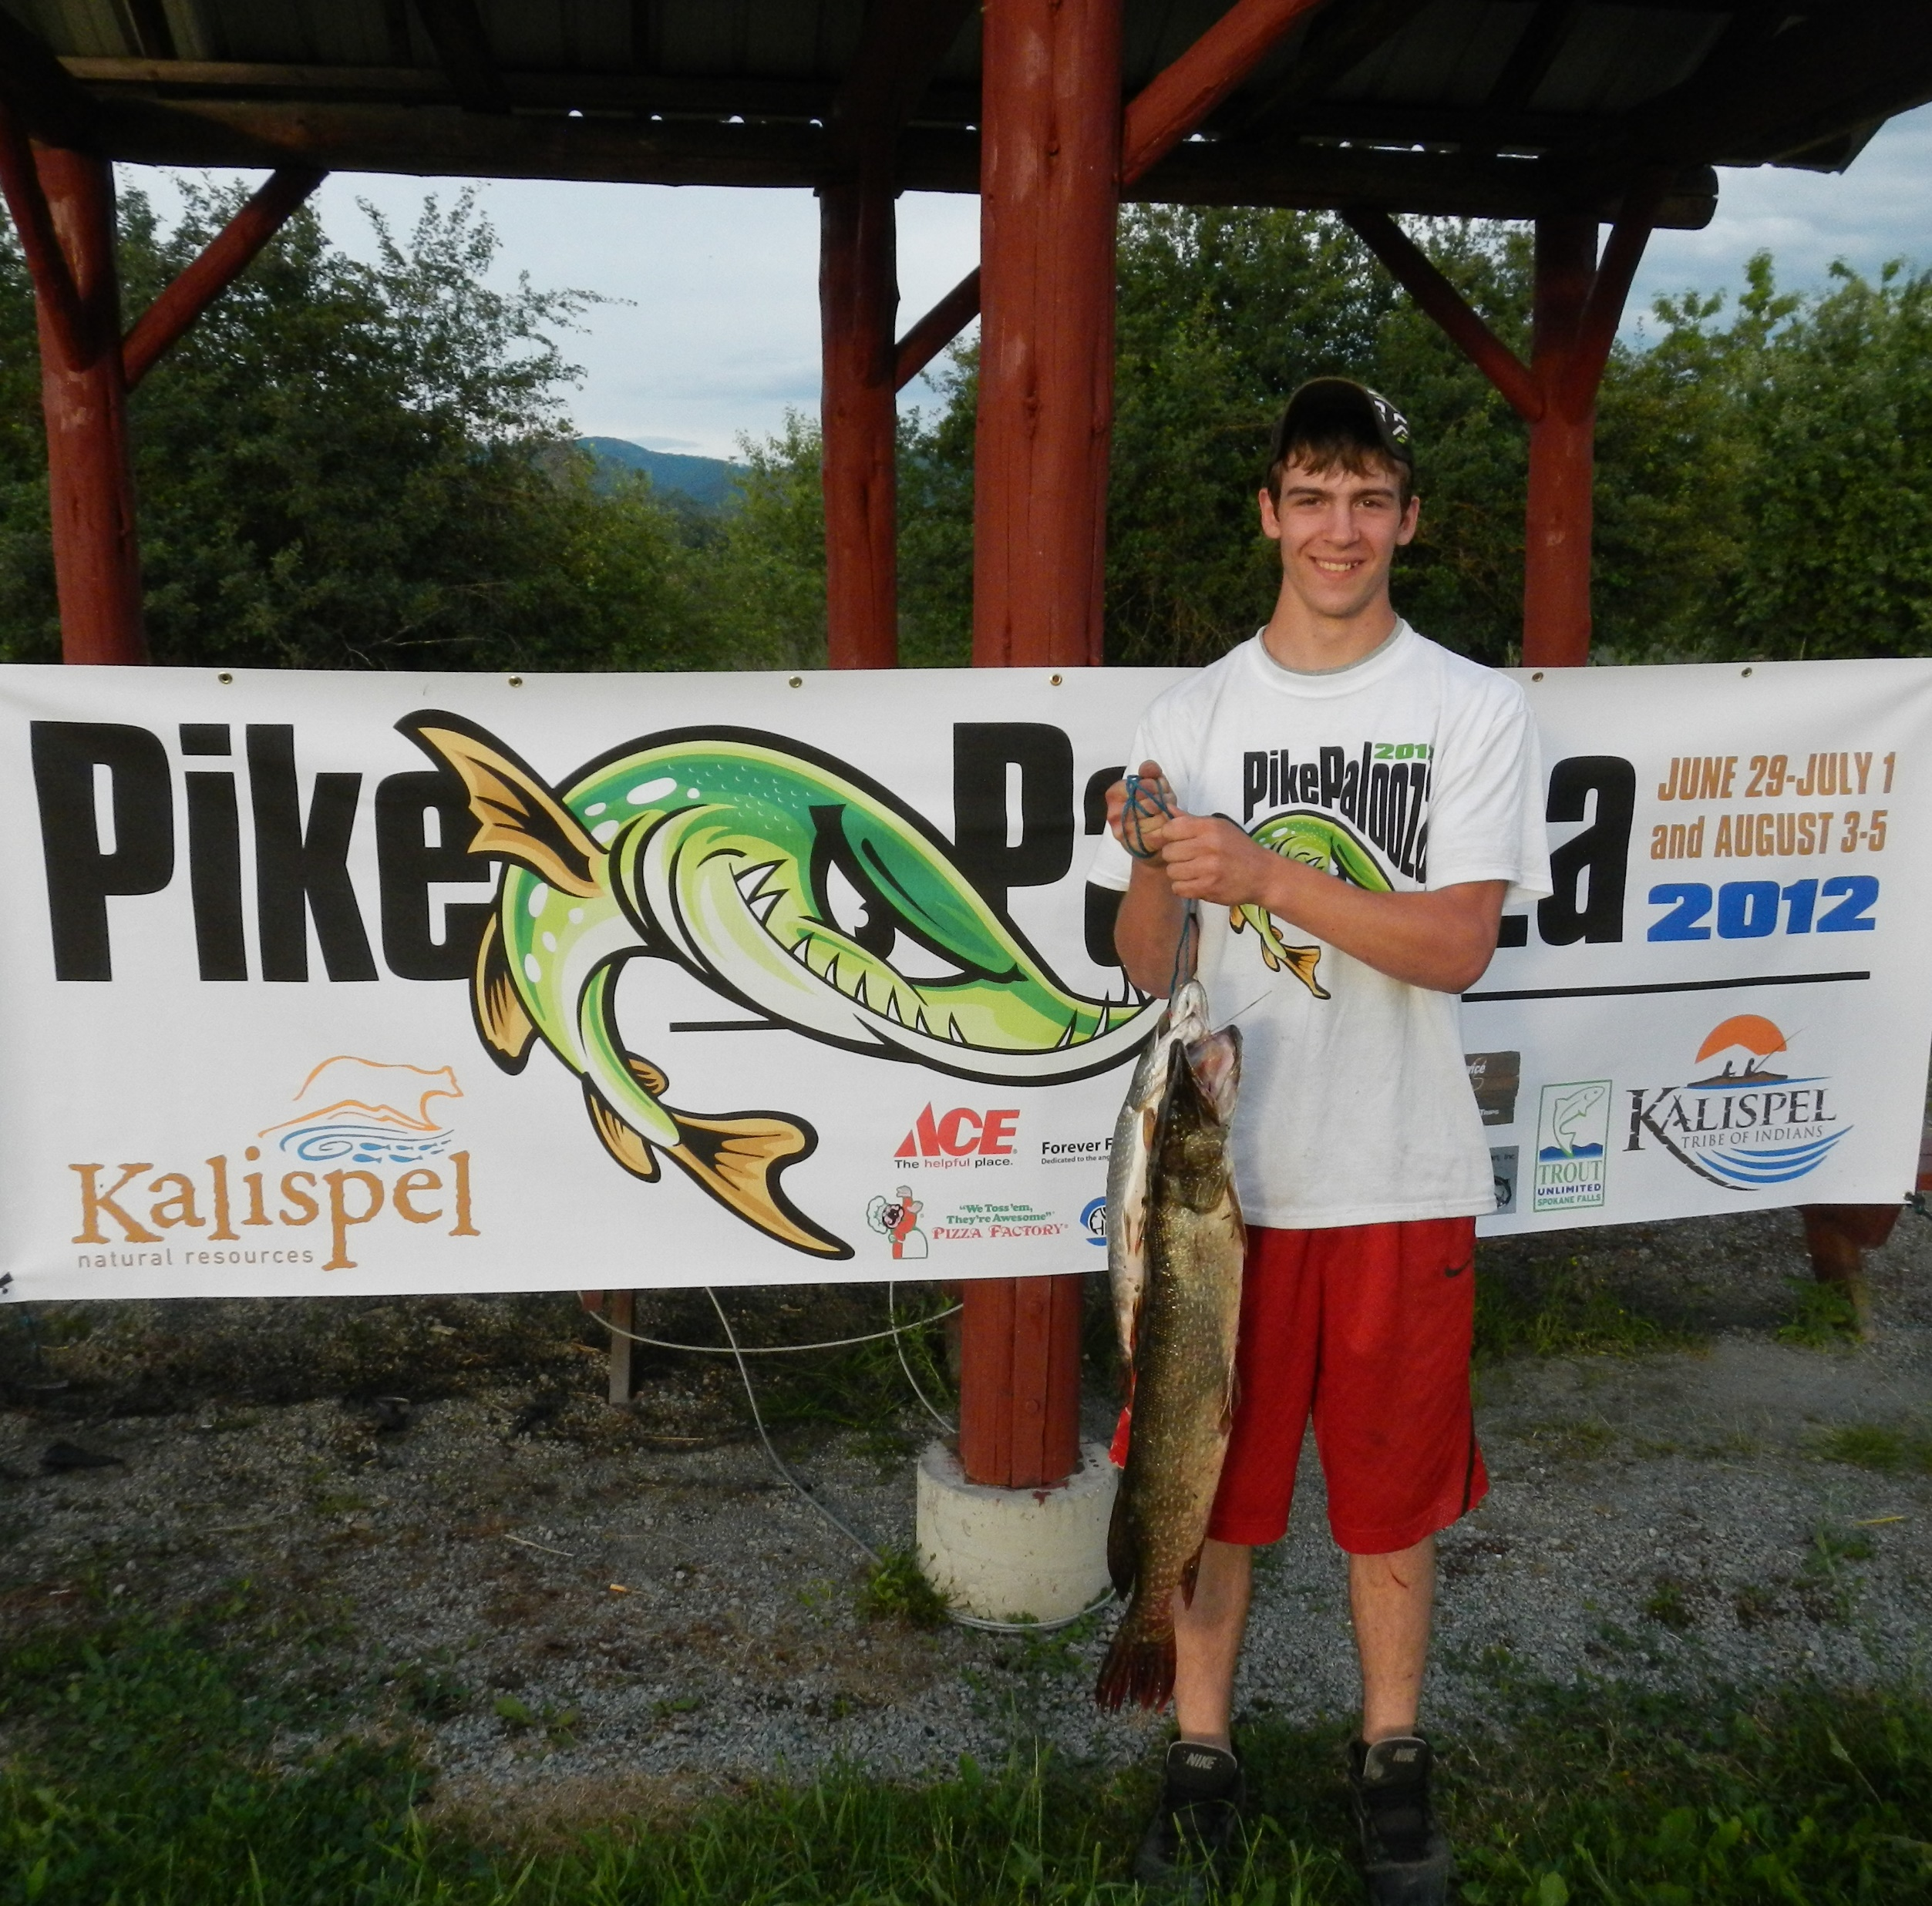
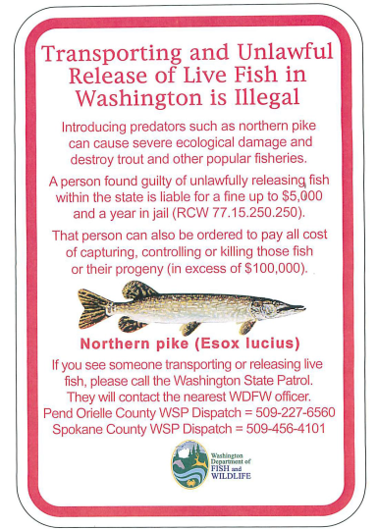
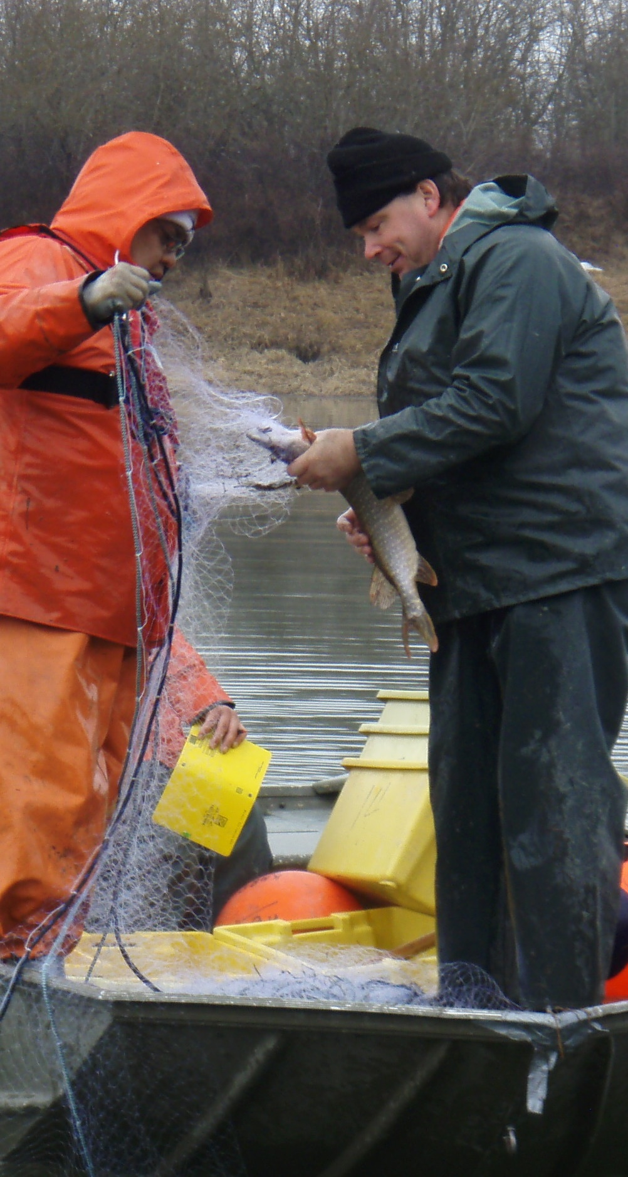
Management Goals:
Minimize further impacts
Reduce spread
Reduce Northern Pike abundance
Three-Pronged Approach:
Increase angler exploitation
Promote harvest contests
Mechanical suppression
Photo: Kalispel Tribe
Photo: Kalispel Tribe
Project Development:
Management Perspective & Approach
Notes:
Given the rapid expansion, impacts observed to date, and likelihood of continued entrainment downstream, the WDFW and KNRD developed management goals for this population: first, minimizing continued impact, reducing spread, and depress the population.
This was done using a Three-pronged approach including 1) angler exploitation (education and outreach, Prohibited Species classification), 2) Fishing contests to promote harvest, 3) Mechanical suppression through extensive gillnetting, which will be the focus of the discussion here today.

Slide 7
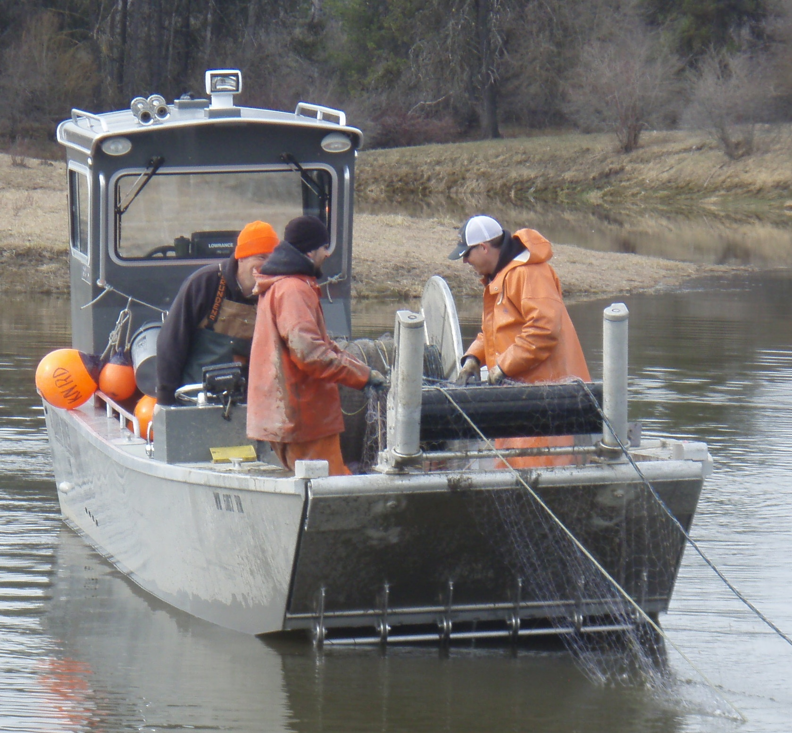
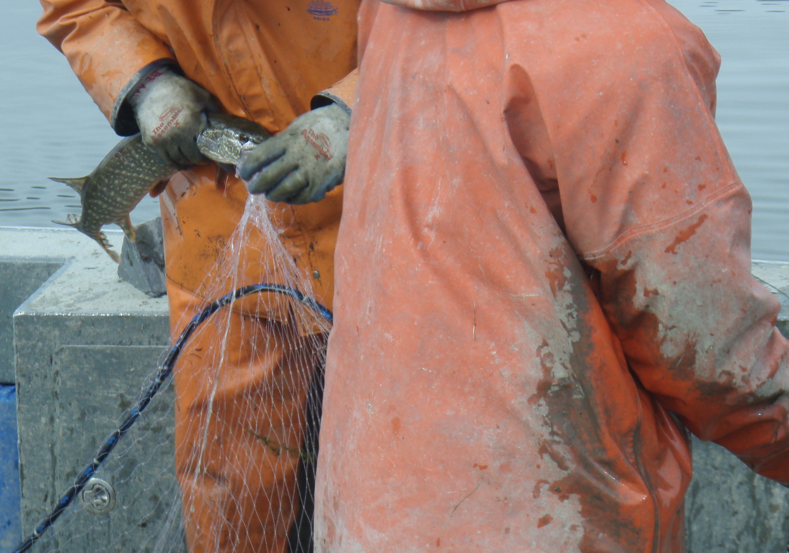
Equipment:
150’x6’ 5-panel mono gillnets
  1”, 1.25”, 1.5”, 1.75”, 2”
Timing & Effort:
Spring season (pre-spawn)
Up to 35 nets/day (24-hr soak)
Net 4-7 days /week
Strategy:
Net ice edge early
Focus on aggregations
Target depths <2 m
Evaluate relative abundance during annual SPIN surveys
Photo: Kalispel Tribe
Photo: Kalispel Tribe
Project Methods:
Mechanical Suppression
Notes:
Mechanical suppression techniques were developed through consultation with Midwest biologist and staff from Alaska Fish and Game that had been managing pike populations for decades.
The nets we utilize are sinking 150x6 5-panel monofilament nets consisting of equal graded mesh panels of 1, 1.25-, 1.5-, 1.75-, and 2-inch bar mesh. We deploy nests during the spring months (typically March and April) although we’ve extended into May and June in the early years. The objective is to target aggregating pre-spawn Northern Pike. We will set up to 32 nets/ day for 24-hour soaks up to 7 days per week although most of ten 4 days per week.
Pike retreat toward shore following the retreating ice edge, which makes targeting them more effective most years. Focusing on aggregations allows the most bang for your buck and the fastest depletion rate.
We’ve identified dozens of locations using telemetry, netting, electrofishing and various surveys, that we repeatedly target each year.
We conduct an annual SPIN survey which is a GRTS sampling design with three elevations based on lidar so we can best match the continuously changing shorelines in the spring. We set between 60 and 200 nets during the survey in Box Canyon Reservoir and 30-40 in Boundary Reservoir. Within each of the reservoirs, there are different strata for the SPIN surveys that divides the habitat type, so sampling is more representative of each system. I’ll talk more about those two distinct systems next.

Slide 8
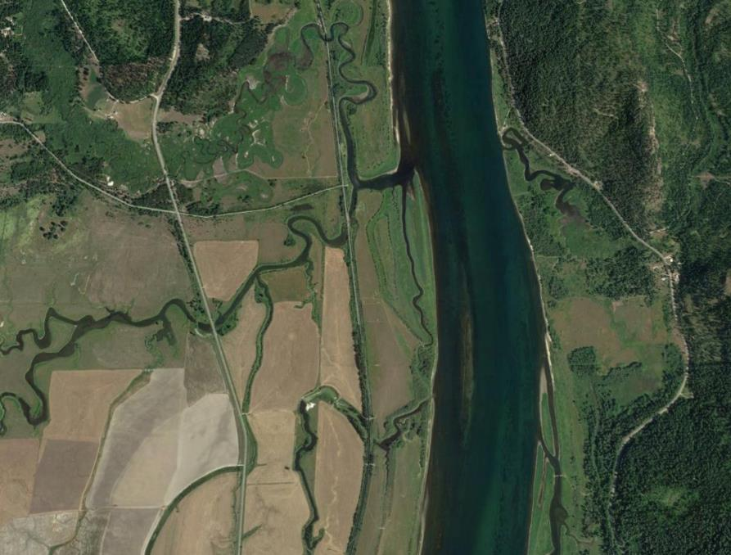
Image: Google Earth
SPIN Abundance Targets:
Strata 1 (North River): <0.5 Northern Pike/Net
Strata 2&3 (Core Area): <1.7 Northern Pike/Net
Project Area and Objectives:
Box Canyon Reservoir
Notes:
Lies between Albeni Falls Dam downstream (just across the Idaho Washington border) upstream flowing north to Box Canyon Dam
89 km (55 mile) long reservoir
3,556 surface ha (8,788 ac)
Objective to reduce relative abundance by 87% in core area and minimal level possible in norther section of the reservoir.
Divided into three strata during SPIN surveys:
Reach 1 from Riverbend to Box Canyon Dam (North) this is a mor narrow valley with less littoral vegetation and far fewer pike,
Reach 2 From Riverbend to Pioneer Park (South), which is contained in a broad alley floor with significant submerged and emergent vegetation and backwater
Reach 3 which is comprised of all the reservoir slough and backwater areas – this is the predominant pike habitat. We combine the reach 2 and 3 strata to form the “core area” which contains most pike and their habitat.
50-60 backwater locations targeted annually and dozens of river sites

Slide 9
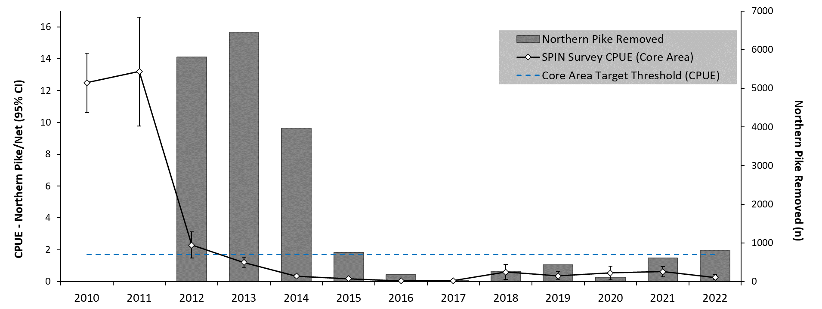
19,431 pike removed in 6,512 nets
Majority removed in first 3 years of suppression (2012-14)
Pre-Suppression (2010-11) CPUE very high
Maintained low abundance with reduced effort (2016-on)
>95% reduction in CPUE from 2011 to 2022 (core area)
Box Canyon Reservoir Results
Notes:
Netting began in 2012 and has continued annually since; SPIN surveys began prior to suppression in 2010 when the population was seeing exponential increases.
The figure shows total annual pike catch 2012-2022 (grey bars) on the second vertical axis, year on the X axis, and CPUE for the core area SPIN survey on the Y axis
The blue dashed line is the abundance target for the combined core area strata
Let’s talk about the catch first: We removed 19431 pike, with 87% removed in first 3 years (52% of total nets set those years).
Looking at the SPIN CPUE line, you can see how high the values were in 2010-2011 and the substantial drop that occurred in the years we initiated suppression.
This trend stabilized and continued even with a reduced overall annual effort starting 2016 on.
We met, exceeded and maintained our target relative abundance reduction with >95% reduction in CPUE from 2011 to 2022

Slide 10
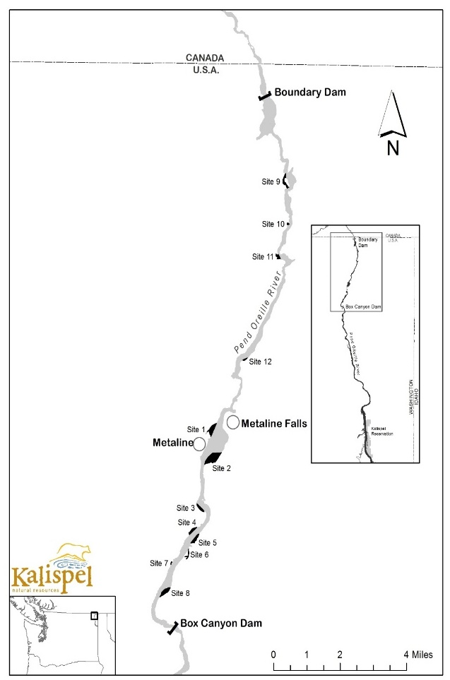
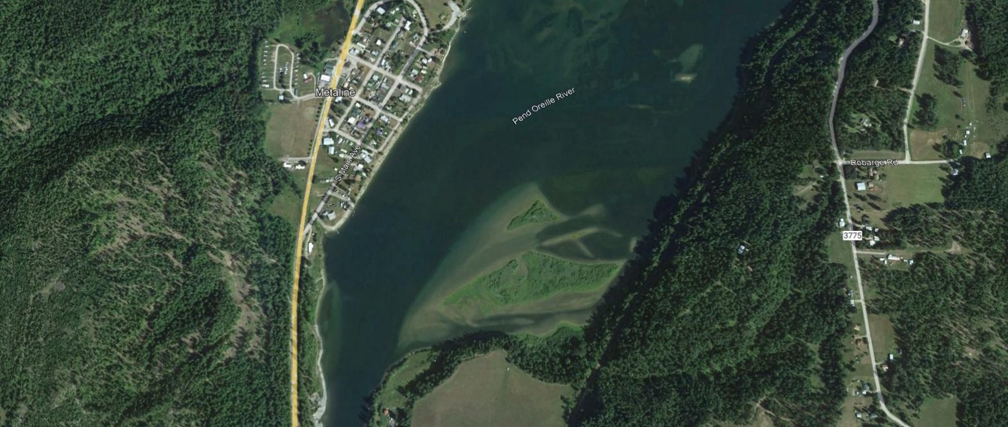
Image: Google Earth
SPIN Abundance Target:
Strata 1 (Core Area): <0.5 Northern Pike/Net
Strata 2 (River): <0.5 Northern Pike/Net
Project Area and Objectives:
Boundary Reservoir
Notes:
Lies between Box Canyon Dam upstream flowing north to Boundary Dam downstream near the US/Canada border
28 km (17.5 mile) long reservoir
726 surface ha (1,794 ac)
As this is downstream of Box Canyon and similar to the northern reach (less habitat and more riverine) our Objective is to maintain the relative abundance of pike at or below the 0.5 pike/net threshold. This allows us to reach the lowest practicable level and reduce entrainment risk into the remainder of the Pend Oreille and ultimately the Columbia river.
There are two strata we use during the SPIN survey (River and Slough) but we chose to combine them for reporting purposes.
10-15 backwater locations and many river sites targeted each year.
Highly variable elevation and shoreline as this reservoir sees nightly swings due to power peaking that occurs form operations at Boundary Dam.

Slide 11
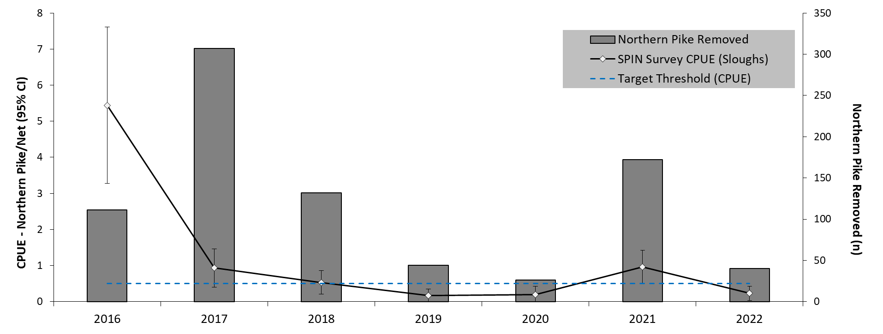
829 pike removed in 664 nets
Season/timing variable due to reservoir fluctuations
2017 1st year significant effort applied
Reduced effort now required to maintain population
>95% reduction in CPUE from 2016 to 2022 (Sloughs)
Boundary Reservoir Results
Notes:
Netting officially began in 2017 and has continued annually since; SPIN surveys began prior to suppression in 2016
The figure shows is structured the same as those for Box Canyon with the blue dashed line as the abundance target of 0.5 pike/net
In total we have removed 829 pike in 664 nets
Looking at the SPIN CPUE line, you can see the decline in abundance that occurred from 2016-2017
This trend stabilized and continued even with a reduced overall annual effort starting 2019 on.
We met, exceeded, and maintained our target relative abundance reduction with >95% reduction in CPUE from 2016 to 2022

Slide 12
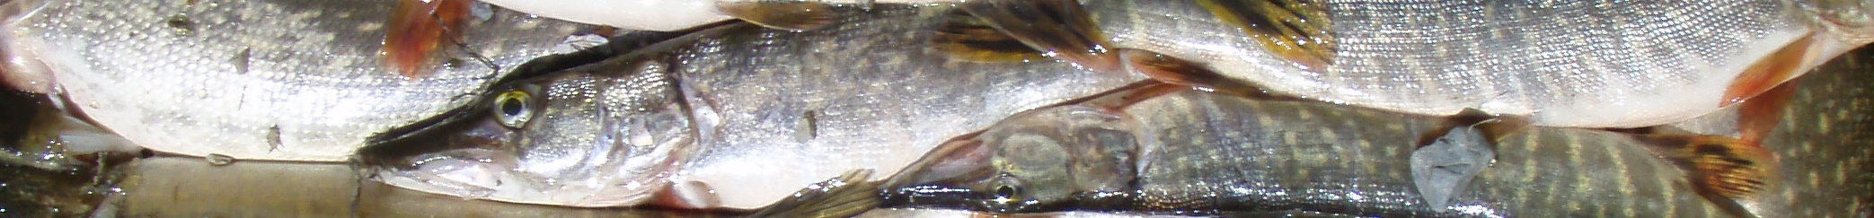

Photo: Kalispel Tribe
Suppression feasible in large systems
Early detection and response is critical
Suppression tools and techniques exist
Maximize effort early – continue until below target
Reduced effort may be sustainable if continuous
Eradication unlikely – prepare for the long-term
Pend Oreille River Northern Pike Suppression:
Takeaways/Lessons Learned
Notes:
Northern Pike suppression in a large system is feasible, but consider:
Early detection and preparedness are critical.
Delayed response increases effort (and funding) required to address issue.
Tools and techniques are in place – don’t reinvent the wheel.
Maximize effort early – continue until well below abundance thresholds.
When population is down, reduced effort is sustainable if consistently applied.
Eradication is unlikely, so prepare for the long-term (e.g., planning, funding, resources).

Slide 13
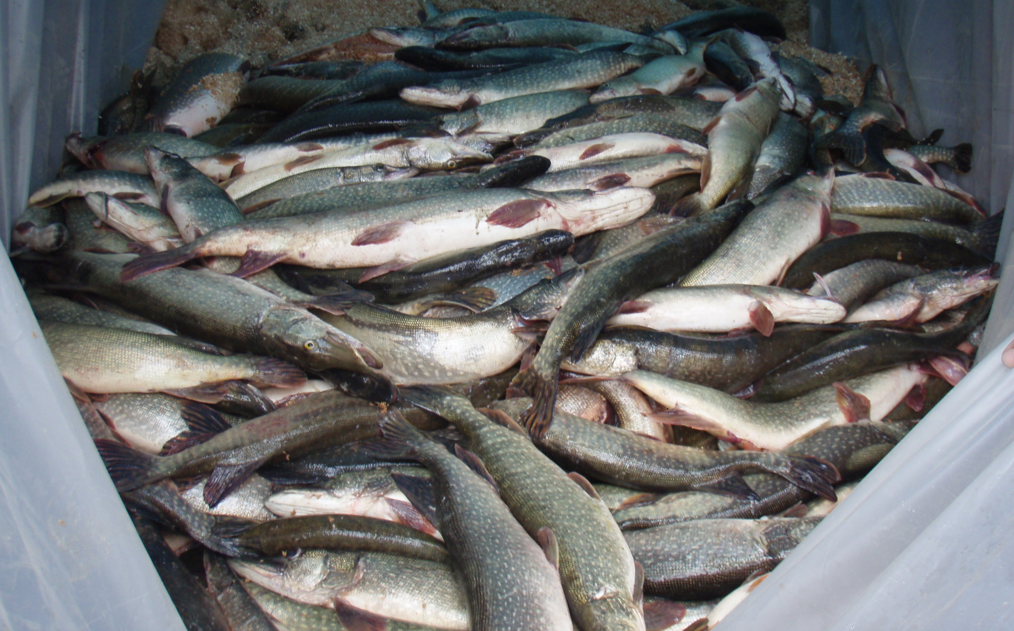
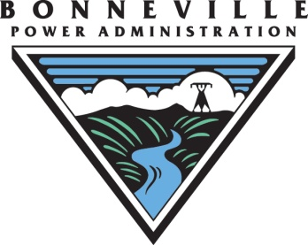




Thank You! Questions?
Contact: Nick Bean, Conservation Program Fisheries Biologist Email: nbean@kalispeltribe.com Phone: (509) 447-7103
Photo: Kalispel Tribe

