Slide 1
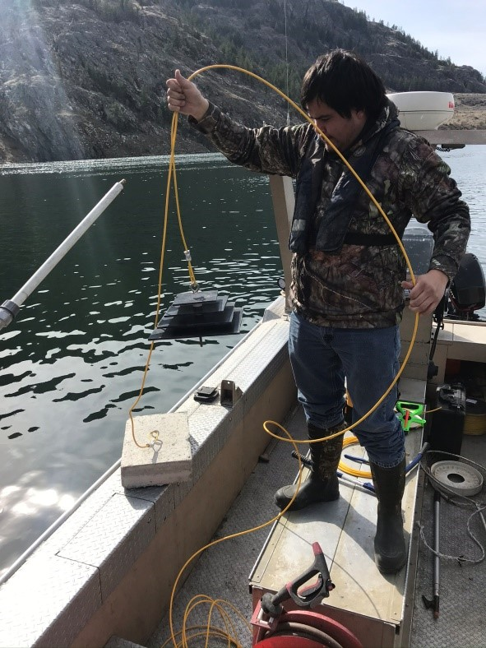
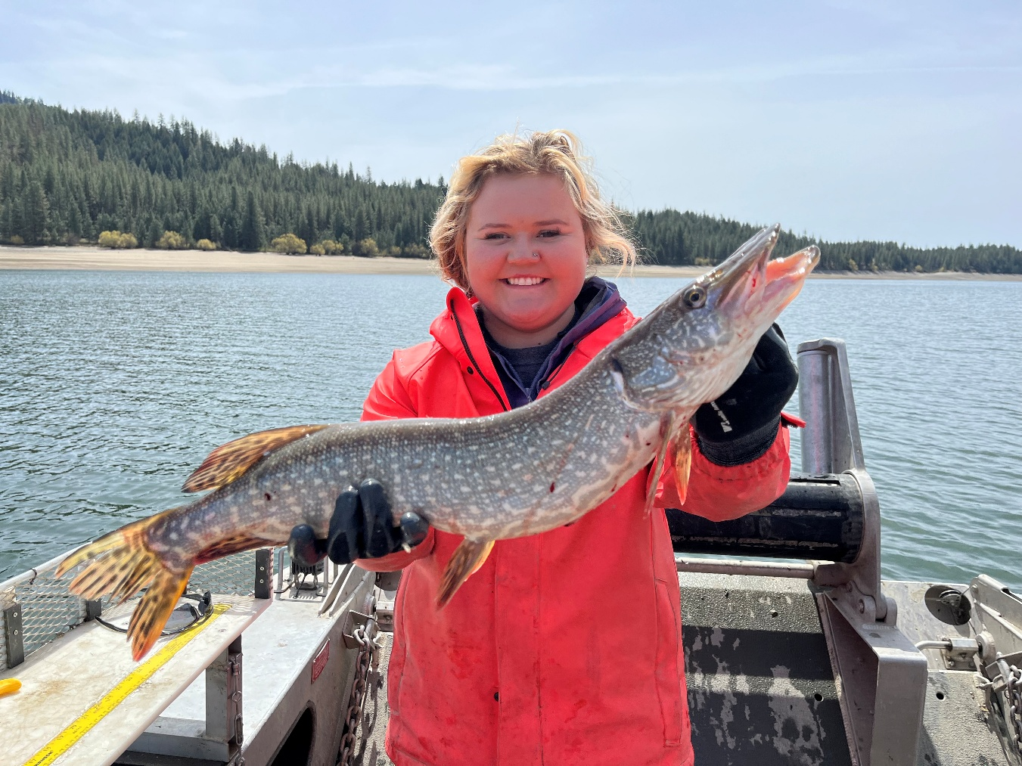
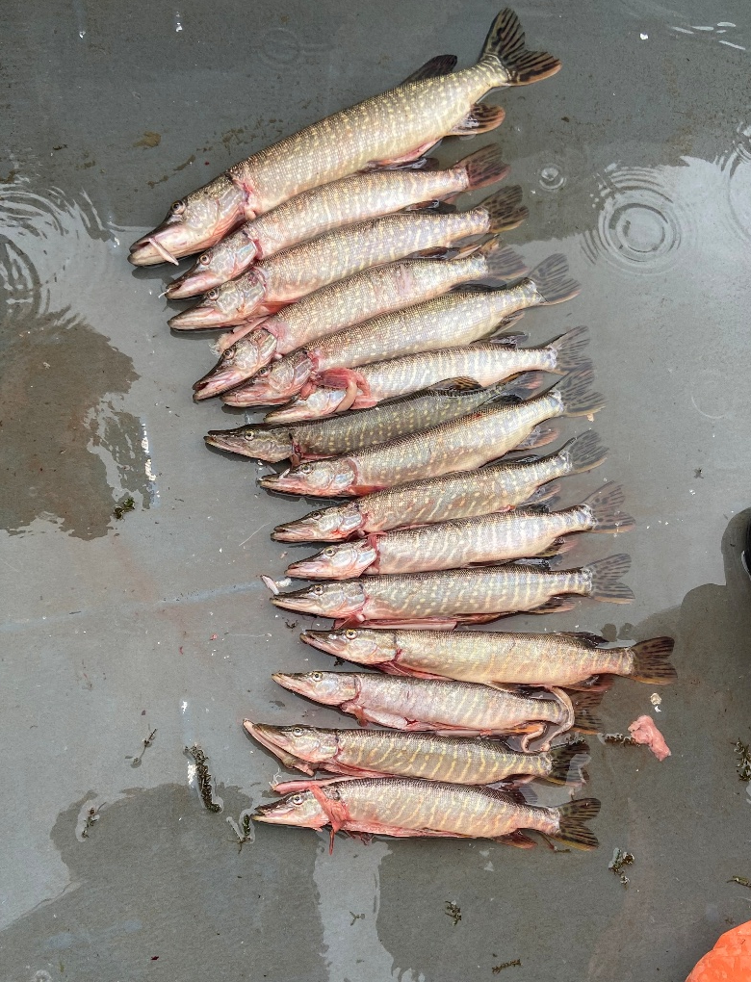
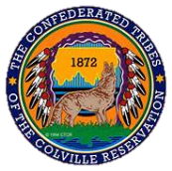
Colville Tribes Aquatic Invasive Species Program
2024 Update
Presented by:
Holly McLellan and Shay Jasper
Confederated Tribes of the Colville Reservation
Presented to the Columbia River Basin AIS Team Meeting _ December 11, 2024

Slide 2
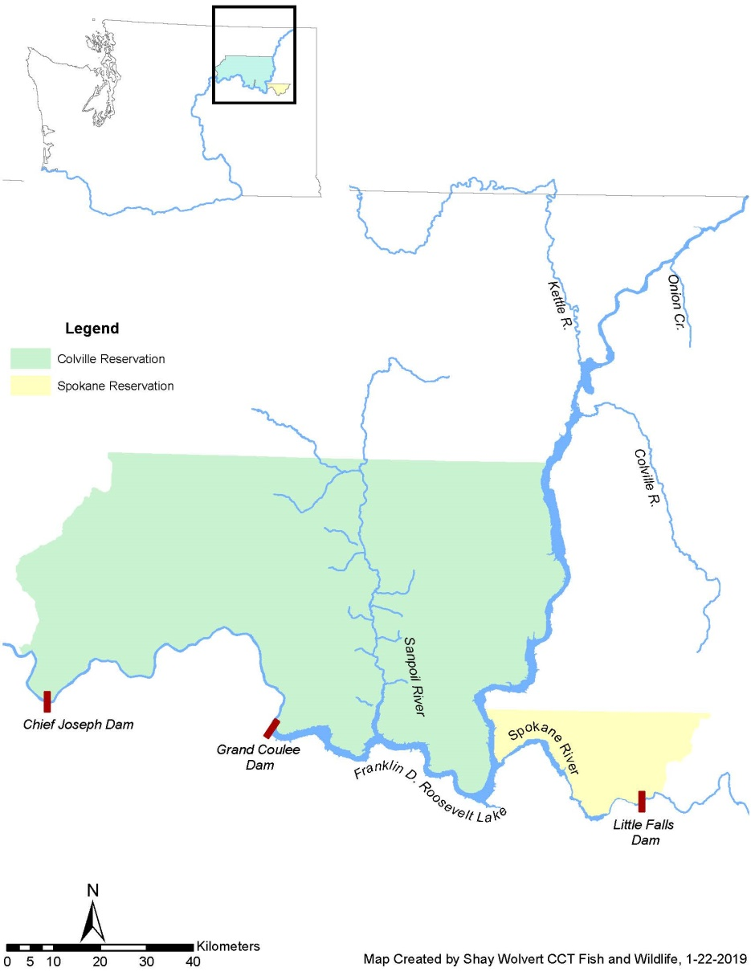

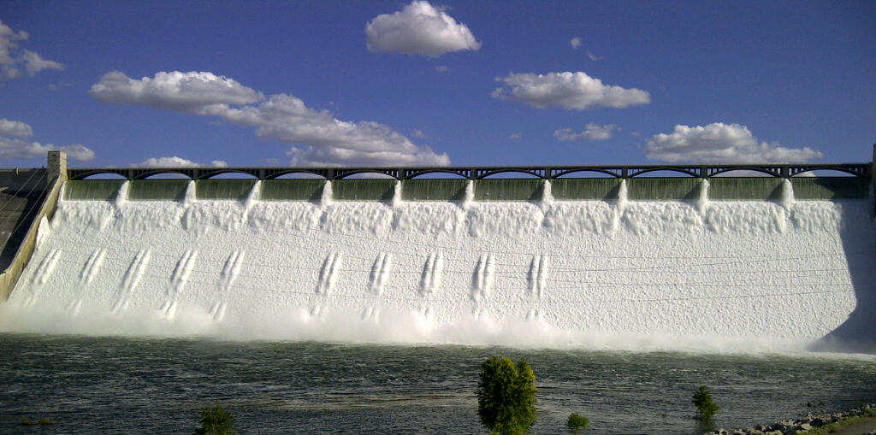
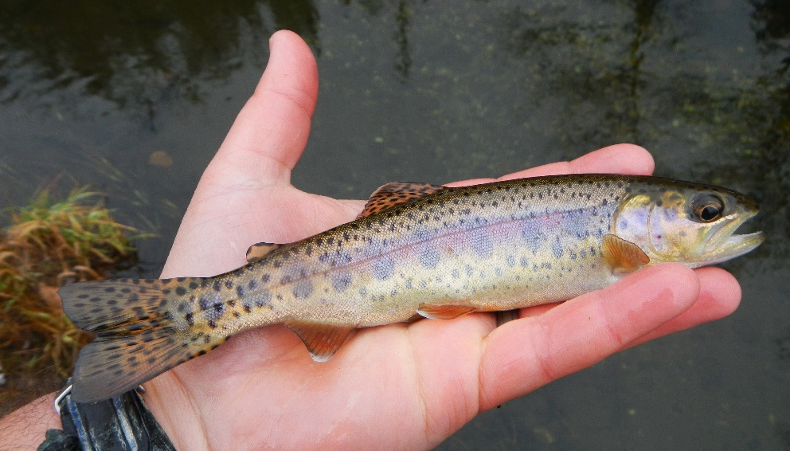
Lake Roosevelt
Created by Grand Coulee Dam in 1942 (240 km long reservoir)
  No fish ladders on Chief Joseph or Grand Coulee dams
Fishery co-managed by Colville Tribes, Spokane Tribe and WDFW
Management Goals: Provide fishing opportunities while protecting native fishes (White Sturgeon, Redband Trout, Burbot, Kokanee)
Tribes and State invest over $8M a year into the Roosevelt fisheries
The fishery provides economic input of at least $16M to local economies
Current upper extent of anadromy
Grand Coulee Dam
Redband Trout

Slide 3
Suppression and Monitoring
Annual Work Plan
Northern Pike Lake Roosevelt Technical Team Developed a Plan, McLellan et al. 2018 Northern Pike Suppression and Monitoring Lake Roosevelt
Implemented annually since 2017
Activity | Jan | Feb | Mar | Apr | May | Jun | Jul | Aug | Sep | Oct | Nov | Dec
Suppression
Gillnetting (All) |  |  | X | X | X | X | X | X | X | X | X
Electrofishing (CTCR/STI) |  |  |  |  |  |  | X | X | X | X
Fyke/Seine Netting (CTCR/STI) |  |  |  |  |  | X | X
Reward Program $10/Pike (CTCR) | X | X | X | X | X | X | X | X | X | X | X | X
Setlines (CTCR) |  |  |  |  |  |  |  | X | X
All Hands On Deck (All) |  |  |  |  | X
Research/ Monitoring
Monitoring survey (WDFW) |  |  |  |  |  |  |  |  |  | X | X
Microchemistry (CTCR) |  |  |  |  |  |  |  |  | X | X | X | X
eDNA and DNA Studies (CTCR) |  |  |  |  | X |  |  |  | X
Reservoir Op./Stranding (CTCR/WDFW) |  |  | X | X
Acoustic Tracking Study (CTCR) |  |  | X | X | X |  |  |  | X | X | X
Harvest via Creel (STI) | X | X | X | X | X | X | X | X | X | X | X | X
Public Outreach (All) boat launch signs | X | X | X | X | X | X | X | X | X | X | X | X
Preventative Measures
AI plant removal – Okanogan 2018 |  |  |  |  |  |  |  |  | X
AI plant removal – FDR ongoing |  |  |  | X | X | X
Flowering Rush Removal

Slide 4
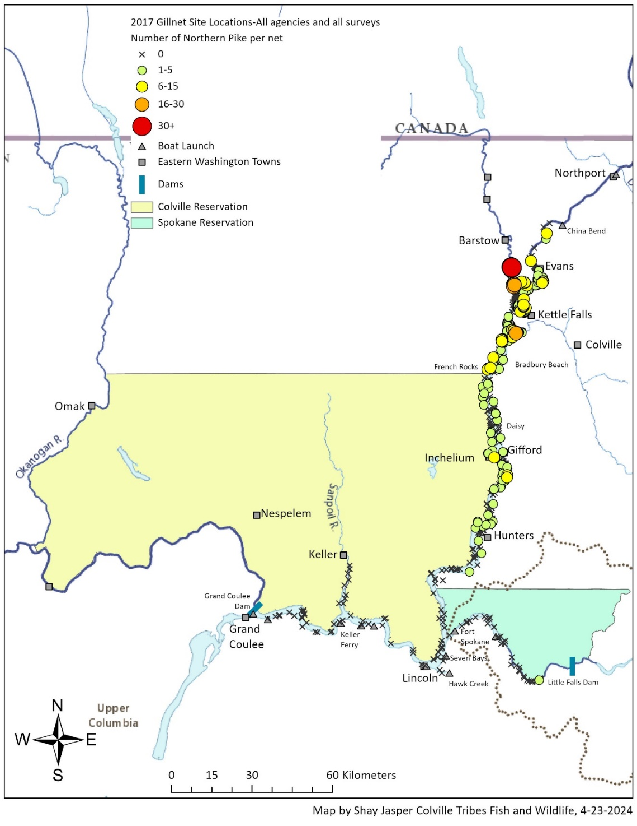
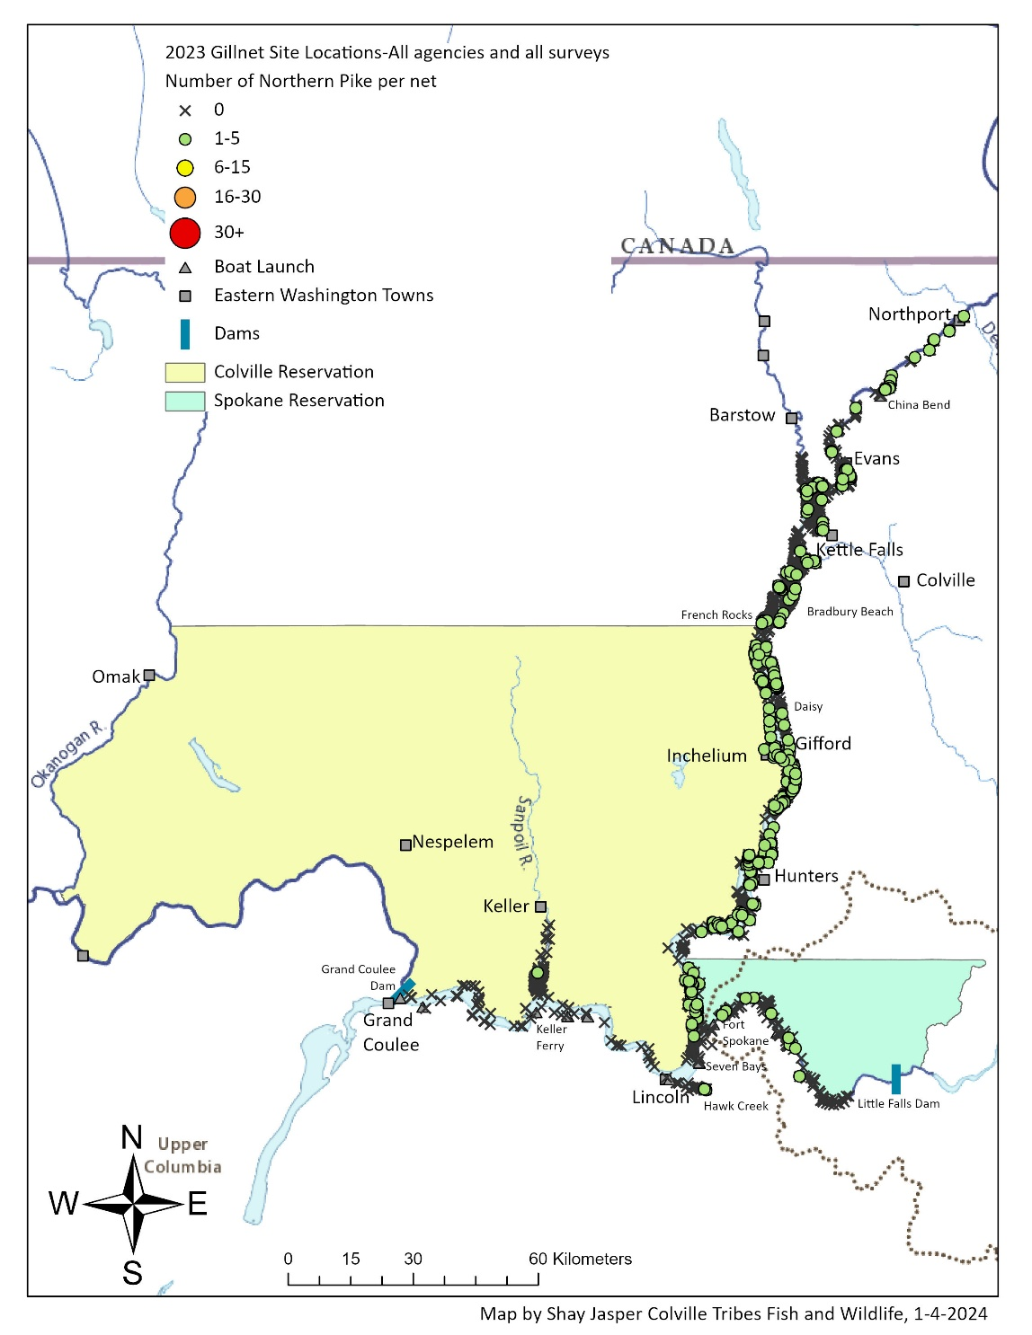
Suppression Update
Since 2015, co-managers have removed 20,396 Northern Pike (average 2,100 nets/yr)
Reduced catch from 3.08 Pike/net to 0.09 Pike/net
However, slow creep downstream
2017
2023
Goal
Goal
Goal

Slide 5
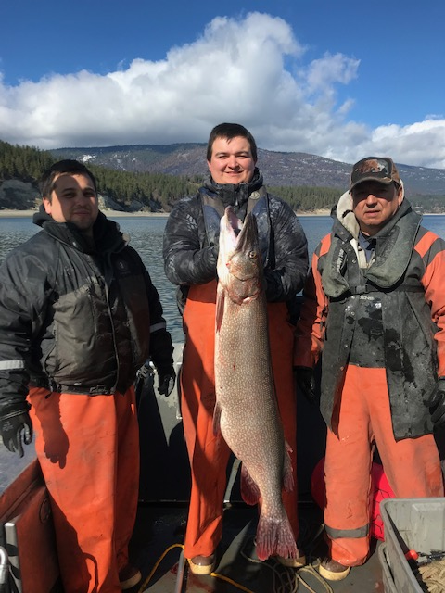
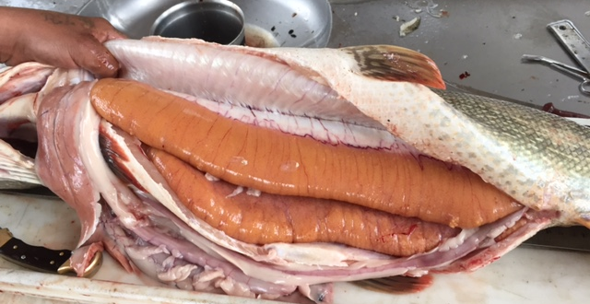
Lake Roosevelt Suppression
All Hands on Deck Survey
  Multiagency Effort
  9 agencies come together for two weeks during the pre-spawn period to remove Pike before they spawn.
  Colville Tribes, Spokane Tribe, Kalispel Tribe, WDFW, Chelan PUD, Grant PUD, Bureau of Indian Affairs, National Park Service, Bureau of Reclamation
Dates | # Nets | # Pike | Pike/Net
May 6-9, 2019 | 475 | 448 | 0.94
COVID-2020 | -- | -- | --
April 25-May 6, 2021 | 642 | 207 | 0.32
April 25-May 7, 2022 | 671 | 272 | 0.40
April 24-May 5, 2023 | 595 | 169 | 0.28
April 29 – May 3, 2024 | 494 | 43 | 0.09
47 in and 27.78 lbs = 140,620 eggs

Slide 6

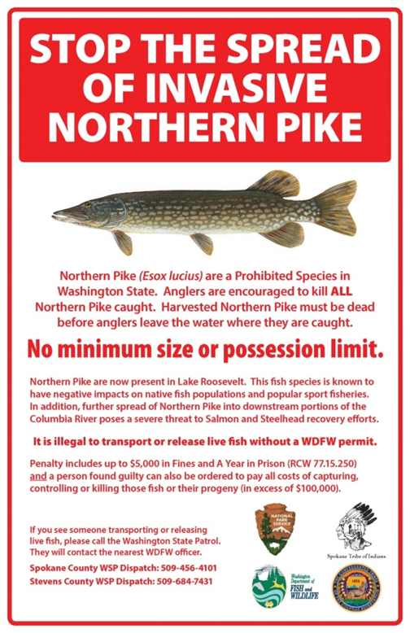
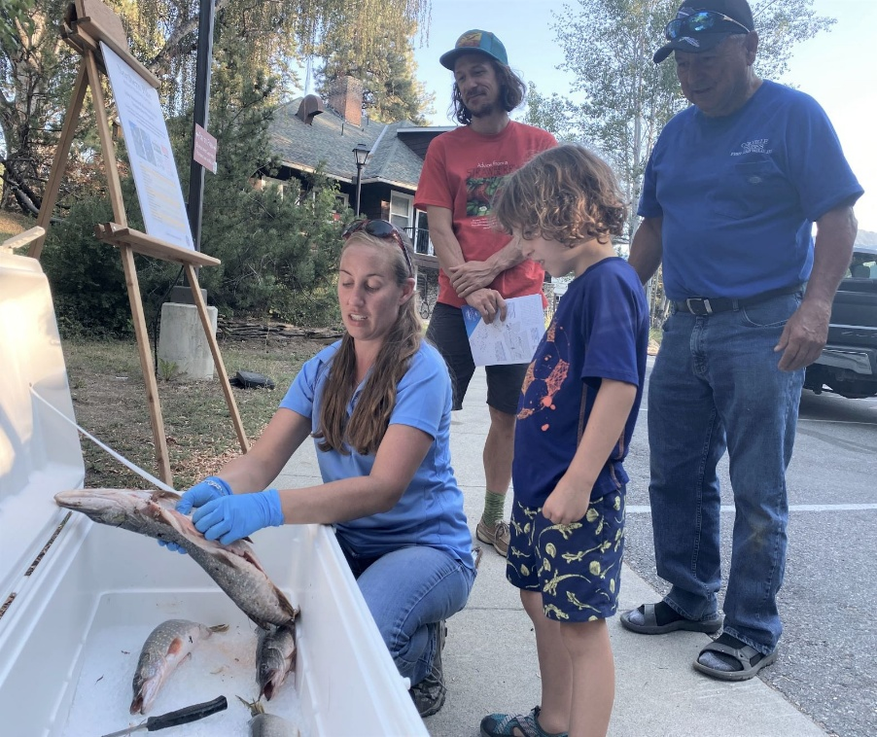
Reward Program/Public Outreach
Reward Program
Program started in May 2017
$10/ Pike head (VISA cards)
  Allowed 59 fish per angler per year
Total payout to date $36,390
Public Outreach
Clean Drain Dry and Pike signs posted at all Tribal boat launches
Notes:
Since 2017, we have given away $35,690 to anglers for turning in Pike heads. For the most part, the trend has been decreasing every year, except 2020 during COVID, but that doesn’t really count.
The decreasing trend is good and reflects what we are seeing in other surveys.
For public outreach, we have these signs posted at all the Lake Roosevelt and Rufus Woods boat launches. We also participate in public out reach events focused towards kids, like the Water Festival at Kettle Falls and Fishfest, which was held at Spring Canyon.

Slide 7
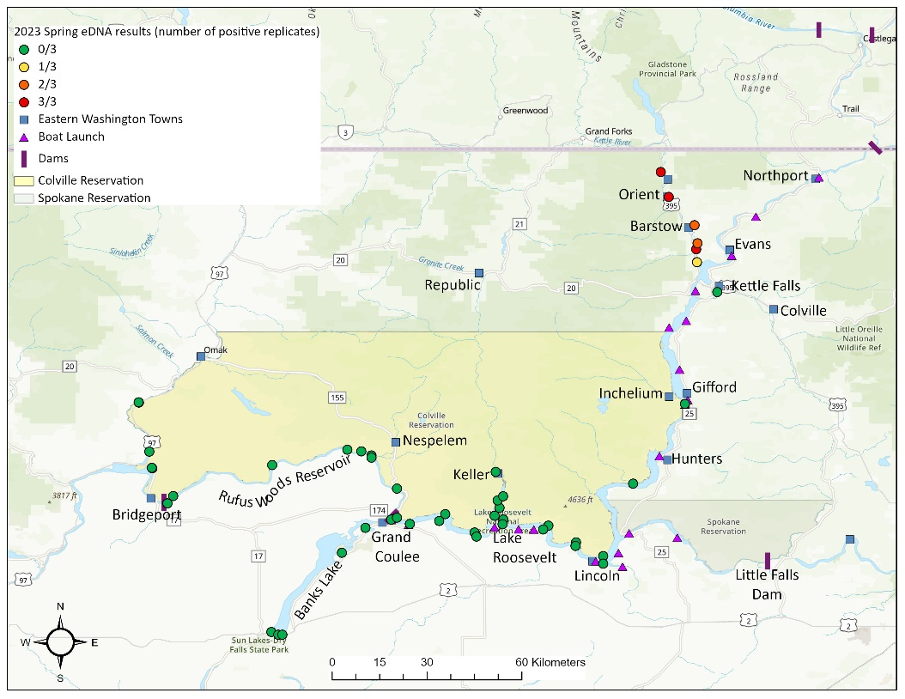
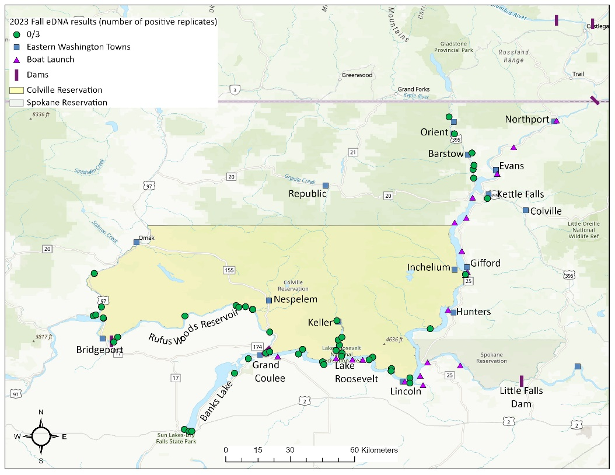
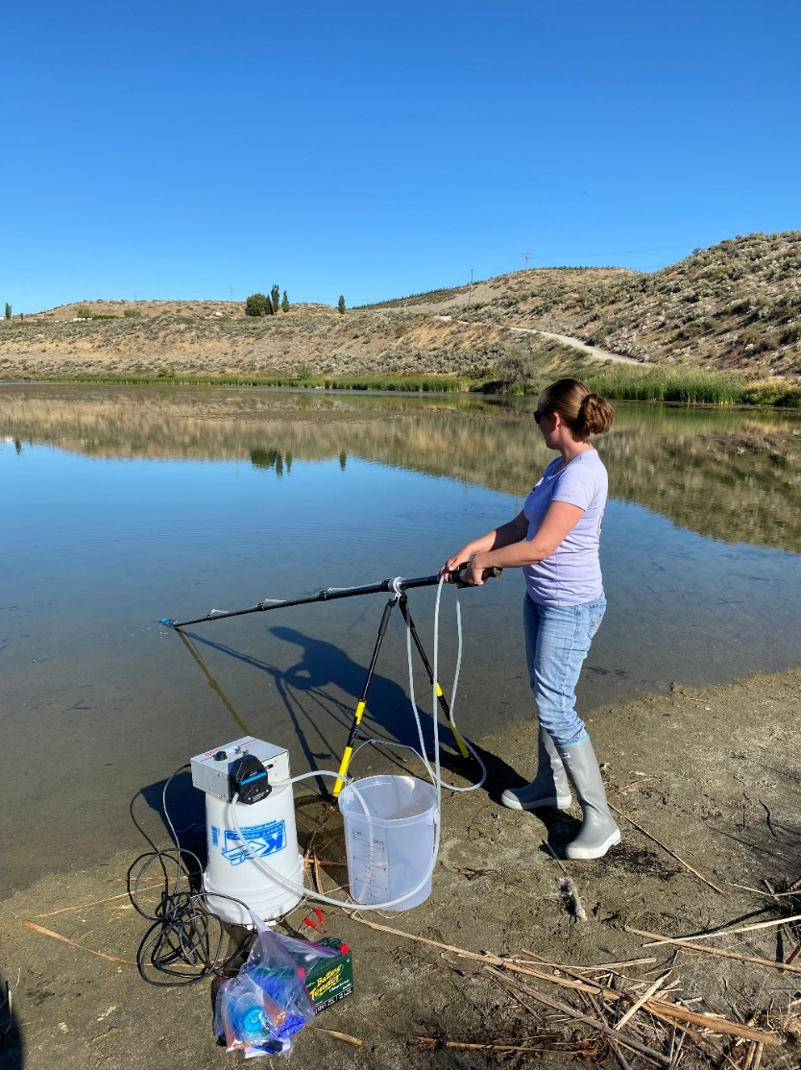
eDNA Monitoring
Spawning Location
Monitor 50 sites in the upper Columbia for Pike eDNA
Monitor Pike twice a year (June/September)
Detects the spawning migration to the Kettle River
No detections below Grand Coulee – however not detecting low densities in middle reservoir
2023 Spring
2023 Fall
No detection

Slide 8
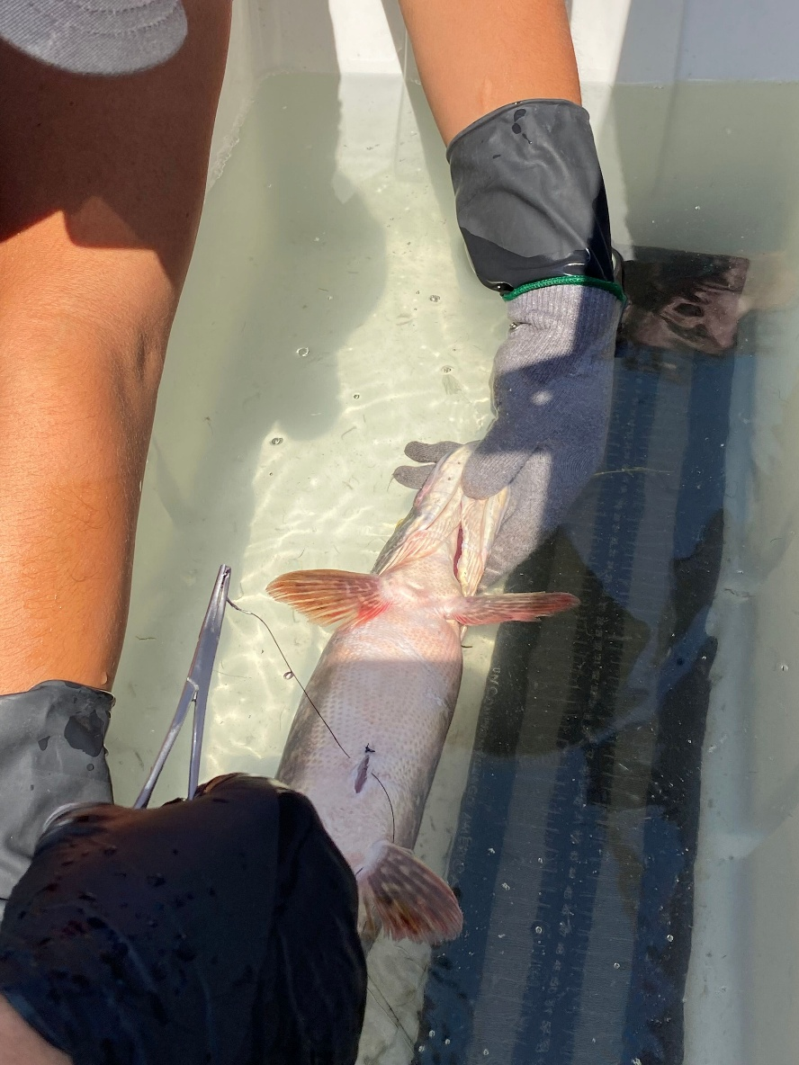
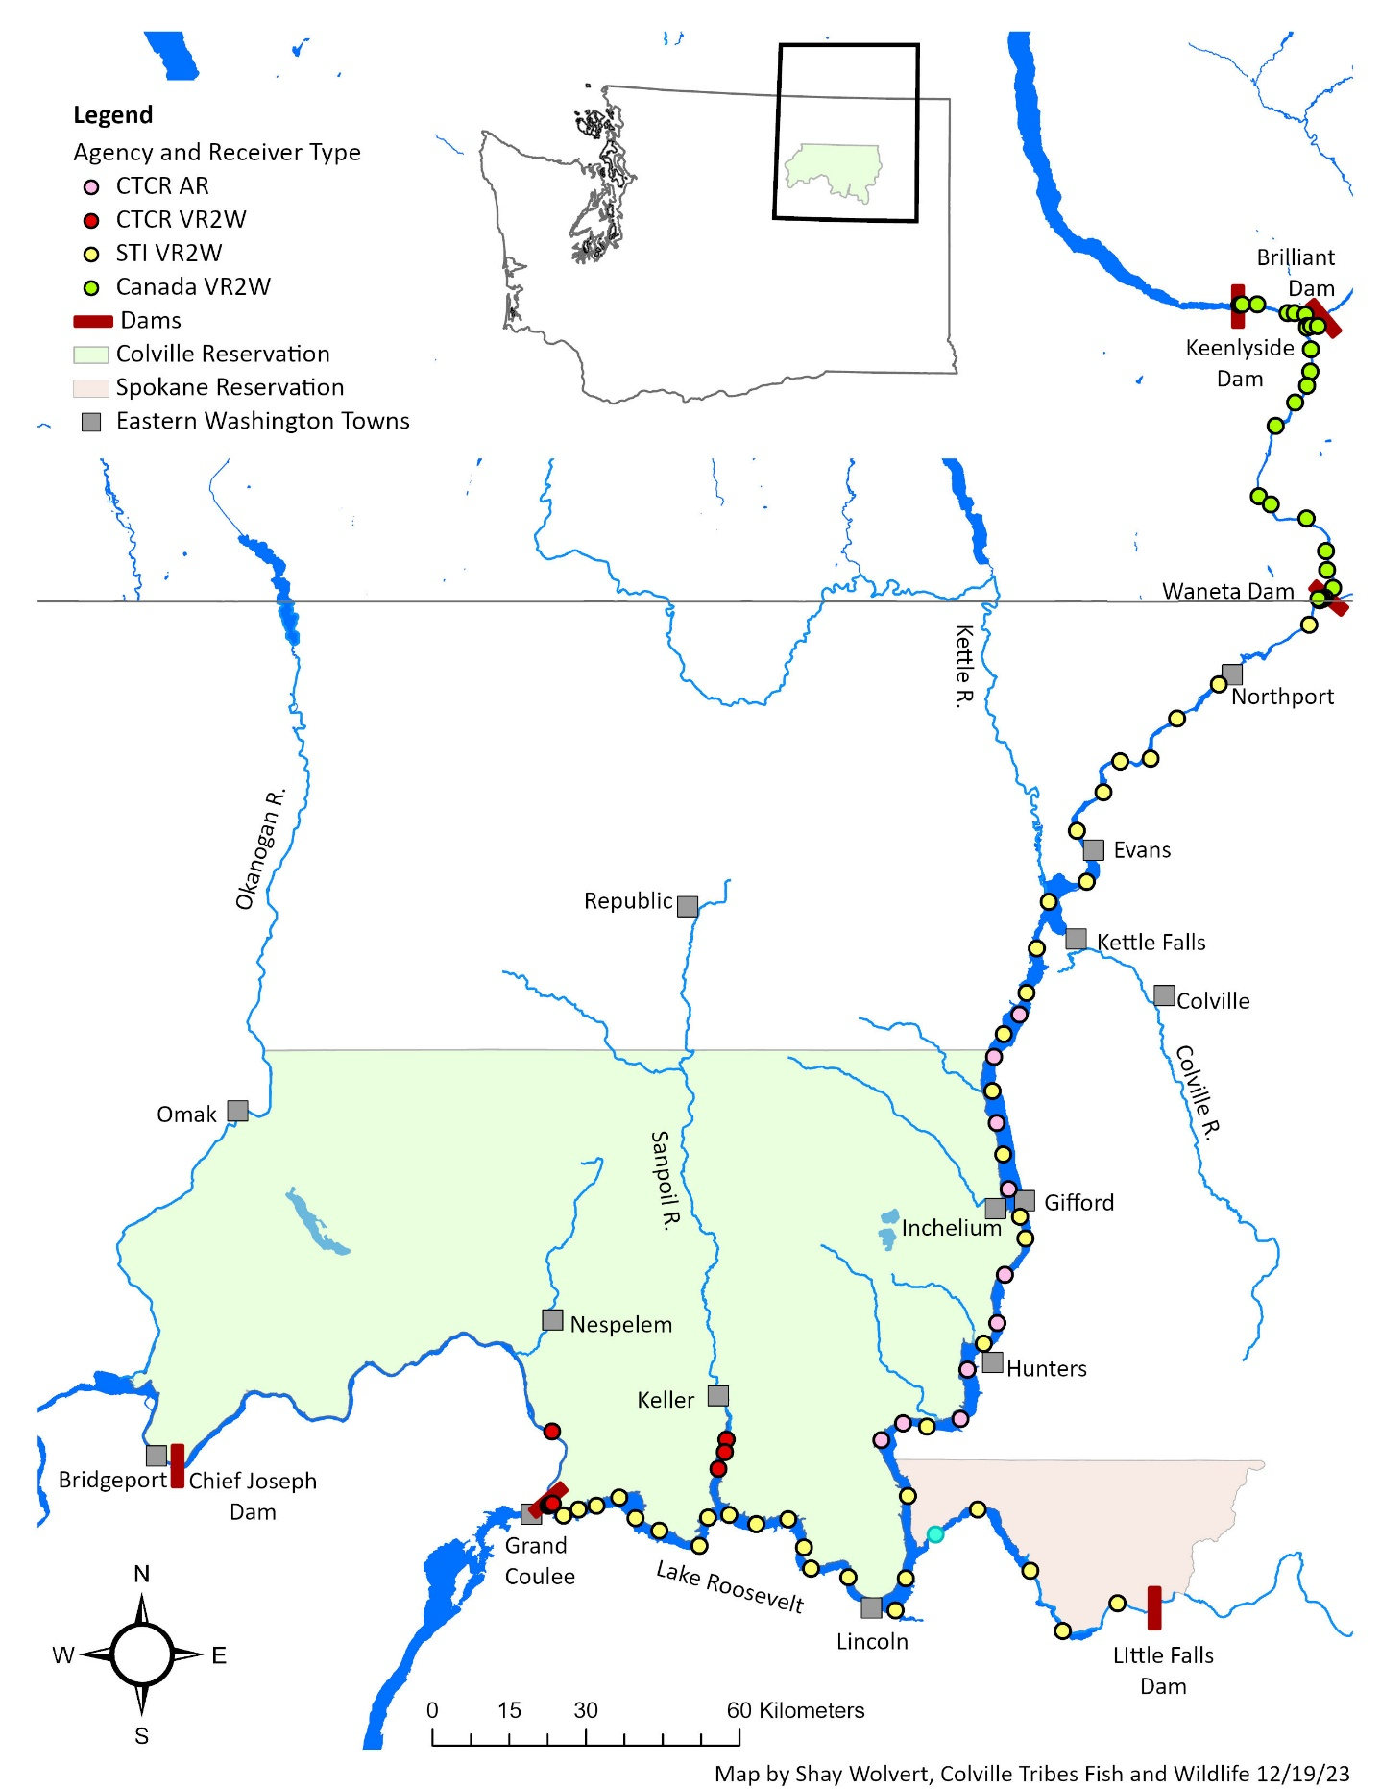
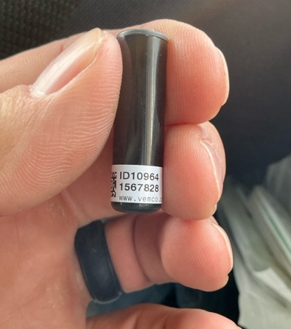
Acoustic Study
Implanted 83 fish with InnovaSea V9 acoustic tags with temperature and pressure sensors
  37 Northern Pike
  41 Walleye
  5 Smallmouth Bass
Roosevelt has an acoustic array system (83 receivers) to detect movements of fish
Monitor movements during 2025 – looking for spawning migration times and summer habitat

Slide 9
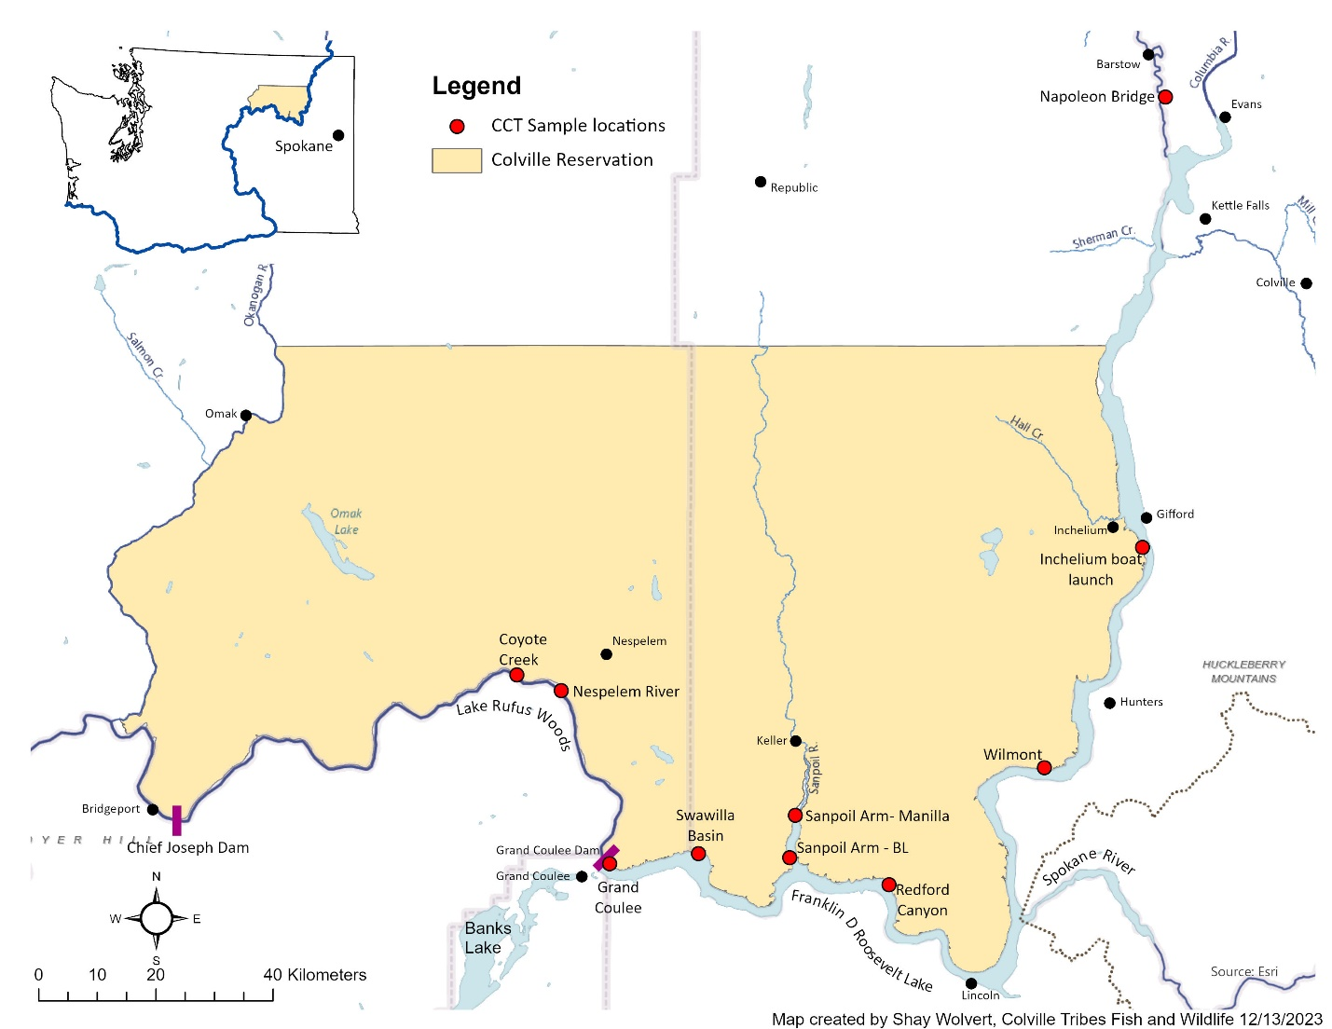
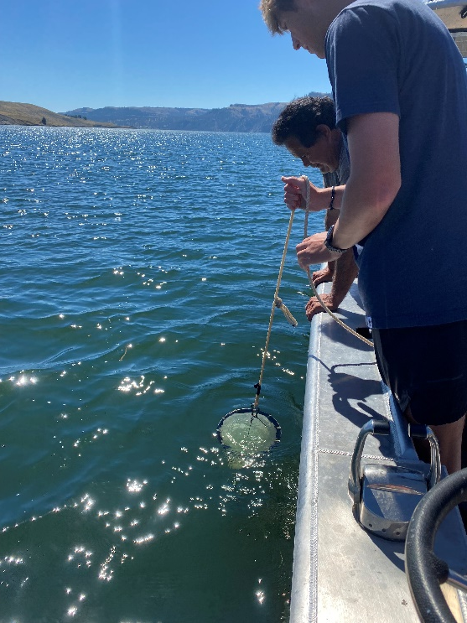
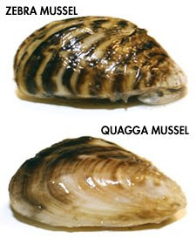

Invasive Mussel Project
Monitor 10 sites in the upper Columbia along the Colville Reservation
  Monitor monthly May – Oct
Implement same methods as WDFW AIS Team
  Veliger analysis: Dr. Wells, Aquatics
  eDNA analysis: Rocky Mountain Research Station
Share data with Robyn to be incorporated in the Western AIS website
To date, no detections
Funded by BOR through 2025
Would like to expand monitoring:
  Roosevelt is a National Recreational Area visited by over 1.7 M people a year
Activity | Apr | May | Jun | Jul | Aug | Sep | Oct | Nov
Plankton tows |  | X | X | X | X | X | X
Artificial Substrates | Set | X | X | X | X | X | X | Pull
Visual Surveys |  | X | X | X | X | X | X
Water Quality |  | X | X | X | X | X | X
eDNA monitoring |  | X | X | X | X | X | X

Slide 10
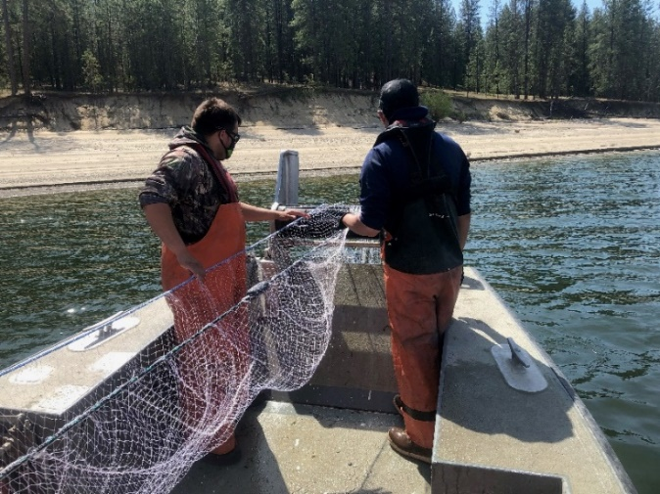
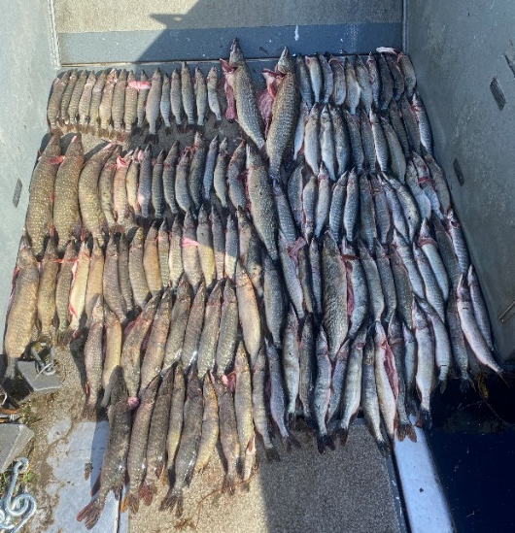
Summary
Northern Pike spread quickly if suppression is not implemented
Mean annual operating budget for all three agencies is $1.5M
Funding is not secure beyond 2025, need continued regional support
  Coordination Teams – both regional and local help the agencies stay organized
  Public Outreach – helpful to have other agency assistance with handouts and signs
  Research is necessary – helps us be more efficient
  Suppression – necessary for at least 10 more years
Goal: to keep the Northern Pike problem contained to the upper Columbia River

Slide 11
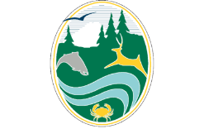
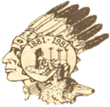
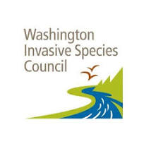
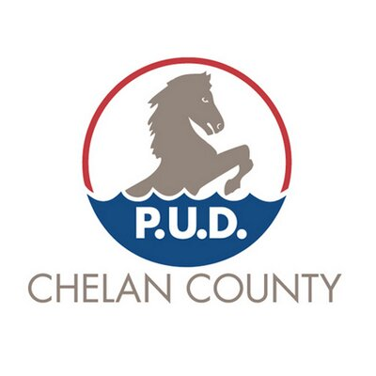
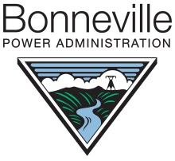
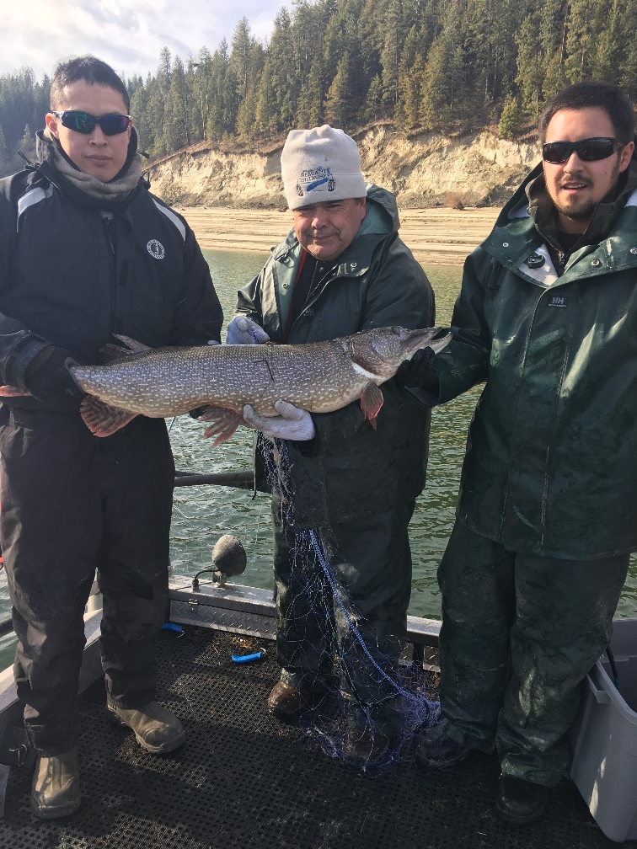
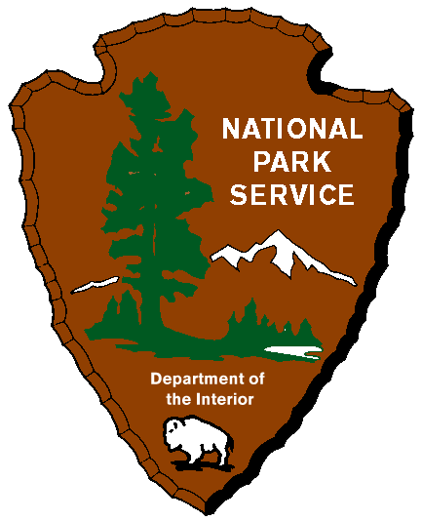
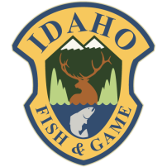
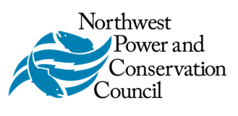
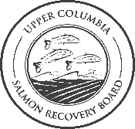
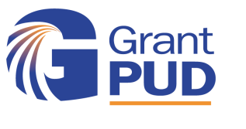


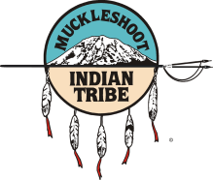



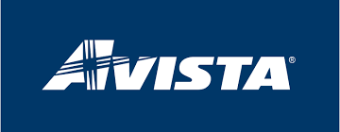

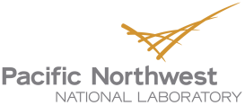

Thanks to our many partners
Holly McLellan holly.mclellan@colvilletribes.com

