Slide 1
Light microscopy and Limnoperna fortunei: impacts on monitoring
By:
Steve Wells
Aquaticus LLC
Columbia River Basin AIS Team Meeting
June 3-4, 2025
Boise Idaho

Slide 2
Light microscopy and Limnoperna fortunei: impacts on monitoring
Key Takeaways:
No change in microscope process for Limnoperna, at this time.
CPLM effective at detection of Limnoperna, similar to Dreissena.
Once detected, isolated veligers are submitted to molecular laboratory for identification to species level.
Next steps:
  Modify sample collection locations?- soft waters, estuaries, not cold winters, etc.,
  Examine veliger shell morphologies- measurements & photographs; share with other labs,
  Examine and document birefringence patterns,
  Confirm 5% acetic acid effective decon soak with Limnoperna veligers.

Slide 3
Light microscopy and Limnoperna fortunei: impacts on monitoring
1. CPLM is effective detecting Limnoperna veligers
CPLM 100% effective w Limnoperna qualitative¹
¹R.B. de Oliveira Jr. et al. 2024. Evaluation of different laboratory techniques to check for the presence of golden mussel larvae, Limnoperna fortunei (Dunker, 1857) in water samples. Brazilian Journal of Animal and Environmental Research. 7(4):1-5.
2. Limnoperna CPLM has same problems as with Dreissena veligers
CPLM labor intensive,
Interfering matrix such as sediment can block targets causing false negatives,
Unable to reliably identify to species level using larval morphology.

Slide 4
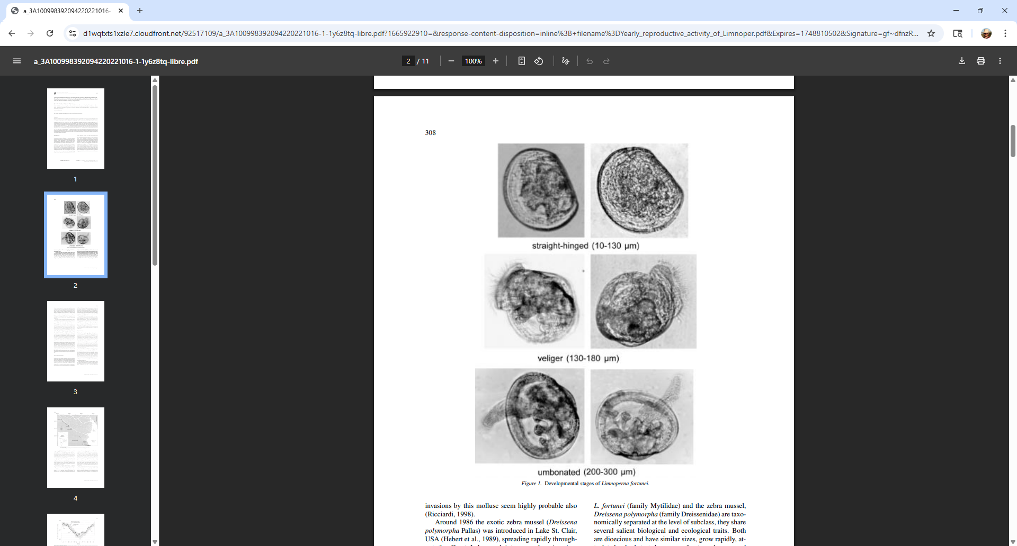
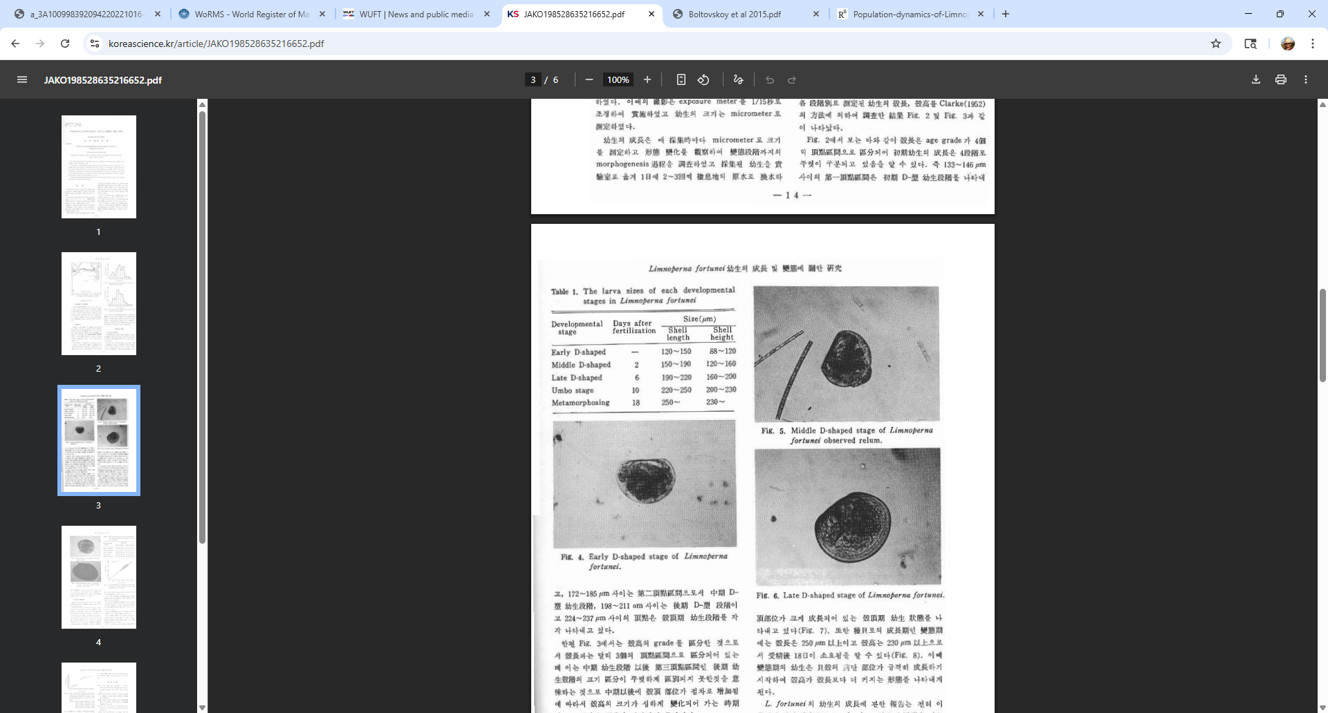
Light microscopy and Limnoperna fortunei: impacts on monitoring
Limnoperna look similar to Dreissena veligers
Similar size and overall shape,
Straight-hinge stage,
Becoming round with ciliated velum,
Asymmetrical with protruding umbones.
Choi S.S. and J.S. Kim. 1985. Study on the early development and larvae of Limnoperna fortunei. Korean J Malacol. 1: 13-18.
Cataldo D.H. and D. Boltovskoy. 2000. Yearly reproductive activity of Limnoperna fortunei (Bivalvia) as inferred from the occurrence of its larvae in the plankton of the lower Parana river and the Río de la Plata estuary (Argentina). Aquatic Ecology. 34:307-317.

Slide 5
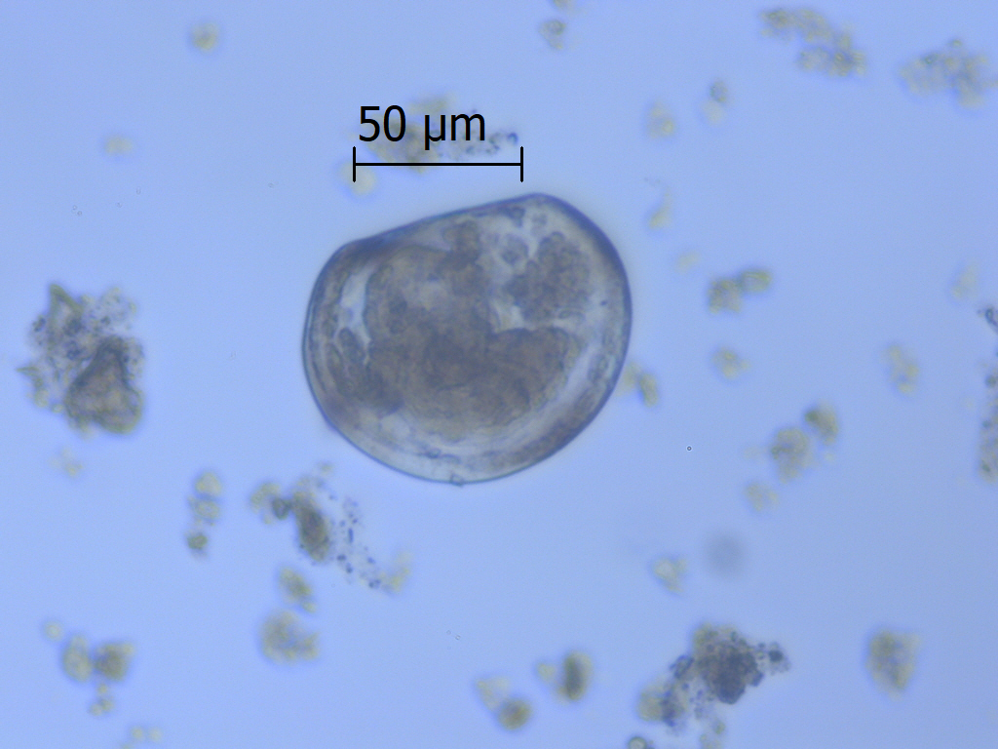
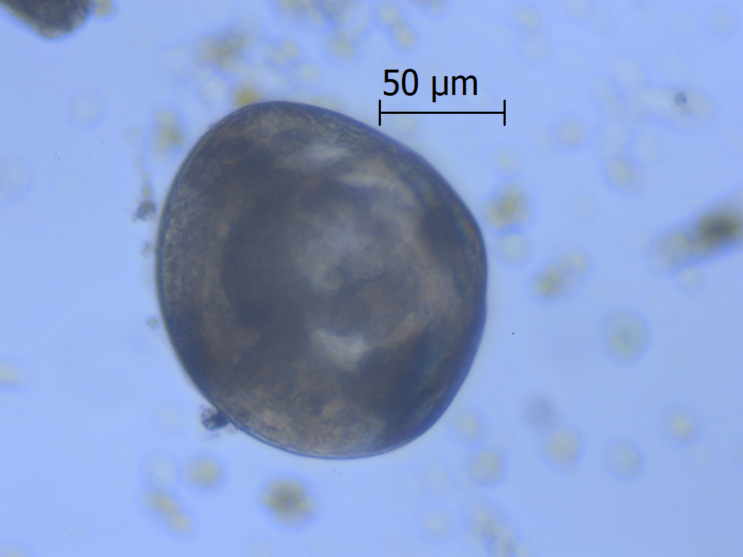
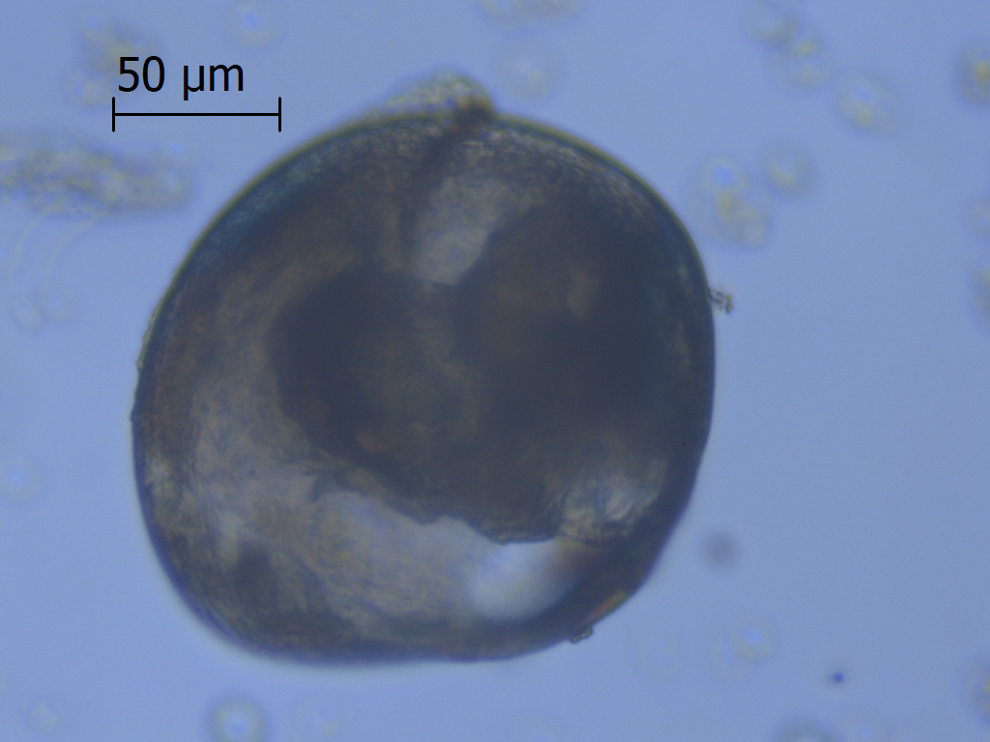
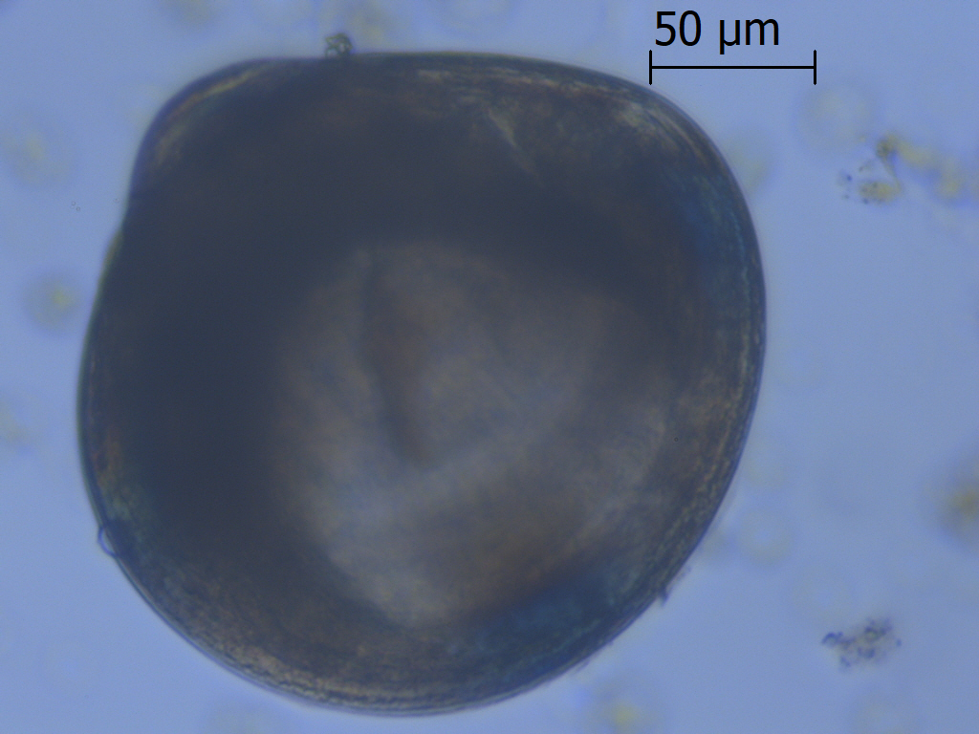
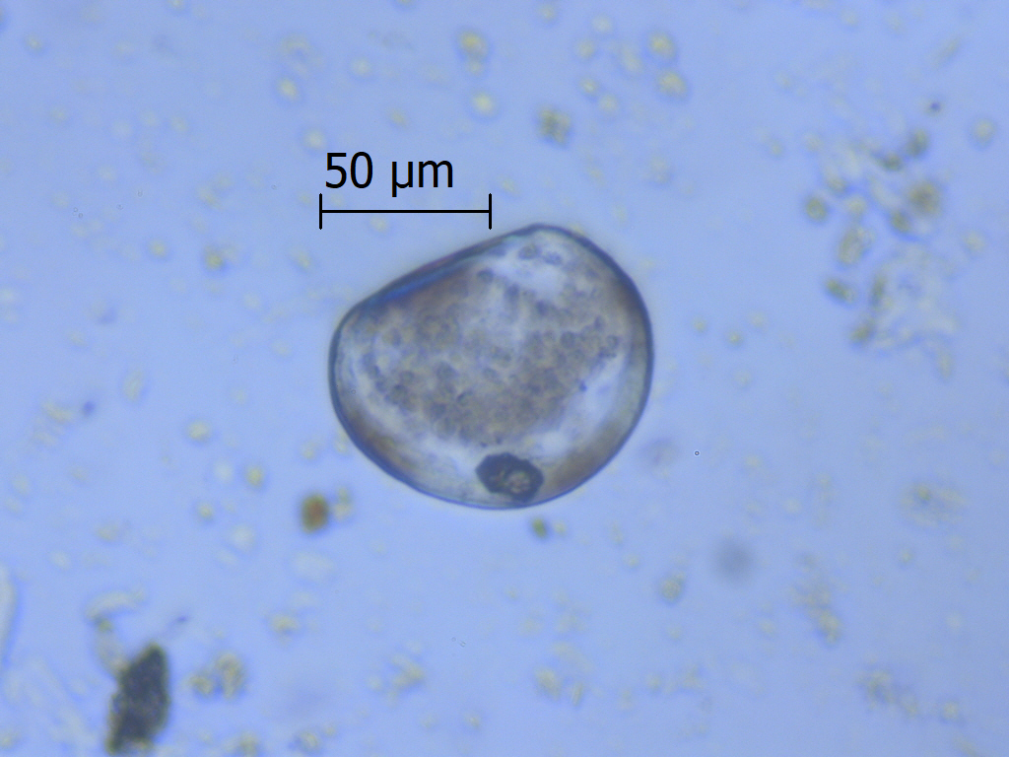
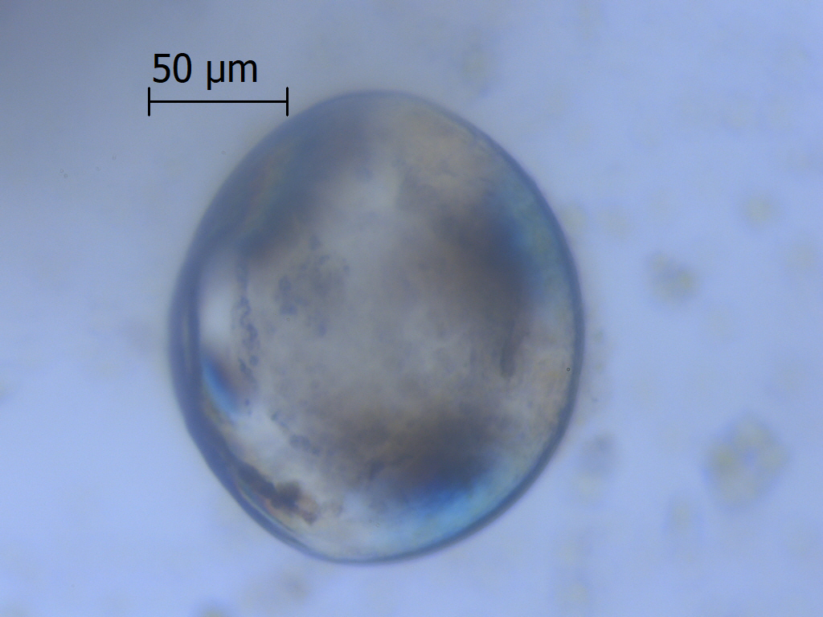
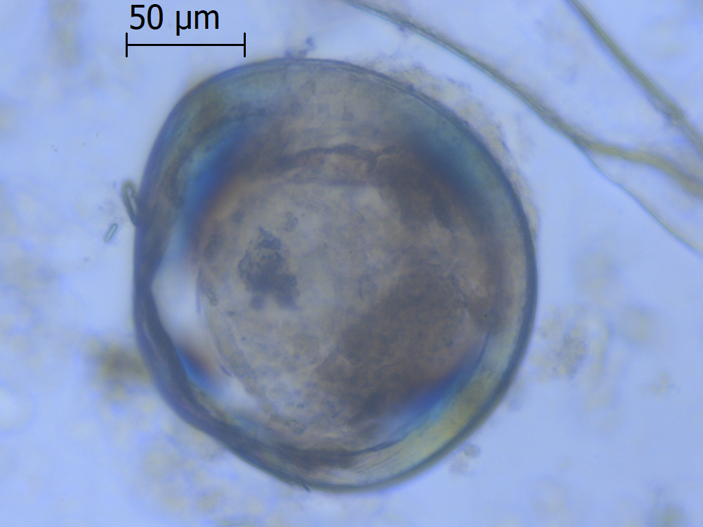
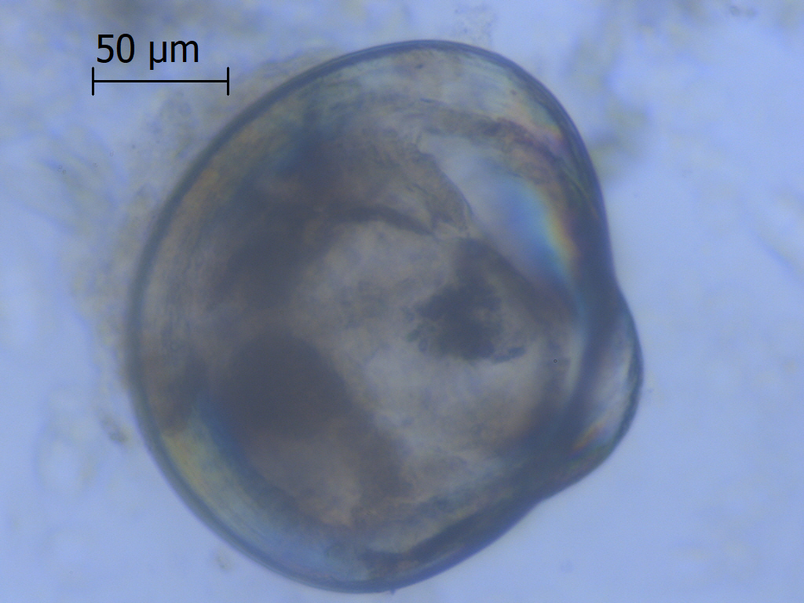
Light microscopy and Limnoperna fortunei: impacts on monitoring
Difficult to ID Limnoperna & Dreissena to species level w/ CPLM
golden mussels
zebra mussels
quagga mussels
straight-hinge stage
umbonal stage
pediveliger stage

Slide 6
Light microscopy and Limnoperna fortunei: impacts on monitoring
~ Size of straight-hinge veligers (D-stage)
 | Shell length (µm)
 | Mean ± SD | Min | Max | n
Golden, Argentina¹ |  | 10 | 130
Golden, Korea² |  | 120 | 190
Zebra, CA³ | 96 ± 13 | 73 | 150 | 192
Zebra, KS³ | 100 ± 11 | 84 | 129 | 58
Quagga, CA³ | 98 ± 9 | 82 | 130 | 212
Limnoperna from Cataldo and Boltovskoy (2000).
Limnoperna from Choi and Kim (1985).
length
¹Cataldo D.H. and D. Boltovskoy. 2000. Yearly reproductive activity of Limnoperna fortunei (Bivalvia) as inferred from the occurrence of its larvae in the plankton of the lower Parana river and the Río de la Plata estuary (Argentina). Aquatic Ecology. 34:307-317.
Dreissena straight-hinge veliger showing shell length dimension.
²Choi S.S. and J.S. Kim. 1985. Study on the early development and larvae of Limnoperna fortunei. Korean J Malacol. 1: 13-18.
³Wells, S. and M. Sytsma. 2013. Light Microscopy to Detect and Identify the Bivalve Larvae Dreissena polymorpha and D. rostriformis bugensis. Prepared for U.S. Fish and Wildlife Service, 105 pp.

Slide 7
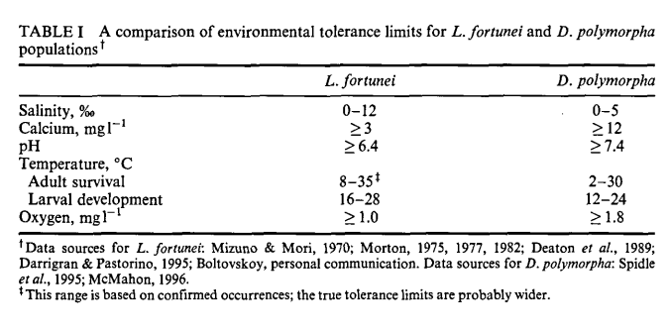
Light microscopy and Limnoperna fortunei: impacts on monitoring
Limnoperna tolerances slightly different vs Dreissena
Both freshwater but found in brackish; Limnoperna found in higher salinities,
Limnoperna not limited by soft water,
Limnoperna may be limited by cold winter water (<8ºC),
Limnoperna may be less limited by warm water (>30ºC),
Limnoperna appears more tolerant of low DO conditions.
Ricciardi A. 1998. Global range expansion of the Asian mussel Limnoperna fortunei (Mytilidae): another fouling threat to freshwater systems. Biofouling 13: 97-106.

Slide 8
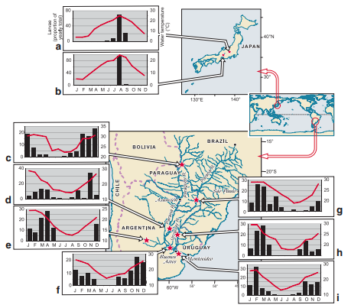
Light microscopy and Limnoperna fortunei: impacts on monitoring
Limnoperna is freshwater mussel w/ broad salinity tolerance
Widespread in freshwater lakes and rivers (Ricciardi 1998).
Common in brackish waters of estuaries (0 - 12‰) (Ricciardi 1998).
Appears introduction via ballast water discharge in estuarine areas, and then once established expands upriver into freshwater habitats.
Timing of reproduction varies; in northern latitudes similar to PNW, one peak during summer months.
Boltovskoy, D., B. Morton, N. Correa, D. Cataldo, C. Damborenea, P.E. Penchaszadeh, and F. Sylvester. 2015. Reproductive Output and Seasonality of Limnoperna fortunei. In Limnoperna fortunei, Invading Nature-Spring Series in Invasion Ecology, 10. pp. 77-103.

Slide 9
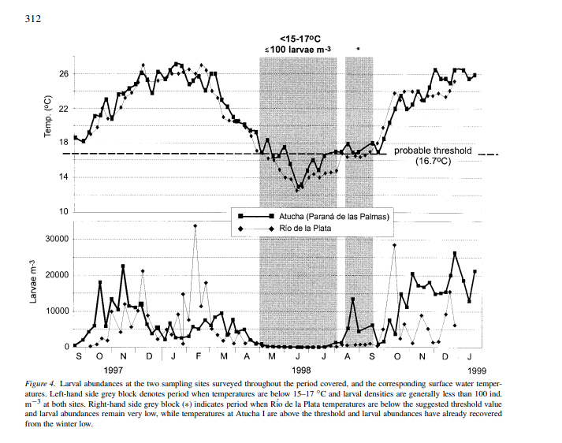
Light microscopy and Limnoperna fortunei: impacts on monitoring
Limnoperna veligers present in water column ~9 months/ yr in Río de la Plata
Onset of spawning triggered by rise in water temp above 15-18ºC following winter lows,
  (Boltovskoy et al. 2015; Cataldo and Boltovskoy 2000)
First two stages (straight-hinge and umbonal) are 80% of larvae in water column in Río de la Plata,
  (Cataldo and Boltovskoy 2000),
Cataldo D.H. and D. Boltovskoy. 2000. Yearly reproductive activity of Limnoperna fortunei (Bivalvia) as inferred from the occurrence of its larvae in the plankton of the lower Parana river and the Río de la Plata estuary (Argentina). Aquatic Ecology. 34:307-317.

Slide 10
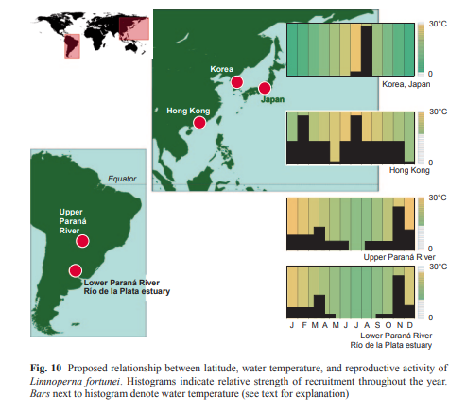
Light microscopy and Limnoperna fortunei: impacts on monitoring
Limnoperna veliger timing expected to be most similar to Korea and Japan
Korea and Japan latitudes most comparable to Pacific Northwest,
Onset once water temp >15-18ºC,
Likely multiple spawning events/ yr
  One peak in Korea and Japan during summer,
  Maybe 3/yr in Río de la Plata,
  2/yr in Hong Kong.
Expect reproductive break in winter.
Boltovskoy, D., B. Morton, N. Correa, D. Cataldo, C. Damborenea, P.E. Penchaszadeh, and F. Sylvester. 2015. Reproductive Output and Seasonality of Limnoperna fortunei. In Limnoperna fortunei, Invading Nature-Spring Series in Invasion Ecology, 10. pp. 77-103.

Slide 11
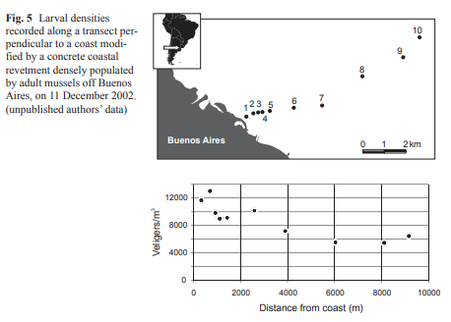
Light microscopy and Limnoperna fortunei: impacts on monitoring
Limnoperna veligers evenly distributed in mixed system
Similar to Dreissena veligers, veliger density not well correlated with adult mussel bed locations,
Veligers tend to be evenly distributed in mixed system, top to bottom and side to side.
Boltovskoy, D., B. Morton, N. Correa, D. Cataldo, C. Damborenea, P.E. Penchaszadeh, and F. Sylvester. 2015. Reproductive Output and Seasonality of Limnoperna fortunei. In Limnoperna fortunei, Invading Nature-Spring Series in Invasion Ecology, 10. pp. 77-103.

Slide 12
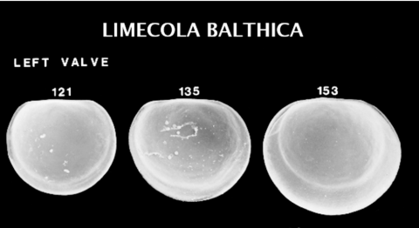
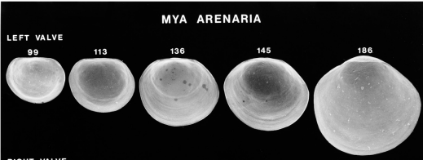
Light microscopy and Limnoperna fortunei: impacts on monitoring
Limnoperna potential CRB estuary habitat overlaps with brackish mussels
Limecola balthica (estuarine mud; planktotrophic larvae)¹,
Mya arenaria (marine, estuarine sand & mud; planktotrophic larvae)¹,
Corbicula spp. (riverine sand & mud; direct development, large D-shaped juveniles)¹,
Anodonta spp. (riverine sand; subtriangular glochidia)¹,
Pisidium spp. (riverine sand & mud; direct development)¹.
B.
C.
C.
A.
C. D. E.
Scanning electron photographs of Limecola and Mya from Lutz et al. (2018)²
¹Tetra Tech. 1992. Reconnaissance Survey of the Lower Columbia River Task 4: Review of Biological Indicators to Support Recommendations on a Biological Monitoring Approach. Report for the Lower Columbia River Bi-State Program. Pg. 66.
²Lutz, R.A. et al. 2018. Scanning electron microscope aids for identification of larval and post-larval bivalves. Journal of Shellfish Research. 37(2):247-448.

Slide 13
Light microscopy and Limnoperna fortunei: impacts on monitoring
Conclusions:
CPLM effective at detection of Limnoperna, similar to Dreissena.
CPLM unable to reliably separate planktotrophic veligers to species level,
Once veligers are detected and isolated, molecular methods used to ID to species level,
Limnoperna expected to overlap with Dreissena range, but expecting more Limnoperna in softer and warmer waters compared to Dreissena,
Limnoperna introduction via ballast water into estuary, then spreads into freshwater,
Next steps:
  Modify EDM collection location?- soft waters, estuaries, not cold winters, etc.,
  Examine Limnoperna veliger morphology and birefringence patterns to look for differences with Dreissena,
  Confirm 5% acetic acid effective decon soak with Limnoperna veligers.

