Slide 1
Columbia River Basin Dreissenid Monitoring Mapping
JANUARY 2022
Robyn Draheim

Slide 2
Dreissenid Monitoring
Regional Mapping
Timing of Monitoring Data Collection
Monitoring Updates: 2021 results and 2022 plans

Slide 3
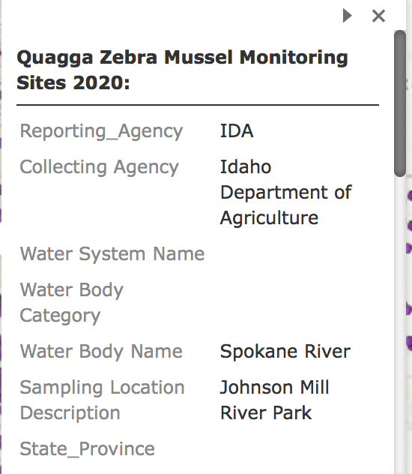
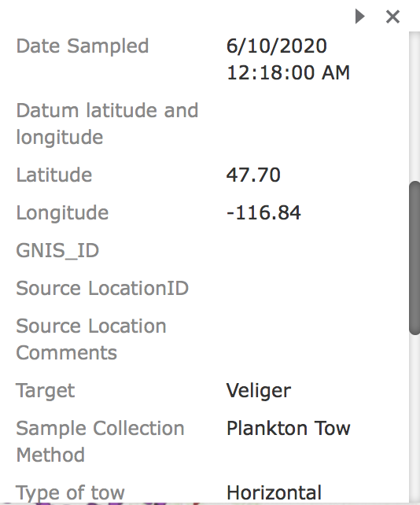
Regional Mapping https://www.westernais.org/monitoring

Slide 4
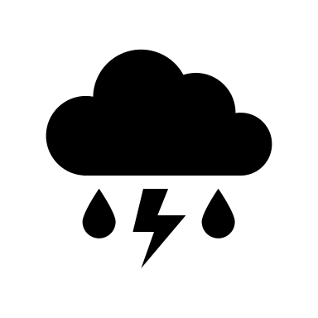
Timing of Data Collection

Slide 5
Monitoring map completion in February
Discuss 2021 map at next stand-alone monitoring remote meeting
Monitoring Updates: 2021 Results and 2022 Plans

Slide 6
Topics for [future] discussion in 2022
Select timing of 2022 data call
Revisit data collection goals
Role(s) of submitting entity
Statewide data assimilation
New intro to public facing monitoring map
Determine audience, communication goals

Slide 7
Contact: robyndraheim@gmail.com

