Slide 1

U.S. Department of the Interior
Invasive Species Update
Hilary Smith, Senior Advisor for Invasive Species
Columbia River Basin AIS Meeting
June 4, 2025

Slide 2
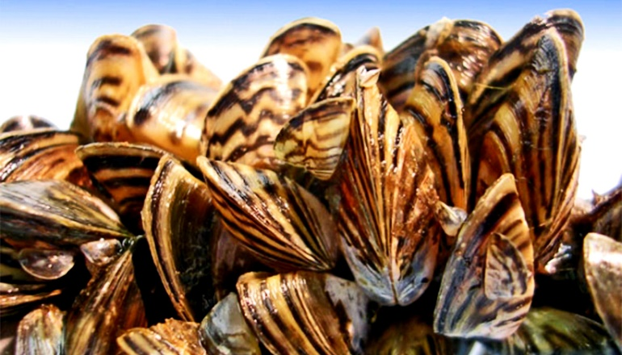
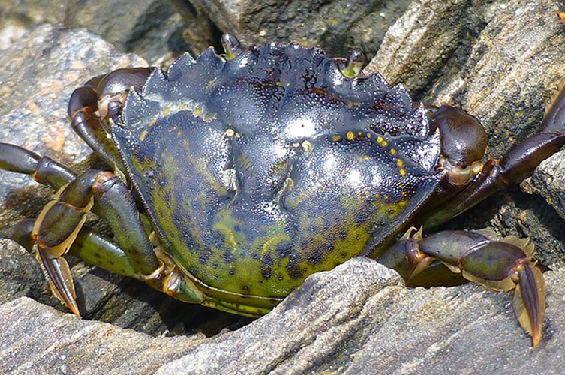
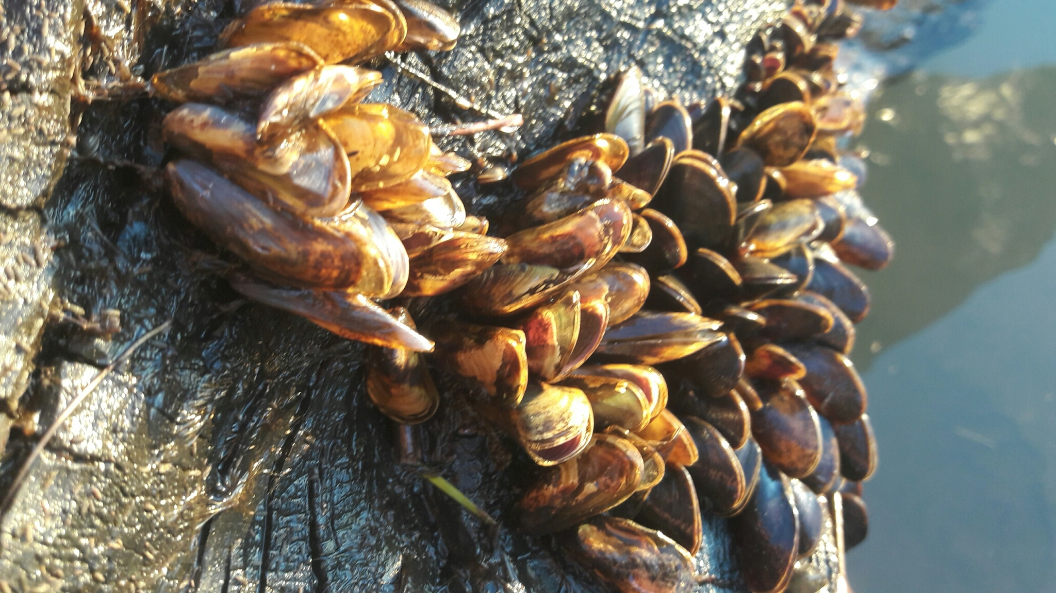
Aquatic Invasive Species Highlights
DOI Mussels Coordination
  Bureau Programs
  Funding, including Interagency Agreement
  QZAP 2.0 Implementation – FY24 Highlights Summary
Interagency Mussels Rapid Response MOU
  Void due to boilerplate legal language re: non-discrimination and civil rights
  Was due to expire this year, so discussing options for revision with signatories
European Green Crab
  BIA, BLM, USFWS, USGS cooperative response measures
  Internal DOI coordination, as needed
  EGC National Management Plan
Golden Mussel
  Supporting lead action agencies

Slide 3
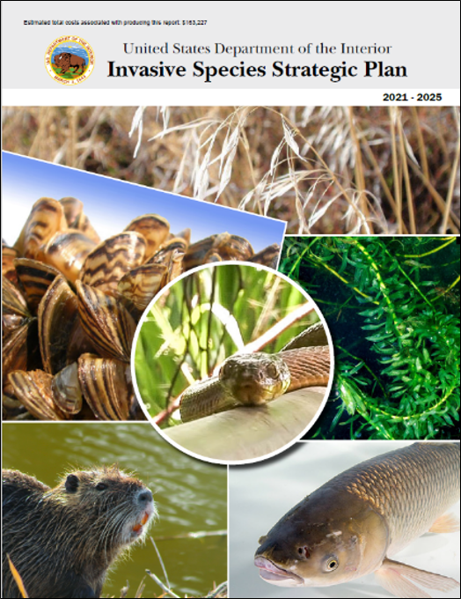
Broader Efforts
Categorical Exclusion Adoption
EXPLORE Act (Expanding Public Lands Outdoor Recreation Experiences)
Infrastructure Investment and Jobs Act
National EDRR Framework
DOI Invasive Species Strategic Plan
DOI Strategic Plan (DRAFT, 2026-2030)
  https://www.bia.gov/sites/default/files/dup/tcinfo/sp_final_for_consultation_and_comment.pdf

Slide 4
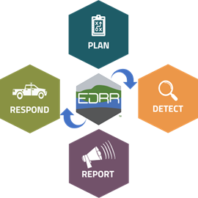
National EDRR Framework
Vision for connected DOI Programs and Activities that strengthen cross-boundary EDRR coordination and capacity
Siren: the National EDRR Information System
Knit local, regional, and national EDRR efforts into one accessible online tool
National EDRR Framework Coordinator
Facilitate Framework planning and implementation
Priority Species: Horizon Scans and Watch Lists
Global, Regional, Assets
Invertebrates, vertebrates, and plants
Priority Places: Identification of Invasion Hotspots
Streams, Lakes, Terrestrial tools
Invasive Species Habitat Tool (INHABIT)
Rapid Response Funding and Capacity
Rapid Response Fund for Aquatic Invasive Species
Interjurisdictional Invasive Species Rapid Response Team pilot program
Detection Tools and Services
Genetic Repository and Sharing Network
Genetic marker development
Managers eDNA Toolbox
Point-of-use eDNA detection tools
Automated eDNA sampling
Molecular Lab Network (MLN) including Science Support, Lab Info Management System (LIMS)
Reporting
Utilize existing national, regional, and local occurrence reporting databases
  E.g., Nonindigenous Aquatic Species (NAS), EDDMaps, iMapinvasives, Wild Spotter
  NAS metabarcoding
Surveillance Capacity
Asset-based protection projects
Invasion hotspot surveillance pilot projects
Citizen Science
Initiated in large part by Infrastructure Investment and Jobs Act funding

Slide 5
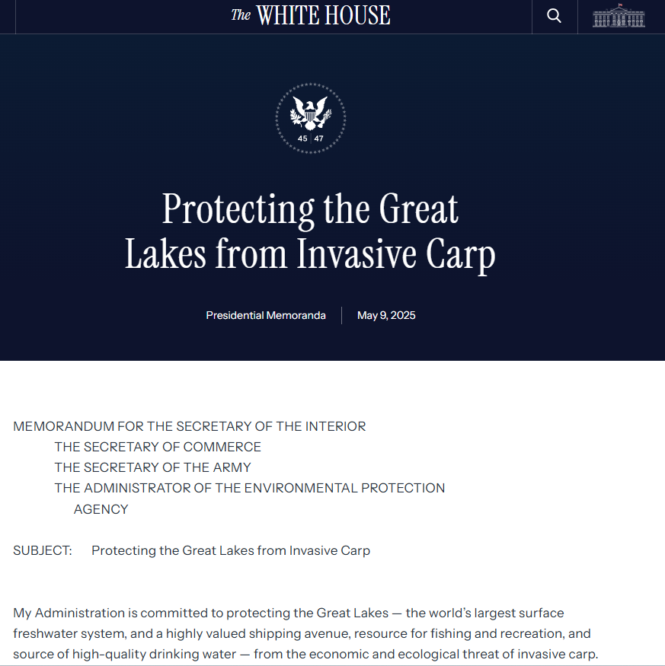
Administration Actions
(with ties or potential ties to invasive species)
Presidential Memorandum on Invasive Carp
USDA Secretary Action to Prevent Introduction of New World Screwworm
Executive Orders (e.g.,)
    Stopping Waste, Fraud, and Abuse by Eliminating Information Silos
    Achieving Efficiency through State and Local Preparedness
    Addressing the Threat to National Security from Imports of Timber, Lumber; Immediate Expansion of American Timber Production
    National Security (general)
Department of the Interior FY 2026 Budget in Brief
  https://www.doi.gov/budget/appropriations/2026/highlights

Slide 6
Thank you.
hilary_smith@ios.doi.gov
202-763-3118

