Slide 1
Columbia River Basin Dreissenid Mussel Monitoring Forum
Jesse Schultz, Aquatic Invasive Species Unit
January 11, 2022

Slide 2
Co-Partners
Co-Partner | Water Body Common Name
Chelan County PUD | Lake Entiat
Confederated Tribes of the Colville Reservation | Lake Roosevelt, Rufus Woods Lake, and Kettle River
Douglas County PUD | Lake Pateros
Grant County PUD | Priest Rapids Lake and Wanapum Lake
Spokane Tribe | Lake Roosevelt
Snohomish County PUD | Spada Lake

Slide 3
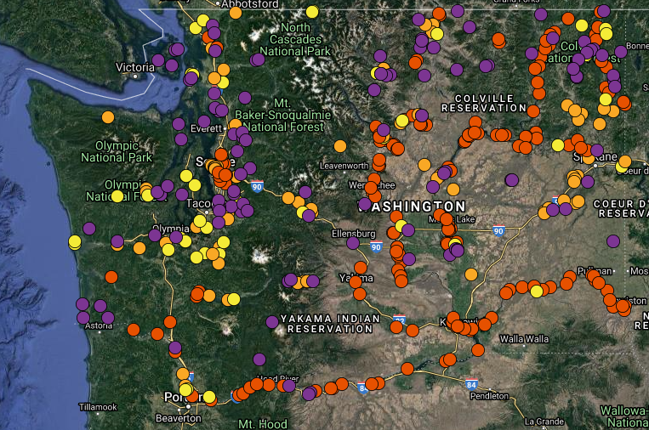
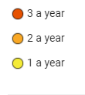
2021 Early Detection Monitoring Sites
(227 water bodies and 400 sites)
Bonus sites

Slide 4
Water Body Risk Assessment
(added salinity for 2022)
Scoring | 0 Point | 1 Point | 2 Point | 3 Point | 4 Point
Establishment
Dissolved Calcium (mg/L) | 0-5 (no monitoring) | 6-11 | 12-15 | 16-24 | 25 or more
Salinity (ppt) | 10 or more (no monitoring)
Introduction
Public | No (no monitoring) |  |  |  | Yes
# Boat Ramps | 0 (no monitoring) | 1 | 2 | 3 | 4 or more
Boat Ramp Paved | No |  |  |  | Yes
Boat Ramp w/Dock | No | Yes
Motorized Watercraft Allowed | No |  |  |  | Yes
Speed Limit > 10mph | No |  |  |  | Yes
Moorage | No |  |  |  | Yes
Private Docks | No |  |  |  | Yes
Access Year Around | No | Yes
Ease of Access |  | Foot | Ferry | Gravel road | Paved road
In Columbia River Basin | No | Yes
Water Body Size |  | 0-10 | 11-49 | 50-99 | 100 or more
Fish Stocked | No | Yes
Hatchery/Net Pens | No |  |  |  | Yes
Fishing Tournaments | No | 1-2 | 3-4 | 5-6 | 7 or more
Motorized Watersports Tournaments | No |  |  |  | 1 or more
Boatyard | No |  |  |  | Yes
Hydropower/Flood Control | No |  |  |  | Yes
Irrigation | No |  |  |  | Yes
Municipal Water | No |  |  |  | Yes
Proximity to Source Population |  | No drainages west of continental divide | West of continental divide | Nearby, but may not be as easily assessable | Downstream, connected, or within easy drive
Monitoring Frequency
0 | 1-20 | 21-34 | 35-39 | 40-49 | 50 or more
No monitoring | Once every 3 years | Once every 2 years | Once a year | Twice a year | Three a year
Notes:
The Chehalis I-5 disaster is an example of infrastructure repair
Tailor flood management programs locally
Federal minimum to protect against risk is low

Slide 5
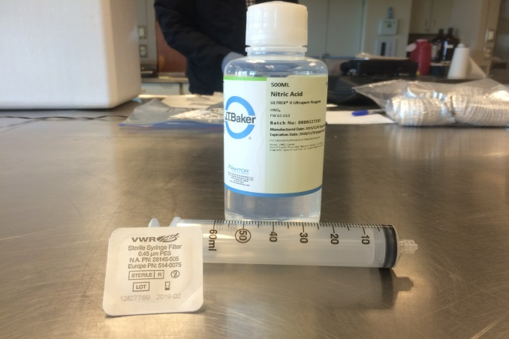
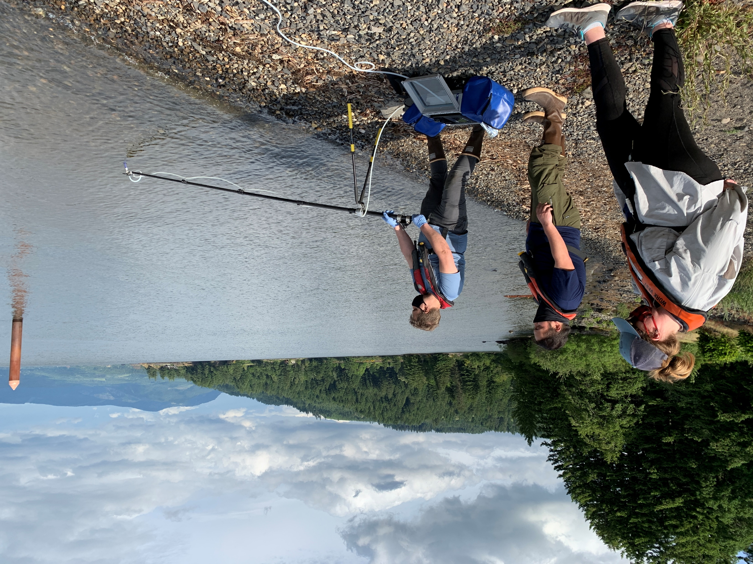
2021 Results

Slide 6
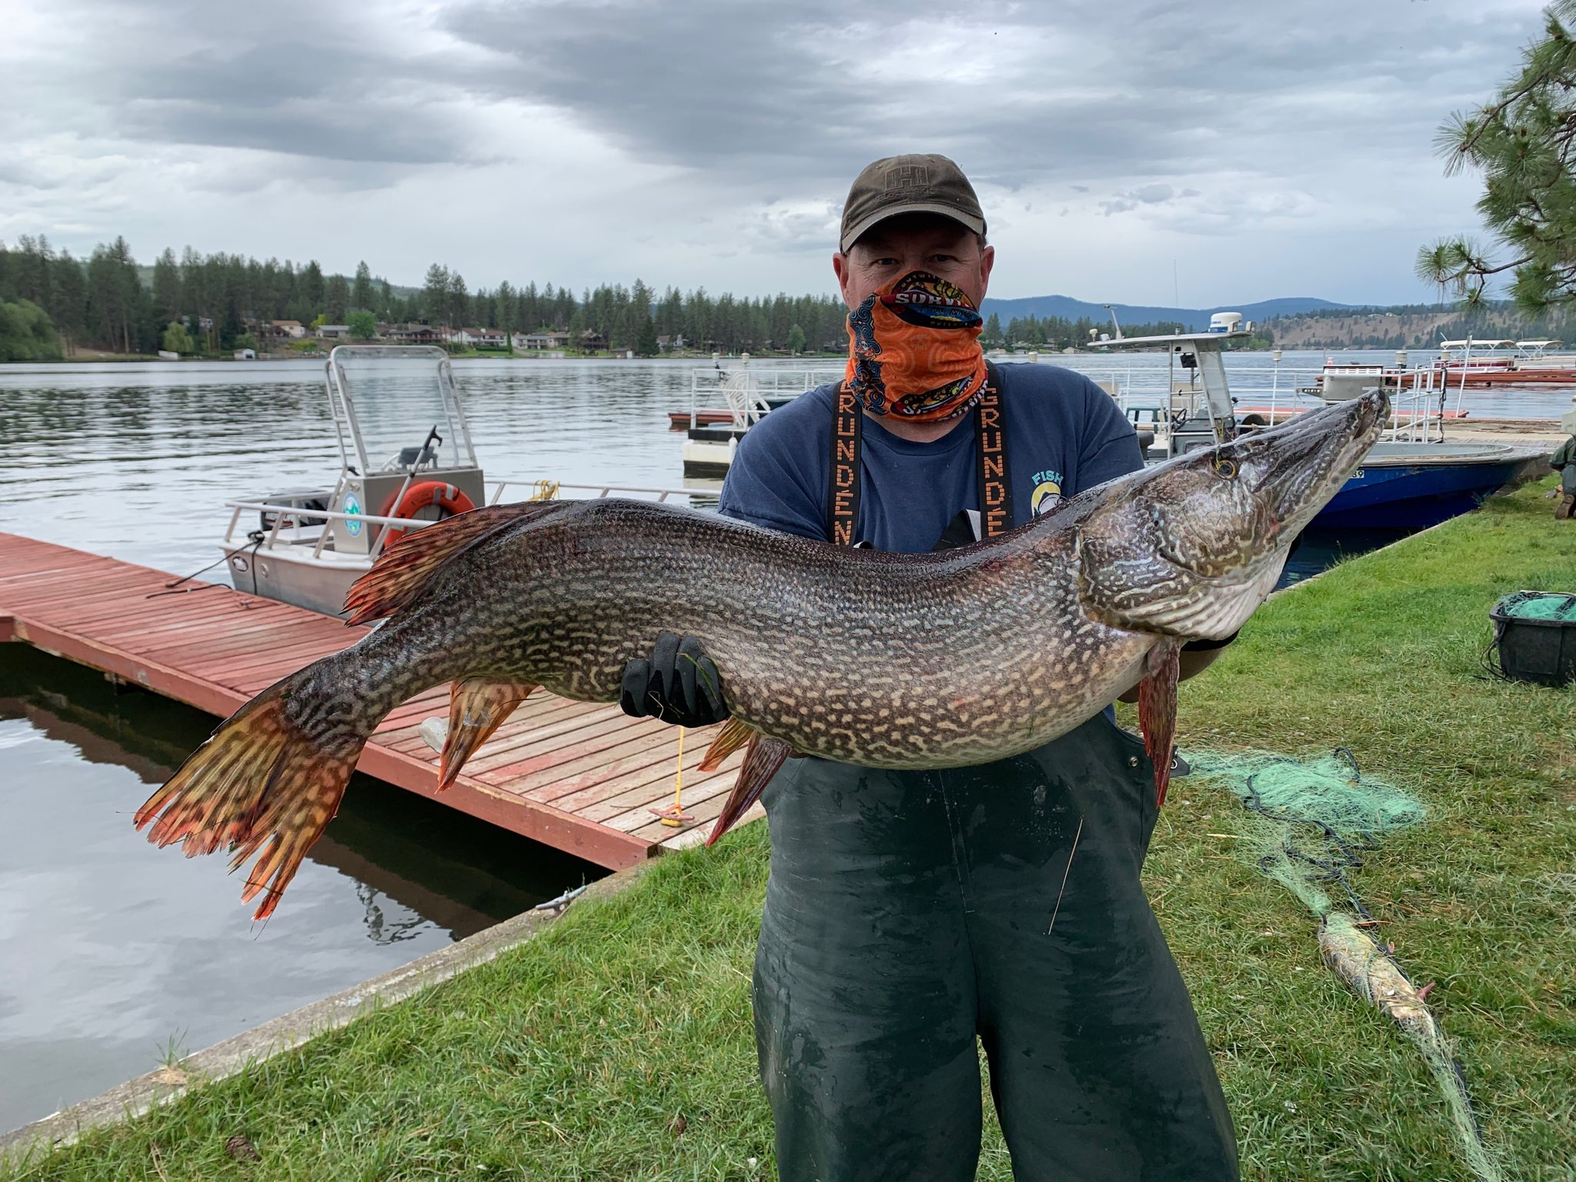
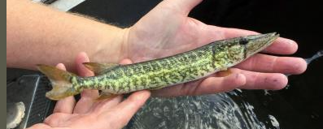
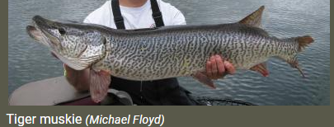
Northern Pike (Esox Lucius)
Classification: Prohibited
Status: Established
Grass Pickerel
Notes:
Northern Pike have light horizontal spots on a dark background
Tiger Muskies have dark spots or vertical stripes on a light background
Grass Pickerel do not have spots on fin and average size 12 inches

Slide 7
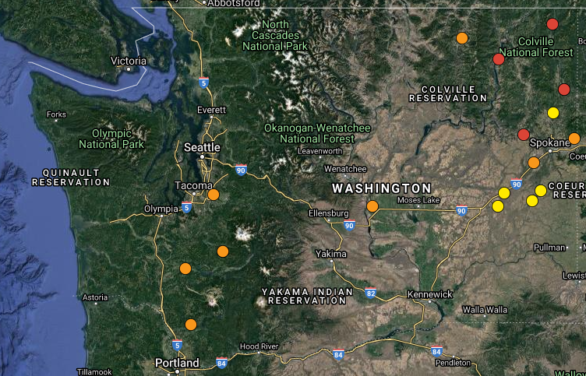

Northern Pike, Tiger Muskie, and Grass Pickerel

Slide 8
2022 Forecast

Slide 9
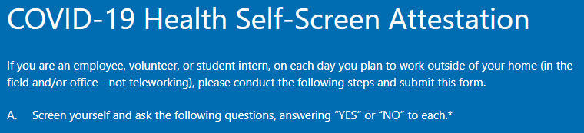
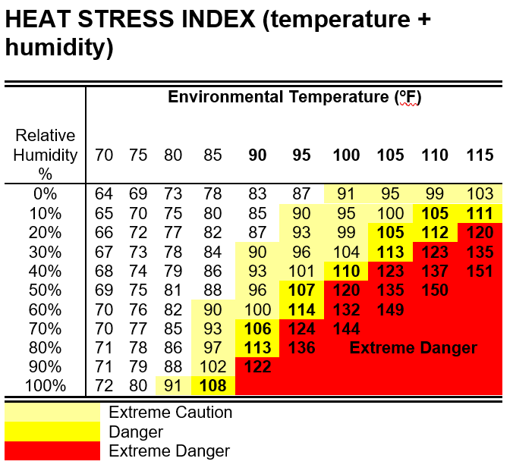
2021 Adapt and Evolve
WDFW Zebra/Quagga Mussel Monitoring Site Protocol
Supervisors and Employees Working Outdoors
Immediately complete the required online Wildfire Smoke Safety Annual Training.
Maintain an adequate supply of KN95 and N95 masks.
Download the Environmental Protection Agency’s AirNow app to your work cellphone.
Prior to the beginning of work and periodically throughout the day, monitor the air quality in your work area, on the AirNow app or at the AirNow website.
If working outside for more than 1 hour in a shift AND there is an Air Quality Index (AQI) >69 Provide KN95 or N95 masks and encourage employees to wear them
If working outside for more than 1 hour in a shift AND there is an Air Quality Index (AQI) >151 Supervisors will notify employees when air quality levels are at or above >151 Implement feasible exposure controls including: Provide KN95 or N95 masks and encourage employees to wear them Provide access to enclosed buildings, structures, or vehicles where the air is adequately filtered Provide portable HEPA filters in enclosed areas Temporarily relocate work to a location with a lower air concentration of <151 AQI Temporarily change work schedules to times with a lower air concentration of <151 AQI Reduce work intensity Provide additional rest periods

Slide 10
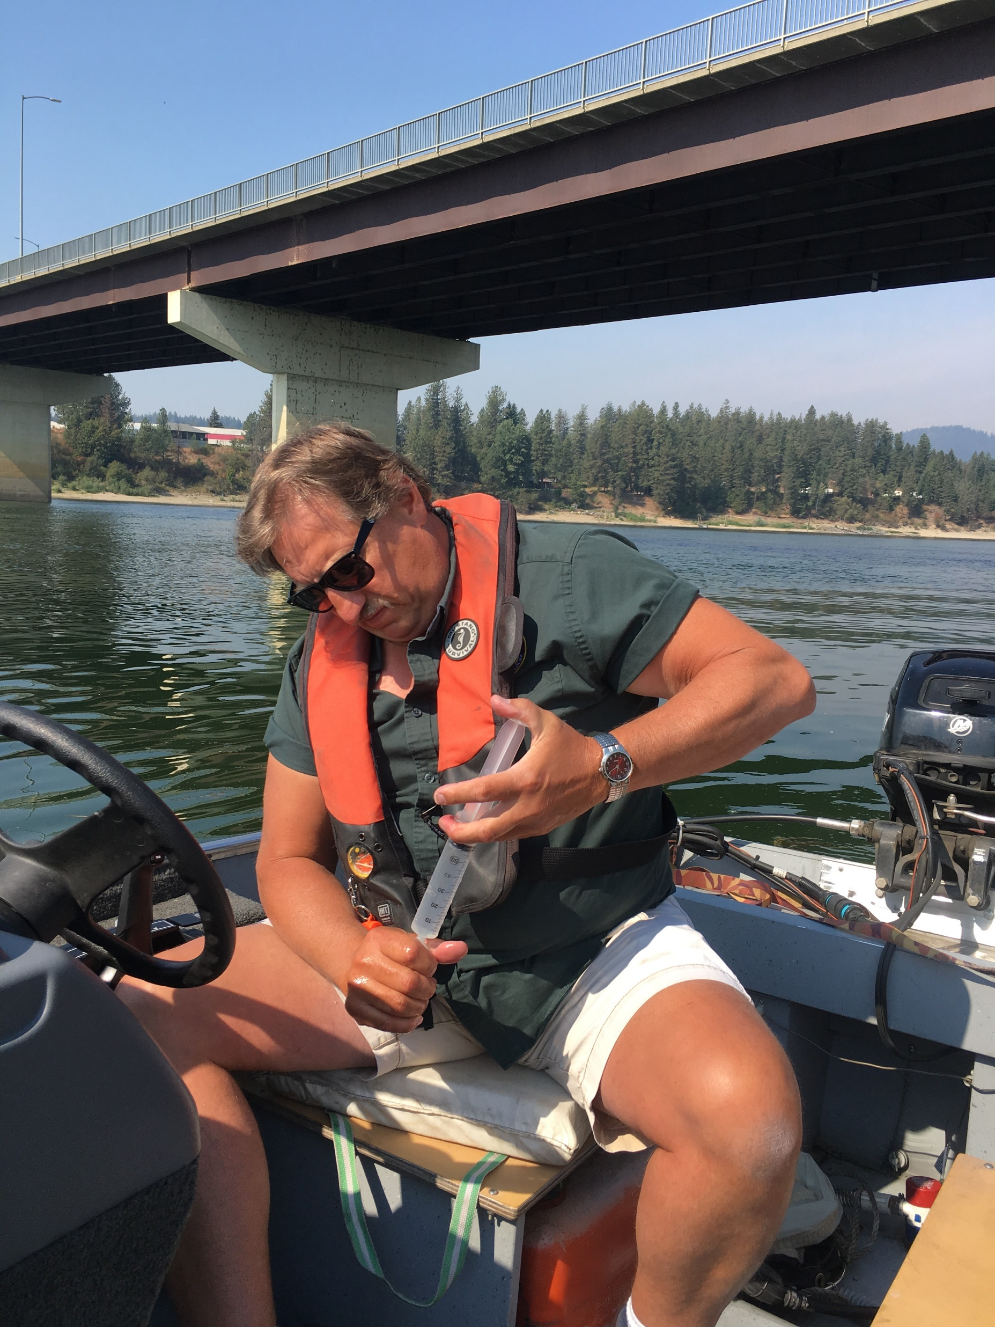
WDFW ZQM Teams (2-person and a boat)
2021May - November
  Olympia (western WA)
  Spokane (eastern WA)
  Ephrata (central WA)
    August
2022 May - November
  Olympia (western WA)
  Spokane (eastern WA)
  Ephrata (central WA)
Staff
  Permanent
  Project career seasonal
  Non-permanent

Slide 11
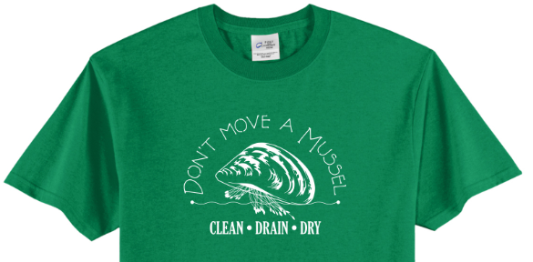
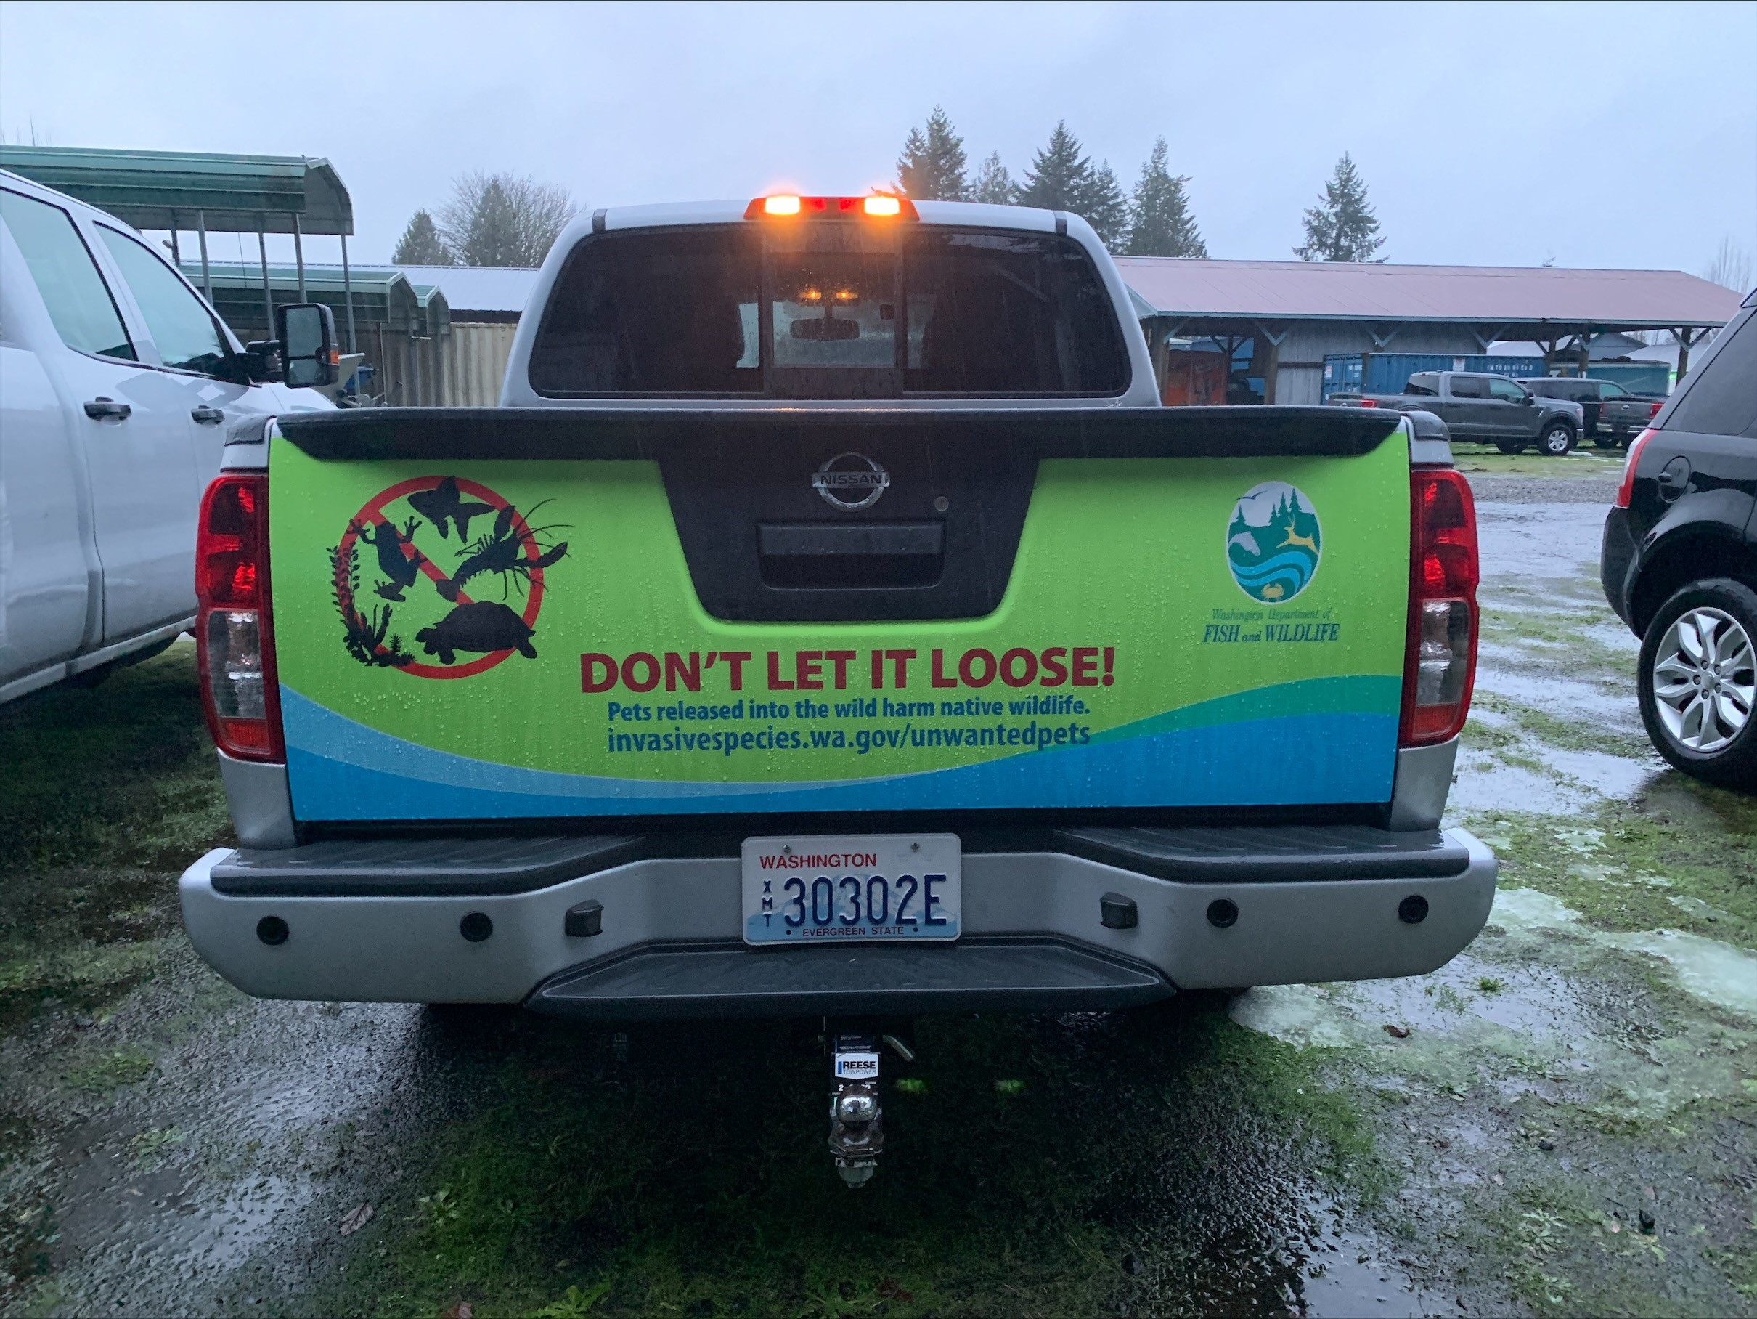
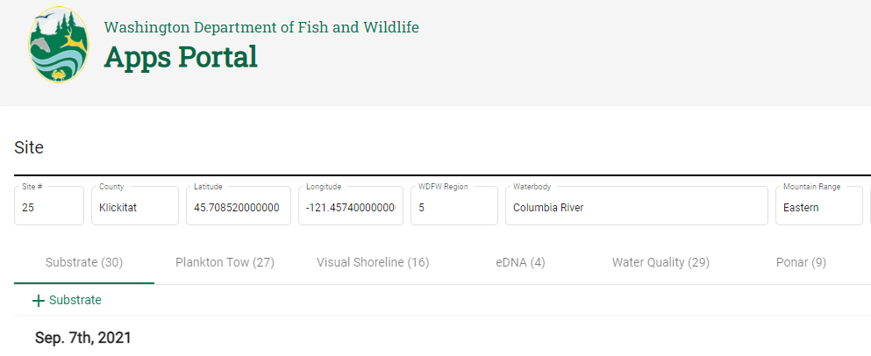
New
  Don’t Move a Mussel t-shirts
  Don’t Let It Loose tailgate wrap and working on zebra/quagga mussel wrap
  App
    Non-WDFW staff can access
    Must create Secure Access Washington account
    Still working out some bugs
    WDFW IT short staffed

Slide 12
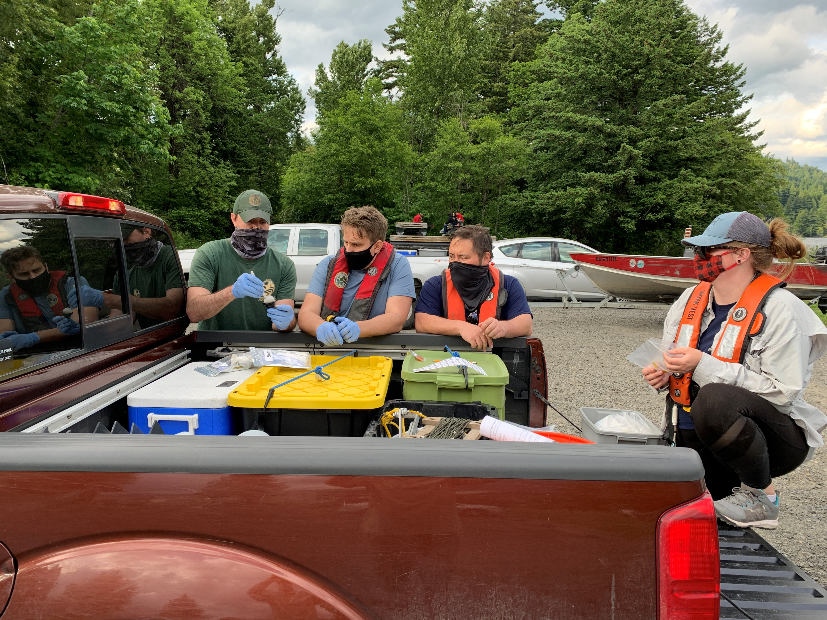
Questions?
Jesse Schultz Aquatic Invasive Species Unit
360 480-2105
Jesse.Schultz@dfw.wa.gov

