Slide 1
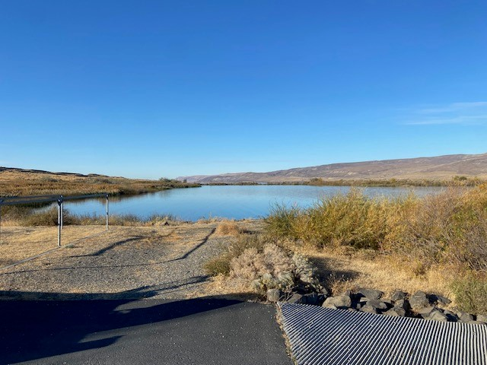
CRITFC Northern Pike Monitoring 2024
Blaine Parker & Denise Kelsey
Columbia River Inter-Tribal Fish Commission
CRB AIS Meeting, Spokane WA
December 10-11, 2024

Slide 2
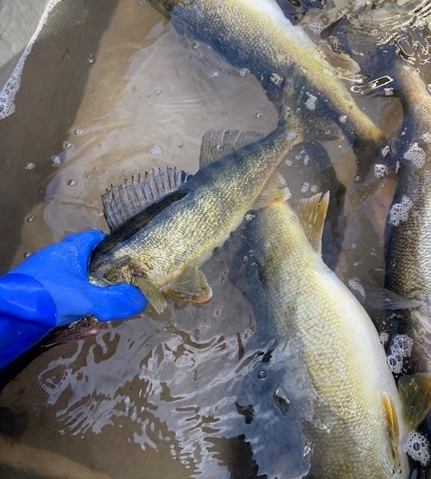
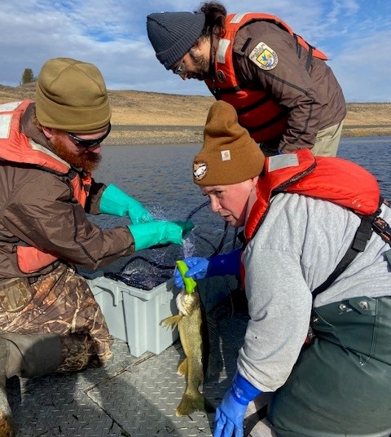
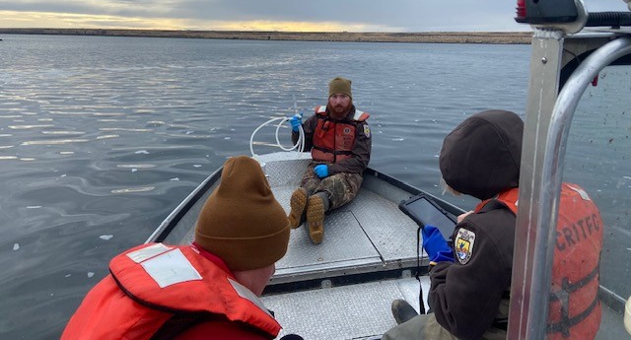
Sampling Summary for 2024
60+ eDNA samples collected between BN and PR dams
12 nets , 198 fish total, 3 native fish, but no northern pike!
Non-natives dominated, 47 NNF to 1 NF ratio, 3 most common species: yellow perch, bullheads and walleye.

Slide 3
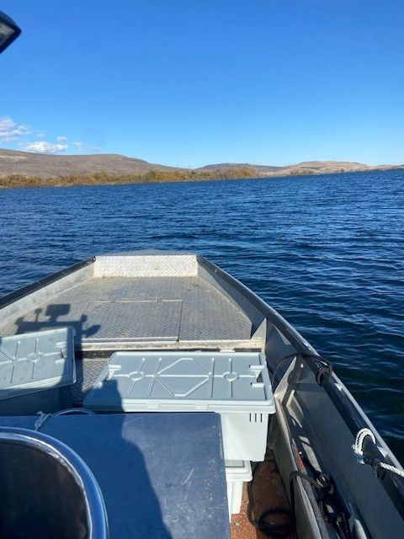
Plans for 2025
Begin eDNA collection in March, expand sample numbers
Focus on spring gillnet sets in NP spawning habitat locales
Continue O&E with our tribal fishers and tribal biologists
Expand coordination and cooperation opportunities wherever possible.

