Slide 1
AIS Legislative Report
CRB 100th AIS TEAM
Spokane, WA
December 10, 2024
Stephen Phillips, Senior Program Manager
Notes:
Glen canyon national recreation area

Slide 2
118th Congress (2023-2024)
AIS Bills
S.4113 —State Boating Act. Unlikely
H.R.6492 Expanding Public Lands Outdoor Recreation Experiences Act (EXPLORE) Act, Maybe
Recovering America’s Wildlife Act DEAD, 119th Congress??
Water Resources Development Act YES !
Coast Guard Authorization Act ???
Appropriations 90 Day Extension into 119th Congress
Notes:
Glen canyon national recreation area

Slide 3
S. 4113: State Boating Act (Shaheen (D-NH), Crapo (R-ID), Risch (R-ID)), House companion bill
Ensure that states can collect fees during the boat registration and certificate of numbering process.
Recently, the Coast Guard has blocked* a number of states from collecting fees, which help fund programs to address aquatic invasive species, boating safety, search and rescue and others. The State Boating Act would reinstate the state’s authority to collect those fees. …which help fund programs to address aquatic invasive species, boating safety, search and rescue and others.
*or “threatened/intending” to block?
States receiving USCG letters: Washington, California, Idaho, Colorado, Minnesota, Ohio, New Hampshire, Vermont
Louisiana has not received letter but would be out of compliance.
Notes:
Senate side – Ted Cruz has been a hold up
Are states paying attention? Ignoring

Slide 4
S. 4113: State Boating Act …continued
A few of the supporters of State Boating Act:
State of Washington; PSMFC, Association of Fish and Wildlife Agencies, American Sailing Association, Congressional Sportsmen’s Foundation, National Marine Manufacturers Association, Pacific Northwest Economic Region, National Association of State Boating Law Administrators
But there is more …
Report language from the recently released Senate FY 2025 DHS appropriations bill. (11/13/24):
State Boating Fees.—The Committee directs the Coast Guard to provide a briefing within 90 days of the date of enactment of this act discussing any statutes, regulations, and policies governing the ability of states to collect fees including those related to boating safety, search and rescue operations, and aquatic invasive species as part of a process for numbering undocumented vessels under chapter 123 of title 46, United States Code.
Notes:
BoatsUS opposed?? Cruz with doubts

Slide 5
S. 4113: State Boating Act (continued)
And more
Senators Shaheen, Crapo, Risch Send Bipartisan Letter Urging Coast Guard to Allow States to Collect Fees When Vessels are Registered to Help Fund Boating and Water Safety Efforts (11/8/24)
(Washington, DC) – U.S. Senators Jeanne Shaheen (D-NH), Mike Crapo (R-ID) and Jim Risch (R-ID) sent a bipartisan letter urging the U.S. Coast Guard to revert to its longstanding statutory interpretation that allowed states to collect fees for boating-related programs during the boat registration and Certificate of Numbering (CON) process
NOW WHAT: Pressure building on Coast Guard to drop fee ban…should happen in the next congress ??? Or will there be a hail Mary in the next two weeks and it gets attached to Coast Guard Bill??, or does the Coast Guard succumb?
Notes:
Seante side – Ted Cruz has been a hold up
Are states paying attention? Ignoring

Slide 6
H.R. 6492 - “Expanding Public Lands Outdoor Recreation Experiences Act” or the “EXPLORE Act” Westerman (R-Ark.), Grijalva (D-Ariz.), (11/29/23)
Outdoor recreation package, includes 12+ bills, bipartisan
Section SEC. 128. Aquatic resource activities assistance.
BOR 75/25 cost share competitive grant program to partners to conduct inspections and decontamination of vessels operating in Reclamation projects,
and more
4/9/24 Passed House. Bi-partisan Support Agreed to by voice vote.
Big push by outdoor groups to get this passed in the lame duck
Now What: Will it find a year-end vehicle like the 90-day continuing resolution?? More than likely?
Notes:
This is a bi

Slide 7
H.R. ???/S. ??? - “Stop the Spread of Invasive Mussels Act, ” Neguse (D-CO); (12/3/24)
Companion Bill to S.2105 - Bennet (D-CO); Daines(R-MT), (6/22/23)
Both “Explore and “Stop the Spread”, have --
SEC. 3. FEDERAL LAND AND AQUATIC RESOURCE ACTIVITIES ASSISTANCE (Similar to Explore Act )
(a) AUTHORITY OF BUREAU OF LAND MANAGEMENT, BUREAU OF RECLAMATION, NATIONAL PARK SERVICE, AND FOREST SERVICE WITH RESPECT TO CERTAIN AQUATIC RESOURCE ACTIVITIES ON FEDERAL LAND
AND WATER.—
(1) IN GENERAL.—The Secretaries may* inspect and decontaminate watercraft entering and leaving Federal land and water located within a river basin that contains a Bureau of Reclamation water project.
(b) BOR 75/25 cost share competitive grant program to partners (i.e. States, Tribes) to conduct inspections and decontamination of vessels operating in Reclamation projects,
* “We” want “shall” or “must”
Notes:
This is a bi

Slide 8
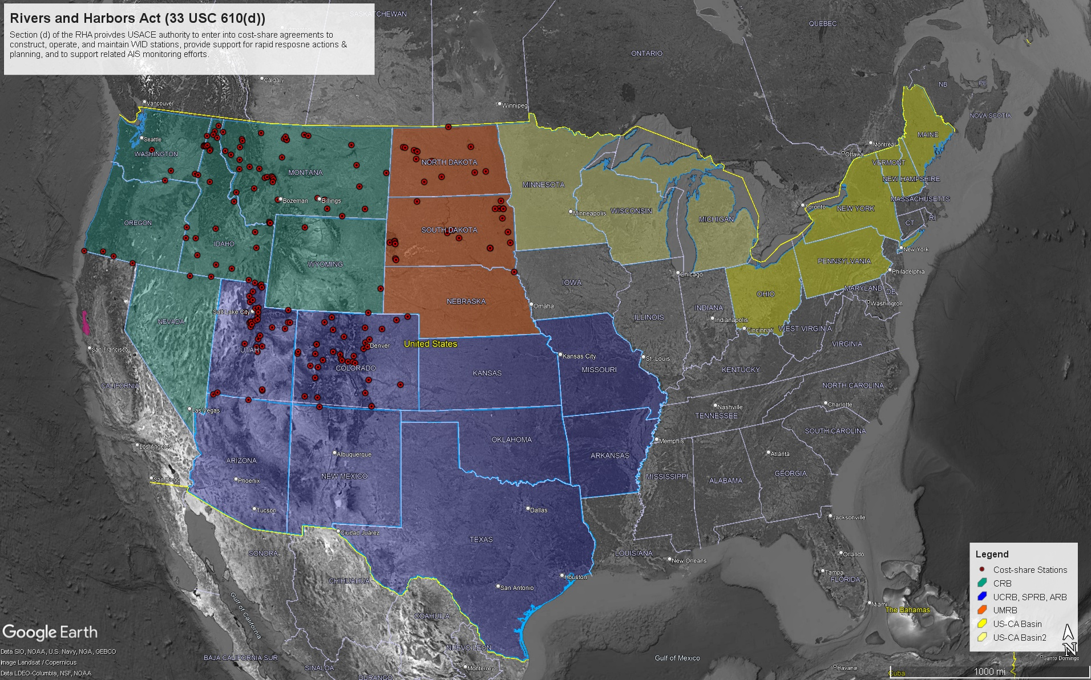
Water Resources Development Act 2024
APC- WID Cost Share
Current 50% non federal / 50% federal for WID, Monitoring, RR
States are match-limited
Let’s change the cost share To 75% - 25%! Or 65% - 35%

Slide 9
WRDA 2024
12/3 Conference Committee Releases Bill
SEC. 1235. REPORT ON EFFORTS TO MONITOR, CONTROL, AND ERADICATE INVASIVE SPECIES.
….a report on the results of, an assessment of the efforts by the Secretary to monitor, control, and eradicate invasive species at water resources development projects across the United States. (1 year time frame)
SEC. 1361. EXPENSES FOR CONTROL OF AQUATIC PLANT GROWTHS AND INVASIVE SPECIES
Section 104(d)(2)(A) of the River and Harbor Act of 1958 (33 U.S.C. 610(d)(2)(A)) is amended by striking ‘‘50 percent’’ and inserting ‘‘35 percent’’ [Senate bill]
Covers Watercraft Inspection and Rapid Response
Section 104 (e) monitoring and contingency planning….will remain at 50/50??
Notes:
Asked House: add to (d) (D) Monitoring and contingency planning – The Secretary may assist States within the areas described in subparagraph (A) with monitoring and contingency planning for aquatic invasive species.

Slide 10
WRDA 2024
SEC. 1139. ABILITY TO PAY [this was in the house bill]
(c) Priority Projects. --The Secretary shall make a determination under section 103(m) of
the Water Resources Development Act of 1986, as amended by this section, of the ability to pay of the non-Federal interest for the following projects:
(2) Any authorized watercraft inspection and decontamination station established,
operated, or maintained pursuant to section 104(d) of the River and Harbor Act of
1958 (33 U.S.C. 610(d)).
NOW WHAT – House and Senate passage all but certain…. and then to President.
Notes:
WRDA usually passes

Slide 11
H.R.7659 - Coast Guard Authorization Act of 2024 (Graves (R-MO), Larsen (D-WA); Webster (R-FL), Rescom (R- PR), Carbajal (D- CA) (3/20/24)
“SEC. 904. Information on type-approval certificates.
“The Commandant of the Coast Guard shall, upon request by any State, the District of Columbia, or any territory of the United States, provide all data possessed by the Coast Guard pertaining to challenge water quality characteristics, challenge water biological organism concentrations, post-treatment water quality characteristics, and post-treatment biological organism concentrations data for a ballast water management system with a type approval certificate approved by the Coast Guard ….
Passed House 5/14/24; Awaiting Senate Action,
= H.R.1452 - To amend the Frank LoBiondo Coast Guard Authorization Act of 2018 to direct the Commandant of the Coast Guard to provide certain data related to water quality, and for other purposes. (3/8/23), Garamendi (D-CA)

Slide 12
FY 2025 APPROPRIATIONS
FY 2025 USFWS AIS: House is at $48,605,000, Senate $50,541,000
FY 2023 and 2024 USFWS Enacted = $50,143,000
Green crab still a winner (commerce and interior)
Energy and Water: USACE Watercraft Inspection/Monitoring APC WID
FY 2022: $18M (Enacted)
FY 2023: $20M (“”)
FY 2024 = $ 9 M (“”)
FY 2025 :
House: $13 million
Senate: $0
the Committee understands the Corps has sufficient funding for fiscal year 2025 activities for watercraft inspection stations and rapid response as authorized in section 104 of the River and Harbor Act of 1958…. [True…still no Bueno]
Now What: 90 Day Continuing Resolution will be passed in the next two weeks

Slide 13
DRAFT BILLS NOT INTRODUCED
Will we see them in 119th Congress??
Aquatic Nuisance Species Program Enhancement Act of 2024 (Draft) “AIS 2.0”
Draft legislation to implement the recommendations of the Aquatic Invasive Species Commission…includes Coastal Aquatic Invasive Species Mitigation Grant Program, WID grant program, Lacey Act Amendments, Invasive catfish processing, NOAA Office of Invasive Species
Notes:
WRP family stephen Elizabeth Monica and Dennis were on this commission
Oe ron this next year if it resurfaces but it contains ???????????

Slide 14
DRAFT BILLS NOT INTRODUCED
Will we see them in 119th Congress??
National Oceanic and Atmospheric Administration Act of 2023 (draft)
Was not introduced, unlikely for introduction in 119th ???
Sec. 218. Office of Aquatic Invasive Species.
(b) PURPOSE.—The purpose of the Office of Aquatic Invasive Species shall be—
(9) in consultation with the Coast Guard, the United States Fish and Wildlife Service, the national Invasive Species Council, and the Aquatic Nuisance Species Task Force, to develop guidelines and protocols to prevent the unintentional introduction of aquatic invasive species through ballast water, boating, international and domestic trade, and other vectors; and
No AIS office authorization

Slide 15
Thank You!
Questions?
sphillips@psmfc.org
PSMFC AIS WEBSITE: WWW.WESTERNAIS.ORG
AIS Newsletter (Robyn Draheim)– bi-monthly, includes legislative items, email sphillips@psmfc.org to be added

Slide 16
Other Bills - No Movement
H.R.210 - Stamp Out Invasive Species Act (Stefanik, R-NY, 1/19/23)
S.773// H.R.1560 —Public Water Supply Invasive Species Compliance Act (Cruz (R-TX) (03/09/23) - exempts certain interstate water transfers from prohibitions on the illegal trade of wildlife, fish, or plants. RESOLVED OK/TX reach $ 10 million settlement to resolve border issue
S.771// H.R.1558 — Saving America's Vulnerable and Endangered Species Act or the (SAVES) Act. (Cruz R-TX, 03/09/23) This bill prohibits a living nonnative species from being listed as a threatened or endangered species under the Endangered Species Act of 1973. Re-introduced
S.1238: Invasive Species Prevention and Forest Restoration Act—Welch, Peter [Sen.-D-VT] (Introduced 04/20/2023)
S.1614 - Lacey Act Amendments of 2023 (Sen. Marco Rubio (R-FL, 5/16/23)
H.R.2881 —Hawaii Invasive Species Protection Act (Case D, Ed [Rep.-D-HI-1]) (Introduced 04/26/2023)
H.R.1713 - DOE and USDA Interagency Research Act Lucas (R-OK)//Lofgren (D-CA) (07/31/2023)
Notes:
https://www.oklahoman.com/story/news/state/2024/10/10/oklahoma-texas-reach-agreement-on-red-river-boundary-in-10m-deal/75570849007/
They redrew the border

Slide 17
H.R. 7408 (Rep. Westerman (R- AR)), “America’s Wildlife Habitat Conservation Act.” …RAWA “light”
Authorize lower levels than the Senate version — approximately $200 million to $500 million per year.
funding depends on annual congressional appropriations and would end after five years.
Makes controversial changes to Endangered Species Act
22 co-sponsors all Republicans
Status: Out of committee (4/16/24) …unlikely house passage .. RAWA Looks Dead in this congress
RAWA will not go away. If “D’s” take House in upcoming election… 2025 passage chances improve. Likely enough R support in the Senate to see it through….”pay for” still an issue

Slide 18
S. 1149, Recovering Americas Wildlife Act (RAWA) (3/31/23) Heinrich (D-N.M.) and Tillis (R-N.C.).
Funds conservation efforts for more than 12,000 species of wildlife and plants in need of assistance by providing $1.4 billion in dedicated annual funding
Includes: (d) Wildlife Management Responsibilities.—(E) To manage, control, and prevent invasive species as well as diseases and other risks to wildlife.
19 bipartisan co-sponsors
Status: Committee on Environment and Public Works.
Notes:
This has been on our radar for the past two congresses

Slide 19
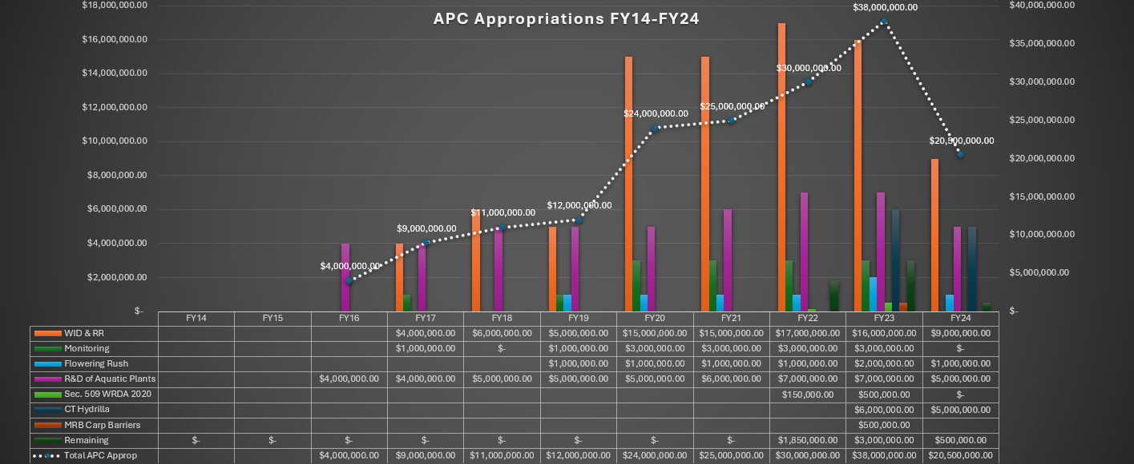
Notes:
Zero out says corps

