Slide 1
Impact and Control of Invasive Mussels at Hydropower Plants
Sherri Pucherelli
Biologist, TSC, Denver, CO

Slide 2
Mussel Impacts at Reclamation

Slide 3
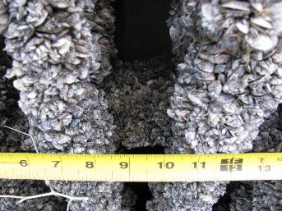
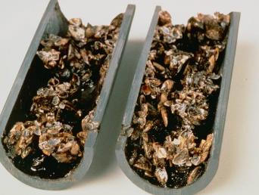
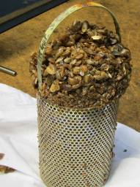
Impacts at Hydropower Plants
Increased maintenance and unplanned outages
Mussel attachment
Low velocity, 4.5 feet per second or less
Intakes, gates, instrumentation, small diameter pipes
Shell debris
Strainers and screens

Slide 4
Challenges
Quantifying the impacts at our hydropower plants
Not easy to track all maintenance and costs
Preparing for potential infestations is difficult
Many variables that are facility specific

Slide 5
Case Study Project
Compiled case studies describing plant experiences with mussels
Purpose:
Understand impacts at Reclamation plants
Information for managers preparing or considering changes to existing approaches
Commitment to the DOI Safeguarding the West Initiative
Funded by Reclamation’s S&T Program
In collaboration with RNT Consulting

Slide 6
Case Studies
Interviewed 13 hydropower plants with mussel infestations
4 Reclamation (Hoover, Davis, Parker, Glen Canyon)
3 Other agencies in USA (USACE, TVA, NY Power Authority)
6 Canadian (Hydo Québec, Ontario Power Generation, Manitoba Hydro)

Slide 7
Questions Asked
Design and operation
Mussel infestation timeline, response planning, and monitoring
Mussel impacts
Systems/ components impacted
Design aspects that prevented or reduced mussel impacts
Unplanned or forced outages
Control methods utilized or examined
Expenses associated with mussels

Slide 8
Plant Differences
Design
Use of raw water in the plant
Different sizes
2- 36 generator units (generating capacity 144-1899 MW)
Mussel infestation timelines
1-31 years

Slide 9
Hoover Dam
Thrust bearing cooler plugging has resulted in unplanned outages
1-3 outages per year
3-5 days per outage
8-12 people working on the outage
$20,000 per day of lost production and unrealized revenue
Estimated cost for 1 outage= $44,000- $80,000

Slide 10
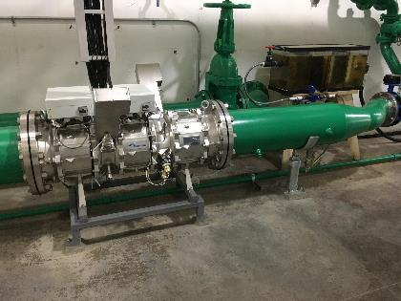
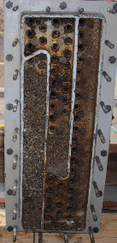
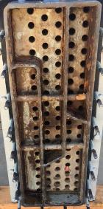
Hoover and Parker Dams
Hoover Dam
Preventative control measures
Conversion to tailbay water= $500,000
Planned HOD UV installation= $2.1 million
Parker Dam
Prior to UV, 8 weeks of labor per year to clean mussels and biofilm out of heat exchangers

Slide 11
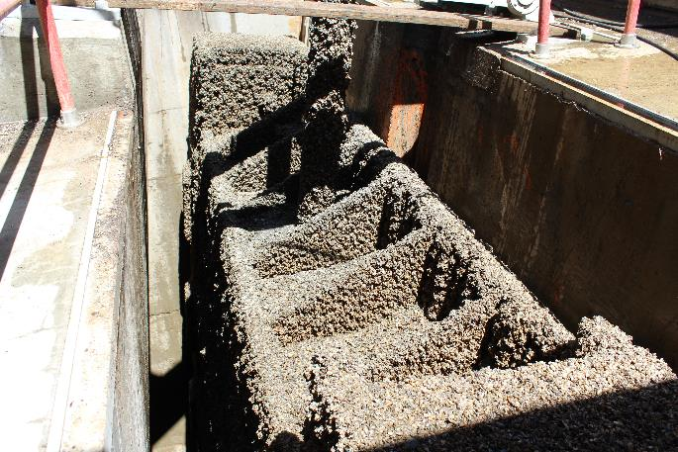
Glen Canyon Dam
Mussel settlement of the fixed wheel gates
2 extra days to remove mussels
Maintenance changes
Yearly to quarterly
Quarterly to monthly
HOD UV installation planned

Slide 12
Ontario Power Generation (4 plants)
First detected 1990
10-day chlorine treatment once per year
Has controlled fouling in cooling system
Capital investment $250,000- $1.3 million
Yearly costs= $7,000- $24,000

Slide 13
Wilson Hydropower Plant
Operated by TVA in Alabama
21 generator units
Mussels detected early 1990’s
Chemical treatments not permitted
Mussel fouling most significant on units 1-8
Service water source
1-8 : Intake 14-ft below surface
9-12: Bottom of penstock scroll case, 45-feet below surface

Slide 14
Wilson Hydropower Plant
Cleaning the headers of units 1-8= $500,000 per cleaning
Extensive outages required
Cutting into pipes and hydro-blasting
Had 12 forced outages per year, now 3
Optimized backwash flushing and temp/ flow monitoring
Increased planned maintenance outages (10 per month)
Swap out generator air coolers when overheating occurs
Purchased 4 replacement coolers= $72,000
Requires outages, additional staff, and overtime= $4,000-$5,000 per swap

Slide 15
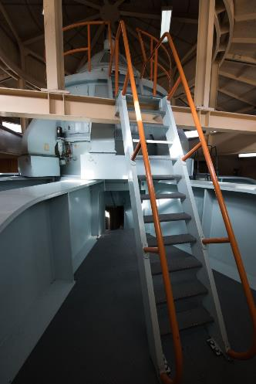
Results
Impact
Significant: 2 plants
Moderate: 8 plants
Little to none: 3 plants
Severity of impact
Design and how raw water is used
Not size or number of generators
Mussel population cycles
5 of 13 plants had experienced unplanned outages
Mussel fouling expenses are not commonly recorded

Slide 16
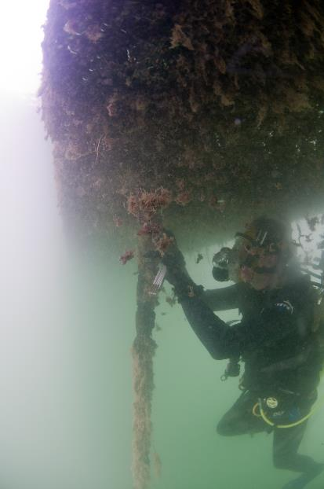
Control Approaches
Preventative treatments: 8 plants
Chlorine $100,000- $1.3 million
HOD UV $1 million- $2.1 million
Increased cleaning and operational changes: 5 plants

Slide 17
Monitoring and Response Plans
7 of the 13 plants had a mussel facility vulnerability assessment or response plan
Allowed control methods to be implemented before fouling became unmanageable
Most sites were not doing early detection monitoring
Monitoring began after adults detected in the waterbody

Slide 18
Hydropower Plant | Location | Waterbody | Waterbody Detection | Plant Detection or Issues | Years to Implement Controls
Hoover | USA, AZ/ NV | Colorado River, Lake Mead | 2007 | 2010 | 3
Davis and Parker | USA, AZ/ NV / CA | Colorado River, Lakes Mohave and Havasu | 2007 | 2008 | 1
Glen Canyon | USA, AZ/ UT | Colorado River, Lake Powell | 2012 | 2013 | 1
Beauharnois | Canada, Québec | St. Lawrence River, Lake St. Frances | 1990 | 1995 | 5
Jenpeg | Canada, Manitoba | Nelson River | 2013 | 2020 | 7
Lewiston | USA, NY | Niagara River | 1986 | 1990 | 4
Sir Adam Beck #1, Sir Adam Beck #2, DeCew NF23, Pump Generating Station | Canada, Ontario | Niagara River, Lake Gibson | 1988 | 1990-1998 | 2-10
Wilson | USA, Alabama | Tennessee River | Unknown | 1990 | ?
Gavins Point | USA, South Dakota | Missouri River, Lewis and Clark Lake | 2014 | 2016 | 2

Slide 19
Recommendations
Risk assessment
Implement monitoring plan
Facility vulnerability assessment
Response plan

Slide 20
Sherri Pucherelli
spucherelli@usbr.gov
303-445-2015

