Slide 1
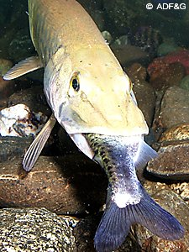
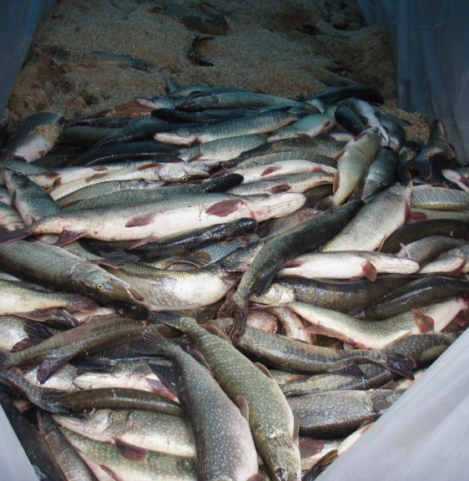

Kalispel Tribe AIS Efforts
Non-Native Aquatic Invasive Species
Joe Maroney
Director of Fisheries & Water Resources
Kalispel Natural Resource Department
December 11, 2024

Slide 2
Impacts to Tribes
Invasive species are not limited by jurisdictional boundaries
  Federally recognized American Indian Tribes are second only to the federal government in terms of amount of land managed (56.2 million acres)
Invasive species intersect with federal, tribal, state & county governments as well as private ownership
Effective coordination and cooperation across jurisdictions is of importance in the prevention, eradication and control of invasive species.
Greatest concerns are to cultural, subsistence and economic resources.

Slide 3
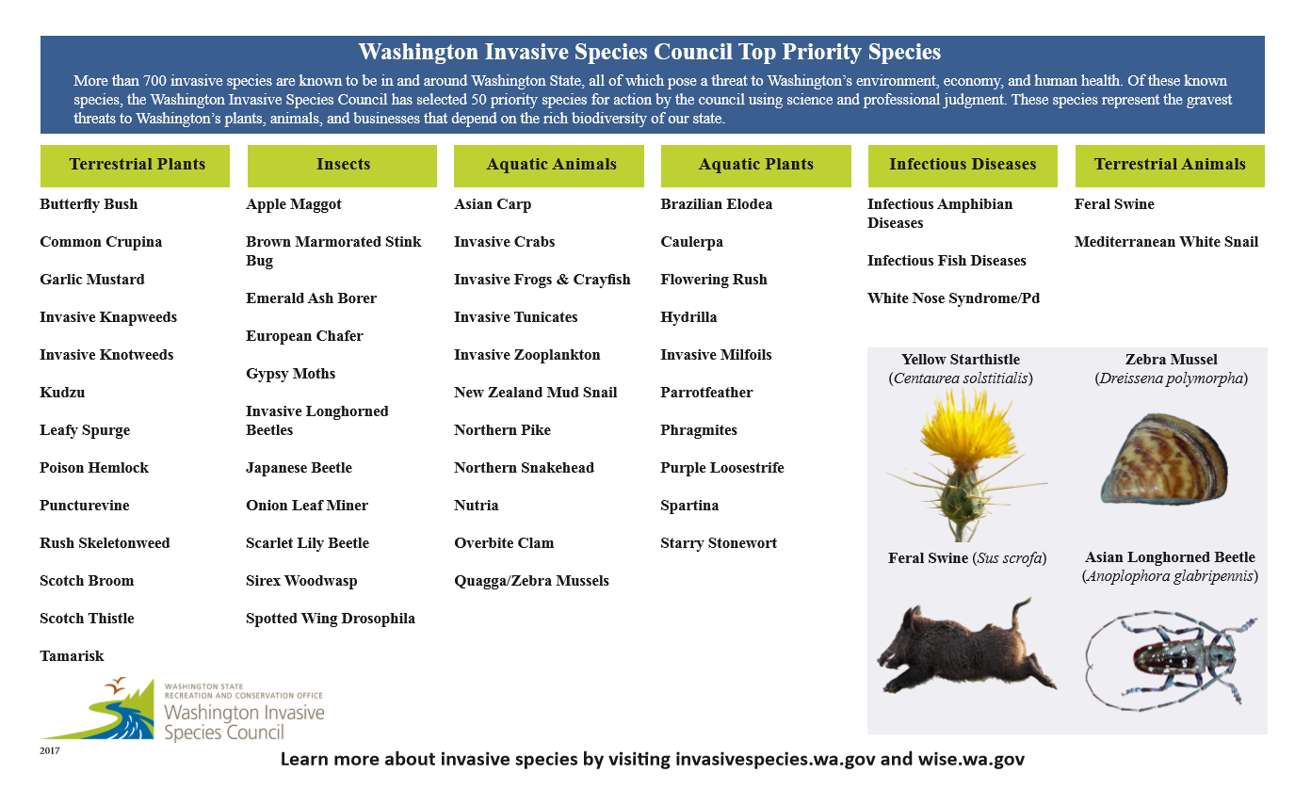
Washington Invasive Species Council Top Priority Species

Slide 4
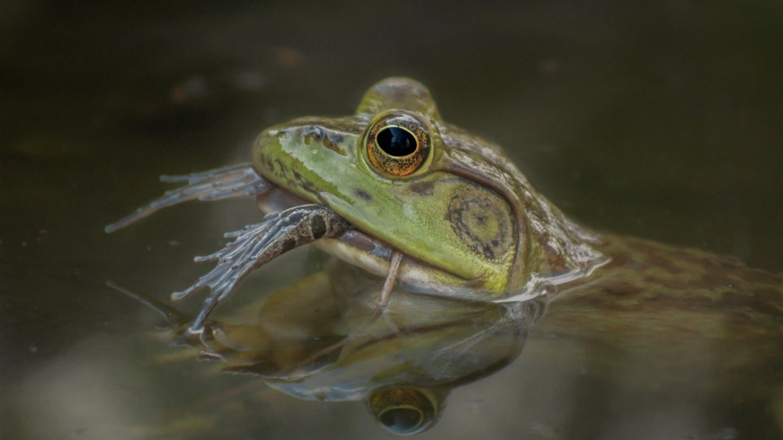
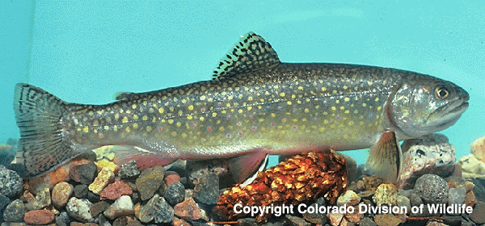
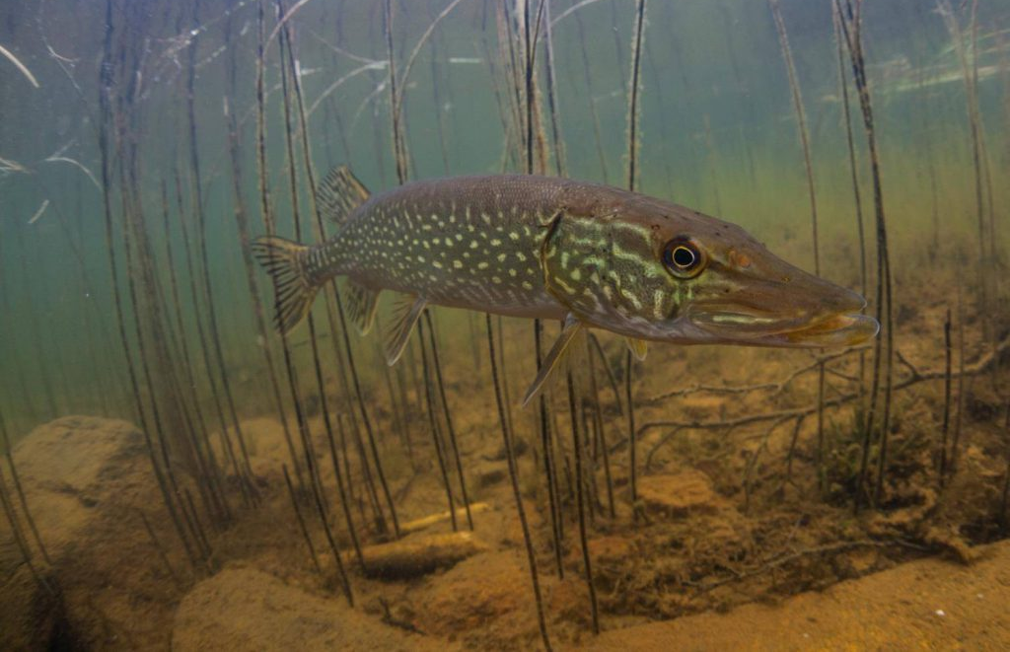
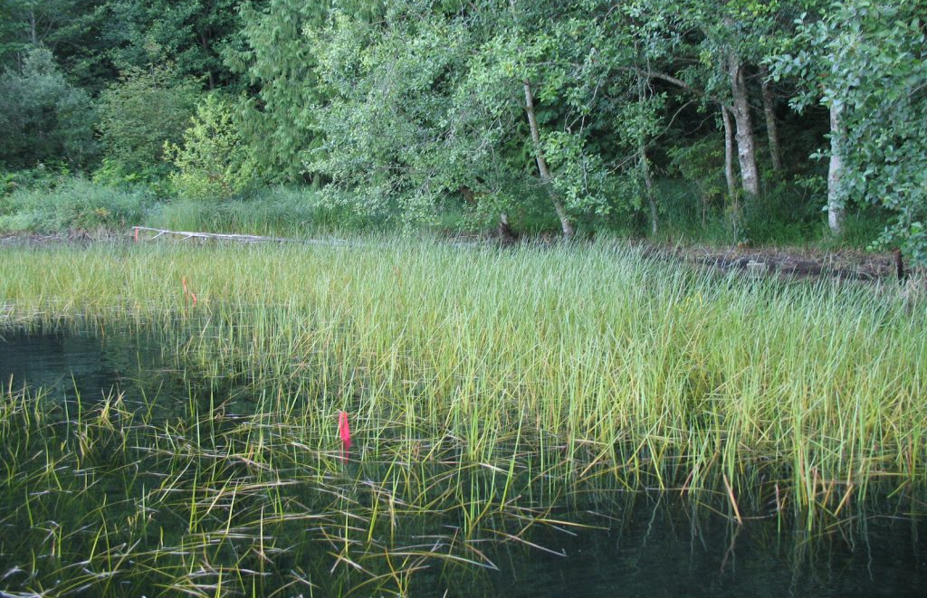
AIS Managed by Kalispel Tribe
Bullfrog
Brook Trout
Photo: Gregory Fischer
Northern Pike
Flowering Rush
Photo: Alaska Fish & Game
Photo: Washington State Noxious Weed Control Board

Slide 5
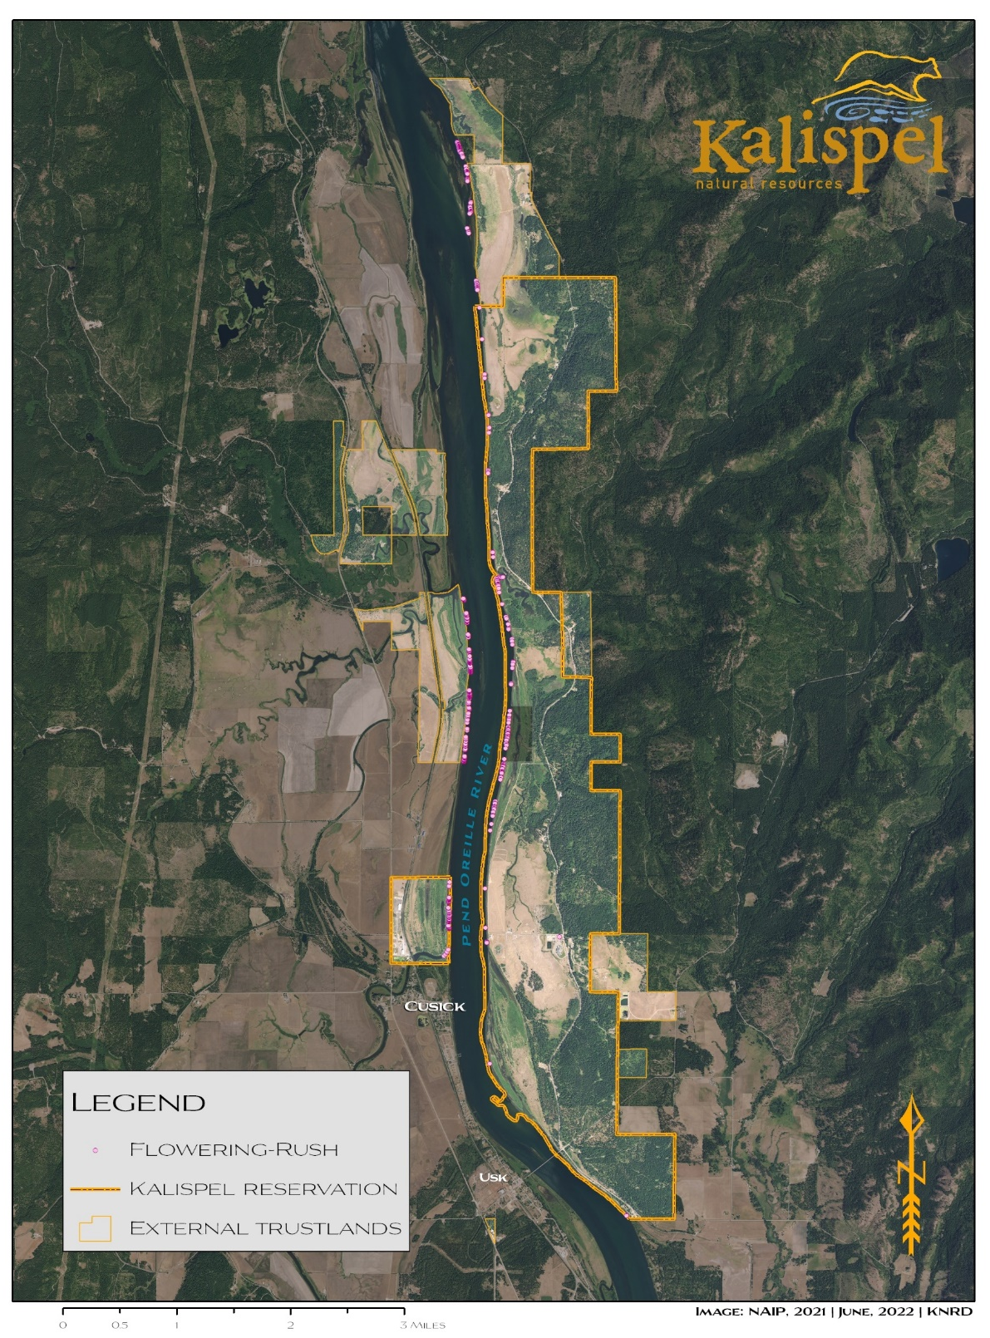
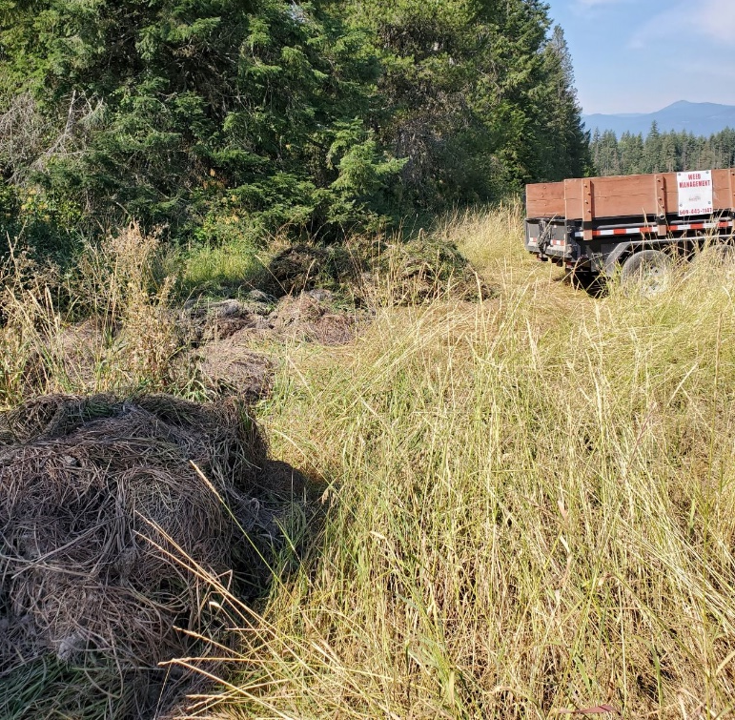
Flowering Rush
Removing Flowering Rush since 2014
Suction harvesting
Removed approximately 9,350 lbs in 2024
Entirely along Kalispel Reservation
Disposal

Slide 6
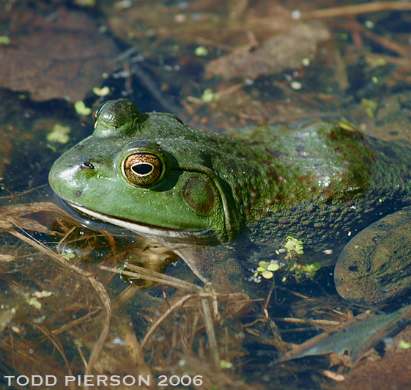
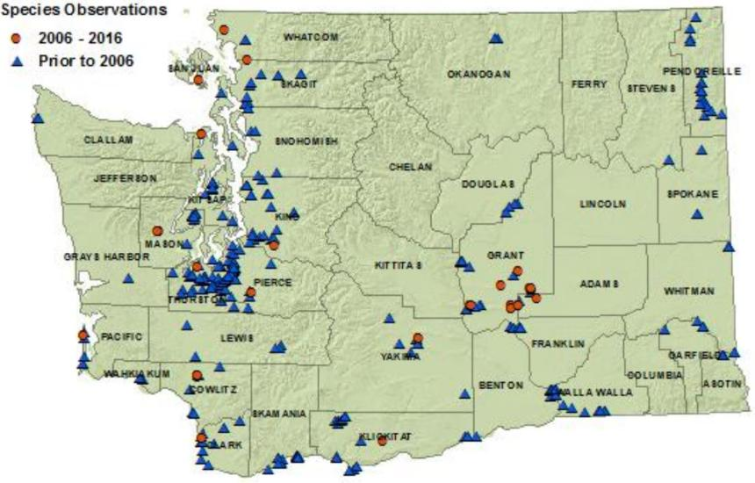
Bullfrog
Prohibited aquatic animal species
Priority invasive species in KNRD Resource Conservation Plan
Notes:
In Washington they are a prohibited aquatic animal species. They are also a priority invasive species in the KNRD Resource Conservation Plan

Slide 7
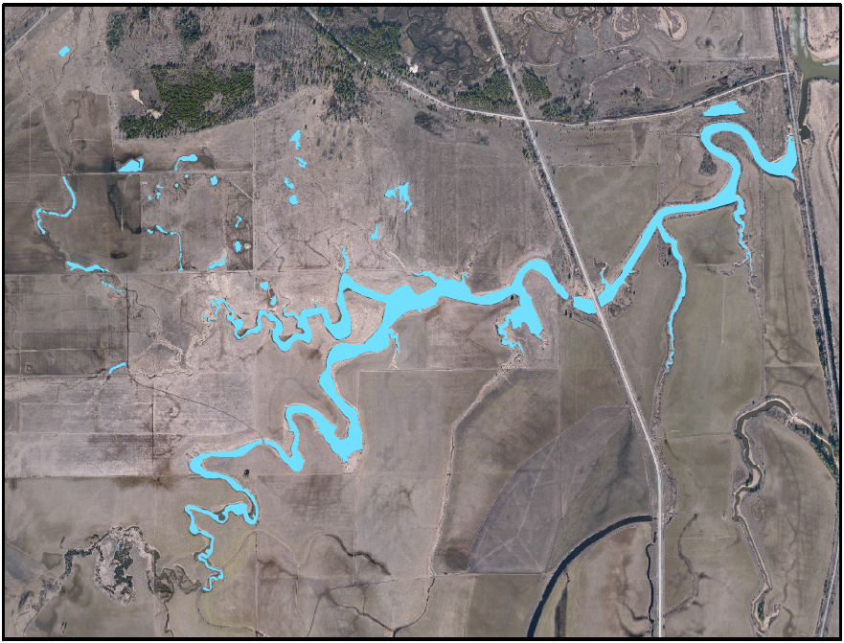
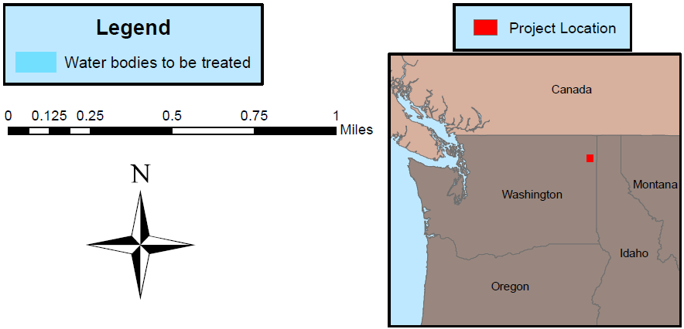
Bullfrog Removal
Funded in 2021 by BIA Invasive Species Grant
Objectives:
Reduce bullfrog populations at Trimble Creek
Contribute to regional bullfrog control efforts
Results
2022: 1,493 removals (adults only)
2023: 7,036 removals
  2,693 adults
  1,885 metamorphs
  2,458 tadpoles
  2 egg masses
Notes:
In Washington they are a prohibited aquatic animal species. They are also a priority invasive species in the KNRD Resource Conservation Plan

Slide 8
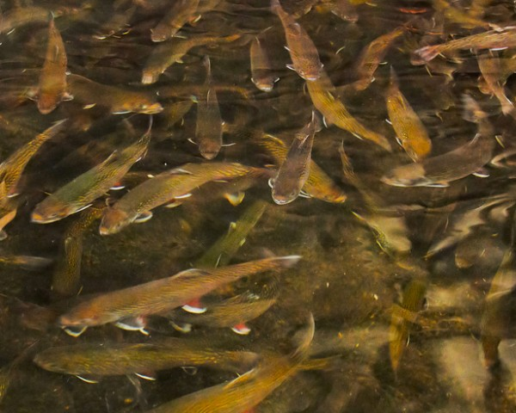
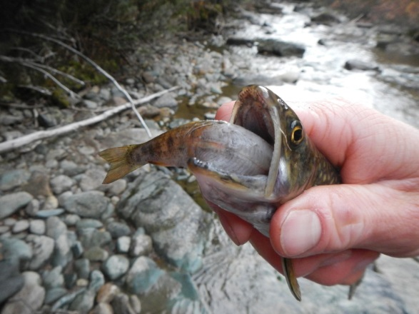
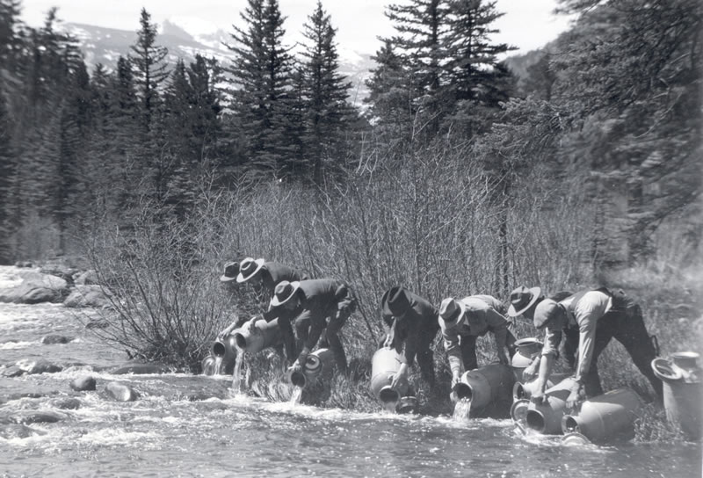
Brook Trout
Non-native fish are a major limiting factor to native salmonids throughout the Pend Oreille River Basin
  Competition for resources and habitat, predation risks, & hybridization
  Extensive stocking history throughout the Basin
  Pure Westslope Cutthroat Trout populations in the Basin now limited to
  headwater areas, primarily above barriers
Photo: Seattle City Light
Photo: http://www.nps.gov/romo/images/lg_stockfishglaciercreek1932_1.jpg
Notes:
Pure meaning non-hybridized and single species (allopatric WCT)
From a management perspective a non-native species is one introduced outside of its native range and impacting native species

Slide 9
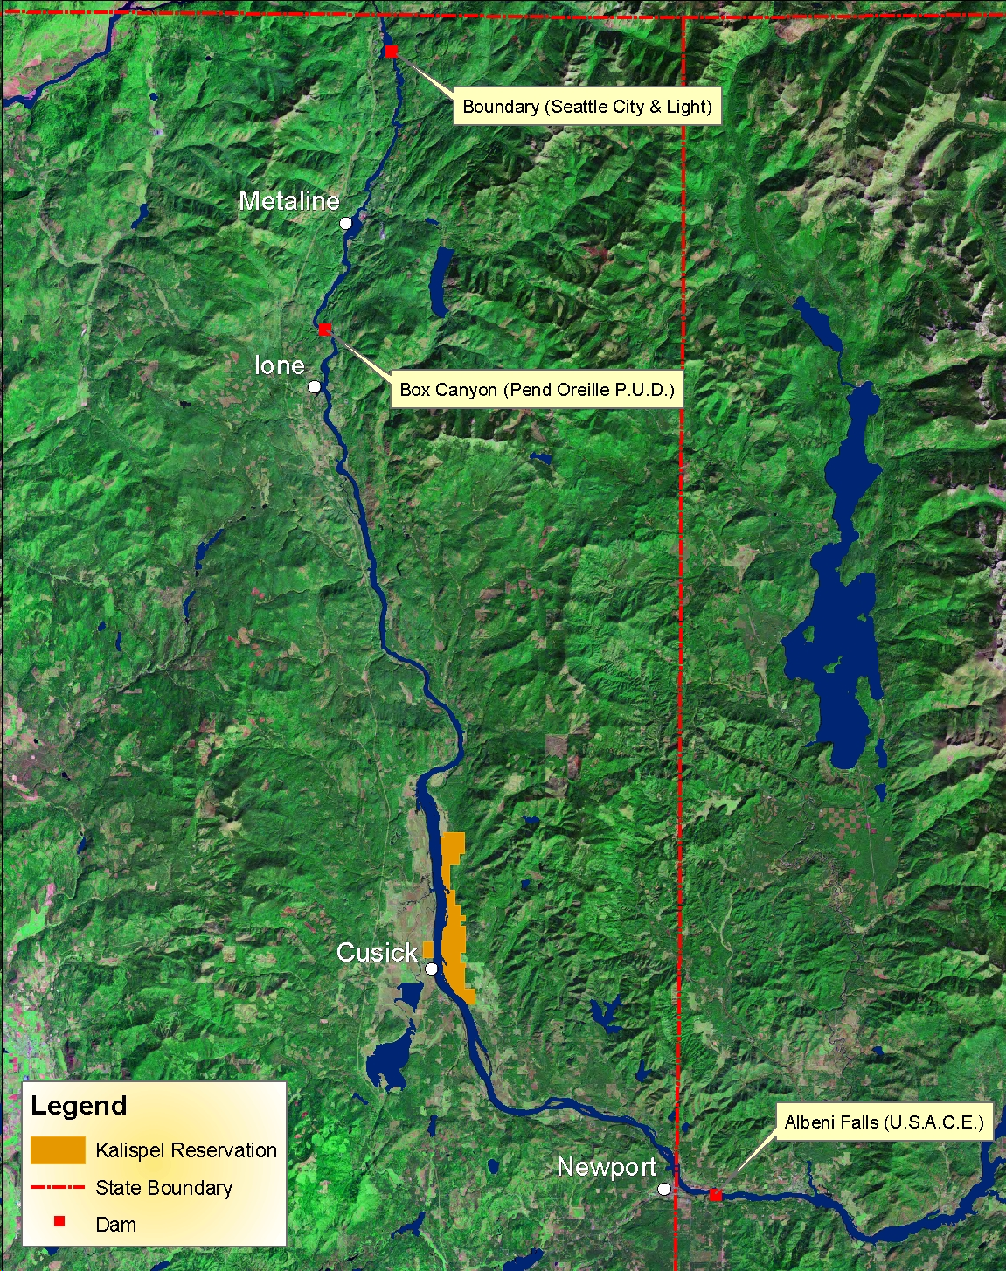
Brook Trout Removal Projects
Flume Creek Rotenone
Highline Creek Rotenone
Sullivan Creek Suppression
Mill Creek Suppression
Cee Cee Ah Creek Rotenone
Smalle Creek Rotenone

Slide 10
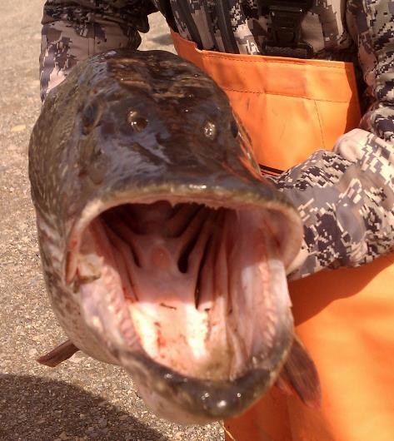
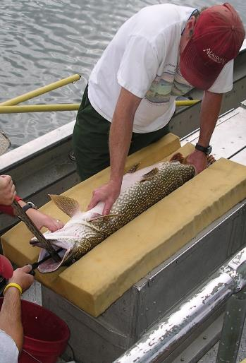
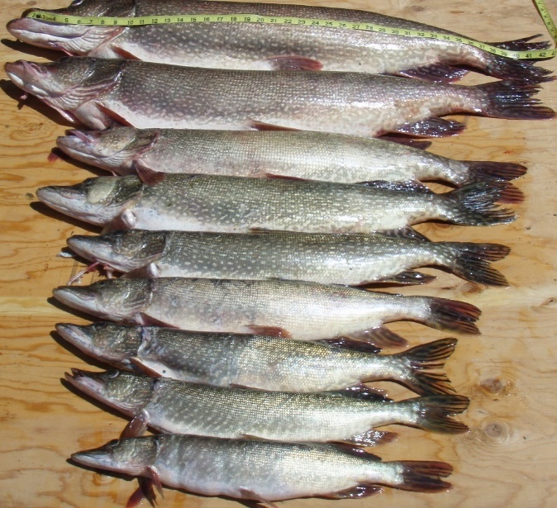
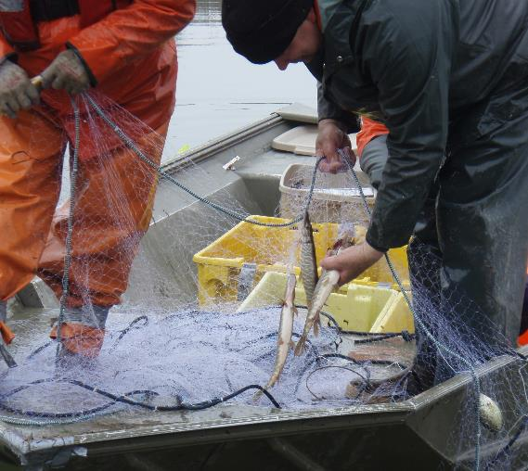
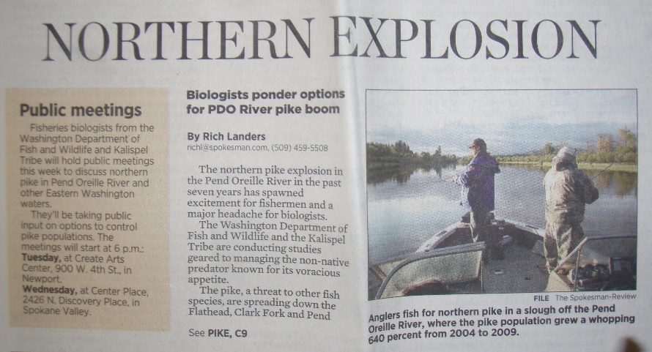
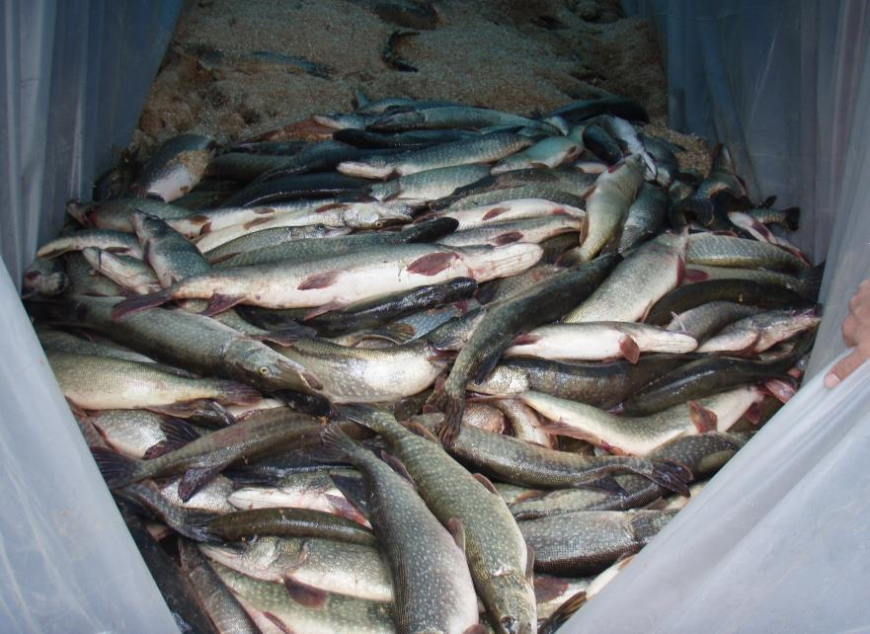
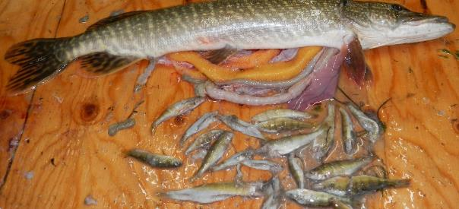
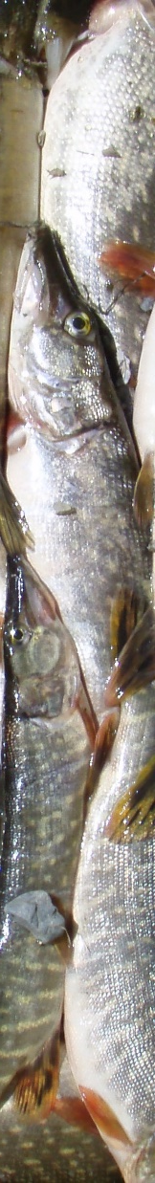
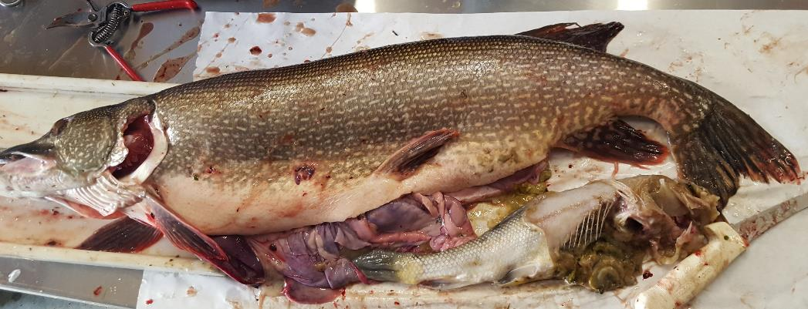
Northern Pike

Slide 11
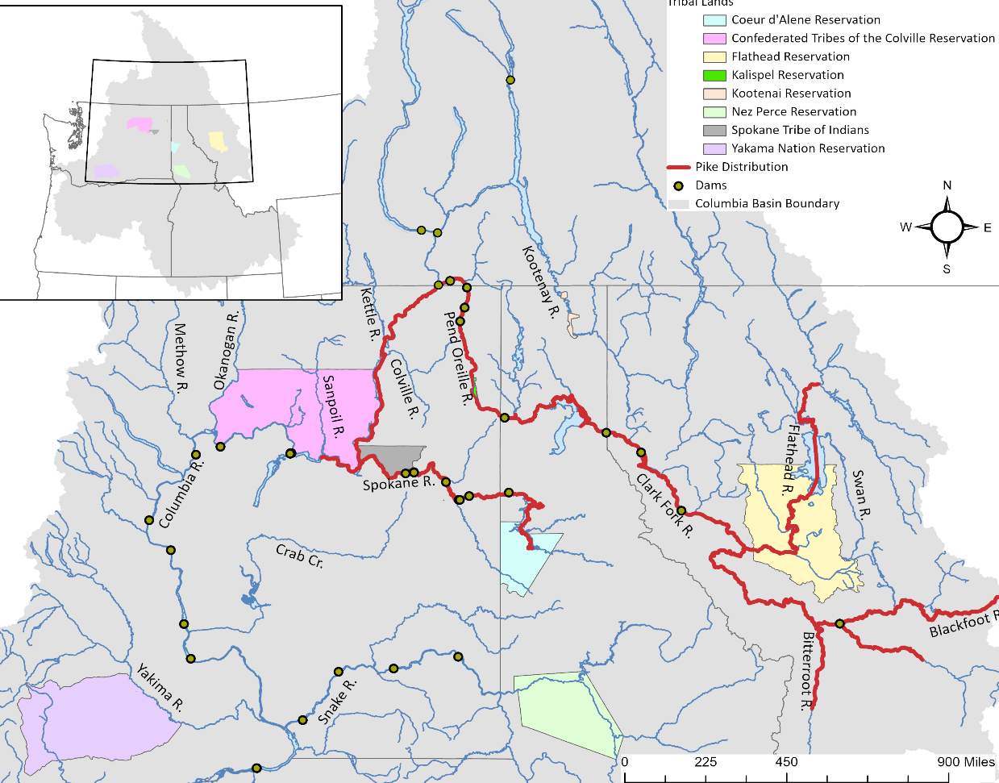

Project Location: Pend Oreille River, WA
Box Canyon Reservoir
Map Credit: Coville Confederated Tribes

Slide 12
Northern Pike Suppression
Box Canyon Reservoir 2010-24
Pike removed: 19,905 (effort: 7,541 nets)
81% removed in first 3 years
>99% reduction in CPUE (2011 to 2024)

Slide 13
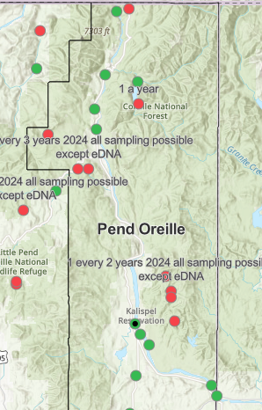
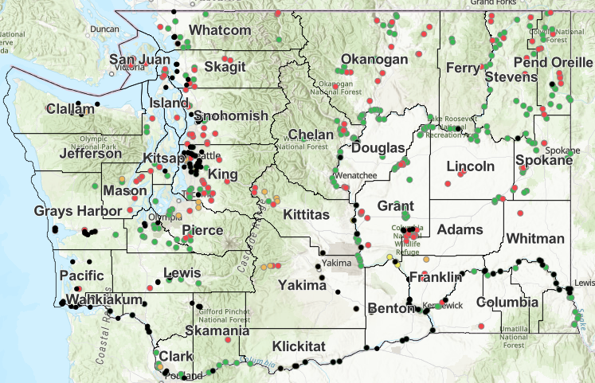
Quagga and Zebra Mussel Capacity Building with WDFW

Slide 14
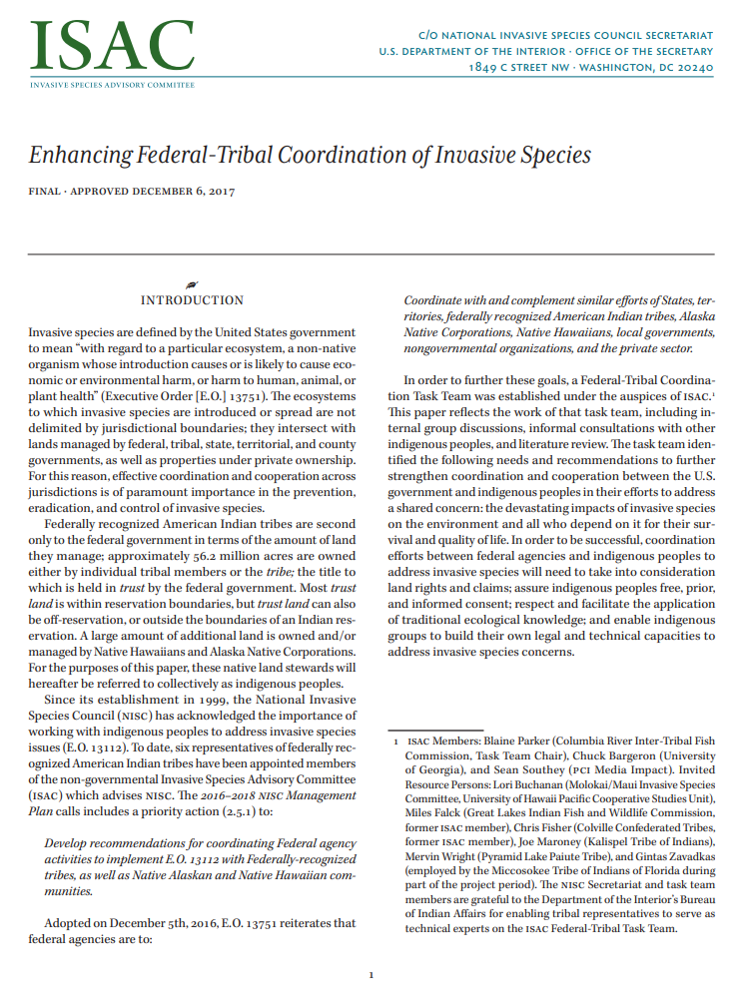
Kalispel Tribal Efforts with ISAC
Approved December 6, 2017
Developed 6 recommendations
Engaging in effective consultation
Strengthening Invasive Species Management Planning
Raising awareness, building capacity and fostering traditional ecological knowledge
https://www.doi.gov/sites/doi.gov/files/uploads/isac_federal-tribal_white_paper.pdf

Slide 15
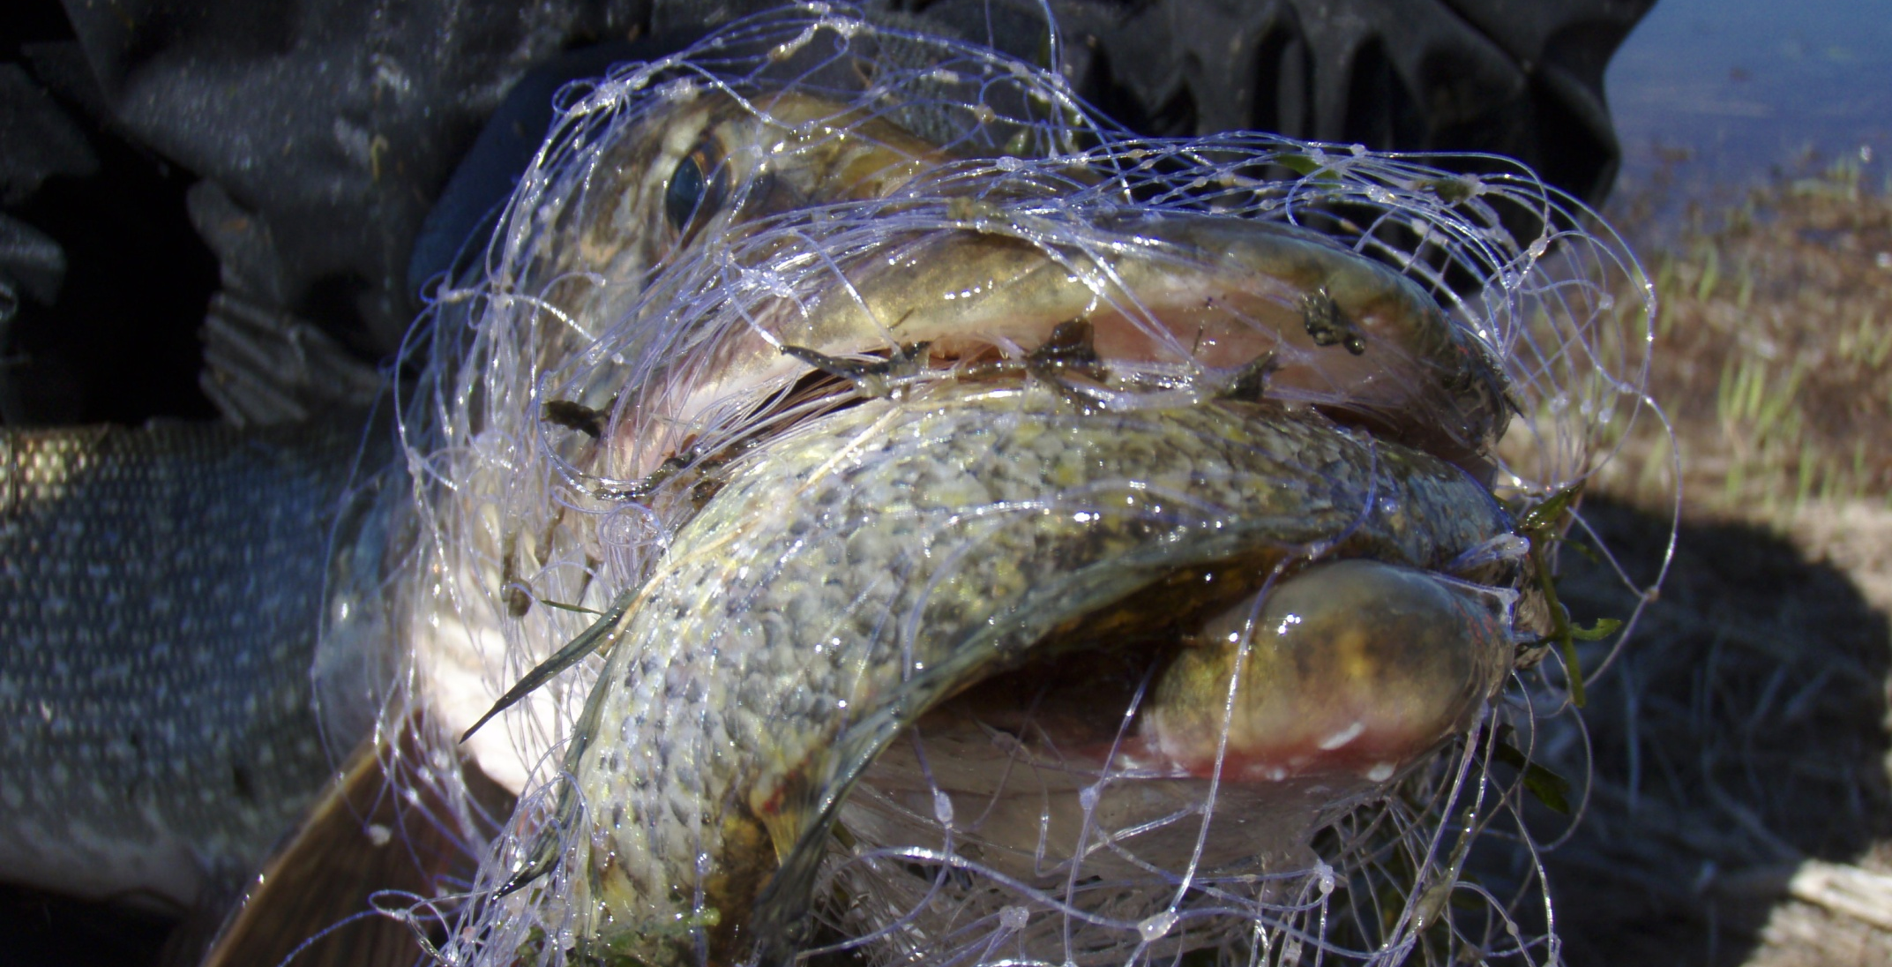
Thank You! Questions?

