Slide 1
2021/2022 ZQM Lake Monitoring update
Martina Beck, ENV
Columbia River Basin Virtual Meeting
January 11th 2022

Slide 2
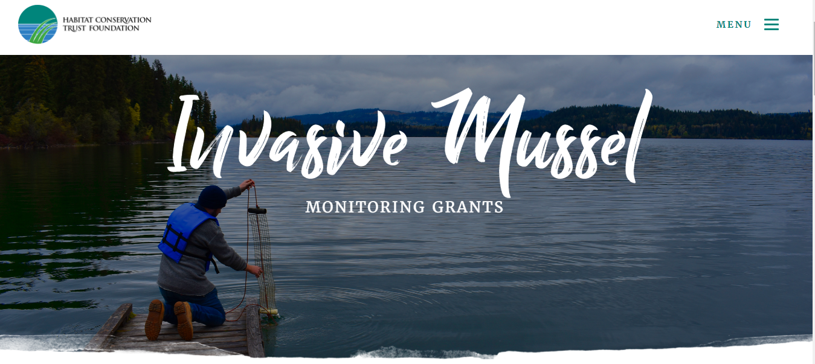
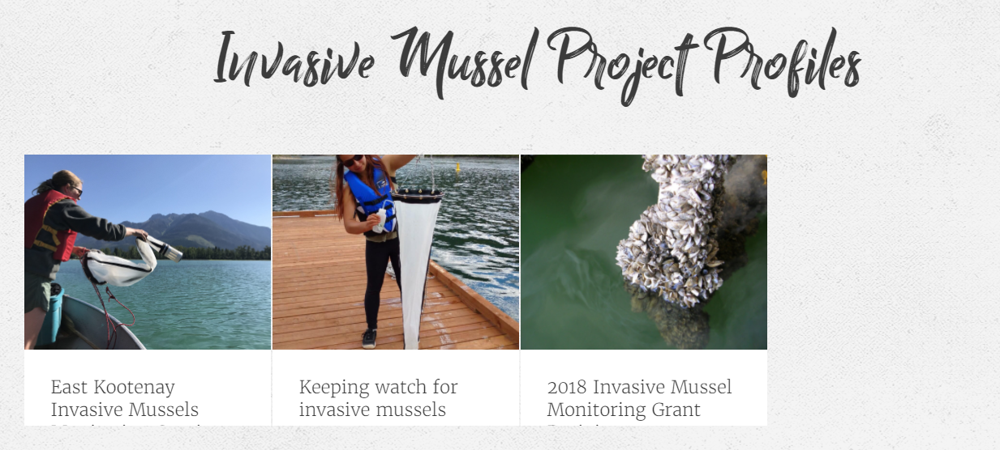
Partner Grant Program
Grants are administered to community organizations across the province to conduct sampling
Program administered by third-party organization (Habitat Conservation Trust Foundation)
Technical review of all grant applications by Ministry staff to ensure sampling efforts occur in priority waterbodies

Slide 3
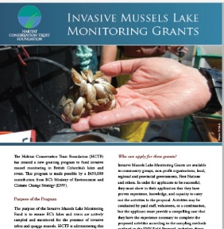
Partner Grant Program
Grants supported by Provincial and Federal funding (starting in 2019)
Supports plankton tow and substrate sampling following Provincial protocol
All samples sent to designated lab by the Ministry

Slide 4
2021 Sampling Season

Slide 5
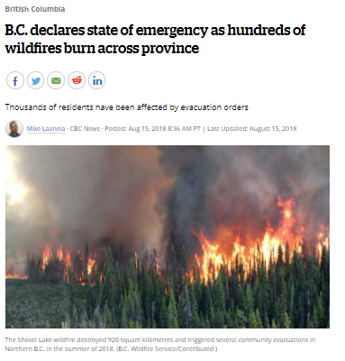
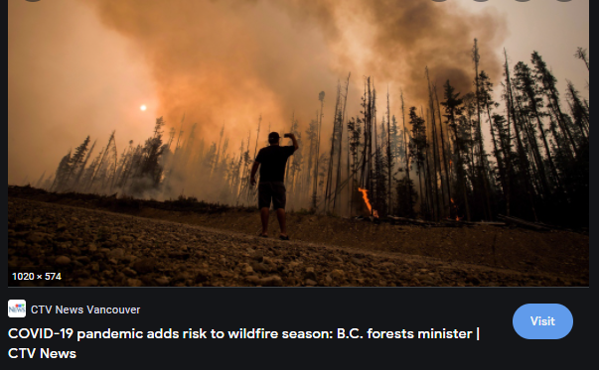
Challenges in 2021

Slide 6
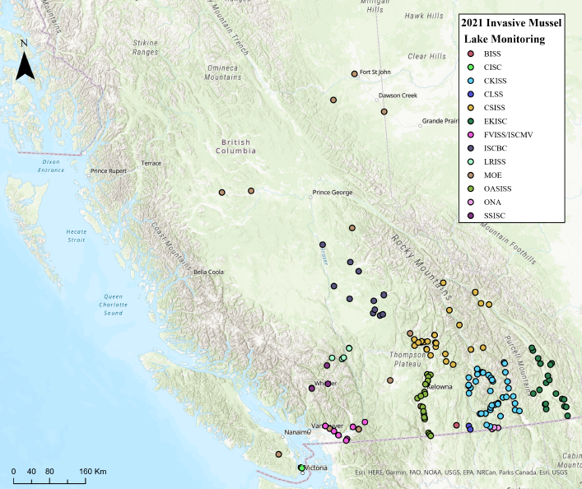
2021 Sampling Efforts
900 plankton tow samples collected across 75 waterbodies
All samples negative for ZQM
Samples analyzed using microscopy by designated lab
Substrate samplers in medium-low priority waterbodies

Slide 7
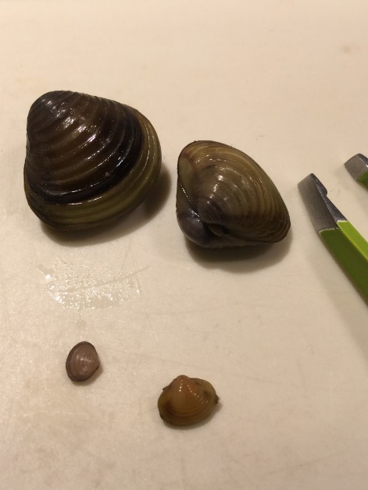
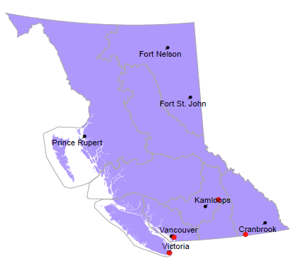
Other AIS
Sample analysis also checks for other AIS such as Corbicula fluminea
Positive samples for Corbicula in three previously confirmed waterbodies

Slide 8
2022 Sampling Season

Slide 9
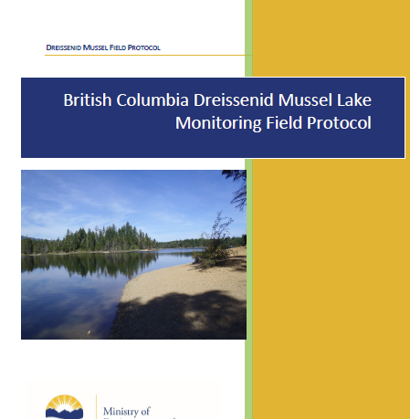
Provincial Sampling Protocol
Update of priority waterbody list for plankton tow sampling using:
risk of survival (Ca and temperature)
risk of introduction (watercraft inspection data; access and recreational use)

Slide 10
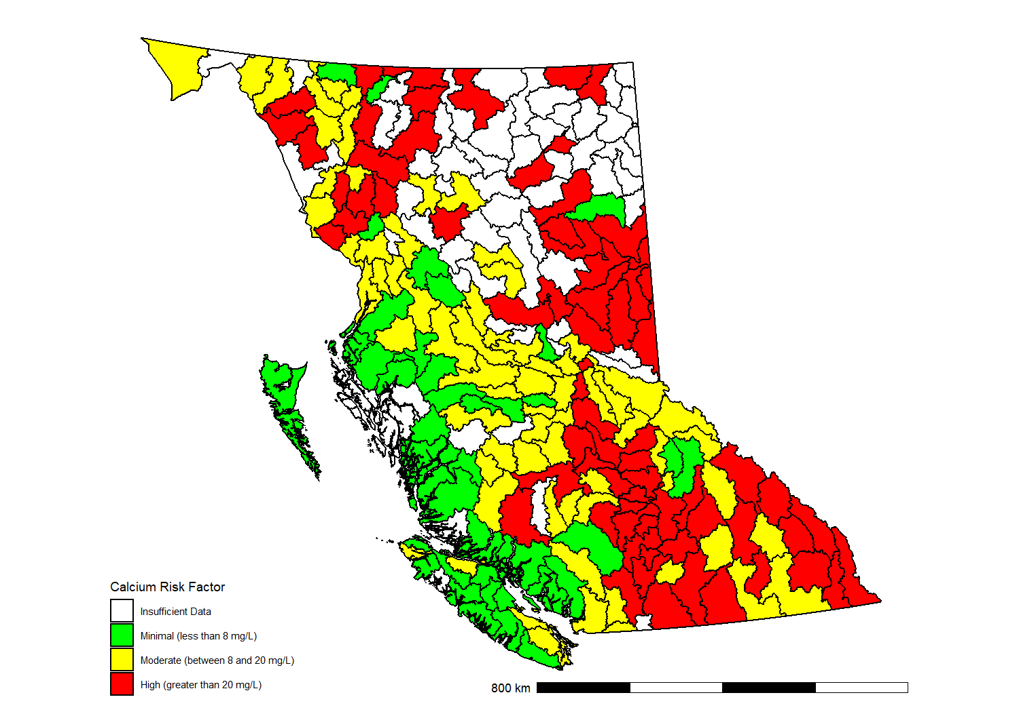
Risk of Survival: sub-watershed

Slide 11
Applications are now open for the 2022 program grant
Deadline for applications is February 4th, 2022
Anticipating similar sampling levels as 2021

Slide 12
Questions?
Martina.Beck@gov.bc.ca

