Slide 1
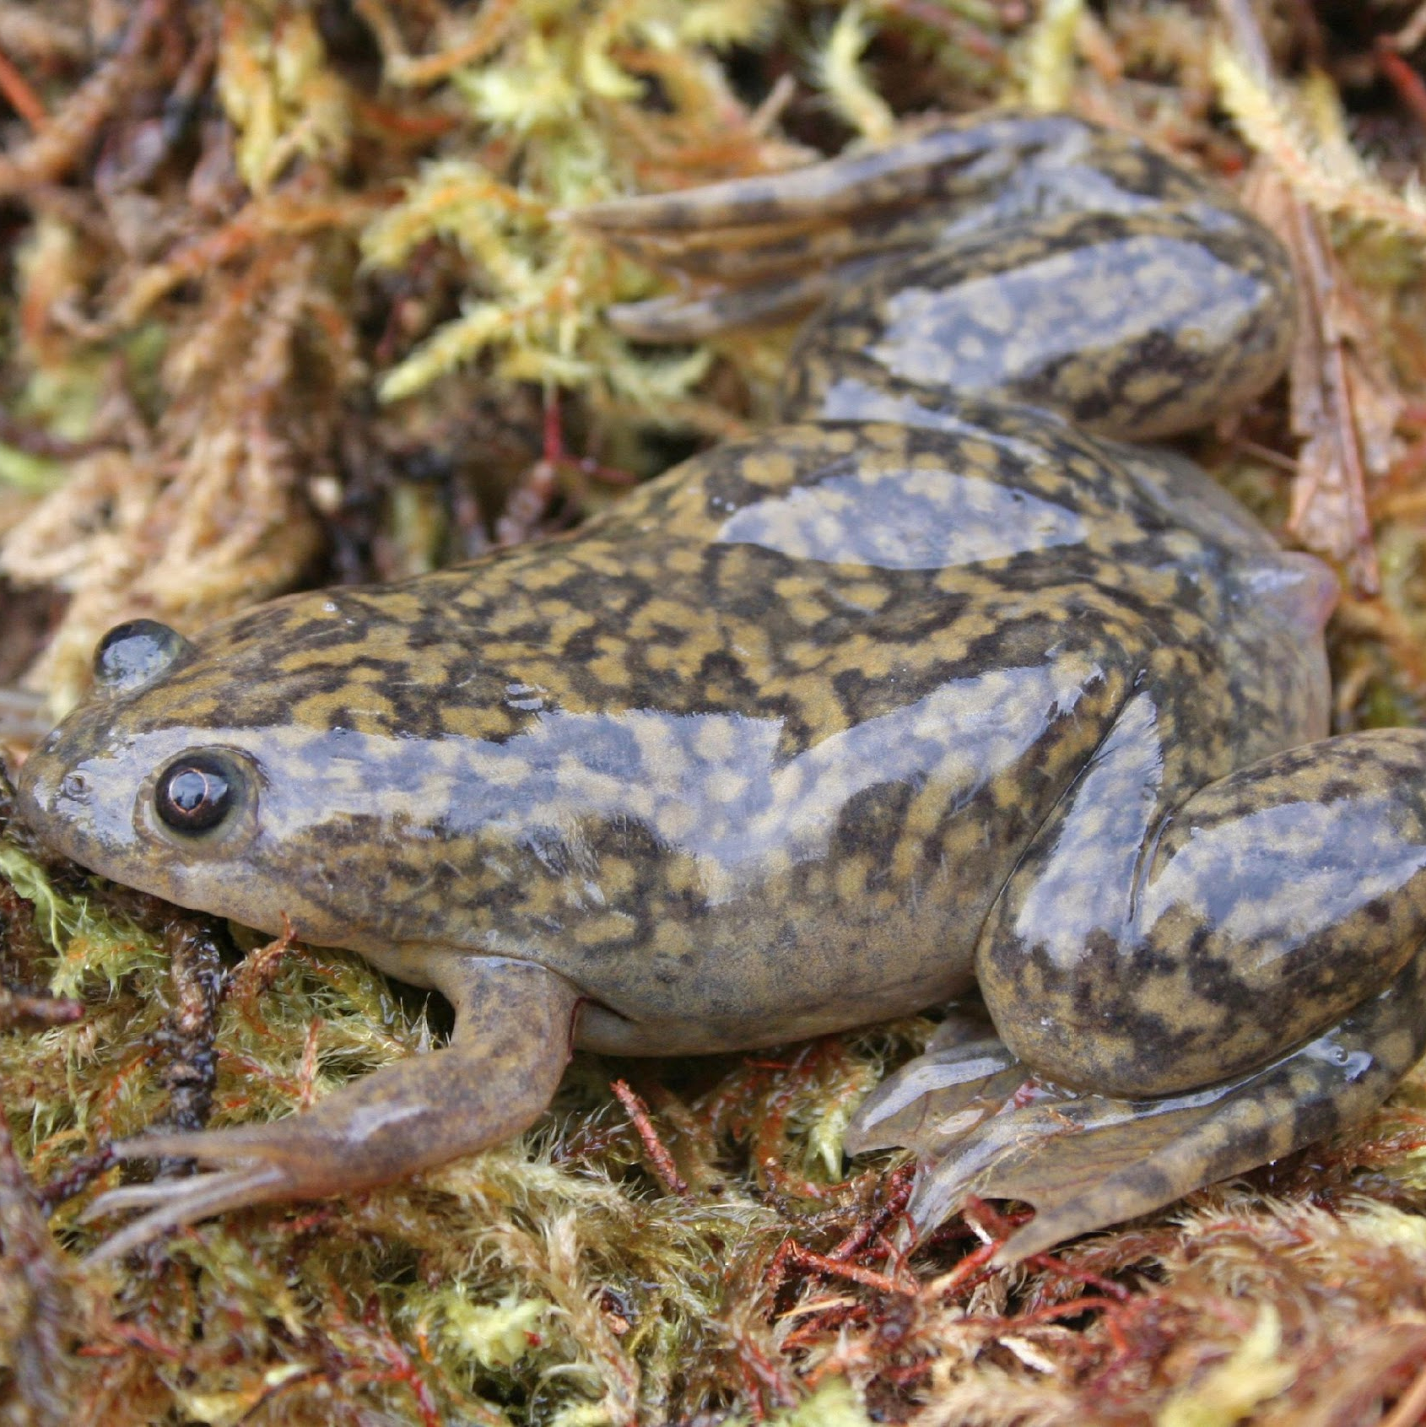
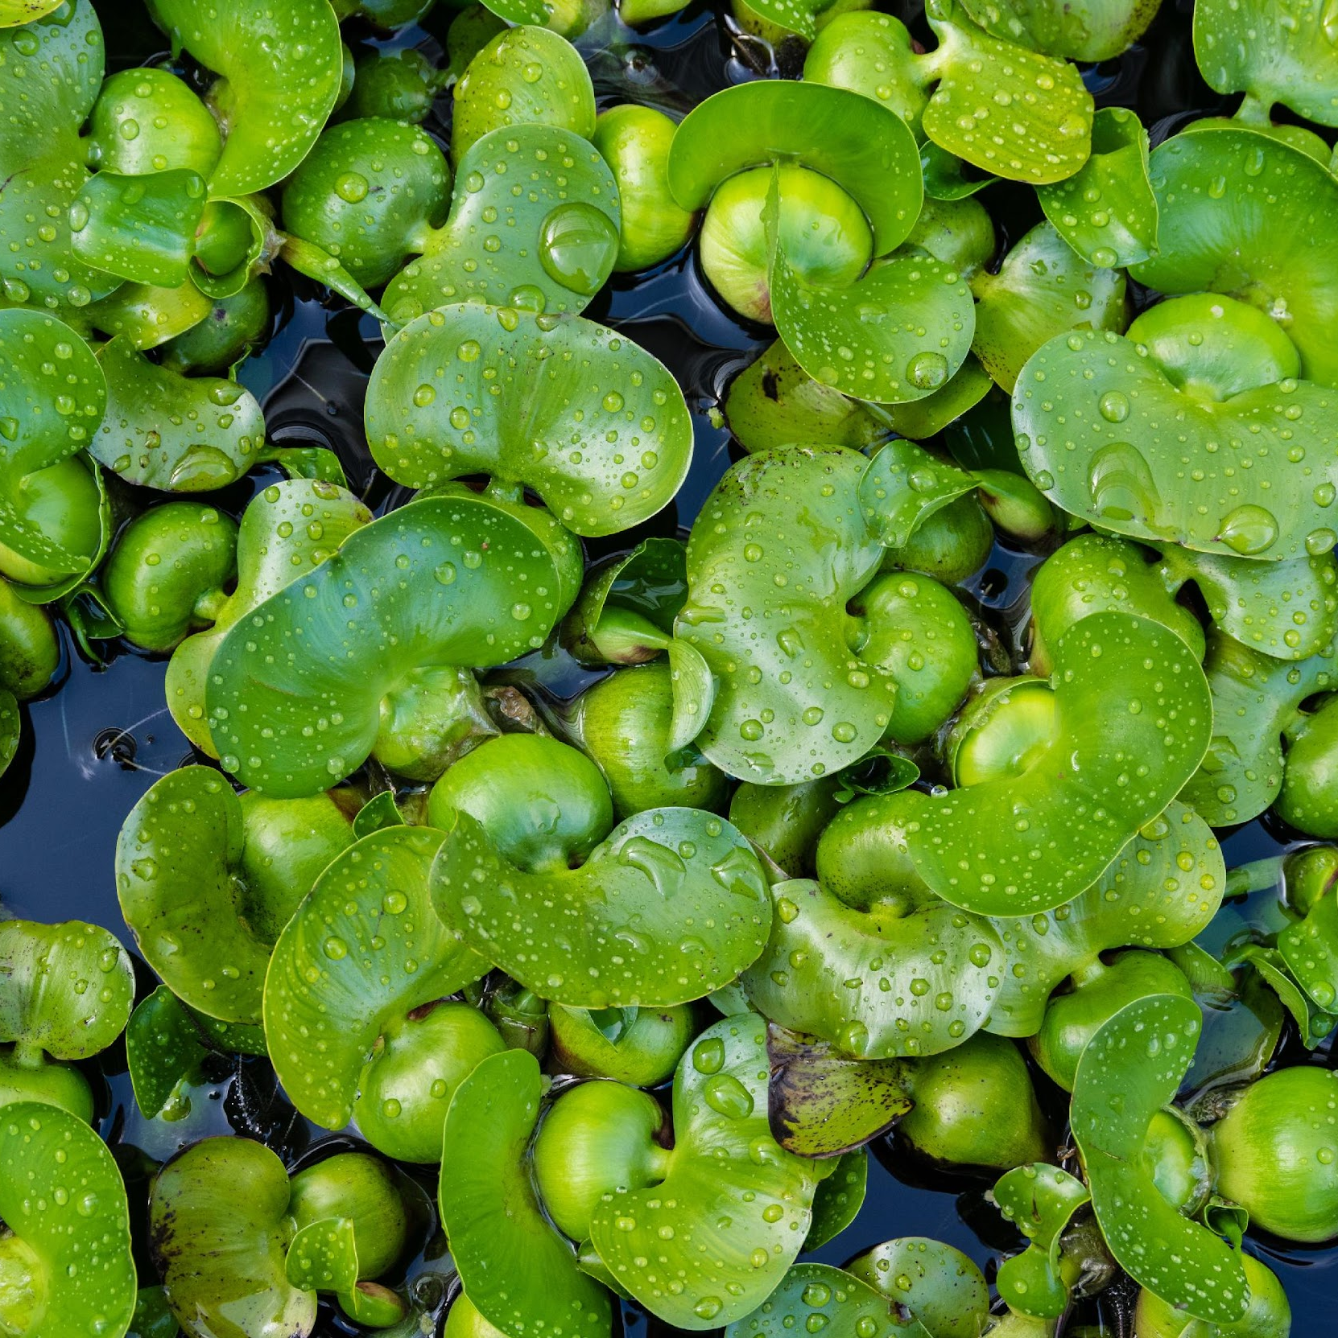
Aquatic Invasive Species in Commerce
Developing Solutions to Mitigate Risks
Leah Elwell, Conservation Collaborations, LLC | Stephanie Otts, National Sea Grant Law Center | Lisa DeBruyckere, Creative Resource Strategies, LLC

Slide 2
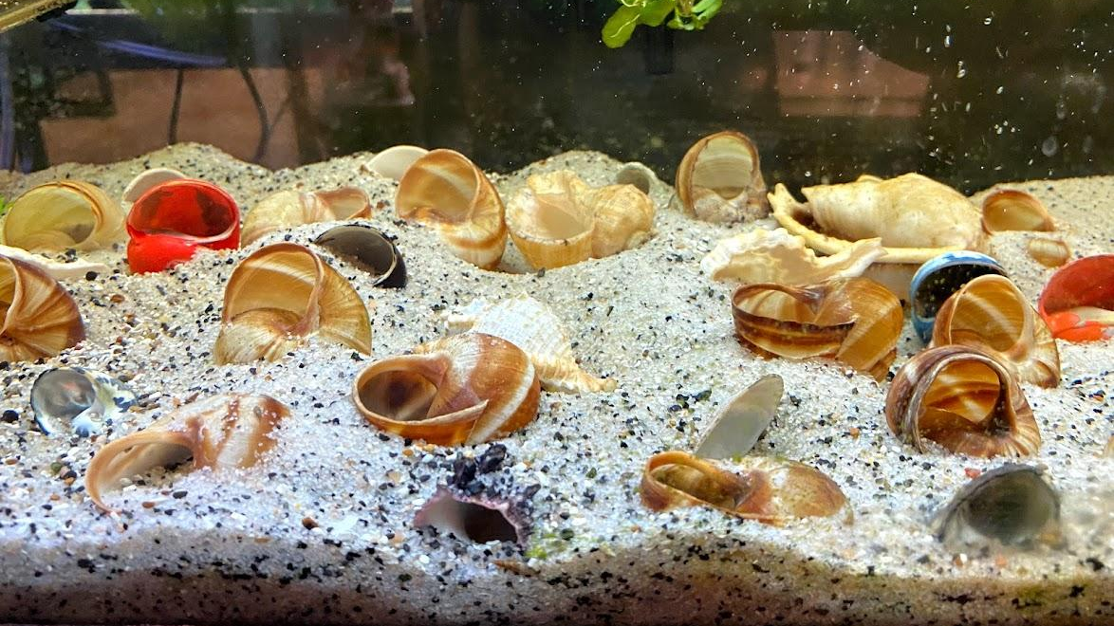
Project supported by the U.S. Department of the Interior

Slide 3
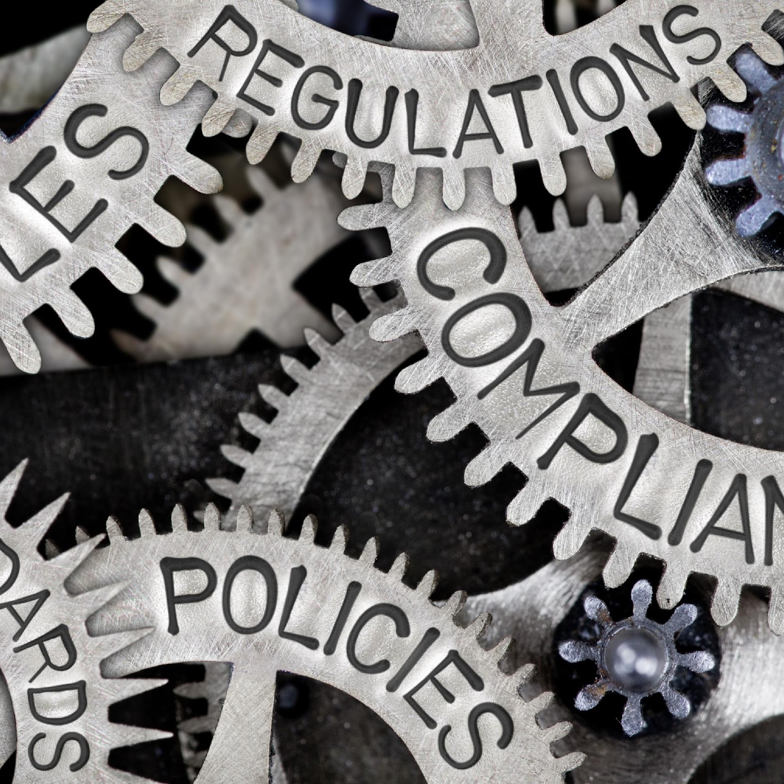
Current Challenges
Labeling
Mislabeling or individual specimens w/in large shipments not labeled
Mixed lot species in informal auctions
Accurate records not kept, or housed in difficult to access locations
Regulations/Incentives
No comprehensive approach to importation of plants and animals in North America
Inadequate pre-screening to determine invasive potential
Reliance on self-regulation by supply chain providers.
Lists of regulated species not easy to access
Shipping
Long-distance dispersal enhanced with mail services.
Regulations circumnavigated via trans shipping
Declaration of package contents not required with direct mail services
Unwanted species hitchhiking on plant and animal material.
Online marketplaces
Increase in Ecommerce results in sale of species not commonly sold in pet stores.
Minimum barriers to entry in retail markets.
Anonymity associated with online auctions.
Notes:
I propose that this is couched slightly differently. I think we outline that these areas all contribute to a commerce landscape that is promoting invasive species spread. All of the items are good examples. Maybe it is “Current Challenges” the information put here should look like the website challenges.

Slide 4
Goal
Develop and implement measures that prevent the introduction, or spread, of aquatic invasive species through commerce using science-based, landscape-level prevention measures implemented across North America.
Notes:
Reducing the sale of restricted aquatic species and lessening their introduction.
High-quality, critical, core habitats will have fewer restricted aquatic invasive species introduced.

Slide 5
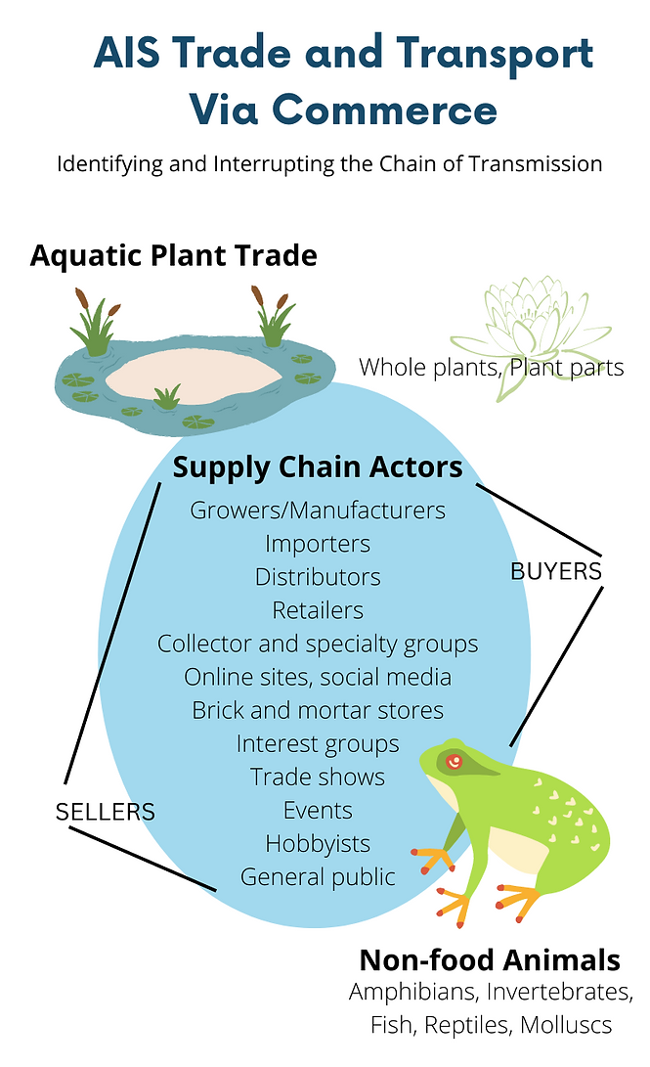
Project Scope

Slide 6
Objectives
Assess the aquatic species supply chain to better characterize those components that a) contribute significantly to the buying and selling of aquatic invasive species and b) can be addressed through regulations, incentives, and other tools.
Convene industry and agency partners to develop a suite of potential solutions that address the key weaknesses in the aquatic plant and animal commerce chain.
Develop model best management practices and voluntary codes of conduct as well as regulations to prevent the sale of restricted species in North America via commerce.
Ensure buyers and sellers have increased awareness, understanding, and appreciation of their roles and responsibilities in preventing the sale and introduction of aquatic invasive species by developing toolkits for these audiences.

Slide 7
A. Convene Partners to Develop Action Plan
Draw from review of supply chain landscape
Conduct targeted stakeholder surveys
Conduct targeted stakeholder focus-groups
Gather key stakeholders to generate action plan that contains timelines and responsible parties

Slide 8
Buyer/Seller and Agency Surveys
Buyers, sellers, and agency employees are participating in surveys to:
Help assess the aquatic invasive species in commerce issue;
Identify key gaps and challenges that contribute to the introduction and spread of aquatic plants and animals in commerce; and
Express interest in participating in a focus group to develop specific strategies that address key gaps and challenges.
DEADLINE TO COMPLETE SURVEYS:
December 15, 2022
Buyers and Sellers Survey: https://form.jotform.com/222828939142059
Agency Staff Survey: https://form.jotform.com/222904672784161

Slide 9
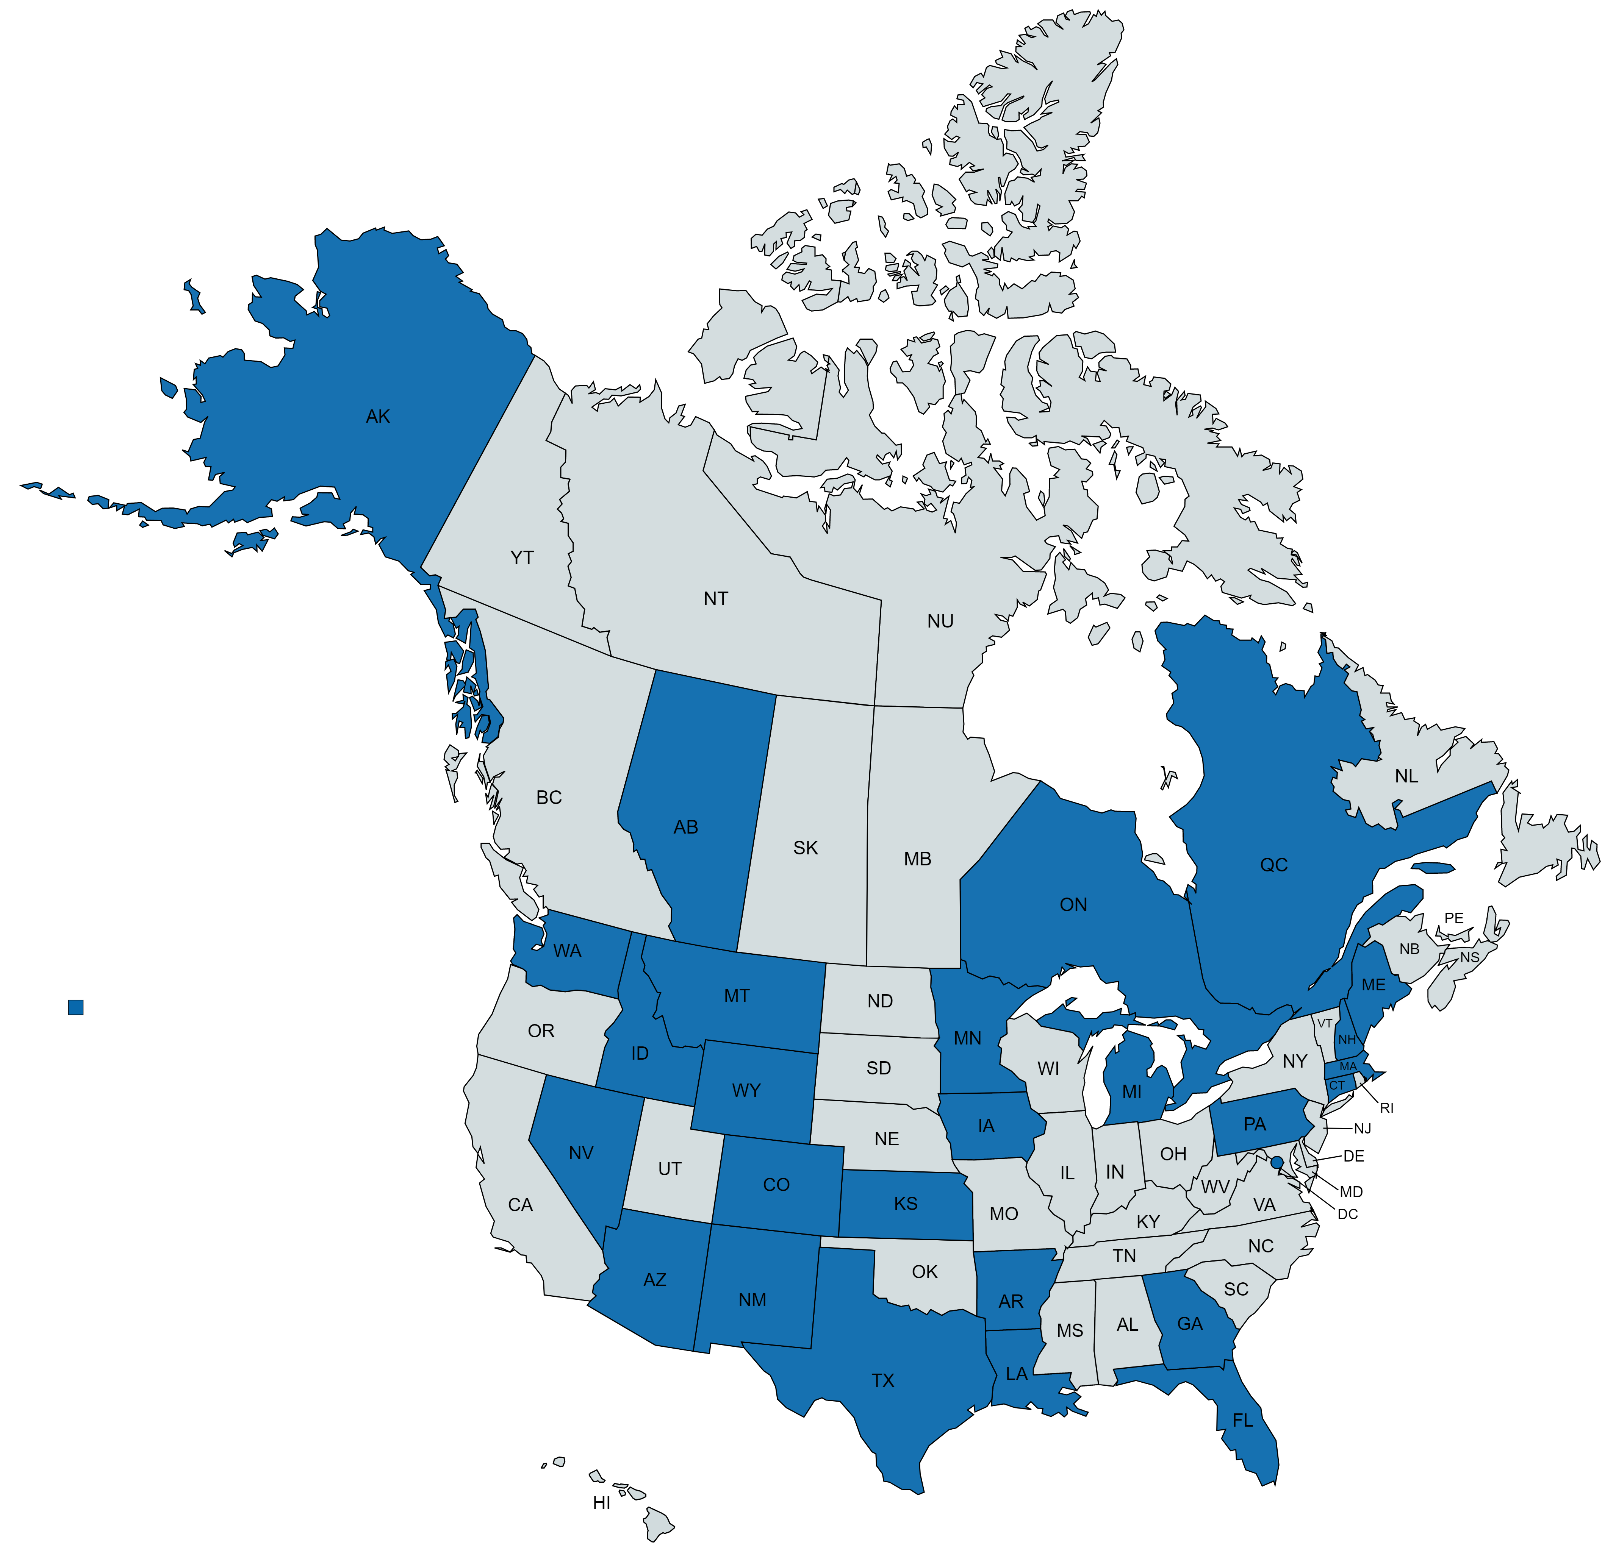
Agency Survey Results To Date
58 respondents:
3 Canadian provinces
23 states and DC

Slide 10
Ranking relative to contribution to spread of AIS in Commerce

Slide 11
Willingness of Agency Staff to Serve on Focus Group
Information and Education – 24 individuals
Species Lists – 22 individuals
Labeling and Packaging – 9 individuals
Monitoring – 13 individuals
Collaboration – 22 individuals
Voluntary Industry Standards – 7 individuals
Record keeping – 9 individuals
E-commerce – 18 individuals
Regulations – 21 individuals
Enforcement – 9 individuals

Slide 12
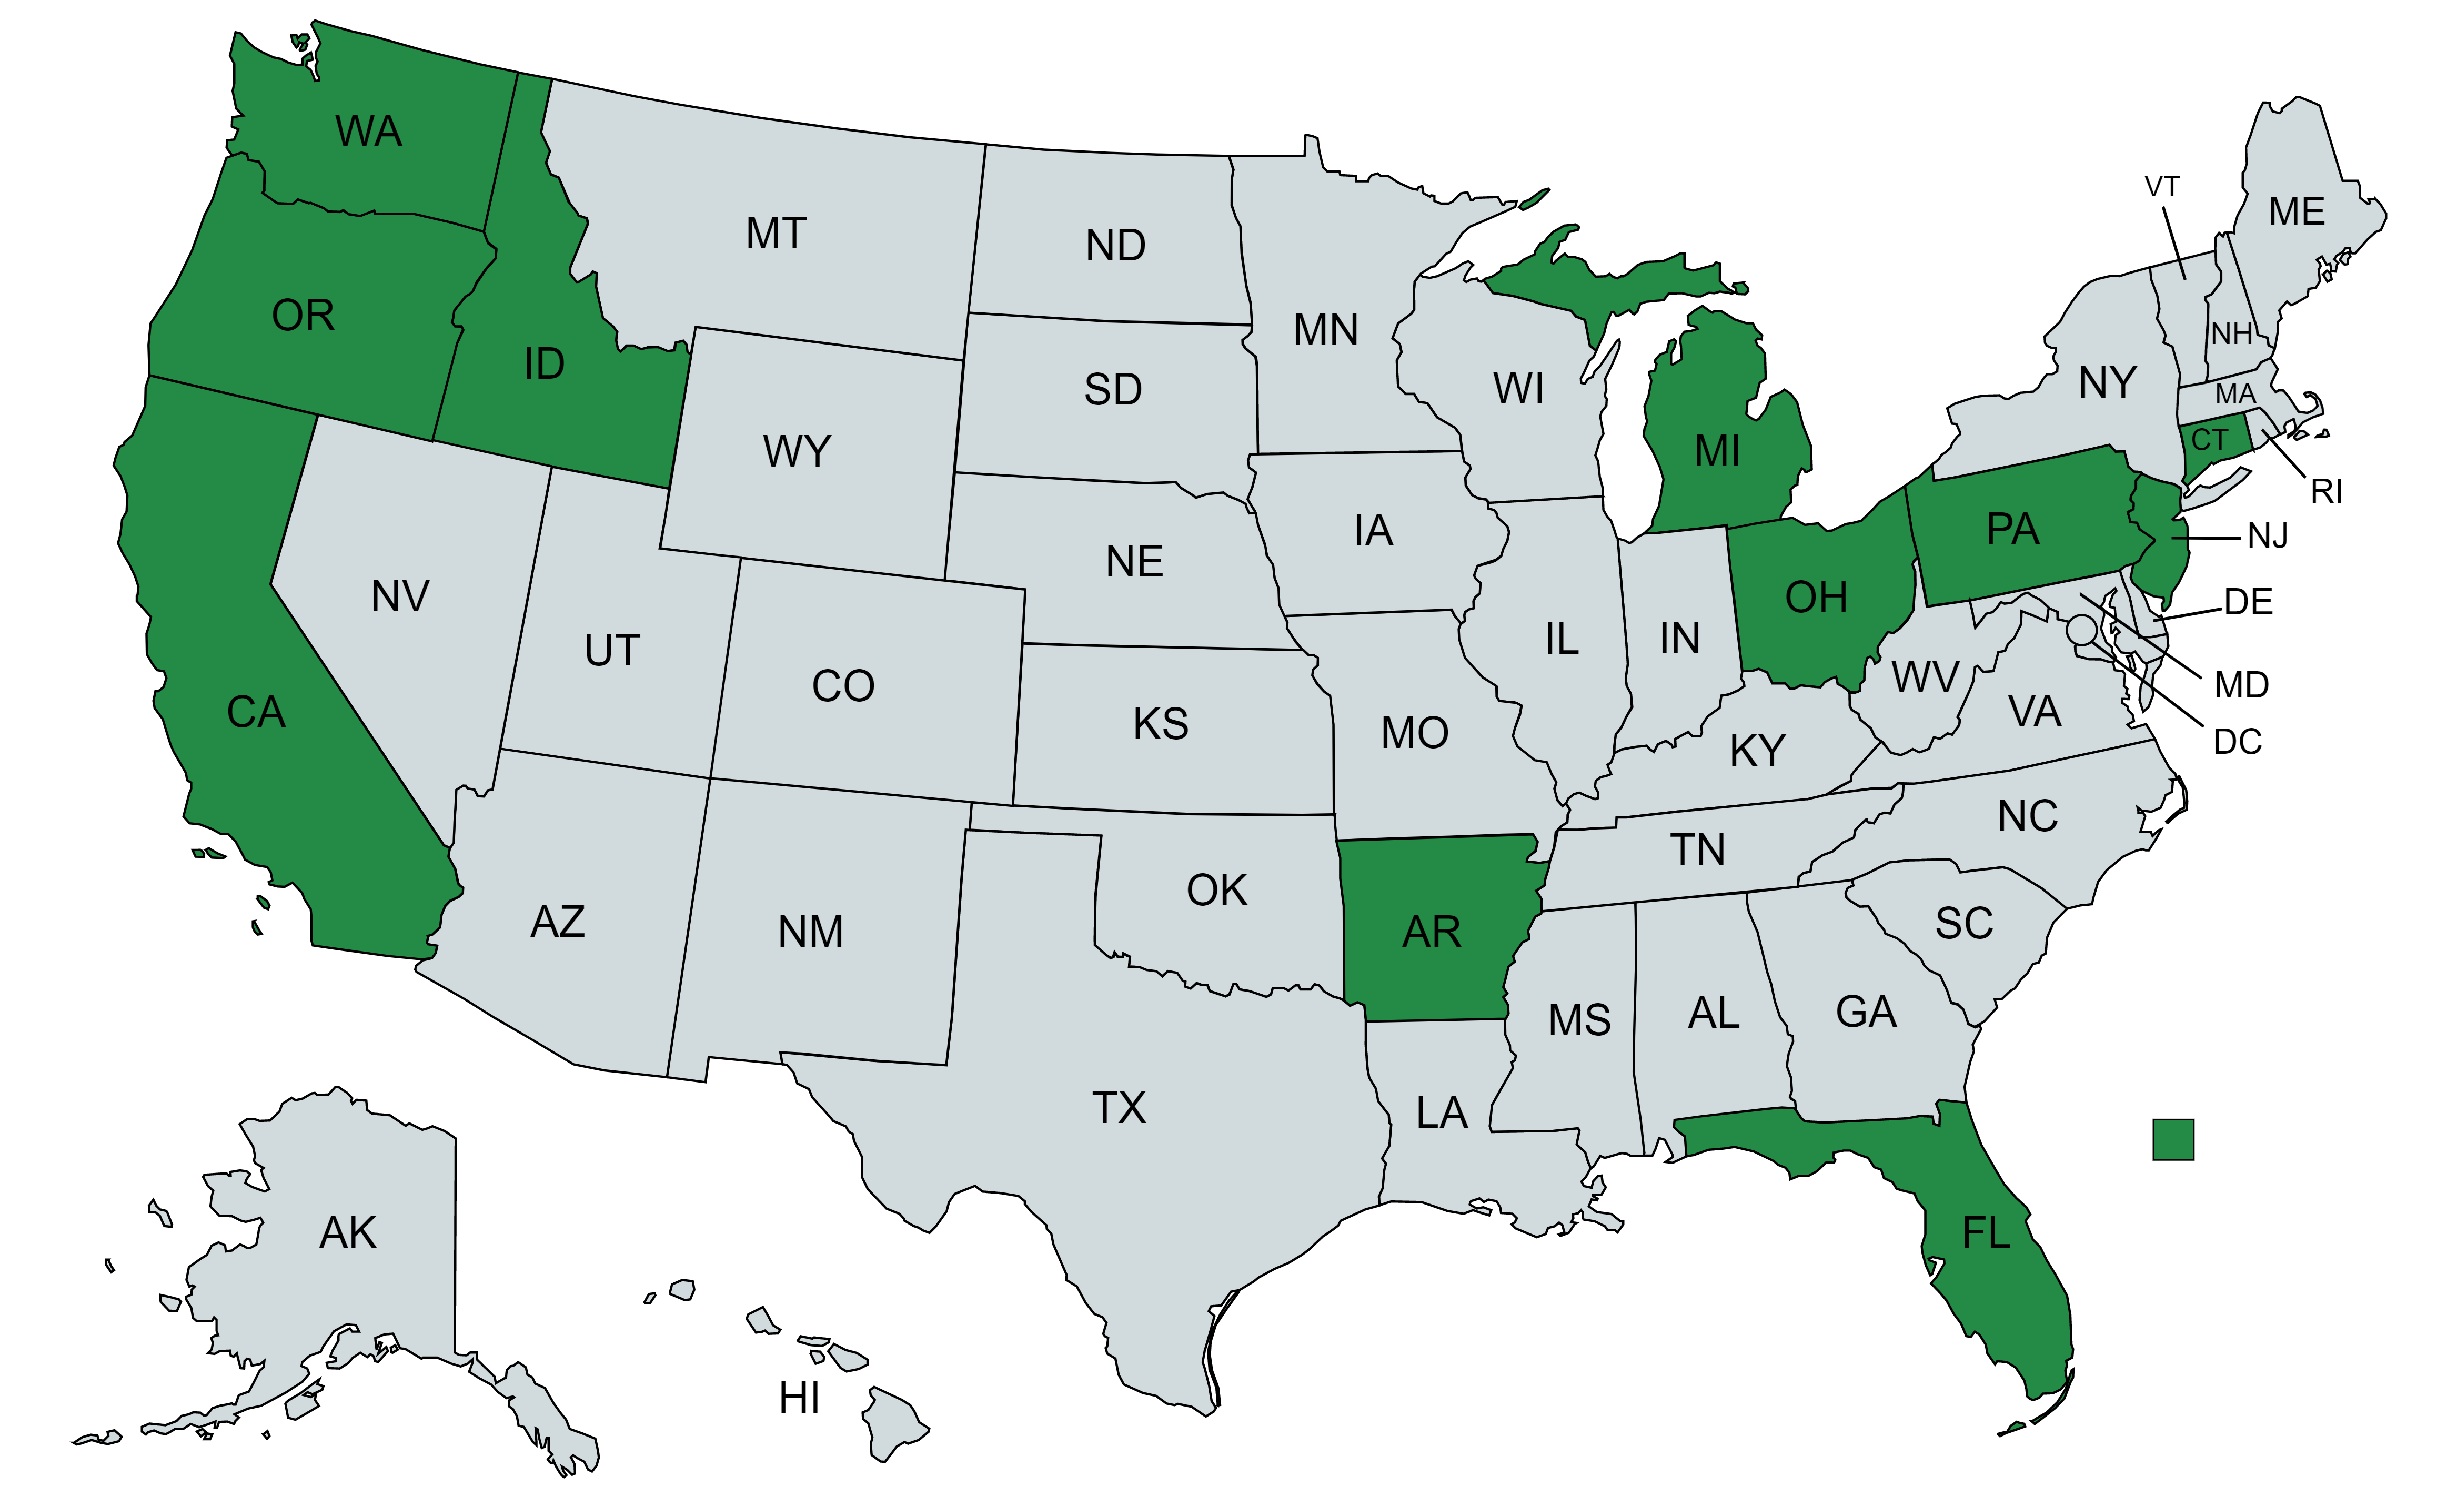
Buyer/Seller Survey Results to Date
18 submissions
Can supplement/compare/contrast survey results with other recent hobbyist/seller aquatic plant and animal surveys

Slide 13
Ranking relative to contribution to spread of AIS in Commerce

Slide 14
Willingness to Serve on Focus Group
Information and Education – 12 individuals
Species Lists – 12 individuals
Labeling and Packaging – 8 individuals
Monitoring –9 individuals
Collaboration – 9 individuals
Voluntary Industry Standards – 12 individuals
Record keeping – 6 individuals
E-commerce – 10 individuals
Regulations – 11 individuals
Enforcement – 10 individuals

Slide 15
Survey Comment Examples
Buyers/Sellers
“The largest problem is lack of education.”
“ . . . The difficulty in finding lists of prohibited animals and plants is one thing that needs fixing. All of this information needs to be clear and easy to find.”
Agency
“Patchwork of regulations across Great Lakes/United States . . .contributes significantly to the introduction and spread of AIS.”
“Businesses and hobbyists need clearer information about:
What species are illegal to sell and possess . . .
Best practices for disposal, euthanasia, re-homing and other alternatives to release, as well as dealing with hitchhikers.
Options for low-risk and native alternatives to invasive species.”

Slide 16
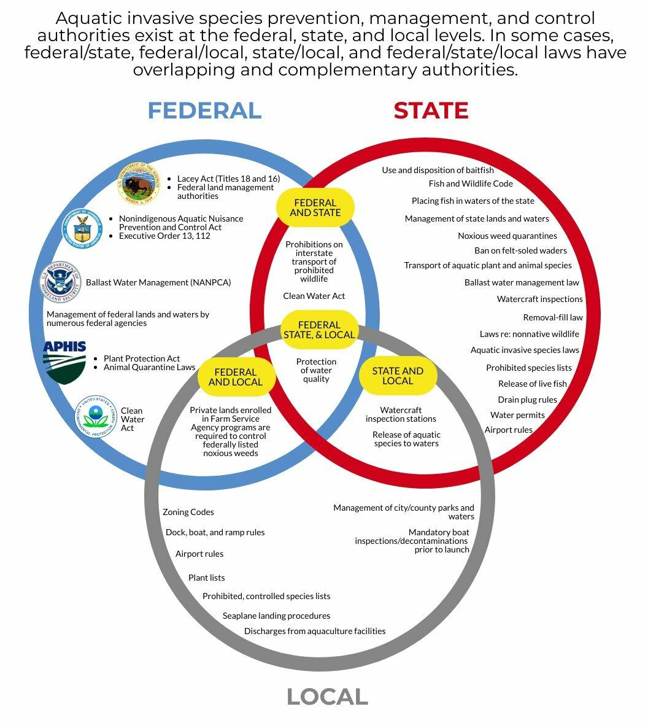
B. Address Regulatory Gaps
Conduct research to identify barriers to application and enforcement of state AIS laws to commerce pathways
Explore models for success stories and potential legal reform
What are the regulatory best practices? For example:
Invoice requirements
Auditing requirements

Slide 17
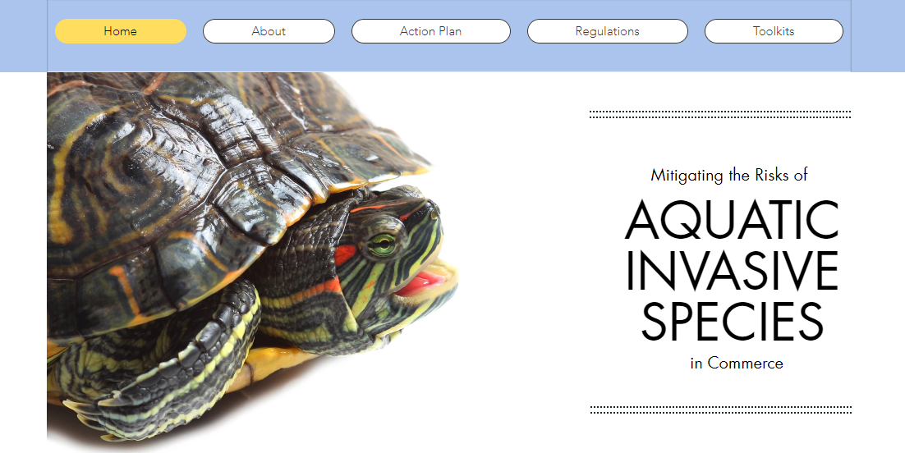
C. Conduct Effective Outreach
Develop and maintain online primer/toolkits for sellers and buyers illustrating best management practices.
Provide toolkit for state agencies.
Provide easy access to restricted species in each state.
Provide outreach materials to states.
Create one-stop shop for buyers and sellers to access information that interrupts the chain of transmission of AIS in Ecommerce.

Slide 18
Milestones
December 2022 – Conduct surveys and compile results
January 2023 – Assessment of supply chain
March 2023 – Conduct focus groups
April 2023 – Develop Action Plan Draft
September 2023 – Define Regulatory Framework
May 2024 – Finalize Action Plan, Toolkits

Slide 19
Questions?
www.aisincommerce.org

