Slide 1
Fish and aquatic conservation
Pacific Region
Aquatic Invasive Species Program
Columbia River Basin Monitoring Coordination December 2024

Slide 2
FAC Assets Pacific Region
Notes:
We manage a network of 40 fisheries field stations in Idaho, Oregon and Washington. These fisheries prove more than 50 million steelhead and salmon each year to support the Pacific Salmon Treaty and $2.8 billion in commercial, recreational, and Tribal harvest.
Stewardship of our land and water resources in the Pacific Northwest is deeply interwoven with the culture, heritage, and historical practices of Native American Tribes. There are 46 federally recognized Tribes in our region, many with treaty rights to manage and harvest fish and wildlife resources. Many of our hatcheries are co-managed with tribes. - Abernathy Fish Technology Center -

Slide 3
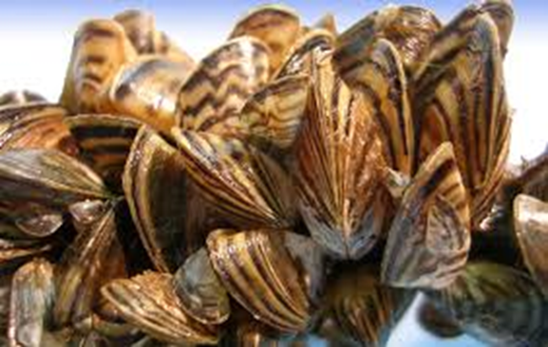
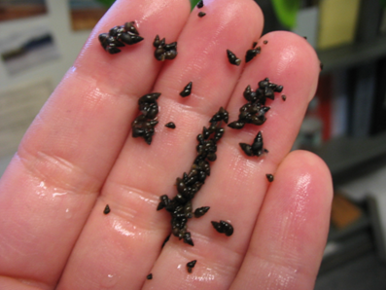
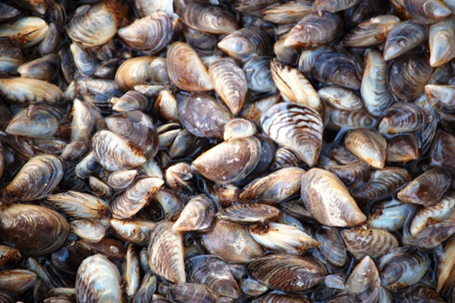
Surveillance Monitoring
Visual inspection surveys
eDNA monitoring
Zebra & Quagga mussel
Northern pike
Common carp
New Zealand mudsnail
American bullfrog
Carson, Willard, Little White Salmon, Spring Creek, Eagle Creek, and Warm Springs NFHs
Notes:
eDNA surveys at Carson, Willard, Little White Salmon, Spring Creek, Eagle Creek and Warm Springs NFHs.
eDNA to test for NZMS at all of the facilities from 2015-Present.
eDNA for QZM in 2017 and 2018.
FY21 - tested the above facilities for NZMS, QZM, northern pike and common carp.
FWS approved funding for a pilot study to test the performance of the Biomeme portable PCR unit for real-time eDNA sample processing at National Fish Hatcheries.
Jen - NZMS surveys and eDNA sampling at our lower Columbia Basin NFHs and up to five reference locations; Testing for five species again in FY22 including: New Zealand mudsnail, zebra mussels, quagga mussels, northern pike and common carp.
pre-proposal to purchase a Biomeme mobile qPCR thermocycler for real-time eDNA sample processing at our National Fish Hatcheries. The objectives of the study would be to 1) sample 3-5 locations with known NZMS presence to evaluate the performance and detection probability of the Biomeme unit, and 2) compare Biomeme sample results and logistics (e.g., processing time, cost, results turnaround timeframe) with those from WSUs eDNA lab. I will be using the Biomeme thermocycler to test for NZMS, but you can also purchase test kits for zebra/quagga mussels and northern pike.

Slide 4
eDNA monitoring at NFHs
Carson, Willard, Little White Salmon, Spring Creek, Eagle Creek and Warm Springs NFHs
ongoing since 2015 to present
FY24 – 8 samples total per facility (x 6 facilities)
64 samples tested for 5 species ($153.00 / sample)
60 samples tested for a single species ($67.32 / sample)
supplies including cellulose nitrate filters
Non-salary costs is approx. $16,000 ($12K in FY23)
Notes:
eDNA surveys at Carson, Willard, Little White Salmon, Spring Creek, Eagle Creek and Warm Springs NFHs.
eDNA to test for NZMS at all of the facilities from 2015-Present.
Added eDNA testing for QZM in 2017 and 2018.
FY21 - tested the above facilities for NZMS, QZM, northern pike and common carp.
FWS approved funding for a pilot study to test the performance of the Biomeme portable PCR unit for real-time eDNA sample processing at National Fish Hatcheries.
Jen - NZMS surveys and eDNA sampling at our lower Columbia Basin NFHs and up to five reference locations; Testing for five species again in FY22 including: New Zealand mudsnail, zebra mussels, quagga mussels, northern pike and common carp.
pre-proposal to purchase a Biomeme mobile qPCR thermocycler for real-time eDNA sample processing at our National Fish Hatcheries. The objectives of the study would be to 1) sample 3-5 locations with known NZMS presence to evaluate the performance and detection probability of the Biomeme unit, and 2) compare Biomeme sample results and logistics (e.g., processing time, cost, results turnaround timeframe) with those from WSUs eDNA lab. I will be using the Biomeme thermocycler to test for NZMS, but you can also purchase test kits for zebra/quagga mussels and northern pike.
$67.32 per sample is a side study of protocol comparison (filer size and volume of water 0.45 um filter with 3 x 0.5L grab sample 3 replicates per location (able to do LT bank, middle, RT bank - WSU protocol ; WDFW – 5 um filter (cellulose nitrate filter) with 5.0 L water sample ---single 5 L filter/ pump a 5 liter volume per location, protocol also used for metabarcoding; USGS 1.0 um filter (cellulose nitrate filter) pumping 1.0L volume; and USDA-FS – 1.5 um glass microfiber filter (cheap; eDNA bulltrout, lamprey) 5.0 L water (volume filtered); protocols testing DNA quantity, difference between protocols – one method testing - -- one time cost)
Ethanol – dehydrate them, put them in dessicant on dessicant beads – faster – shorter processing time; better long term preservation method – ok if they sit in dessicant – 1 month process time
Minimum # of samples 3 samples in large and small waterbodies, more powerful with time of year – vs 8 visual surveys for confidence in collecting water samples at a location, eDNA for NZMS better than visual surveys, both a high and low densities, eDNA superior at large waterbodies where NZMS are in low densities – regular known location sites -
Minumum == pumps $2K 4 new pumps and create eDNA sampling kit for our FWCOs schedule, sampling, mail kits to hatchery; 12 kits – use 8 samples; 4 at top, 4 at bottom, field negative; everything to take a sample; desicant beads, envelope with desicant beads – mail back to Jen – shared calendar for sampling; = one pump per facility = FWCOs or hatchery – self-sufficient – limiting thing is pumps – POC – occupancy modeling – visiting sites with known presence of NZMS – detection probability - different for every species – NZMS – priority right now -

Slide 5
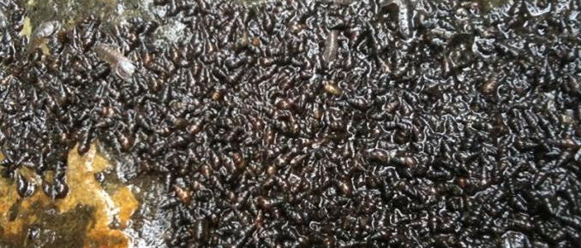
eDNA monitoring at NFHs
In 2024, staff also assessed four eDNA sample collection/filtration protocols (WDFW, WSU, USGS, USFS) to compare eDNA capture yield and detection of NZMS at three reference locations with varying snail densities.
Three separate projects in one:
1) Presence / absence for high priority AIS
2) eDNA protocol testing (WDFW, WSU, USGS, USFS)
3) Occupancy modeling and detection probability New Zealand mudsnail
Notes:
eDNA surveys at Carson, Willard, Little White Salmon, Spring Creek, Eagle Creek and Warm Springs NFHs.
eDNA to test for NZMS at all of the facilities from 2015-Present.
Added eDNA testing for QZM in 2017 and 2018.
FY21 - tested the above facilities for NZMS, QZM, northern pike and common carp.
FWS approved funding for a pilot study to test the performance of the Biomeme portable PCR unit for real-time eDNA sample processing at National Fish Hatcheries.
Jen - NZMS surveys and eDNA sampling at our lower Columbia Basin NFHs and up to five reference locations; Testing for five species again in FY22 including: New Zealand mudsnail, zebra mussels, quagga mussels, northern pike and common carp.
pre-proposal to purchase a Biomeme mobile qPCR thermocycler for real-time eDNA sample processing at our National Fish Hatcheries. The objectives of the study would be to 1) sample 3-5 locations with known NZMS presence to evaluate the performance and detection probability of the Biomeme unit, and 2) compare Biomeme sample results and logistics (e.g., processing time, cost, results turnaround timeframe) with those from WSUs eDNA lab. I will be using the Biomeme thermocycler to test for NZMS, but you can also purchase test kits for zebra/quagga mussels and northern pike.
$67.32 per sample is a side study of protocol comparison (filer size and volume of water 0.45 um filter with 3 x 0.5L grab sample 3 replicates per location (able to do LT bank, middle, RT bank - WSU protocol ; WDFW – 5 um filter (cellulose nitrate filter) with 5.0 L water sample ---single 5 L filter/ pump a 5 liter volume per location, protocol also used for metabarcoding; USGS 1.0 um filter (cellulose nitrate filter) pumping 1.0L volume; and USDA-FS – 1.5 um glass microfiber filter (cheap; eDNA bulltrout, lamprey) 5.0 L water (volume filtered); protocols testing DNA quantity, difference between protocols – one method testing - -- one time cost)
Ethanol – dehydrate them, put them in dessicant on dessicant beads – faster – shorter processing time; better long term preservation method – ok if they sit in dessicant – 1 month process time
Minimum # of samples 3 samples in large and small waterbodies, more powerful with time of year – vs 8 visual surveys for confidence in collecting water samples at a location, eDNA for NZMS better than visual surveys, both a high and low densities, eDNA superior at large waterbodies where NZMS are in low densities – regular known location sites -
Minumum == pumps $2K 4 new pumps and create eDNA sampling kit for our FWCOs schedule, sampling, mail kits to hatchery; 12 kits – use 8 samples; 4 at top, 4 at bottom, field negative; everything to take a sample; desicant beads, envelope with desicant beads – mail back to Jen – shared calendar for sampling; = one pump per facility = FWCOs or hatchery – self-sufficient – limiting thing is pumps – POC – occupancy modeling – visiting sites with known presence of NZMS – detection probability - different for every species – NZMS – priority right now -
In 2024, staff also assessed four eDNA sample collection/filtration protocols (WDFW, WSU, USGS, USFS) to compare eDNA capture yield and detection of NZMS at three reference locations with varying snail densities.

Slide 6
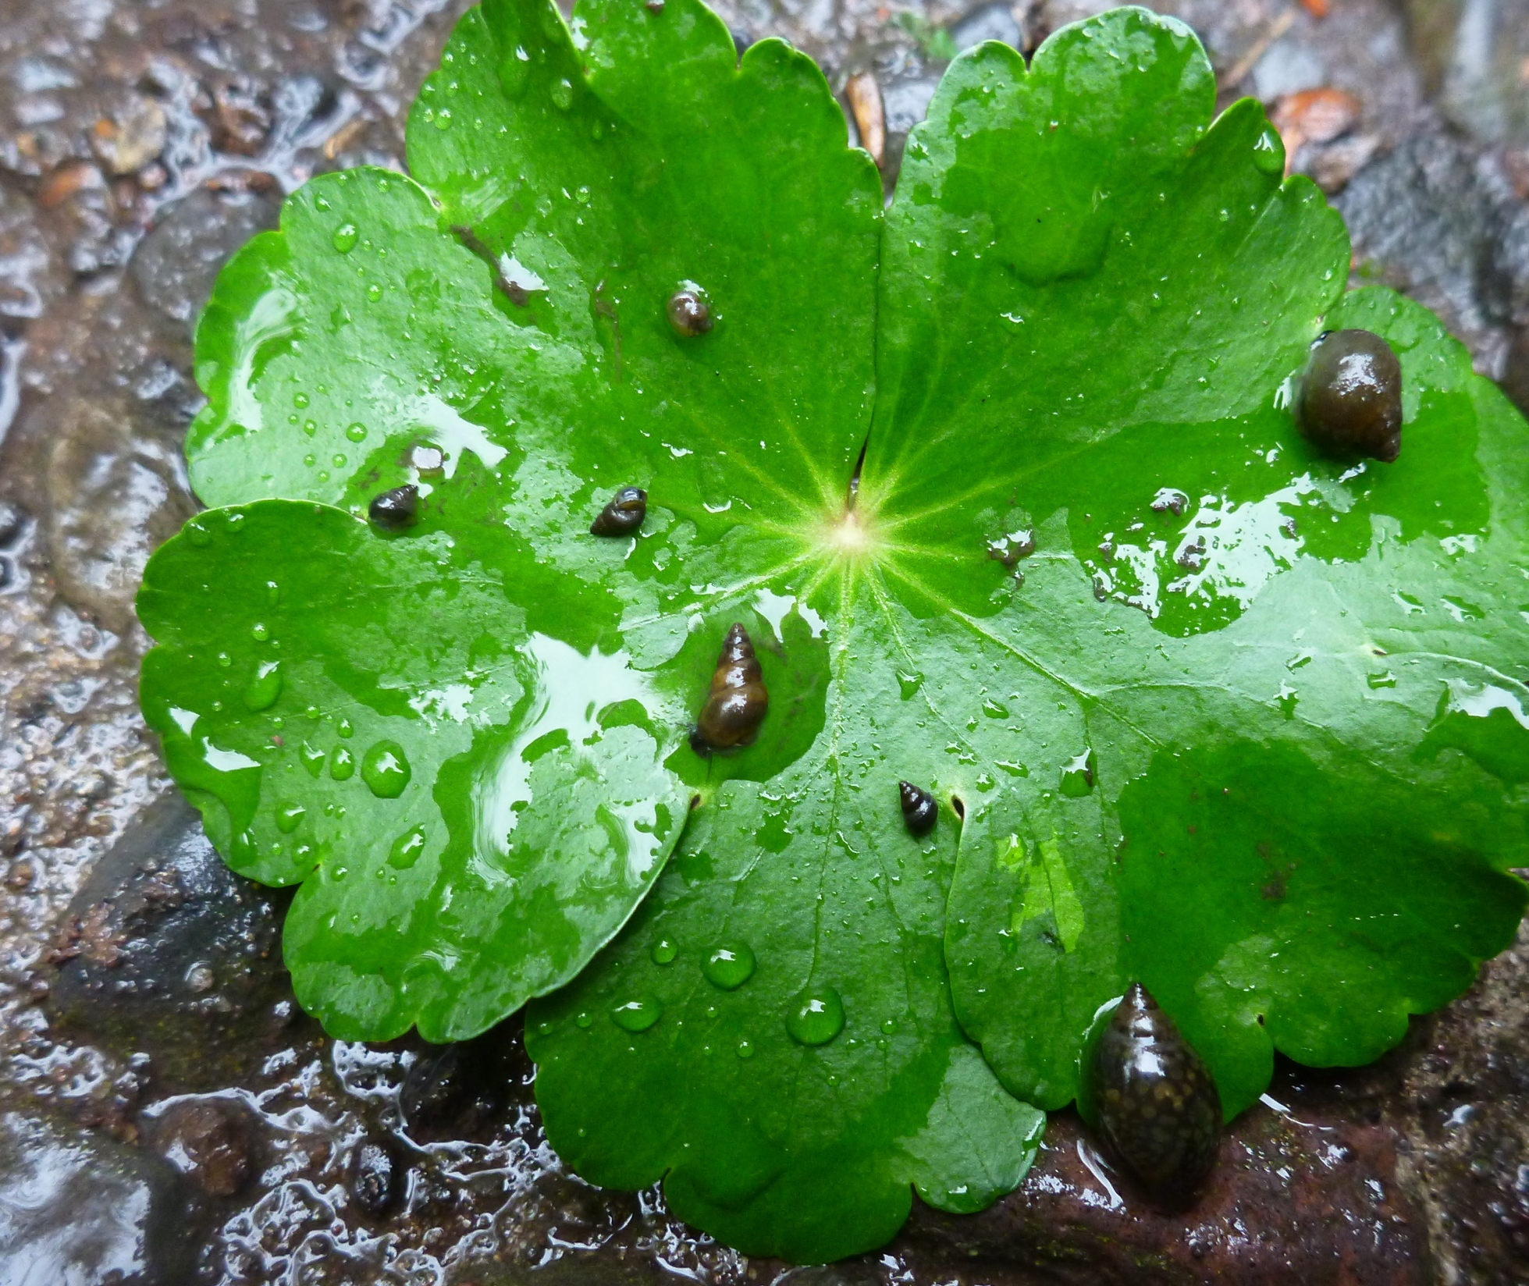
Questions?
Theresa Thom
Regional Office (Portland, OR)
theresa_thom@fws.gov
Jen Poirier
Columbia River FWCO
Jennifer_Poirier@fws.gov
Julie Harris
Columbia River FWCO
Julianne_Harris@fws.gov
Notes:
Columbia River Fish & Wildlife Conservation Office
Regional Aquatic Invasive Species Coordinator
Brady Foreman is also here online, Brady besides being our Supervisory Fish Biologist and hatchery manager for Quilcene NFH, liaison

