Slide 1
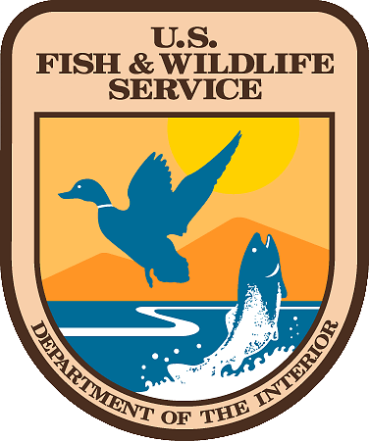
Fish and aquatic conservation
Aquatic Invasive Species Program
Columbia River Basin
100th Meridian Working Group Meeting
December 2022 Update

Slide 2
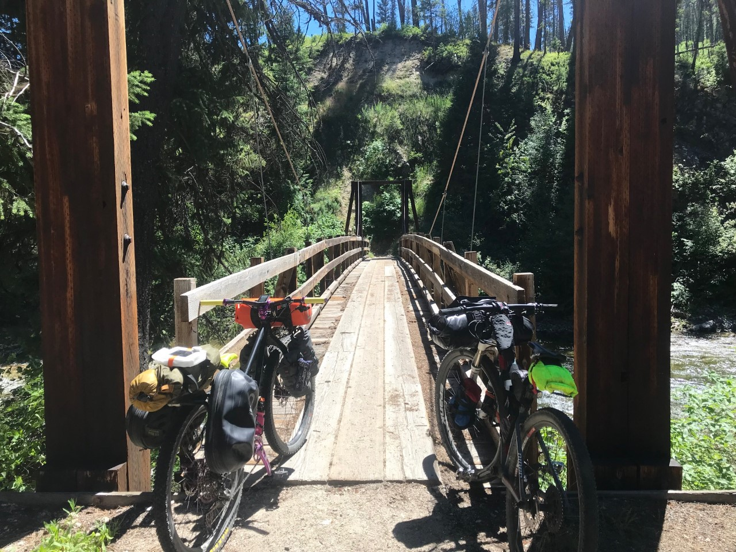
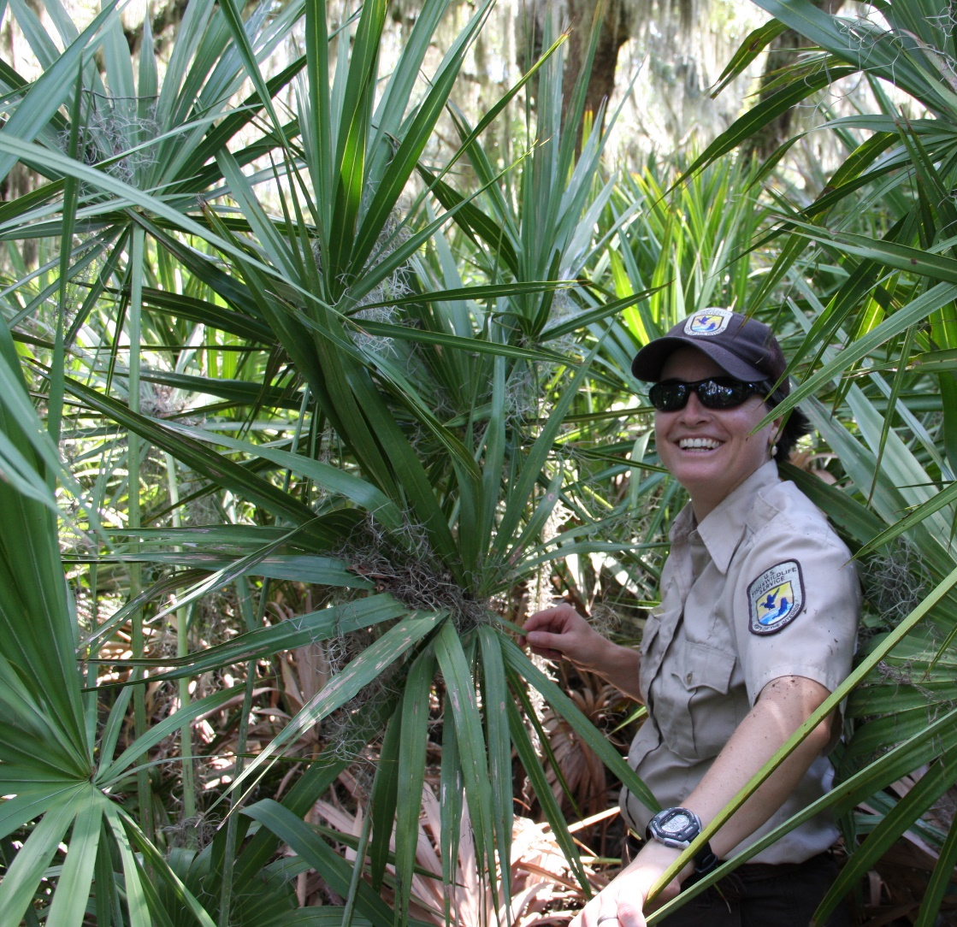
Your Regional AIS Coordinator

Slide 3
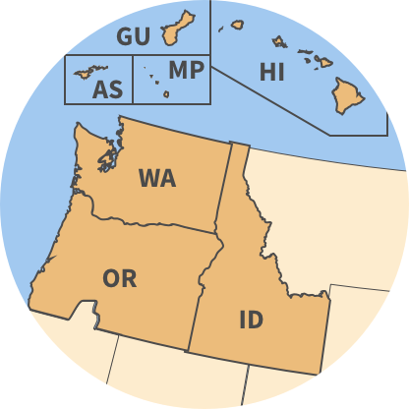
Geographic Scope

Slide 4
Program Priorities

Slide 5
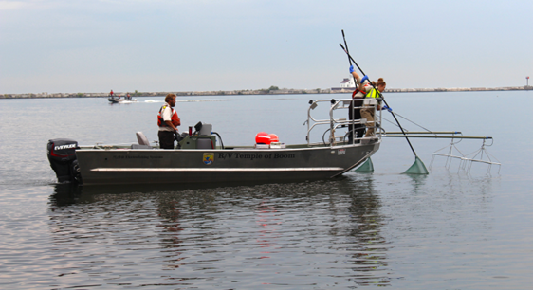
Prevention
Early Detection
Rapid Response
Control / Management
Coordination / Communication

Slide 6
Prevention
Horizon Scanning
Risk Assessments, HACCP
Early Detection
Broad Spectrum Monitoring
Targeted Species
Rapid Response
Control / Management
Coordination / Communication

Slide 7
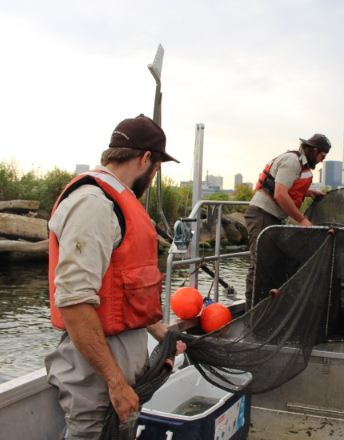
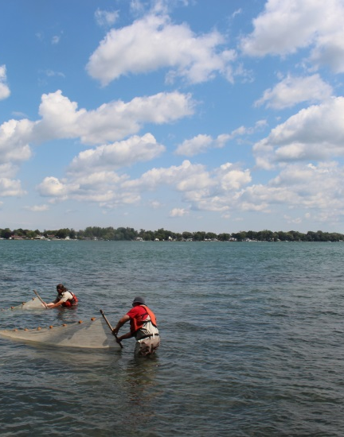
Monitoring

Slide 8
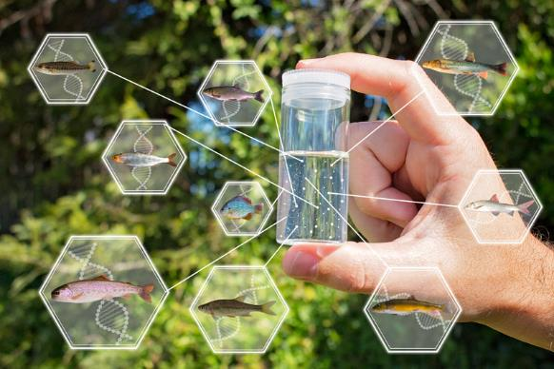
eDNA Monitoring
eDNA work to test for NZMS (2015-present)
Added QZM (2017)
FY21 & FY22 : NZMS, QZM, northern pike, invasive carp
Testing portable PCR unit for real-time eDNA sample processing at NFHs in FY22
Notes:
eDNA surveys at Carson, Willard, Little White Salmon, Spring Creek, Eagle Creek and Warm Springs NFHs.
eDNA to test for NZMS at all of the facilities from 2015-Present.
eDNA for QZM in 2017 and 2018.
FY21 - tested the above facilities for NZMS, QZM, northern pike and Asian carp.
FWS approved funding for a pilot study to test the performance of the Biomeme portable PCR unit for real-time eDNA sample processing at National Fish Hatcheries. – which will happen in FY22
Jen - NZMS surveys and eDNA sampling at our lower Columbia Basin NFHs and up to five reference locations; Testing for five species again in FY22 including: New Zealand mudsnail, zebra mussels, quagga mussels, northern pike and common carp.
pre-proposal to purchase a Biomeme mobile qPCR thermocycler for real-time eDNA sample processing at our National Fish Hatcheries. The objectives of the study would be to 1) sample 3-5 locations with known NZMS presence to evaluate the performance and detection probability of the Biomeme unit, and 2) compare Biomeme sample results and logistics (e.g., processing time, cost, results turnaround timeframe) with those from WSUs eDNA lab. I will be using the Biomeme thermocycler to test for NZMS, but you can also purchase test kits for zebra/quagga mussels and northern pike.

Slide 9
YY Brook Trout Stocking
Tyee Springs / Wind River
Stocking YY Brook Trout
Annual Brook Trout removal
PIT array to monitor movement and survival of YY brook trout
Notes:
In any case, we (the CRFWCO) will be continuing our YY brook trout stocking project out at Carson NFH. Activities will include coordinating the installation of a screen on the bypass channel to eliminate the egress of brook trout into the Wind River, performing annual brook trout removals, installing a PIT array to monitor movement (and potentially survival) of YY brook trout in Tyee, and finally stocking a new batch of YY fish into Tyee.
Region 1 Proposal for HQ 2018 Prevention Funding: Abernathy Fish Technology Center (FTC), Columbia River Fish and Wildlife Conservation Office (FWCO), and Carson NFH submitted a proposal for $150,000 for a proof-of-concept eradication of brook trout in Tyee Springs (above ATC) using the YY male approach. The proof-of-concept evaluation of the YY male methodology can help the Service and its partners determine if and how this approach could control nuisance brook trout populations in other locations, and for other nuisance AIS, like common carp. A feasibility study for control of common carp at Malheur using the YY male approach has been proposed. The results of this brook trout eradication project will provide science to inform that effort.

Slide 10
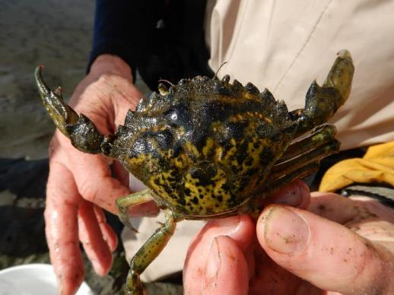
European Green Crab
Ongoing monitoring / removal
Billy Frank Jr. Nisqually NWR Complex
Washington Maritime NWR Complex (including Dungeness NWR)
Willapa Bay NWR Complex
Puget Sound Federal Task Force
ANSTF Control Plan Update
https://www.fws.gov/anstaskforce/Species%20plans/GreenCrabManagementPlan.pdf
Notes:
European Green Crab Control/Rapid Response: The Service provided funding to the Makah Tribe to respond to the recent invasion of European Green Crab to estuaries on the Makah Indian Reservation. Efforts include assessing the extent of invasion, controlling crab population growth, and providing training to tribal staff to continue and expand control efforts. The Service provided $30K through the National Fish Habitat Partnership Program, with $52K in matching funds from the Makah. The Pacific Marine and Estuarine Partnership selected this project for funding in 2018
November 15, 2021 - the U.S. Environmental Protection Agency (EPA) has assessed penalties totaling $81,474 against two commercial ships over inspection, monitoring, and reporting violations in California and Louisiana. The MSC Aurora container ship and the Western Durban bulk carrier both violated EPA’s Vessel General Permit (VGP) issued under the Clean Water Act (CWA).
From November 2016 to July 2021, the MSC Aurora failed to conduct required routine visual inspections for 11 voyages to Ports of Long Beach, Los Angeles, and Oakland. The MSC Aurora also failed to submit timely annual reports to EPA for 2016 – 2019. For these multiple inspection and reporting violations, Mediterranean Shipping Company, SRL has agreed to pay a civil penalty of $66,474 under the settlement.
In August 2017, the Western Durban failed to perform monthly functionality monitoring and an annual calibration of the ballast water treatment system before discharging ballast water at the Port of New Orleans. The ship also failed to conduct required biological monitoring after the discharge. EPA assessed penalties totaling $15,000 to the Tokyo-based Victoria Ship Management company.
The Lummi Indian Business Council passed a resolution Tuesday, Nov. 23, following a multi-agency effort led by the Lummi Natural Resources Department to remove European Green Crab. The resolution establishes a task force that will confront the crisis with a comprehensive response strategy.

Slide 11
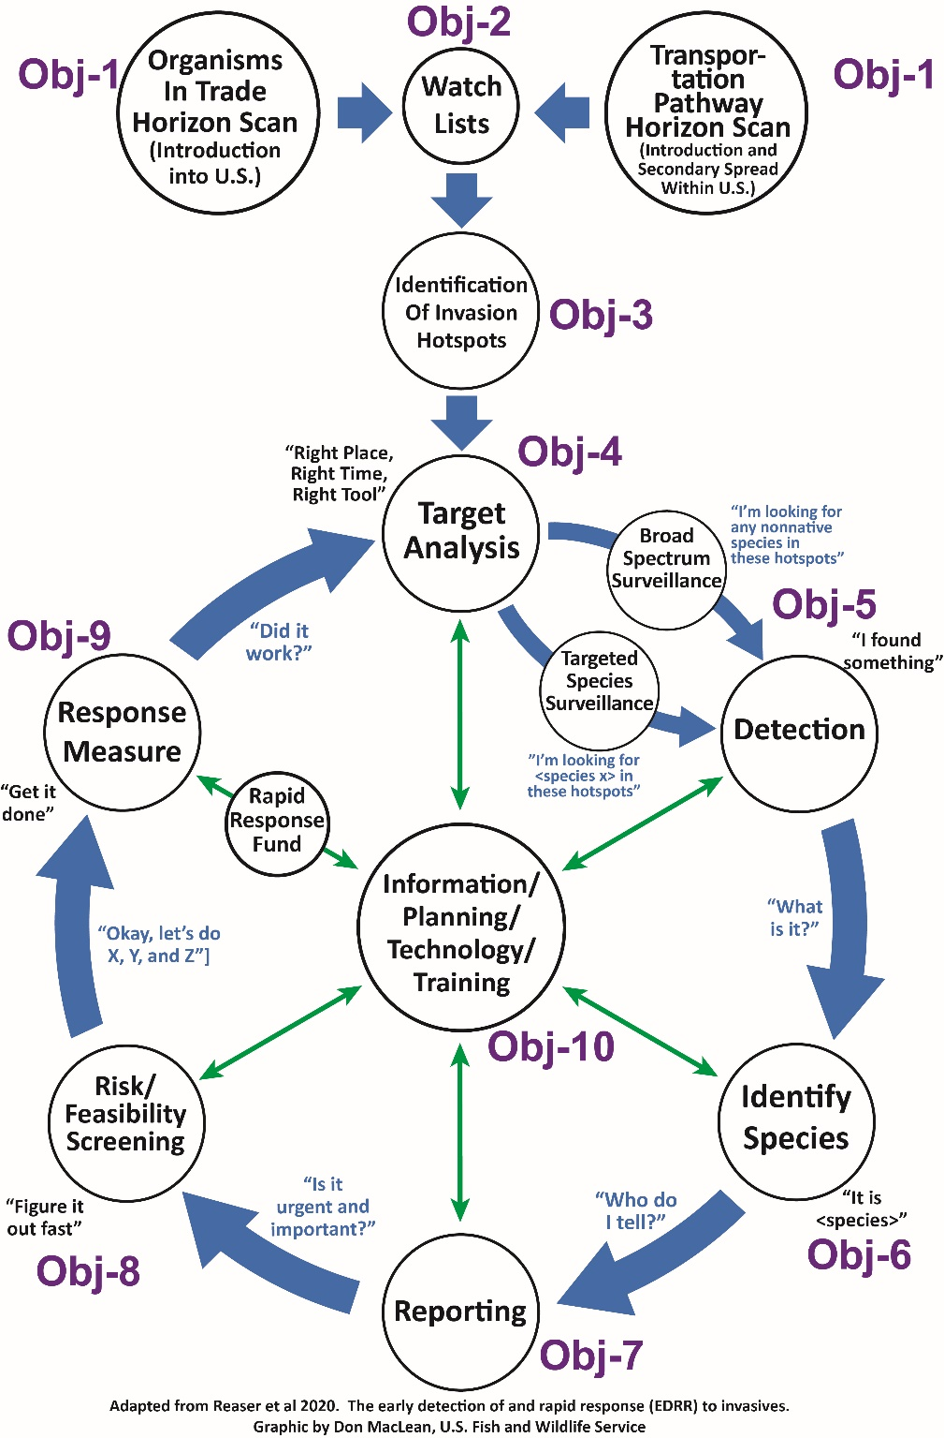
Early Detection Rapid Response Framework

Slide 12
FY22 Budget

Slide 13
FY2022 State ANS Plan Funds: $4.084 Million ($95K /state)
FY2022 QZAP Funds: $2.25 Million
Inter-Agency Agreement: $250K
FWS, BLM, BOR, NPS
FY2021 Funds to USGS
Rusty Crayfish/Flowering Rush
European Green Crab
Notes:
FY2022 state plan funding – there are 45 state and interstate approved plans ----
Inter-Agency Agreement (5 years)
Funding for Watercraft Inspection and Decon classes (PSMFC) and western Watercraft Inspection and Decon database (CPW)
Signatories – Lead: FWS
BLM, BOR, NPS
FWS / USGS Science Support Partnership Projects
FY21 successful proposal with Sarah Converse with the WA Cooperative Fish & Wildlife Research Unit
(Rusty Crayfish and Flowering Rush) – optimizing AIS control and monitoring
European Green Crab
FWS and USGS – Interagency Agreement starting in FY21
Focus on optimizing sampling for EGC – esp. in WA

Slide 14
Bipartisan Infrastructure Law (BIL)
https://doi.gov/priorities/investing-americas-infrastructure/ecosystem-restoration/projects
Provides $905 Million to DOI for Ecosystem Restoration Activities over 5 yrs (FY22-26)
10 Activities - Ecosystem Restoration Section (7 of 10 funded through DOI)
Activity | Total over 5 years
Activity 1: Contracts and Capital Funds to Restore Ecological Health on Federal Lands | $ 150,000,000
Activity 2: Good Neighbor Agreements with States and Tribes | $ 40,000,000
Activity 3: Coordination with USDA on Wood Products Infrastructure
Activity 4: Grants to States and Tribes for Voluntary Restoration | $ 400,000,000
Activity 5: Grants to States and Tribes for temporary water crossings
Activity 6: Invasive Species | $ 100,000,000
Activity 7: Resilient Recreation Sites on Federal Lands | $ 45,000,000
Activity 8: Revegetation and Hazard Mitigation on Mined Lands | $ 100,000,000
Activity 9: National Revegetation Effort including National Seed Strategy | $ 70,000,000
Activity 10: Coordination with USDA for Landscape Scale, Aquatic-Focused Restoration
Notes:
(PL-117-58), Title VIII, Section 40804 “Ecosystem Restoration”

Slide 15
Bipartisan Infrastructure Law (BIL)
Activity | Total over 5 years
Activity 6: Invasive Species | $ 100,000,000
“ … invasive species detection, prevention, and eradication, including conducting research and providing resources to facilitate detection of invasive species at points of entry and awarding grants for eradication of invasive species on non-Federal land and on Federal land.”

Slide 16
Bipartisan Infrastructure Law (BIL)
Ecosystem Restoration Priorities
Invasive Species Priorities
DOI Invasive Species Task Force
Prevent the introduction and spread of invasive species in the United States
Strengthen a coordinated national framework to detect invasive species early and rapidly respond to eradicate hem before they cause harm
Implement eradication projects on island ecosystems and in other high-risk and vulnerable areas
Support states, tribes, territories, and underserved communities, to build capacity and undertake strategic prevention, detection, and eradication projects,
Invest in at risk ecosystems and other priority areas to advance strategic prevention, detection, and eradication projects
Ecosystem Restoration Work Group
Build Climate Adaptation and Resilience for Ecosystems and Communities
Restore or Improve Cores and Connectivity
Build and Leverage Activities and Partnerships for Restoration at Scale

Slide 17
Bipartisan Infrastructure Law (BIL)
FY22 Funded Projects (FWS)
3 for 3 for the WIN with the BIL invasive species funding.
"W" for Wildfires and Invasives
"I" for Islands and invasives,
"N" for the National EDRR Framework.
Preventing the Introduction and Spread of Invasive Species Through Strategic Landscape-Level Approaches ($1,852,550)
Supporting Inter-Bureau Endemic Species Extinction Prevention Efforts: Novel Eradication Techniques for Invasive Mosquitoes ($1,000,000)
https://doi.gov/priorities/investing-americas-infrastructure/ecosystem-restoration/projects

Slide 18
Funding Guide
https://www.doi.gov/sites/doi.gov/files/doi-funding-guide-for-invasive-species-issued-september-2022_0.pdf

Slide 19
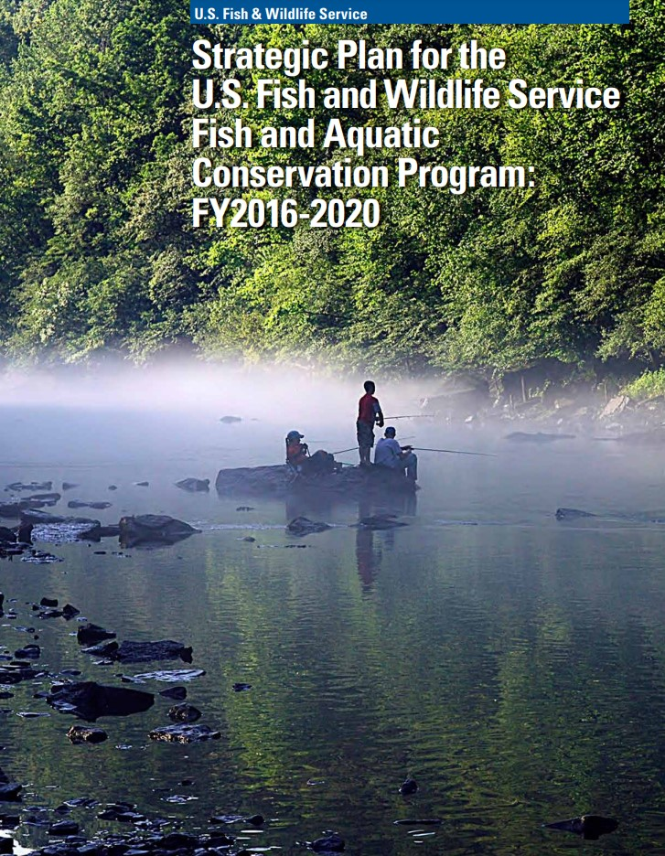
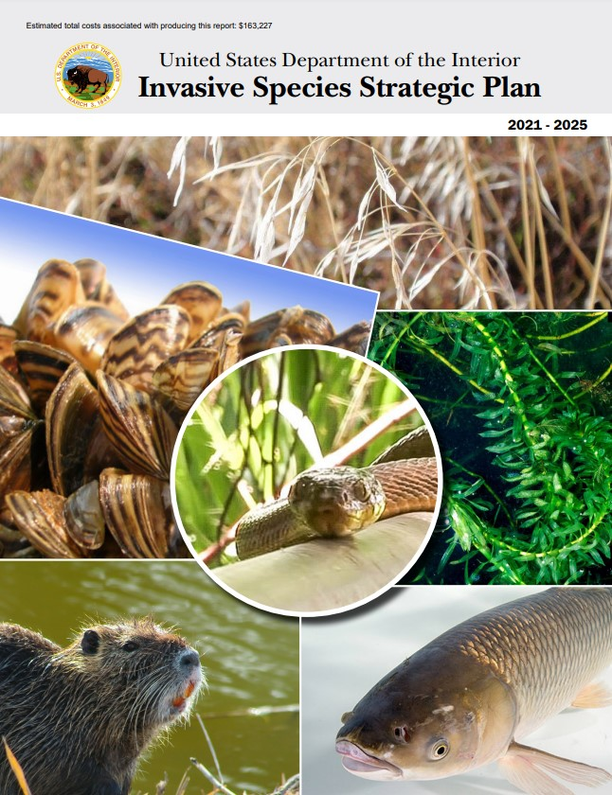
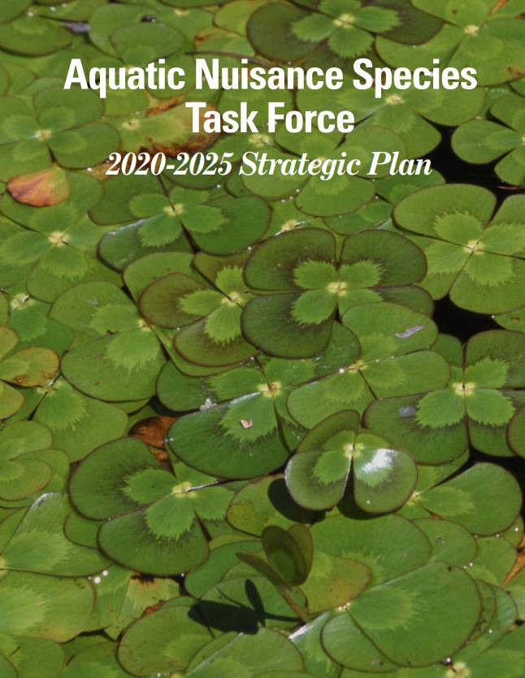
Policy Level Representation
Pacific Region Invasive Species Prevention Policy
FWS FAC Strategic Plan
DOI Invasive Species Strategic Plan
Service Policy Requirements (HACCP, IPM, etc.)
NISC Strategic Plan; ANSTF Strategic Plan

Slide 20
Challenges

Slide 21
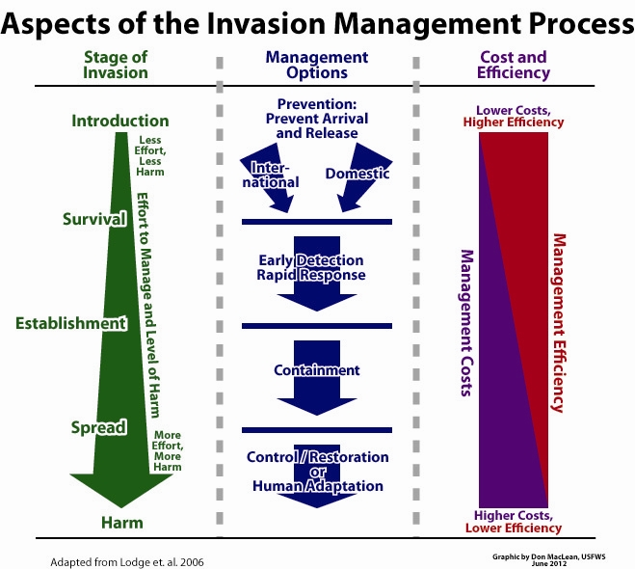
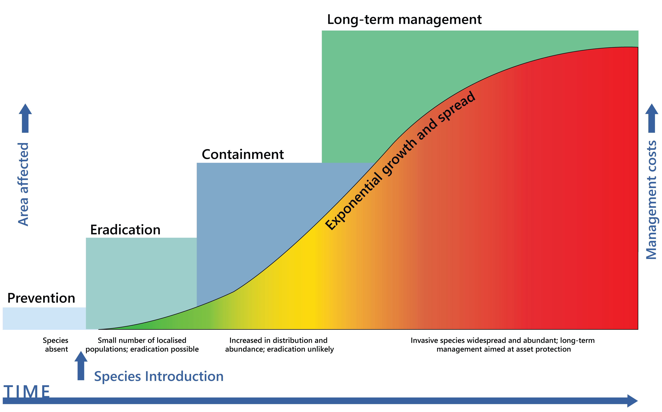
Notes:
You are all very familiar with the invasive species invasion curve, that helps visualize the importance of prevention.
Invasive Species Invasion Curve – (from Invasive Species Council accessed 2021); adapted from Lodge et al 2006
Prevention can be at two levels – international and domestic – we all experienced this with moss balls earlier this year.

Slide 23
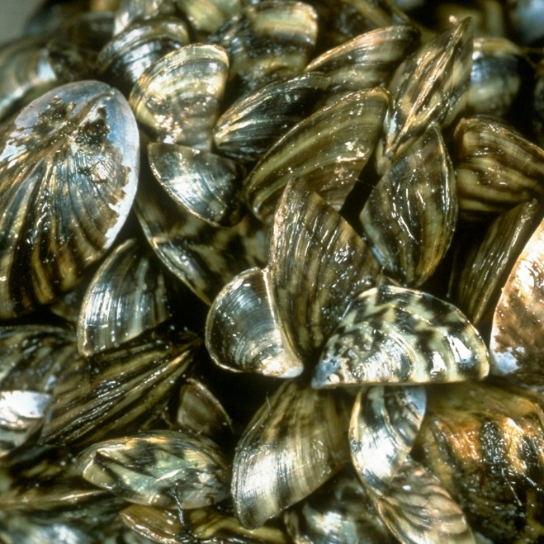
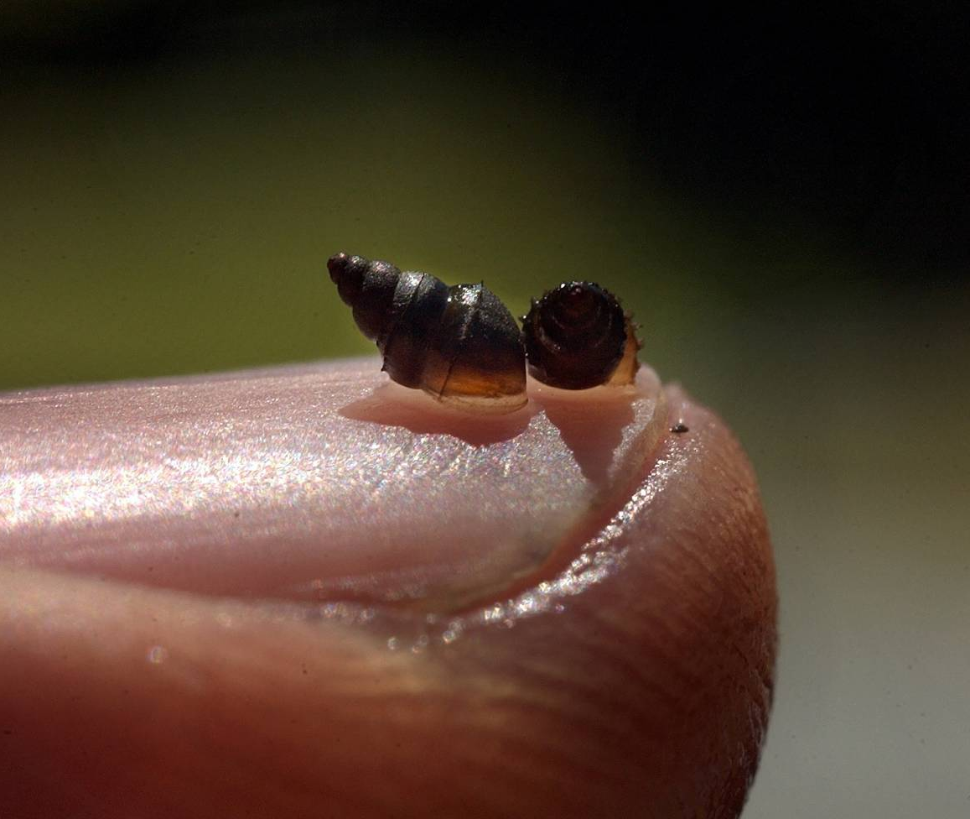
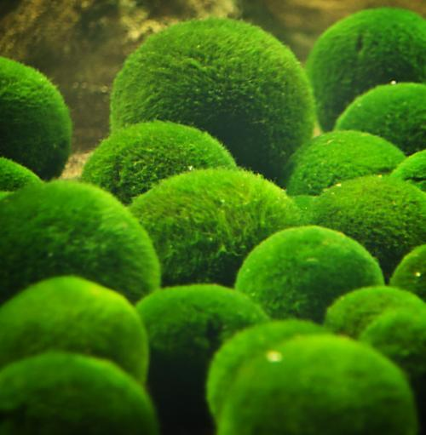
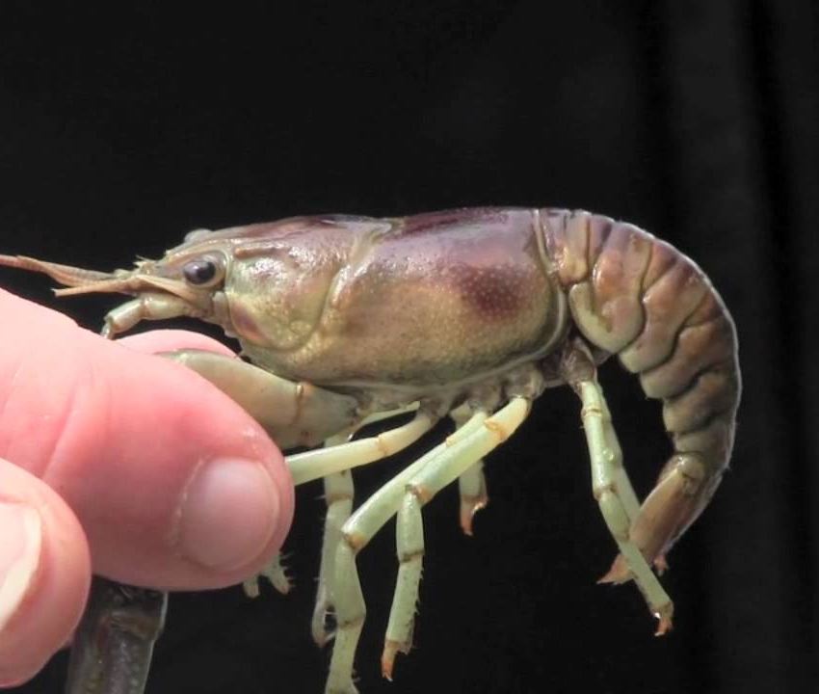
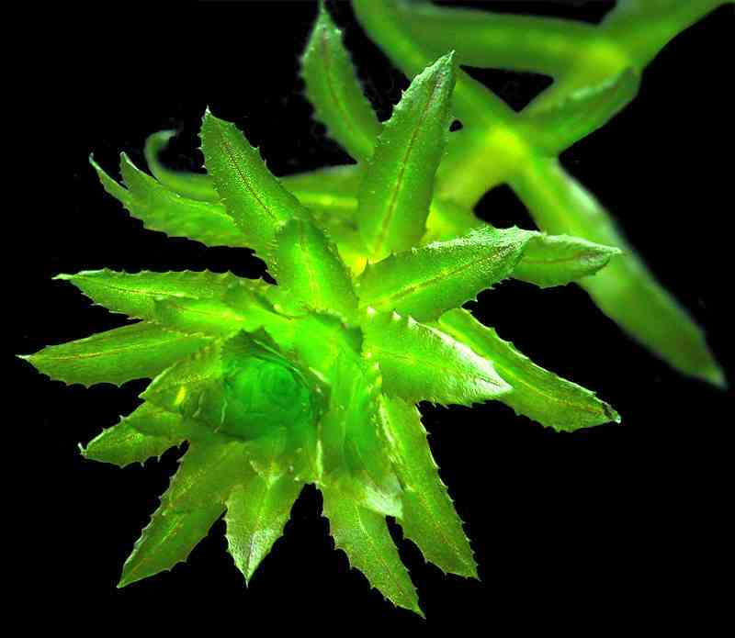

Slide 24
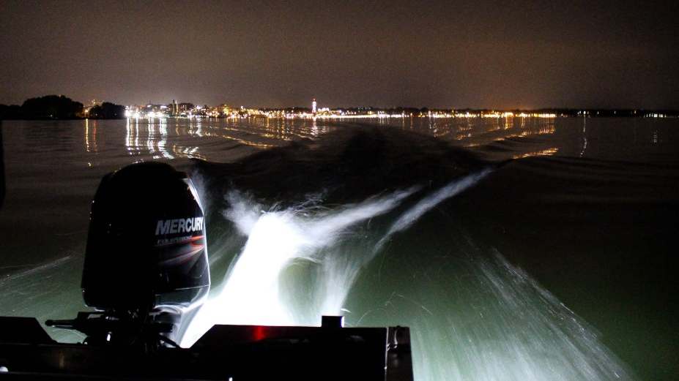
Theresa Thom
971-278-8029
theresa_thom@fws.gov

