Slide 1
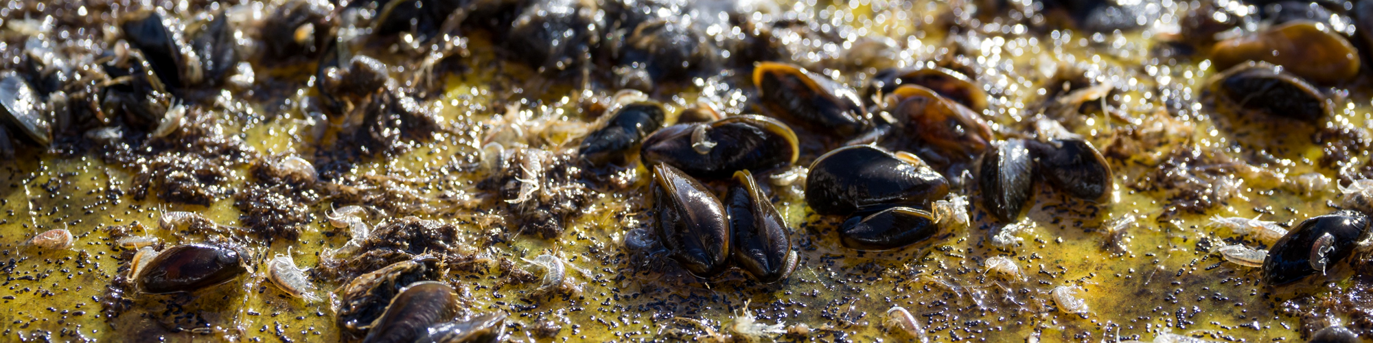

Golden Mussel Status Report
DWR
What’s New - What Next
Columbia River Basin AIS Team Meeting
June 4, 2025| Martha Volkoff
California Department of Fish and Wildlife

Slide 2
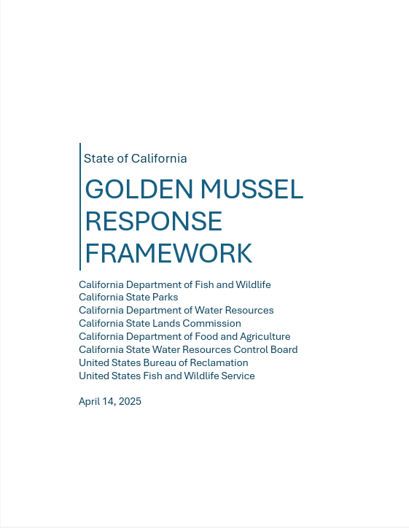
Golden Mussel Response Strategy
Goal: Prevent further spread of GM and minimize their impacts on the environment, economy, infrastructure, and human health.
Objectives
  Communication
  Containment
  Prevention
  Monitoring
  Partner Engagement
  Population Suppression
  Science and Capacity Building

Slide 3
Golden Mussel Response Strategy
Goal: Prevent further spread of GM and minimize their impacts on the environment, economy, infrastructure, and human health.
Objectives
  Communication
  Containment
  Prevention
  Monitoring
  Partner Engagement
  Population Suppression
  Science and Capacity Building

Slide 4
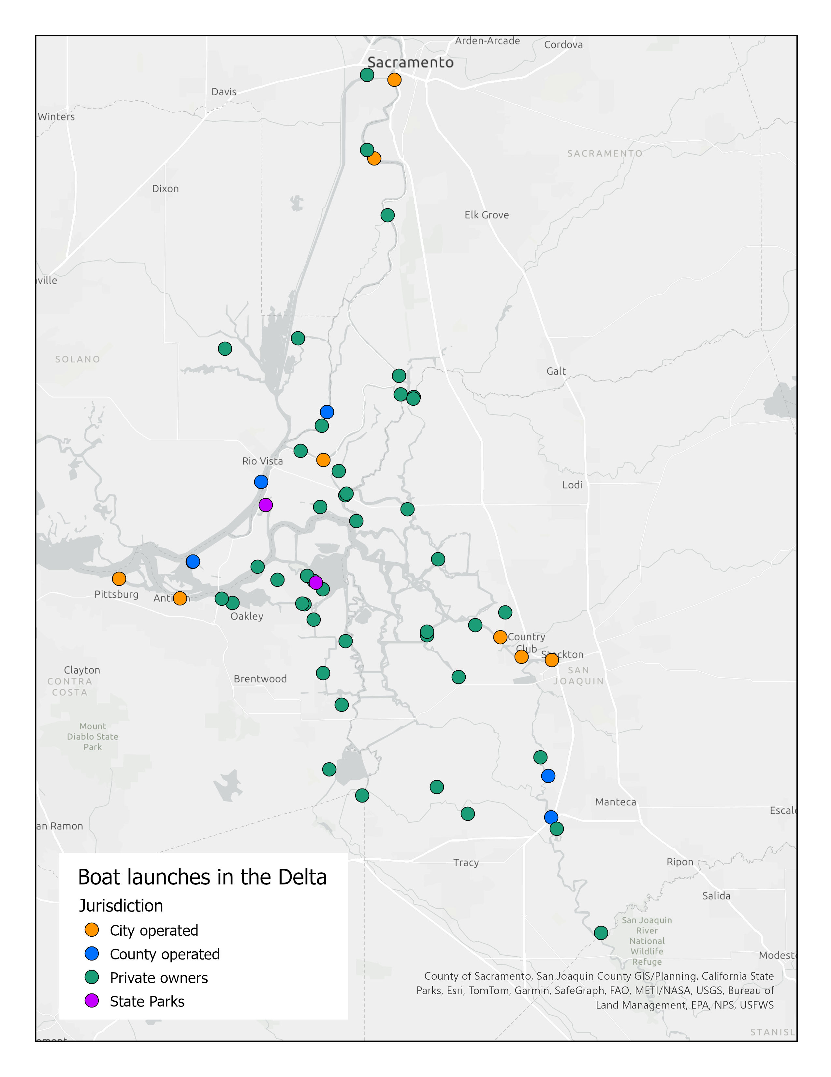
Containment and Prevention Authority
Infested waters (Delta)
  Water supply
  Commerce
  Recreation
Uninfested waters
  Public and private
  State, Federal, and Local management
  Most multi-use

Slide 5
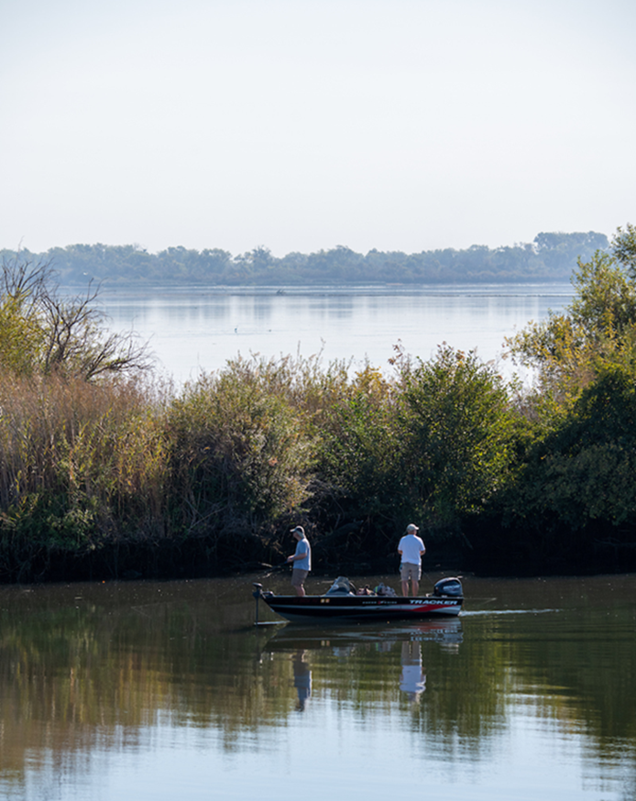
SFRA Boating Access Grant
$1M Funding Opportunity
Eligible projects:
  Equipment
  Facility enhancements
  Training (to implement mussel prevention)
15 applications received totalling $5.7M requested

Slide 6
Challenges
Containment
  Geographic scope
  Cost
Prevention
  Geographic scope
  Cost
  Authority/responsibility

Slide 7
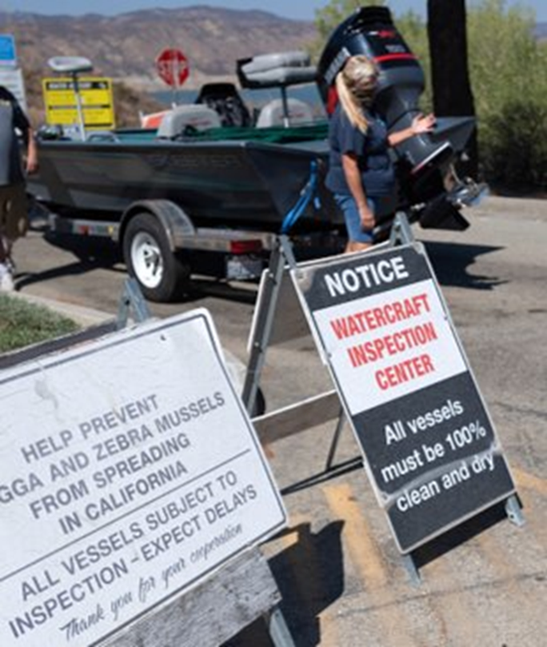
Statewide Coordination of Prevention Programs
State-set standards (UMPS)
WID Database
Develop a network of service providers (public and private)
CDFW oversight and QA/QC
Central website for WID Program details
Benefits
  Standardization
  Improve boater experience
  Lightened demand at launches

Slide 8
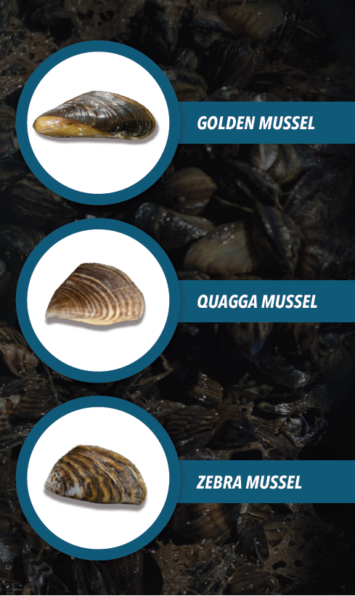
Outreach and Education
Interest in partnering from a major retail corporation
Developing a comprehensive OR Plan
Samples and displays

Slide 9
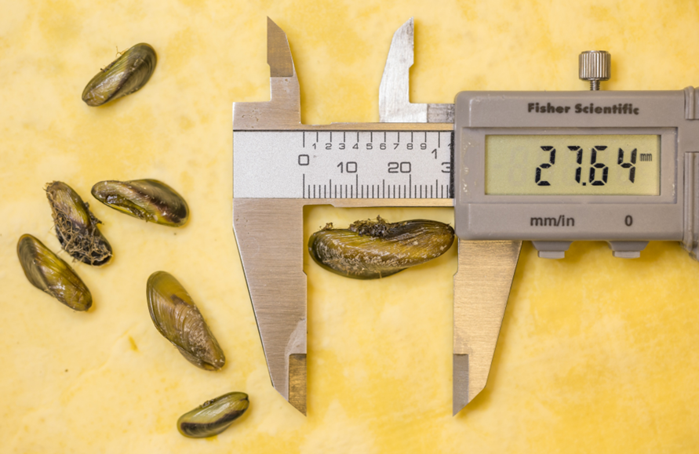
Research and Capacity Building
Veliger identification
Veliger survival in entrapped water
Lethal conditions (hot water, drying; temps and duration)
Equipment decon chemical efficacy
Molluscicide toxicity
Salinity tolerance
Settlement rates
DWR

Slide 10
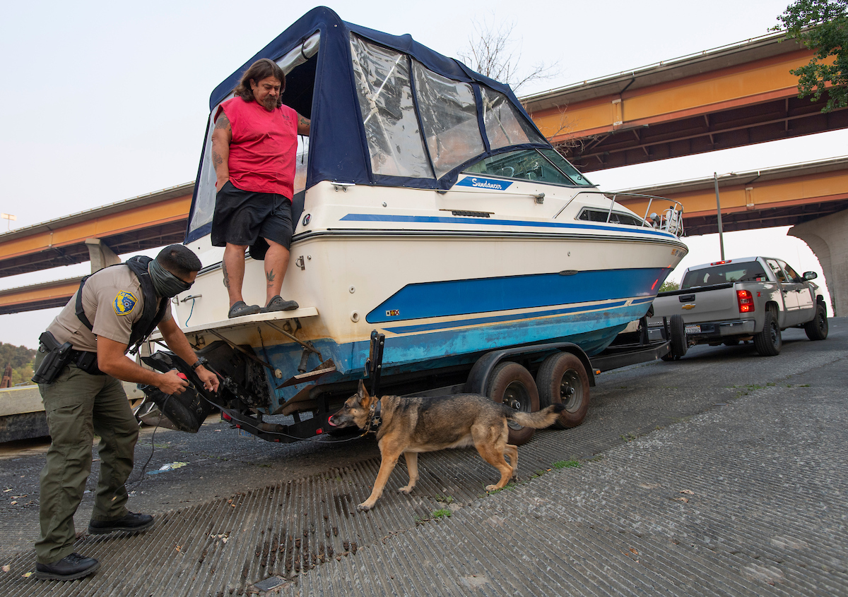
Questions | Contact
Martha Volkoff
Invasive Species Program
Fisheries Branch
Invasives@wildlife.ca.gov
DWR

