Slide 1
Understanding Spatial/Temporal Variability to Improve Confidence in Water Quality Based Establishment Risk

Slide 2
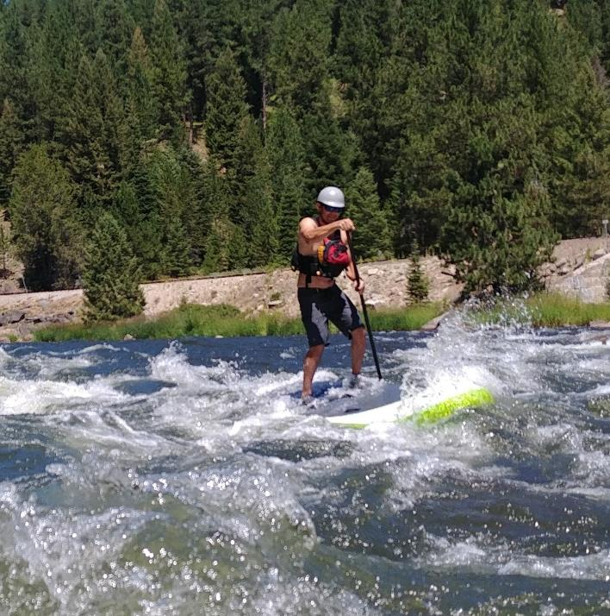
Lentic Lotic
Lakes/Reservoirs Streams/Rivers
Today’s focus Ask me later

Slide 3
Mussel Invasion Risk
Introduction Risk
How likely are mussels to be introduced
Establishment Risk
How likely are mussels to develop a self sustaining population if introduced

Slide 4
Establishment Risk
Extent of drawdown
Floating structure presence
Veliger concentration potential
Enclosed bays, marinas, wave breaks
Residence time
Water quality
DO
Temperature
Calcium
pH
Other/Unknown

Slide 5
Establishment Risk
Extent of drawdown
Floating structures
Veliger concentration potential
Residence time
Water quality
DO
Temperature
Calcium
pH

Slide 6
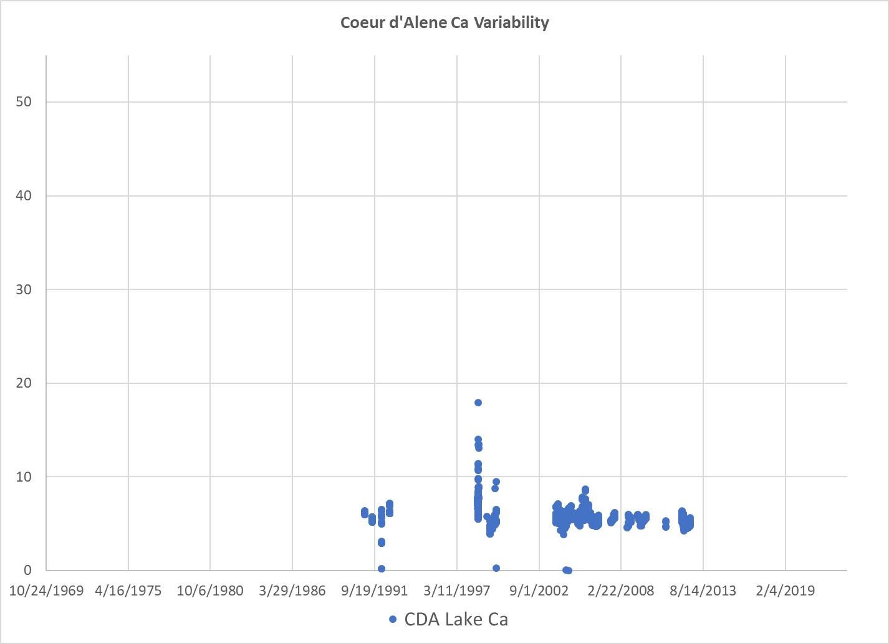
Calcium Establishment Risk Categories
High Risk >20
Calcium mg/L
Medium Risk 8-20
Low Risk 0-8

Slide 7
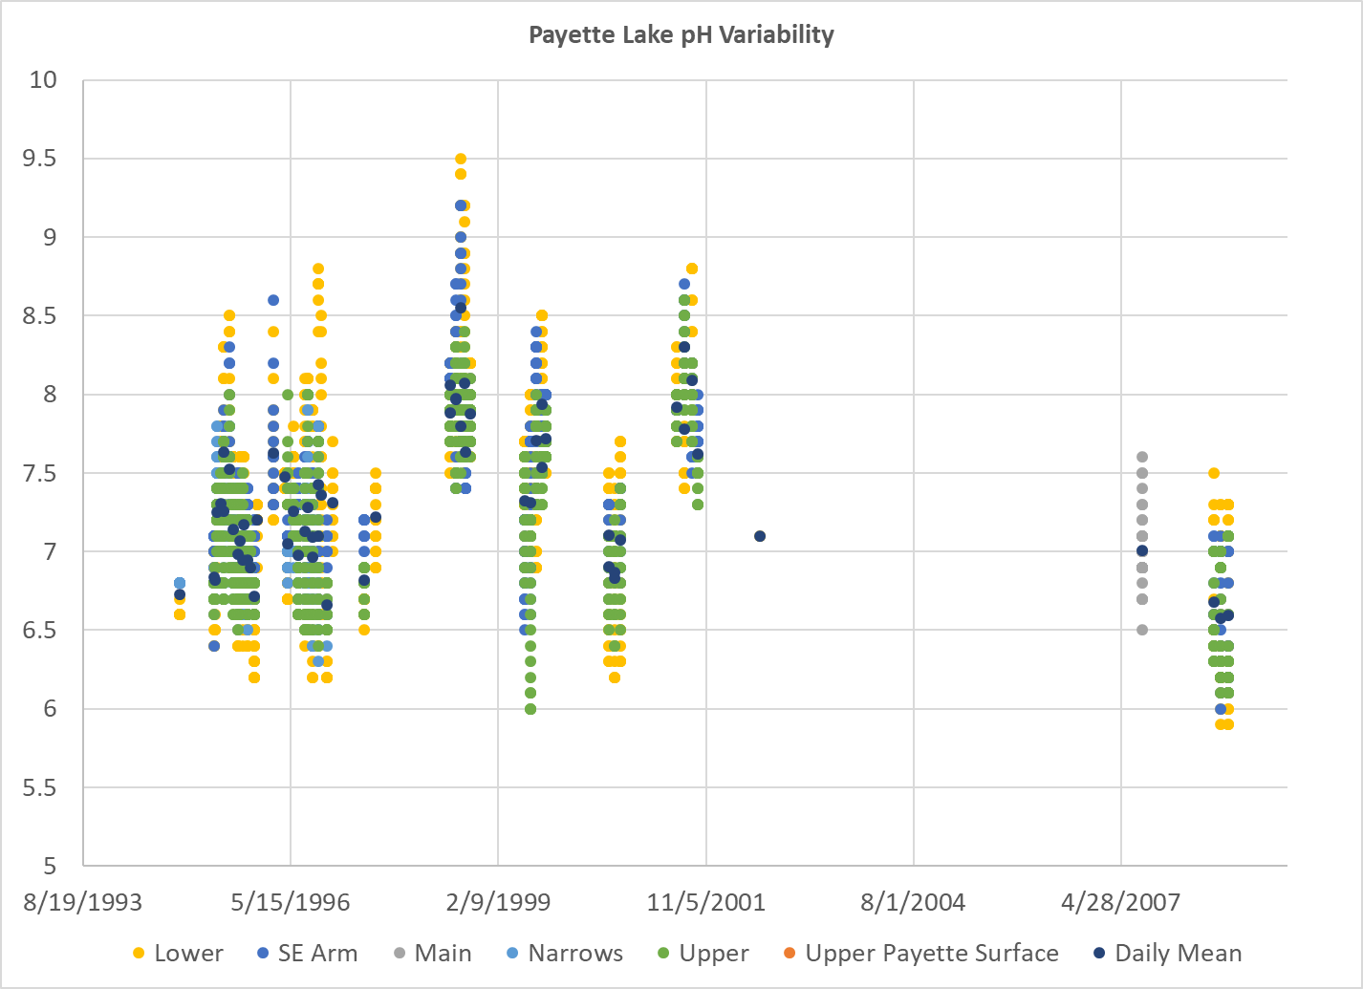
pH Risk Categories
pH Establishment Risk Categories
Low Risk
Medium Risk
High Risk
pH
Medium Risk
Low Risk

Slide 8
Risk Category Development
Lab studies with stable calcium and pH levels
Field studies with natural variability in calcium and pH
Uncertainty exists in spatial and temporal variability in sampling for field studies
Acknowledge variability and use mean value
Mean values are often being used for risk analysis

Slide 9
Variability… Mean vs. Range vs. break points?
Calcium
pH

Slide 10
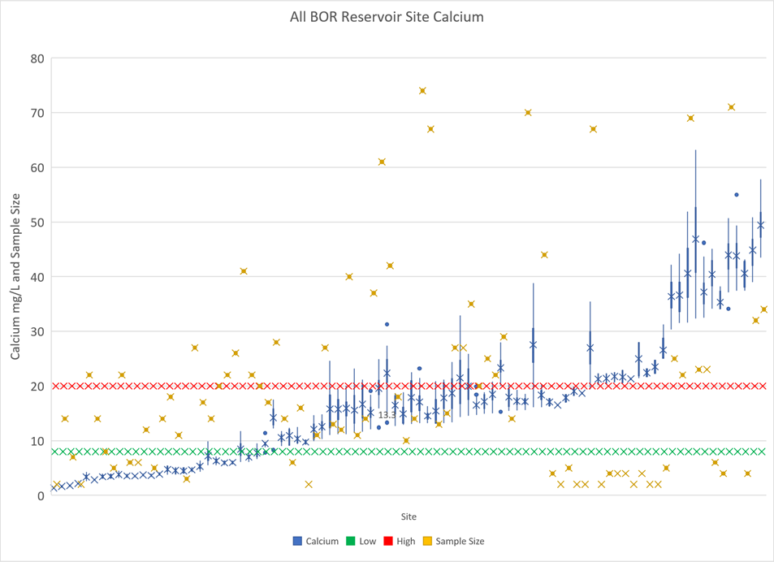
All C-PN Reclamation Lentic Site Calcium

Slide 11
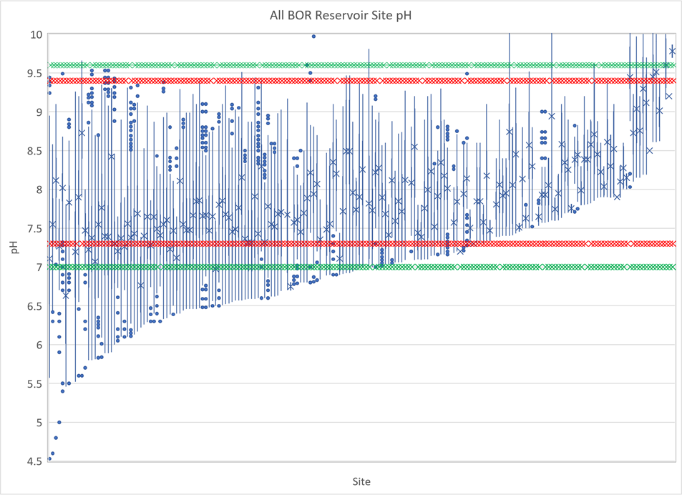
All C-PN Reclamation Lentic Site pH
pH is more complicated

Slide 12
Biological Activity and pH
Atmospheric CO2 is dissolved into the water
Adding more CO2 (respiration) decreases pH by creating carbonic acid
Taking out CO2 (photosynthesis) increases pH
Carbon dioxide dissolved in water creates CARBONIC ACID

Slide 13
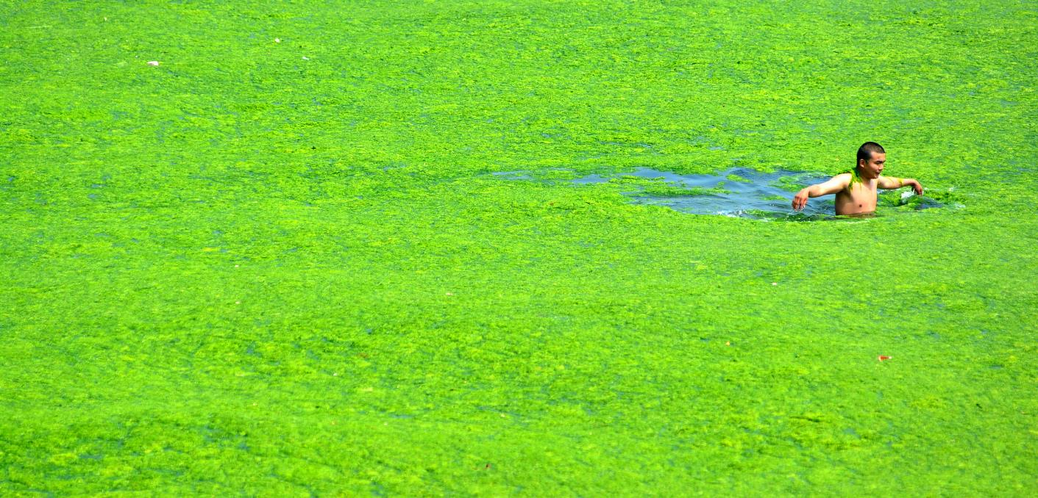
Photosynthesis
Increases pH
Mainly above thermocline

Slide 14
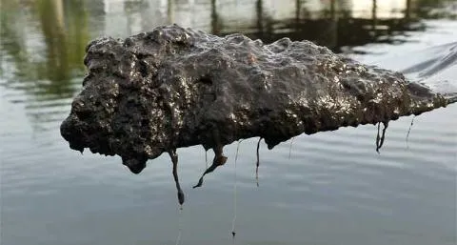
Respiration
Decreases pH
Mainly below thermocline

Slide 15
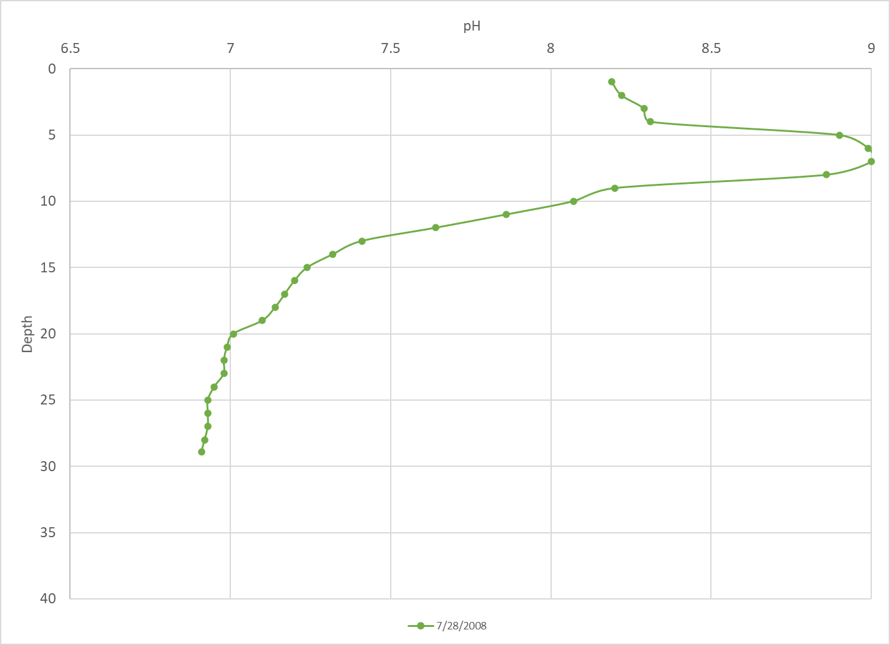
pH Depth Profile
7.61 mean

Slide 16
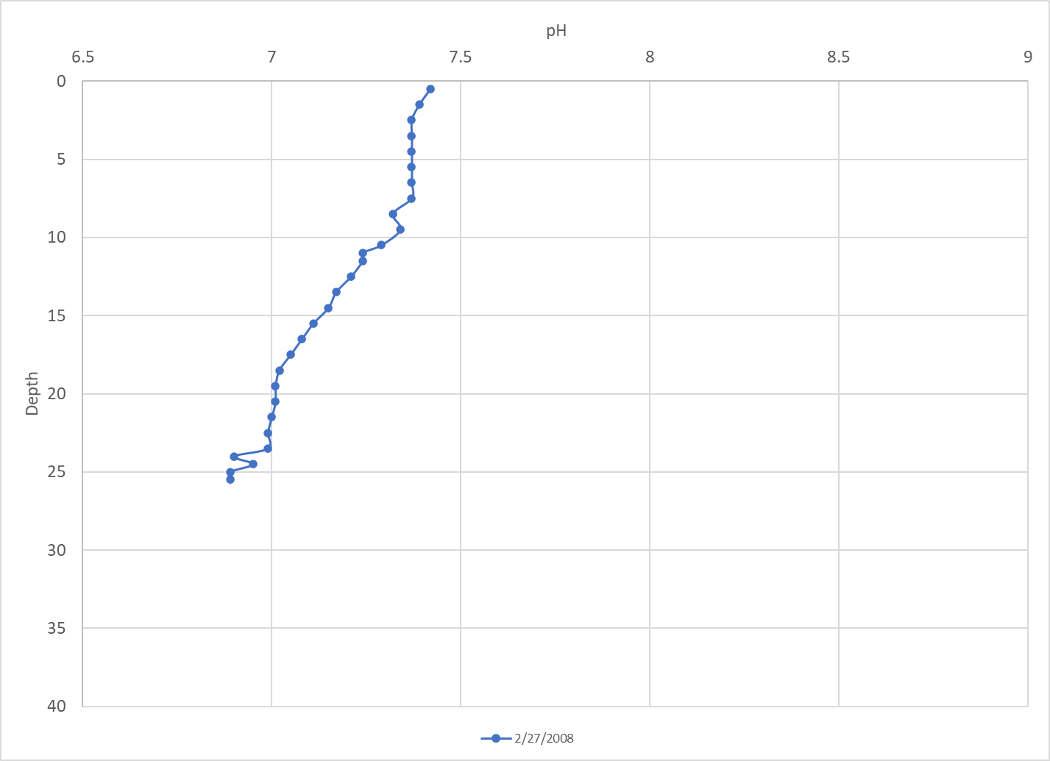
7.17 mean
Seasonal Variation

Slide 17
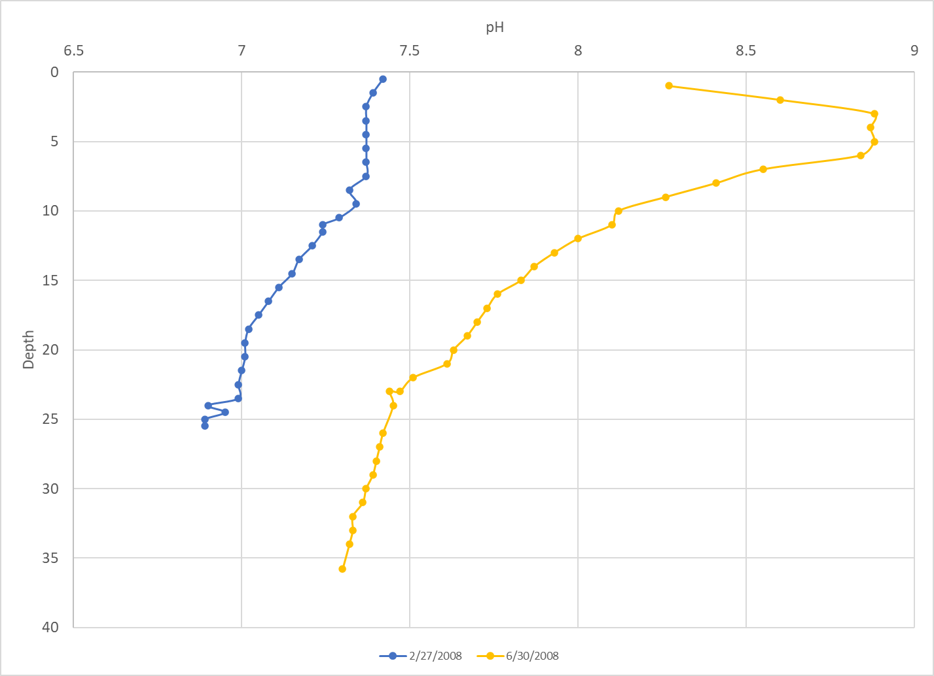

Slide 18
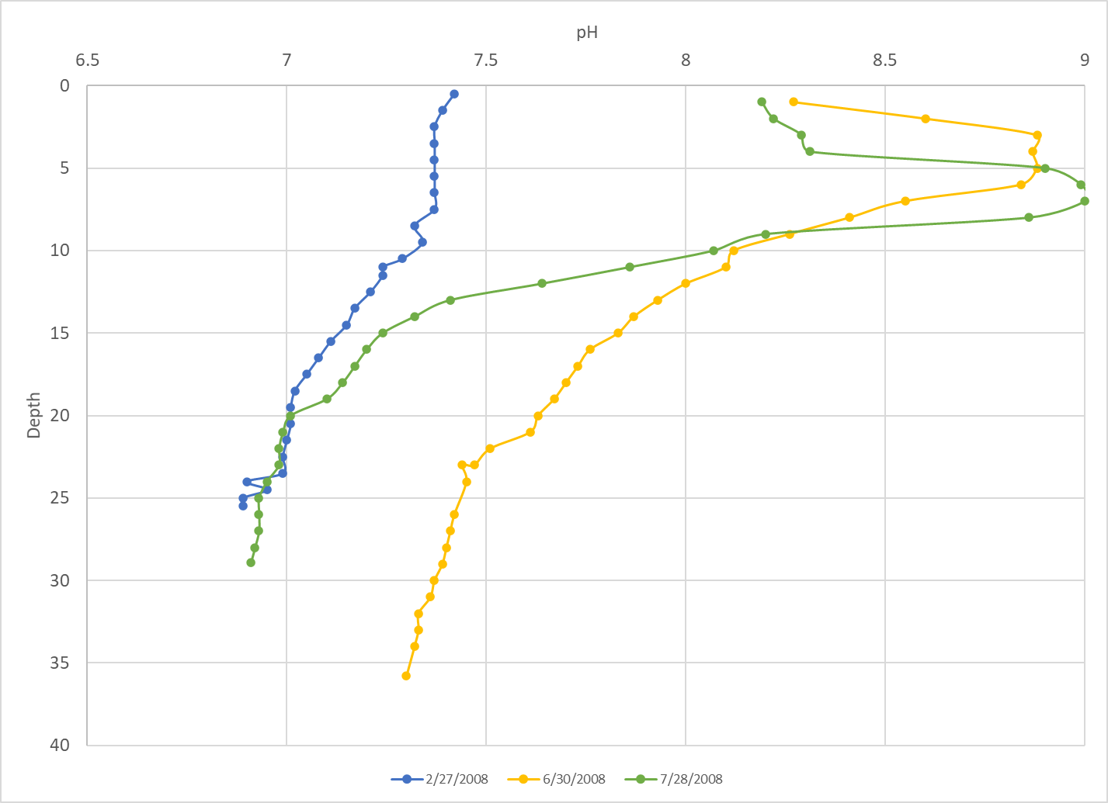

Slide 19
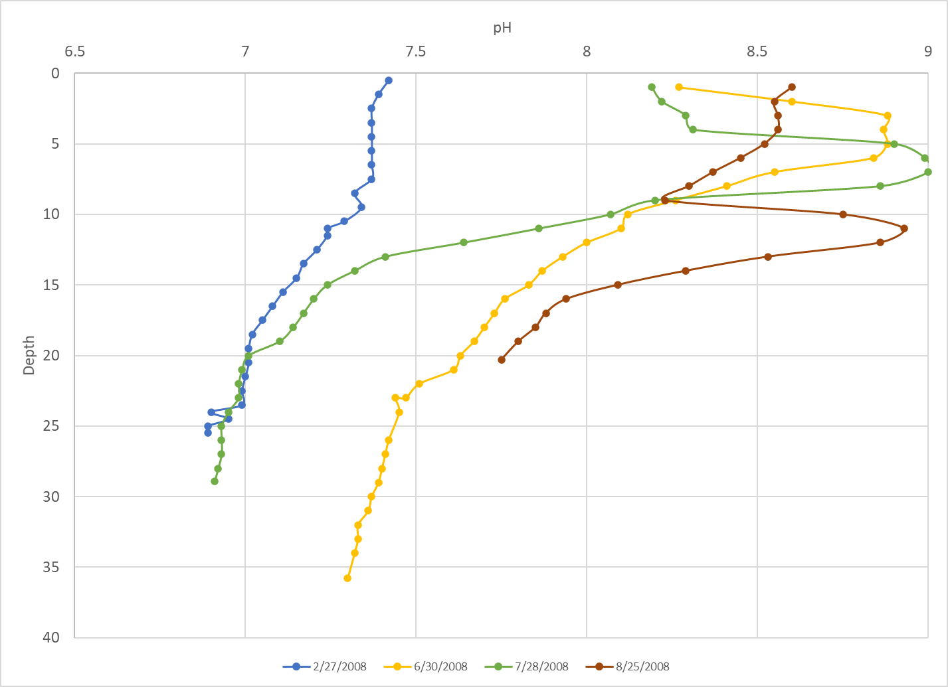

Slide 20
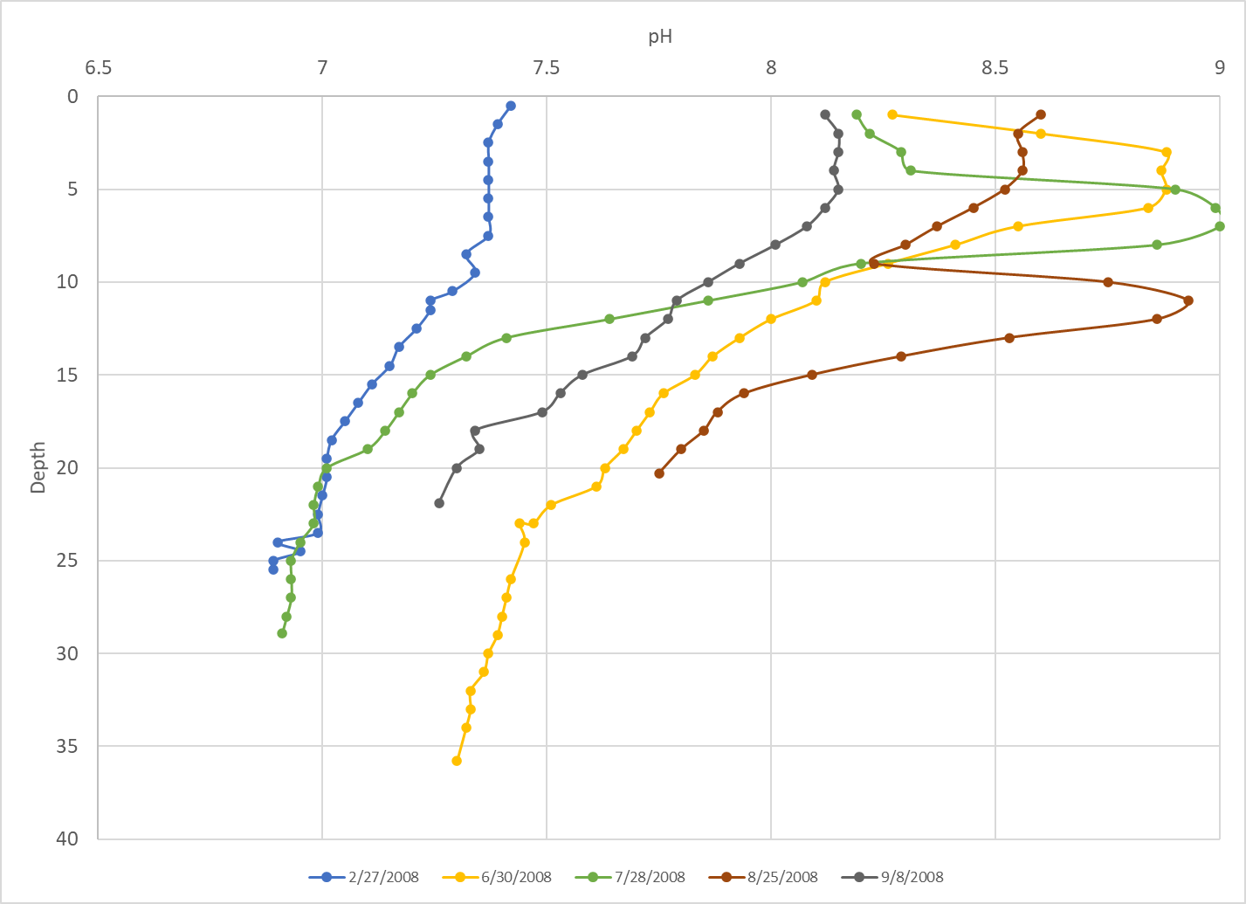

Slide 21
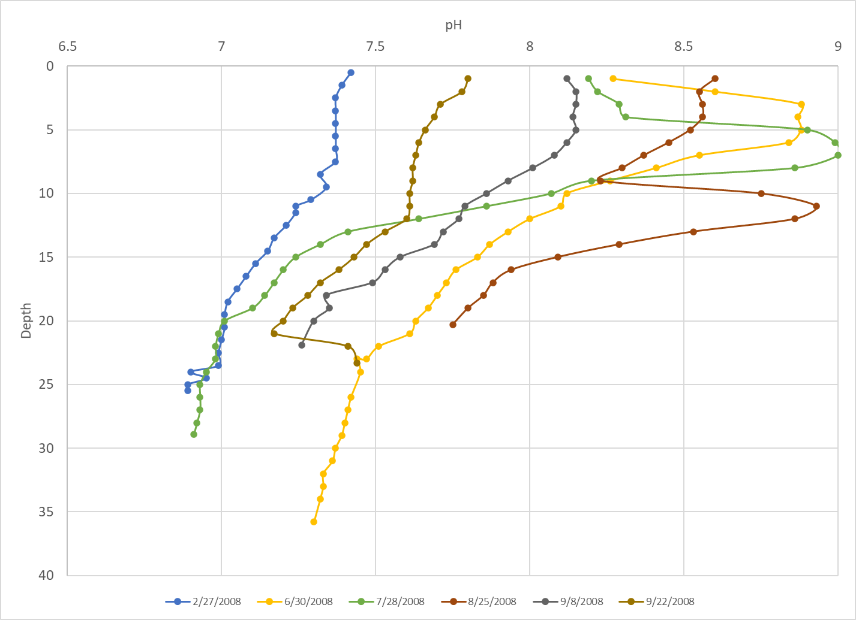

Slide 22
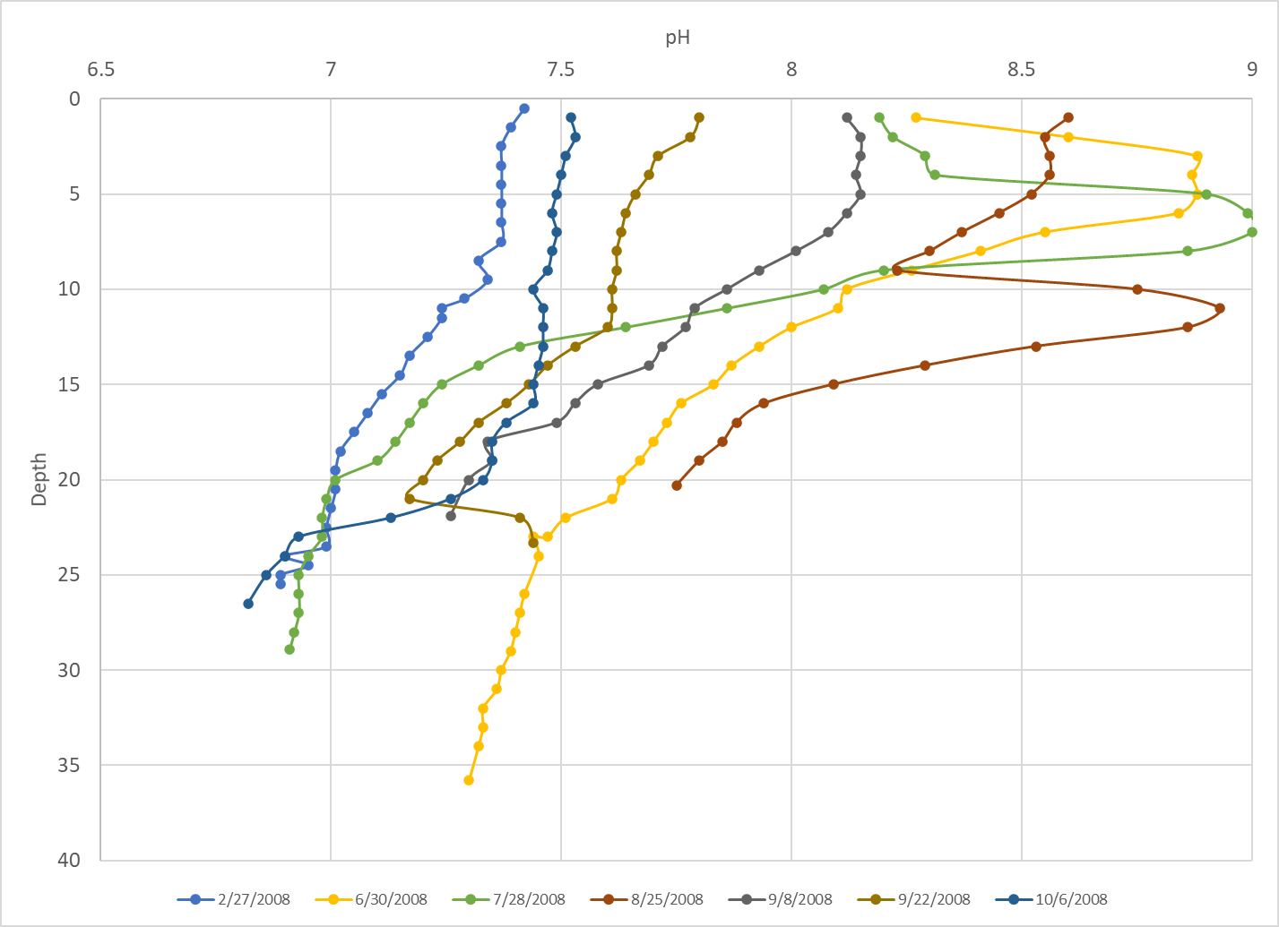
7.65 mean 2008
7.39 mean all years

Slide 23
All C-PN Reclamation Lentic Site pH
pH is more complicated

Slide 24
Interannual variation

Slide 26
Mean of
Means
Lower 7.3
SE Arm 7.3
Main 7.0
Narrows 7.0
Upper 7.2
Max of Means
8.6
8.4
7.0
7.5
8.2
Min of Means
6.5
6.6
7.0
6.6
6.5
Count of Means
49
43
1
22
42

Slide 27
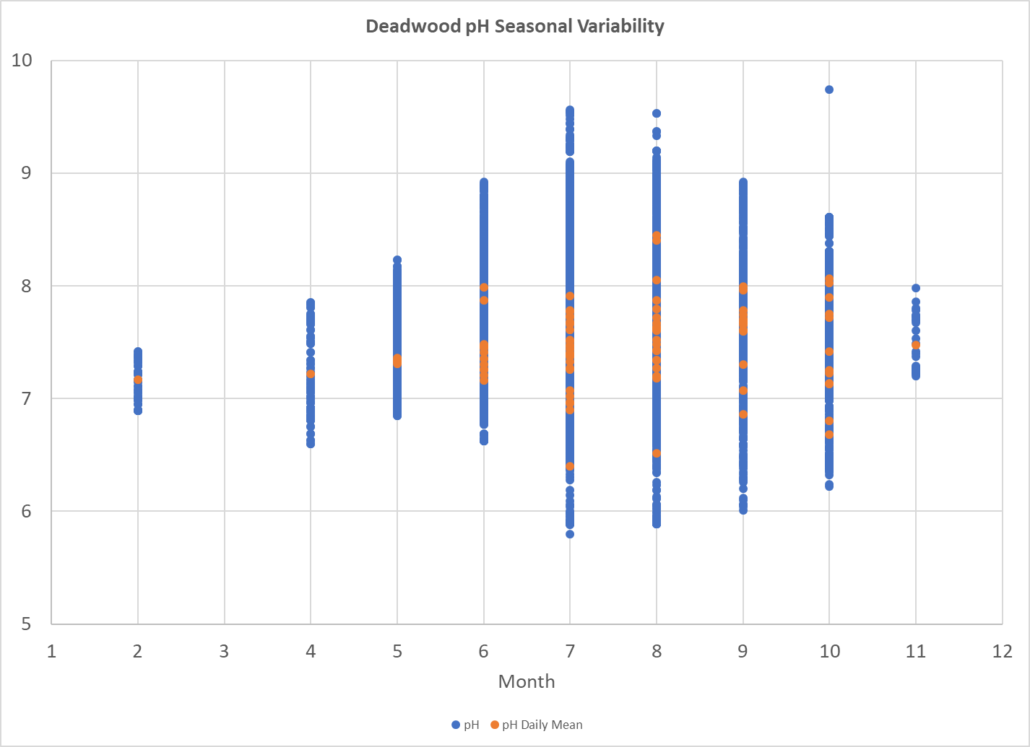
Deadwood Overall Variability

Slide 28
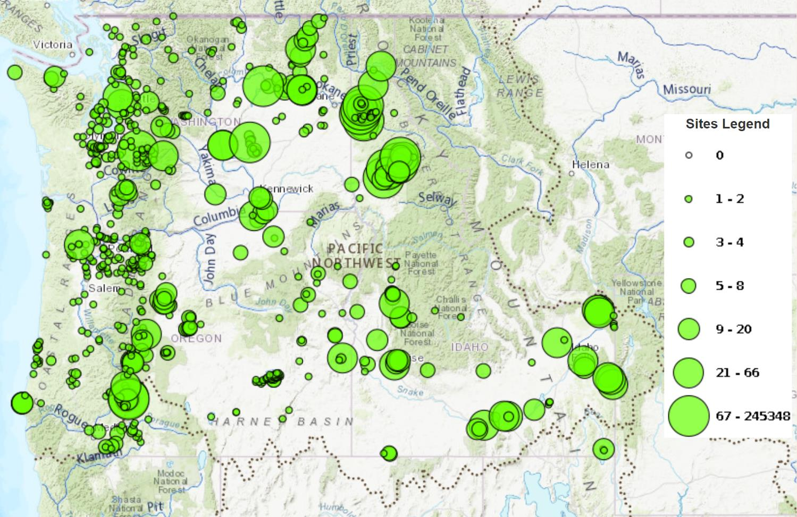
Calcium Data Distribution (982 sites)

Slide 29
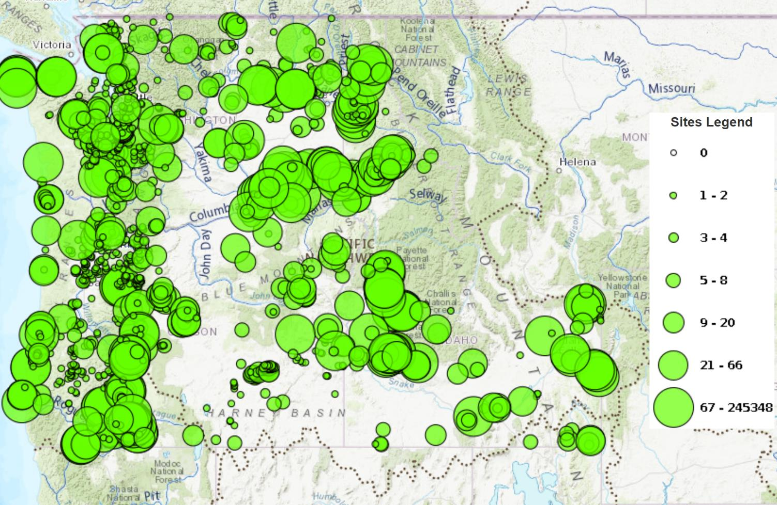
pH Data Distribution (1996 sites)

Slide 30
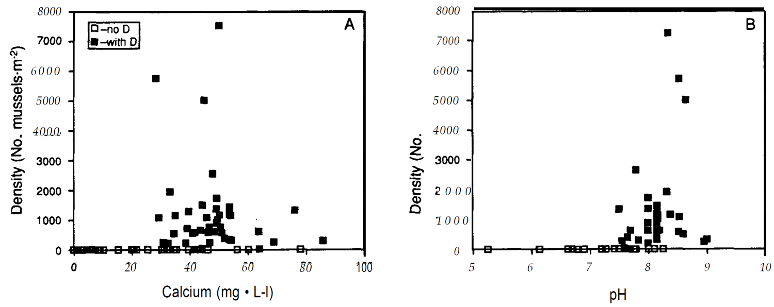
Variable pH in the field
Field based pH data for 7.3 cut off is from one study using mean pH at “278” European lakes from other literature

Slide 31
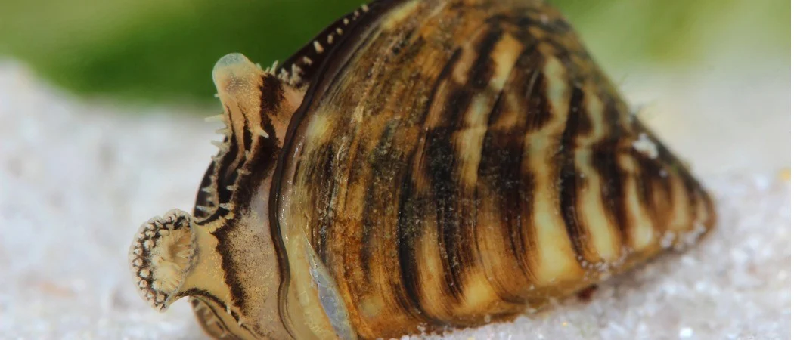
Constant pH in the Lab
Lab studies at a constant pH show increased mortality with pH <7.3

Slide 32
Correlation but not Causation?
Lab and field studies show pH of 7.3 as significant
Field sites with a mean of 7.3 will have some areas constantly with higher pH levels where mussels would survive in the lab

Slide 33
Calcium, pH and Alkalinity Interactions
Calcium and alkalinity are often highly correlated
Both derived from calcium carbonate
Alkalinity (resistance to acidification) regulates the extent of pH variability
For mean pH of any individual profile to be “low” alkalinity must be also be “low”
“Low” pH= “low” alkalinity = “low” calcium
“Low” pH = “low” calcium

Slide 34
What is “low?”

Slide 35
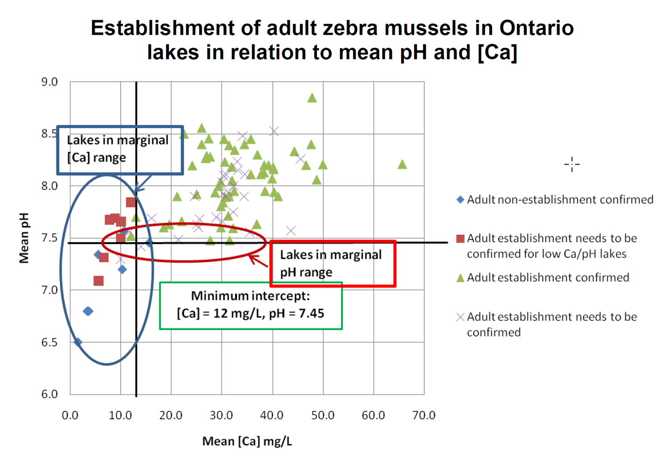

Slide 36
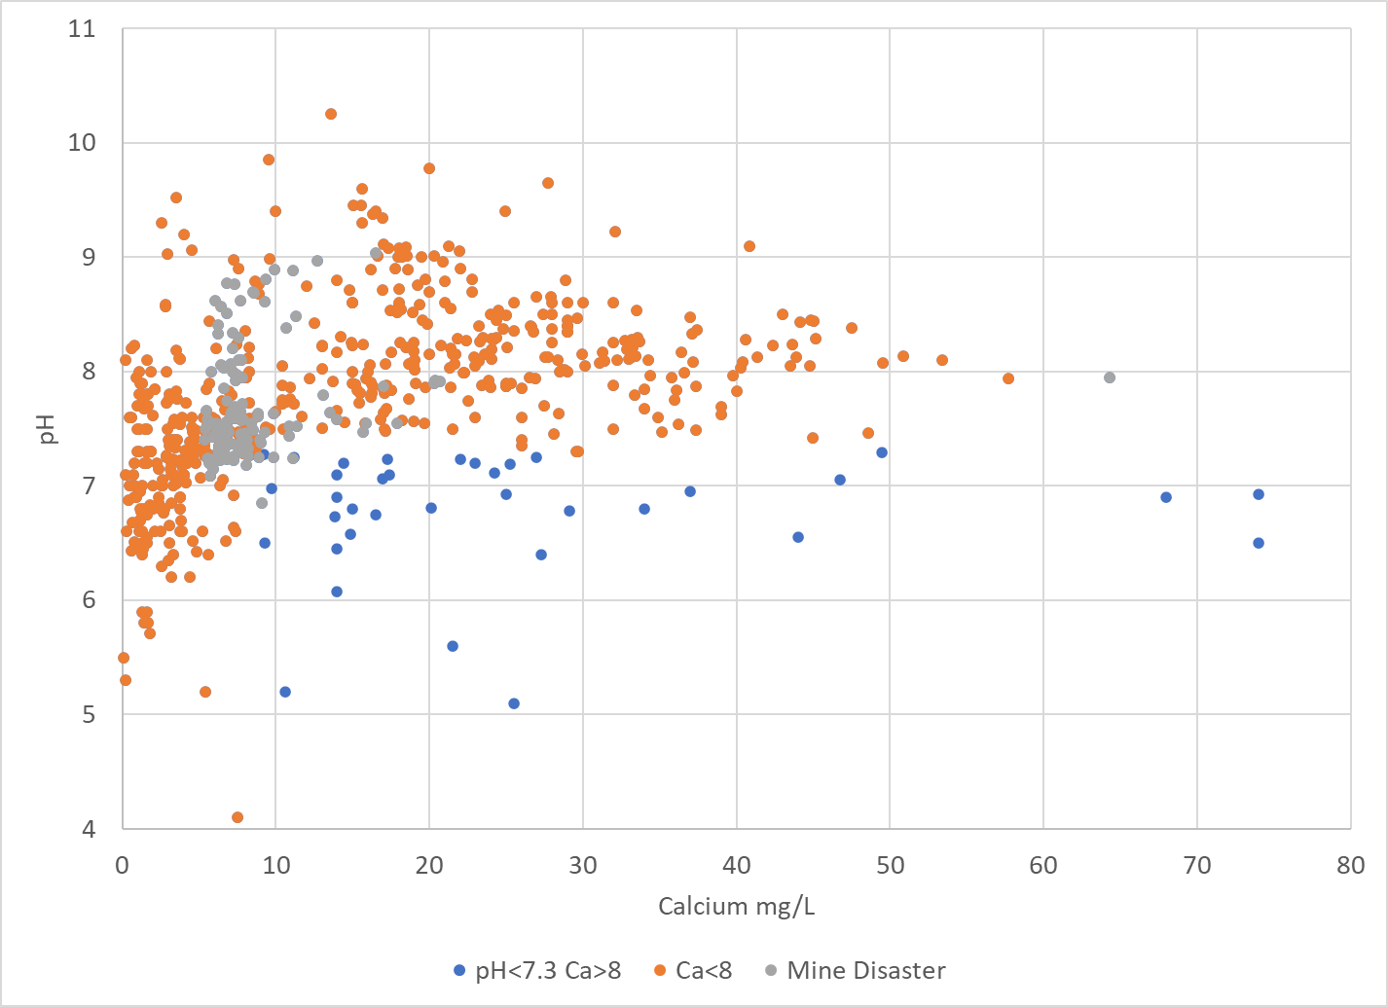
All Columbia basin WQP Lake/Reservoir Data
Notes:
In other words, if we can better understand the sites in the red box, we may be able to use the relationship in the green box. So what sites are in the red box?

Slide 37
All WQP Lake/Reservoir Data
15 lake sites on Mount Saint Helens
4 more in volcanic craters in Oregon
5 Mine Sites
2 bogs
4 High Mountain Lakes in Teton NP (70s-81 and n=1)
10 Sites with low pH sample size (n≤3)
2 “Normal” sites all with pH>7.27 Ca<8.5
Notes:
Of the 42 sites with pH<7.3 AND Ca<8…
19 are influenced by volcanic activity
5 are in tailings or during mining disasters
2 are bogs
14 have 3 or fewer sampling events. Most of these events are single sample sand not profiles. At 8 of those 14 sites, data from another site on the same waterbody is available the profile shows a mean pH>7.3
I called out the 4 sites in Teton NP high mountain lakes as they are really old data too
Only 2 of the 42 sites would be someplace I would consider “Normal” and they are very close to not making the cut off for both pH and Ca

Slide 38
pH Risk: Direct vs Indirect
There are some direct influences of pH on mussels ability to build and maintain shells.
The overall correlation between calcium and pH is only 0.33, but it looks like there is an important relationship with some caveats
Field studies in the literature may describe a relationship between pH and mussels that could be, at least in part indirect through calcium
Notes:
So what does this mean? I assume Ramcharan 1992 checked for a correlation between Ca and pH before publishing separate tables and results for each variable in relation to mussel populations. The overall correlation for Reclamation data (0.22) and all WQP Lentic data (0.33) suggest they would not have found any. That doesn’t mean there isn’t a relationship.

Slide 39
Confidence in calcium risk
Field and lab studies show similar critical values
Field data is not as variable as pH
Low calcium concentrations are more stable as they are below carrying capacity in most if not all of the pH range
Higher calcium concentrations are less stable as fluctuating pH alters the carrying capacity
Causes of variability are mostly influential above risk break points

Slide 40
All C-PN Reclamation Lentic Site Calcium

Slide 41
This pattern is similar for CRB as a whole
695 sites with more than one calcium measurement on the Water Quality Portal
A few exceptions
Mine sites
Lakes on volcanoes
Lakes near ID/NV border
Lake McDonald
Flathead Lake

Slide 42
Confidence in Calcium Risk
With very few exceptions no sites in CRB have calcium measurements in both the low and high risk categories
Mine sites
Lakes on volcanoes
Lakes on ID/NV border (extreme evaporation reduces carrying capacity through salts)
Lake McDonald (likely data error 14,000 mg/L vs 13mg/L)
Flathead Lake (Low calcium data is from ’79, Any Ideas? Flooding?)

Slide 43
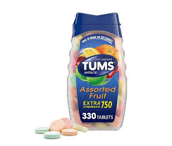
Calcium Summary
Calcium seems to be the best metric to inform risk
Note exceptions for
Extreme Evaporation
Local Mining Influence
Volcanic influence
If pH is also available, it may not add anything

Slide 44
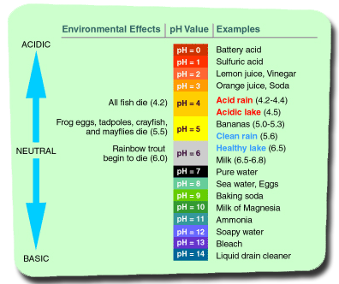
pH Summary
If only pH data is available, use with caution
Surface measurement vs profile
High spatial and temporal variability
Unknowns exist where high calcium levels persist at low pH
Mine influence
Volcano Influence
“Low” pH could prioritize where to focus calcium sampling

Slide 45
Small part of overall risk
Introduction Risk
Extent of drawdown
Floating structure presence
Veliger concentration potential
Enclosed bays, marinas, wave breaks
Residence time
Water quality
DO
Temperature
Calcium
pH
Other/Unknown

Slide 46
Potential Future Research
Look at available data to investigate if a single profile with a mean pH less than 7.3 or 7.0 is related to mussel presence and/or calcium levels
Investigate quantifying other risk factors
Presence of floating marinas
Veliger concentration potential

Slide 47
Anthony Prisciandaro
Aprisciandaro@usbr.gov
208-383-2233
Questions?

Slide 48
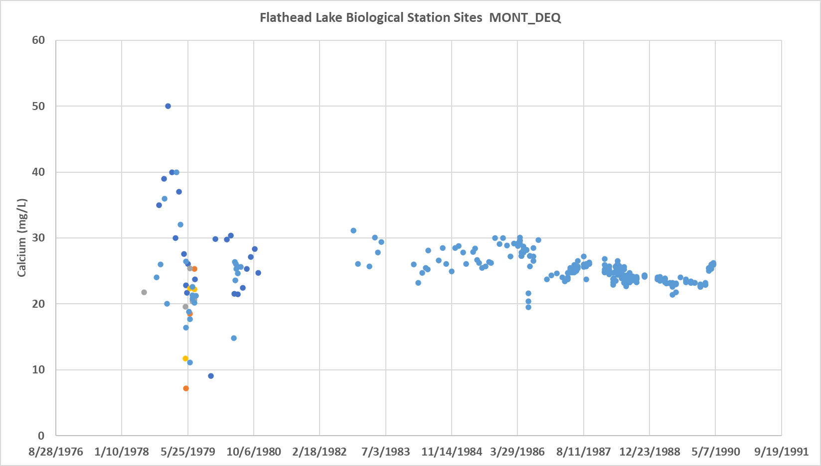
Flathead Lake Sites 1979

