Slide 1
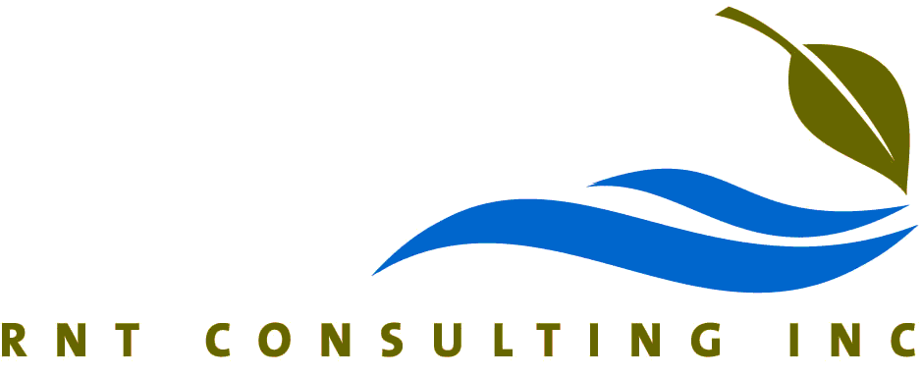

Evaluation of the Efficacy of HOD UV for Control of Invasive Mussels in Turbid Waters
Renata Claudi MSc., T. Prescott P.Eng MSc, Ytzhak Rozenberg
RNT Consulting and Atlantium Technologies
June 4, 2025
Atlantium Technologies

Slide 2
Main biofoulers which impact industrial cooling water systems
Freshwater
Zebra Mussels
Quagga Mussels
Golden Mussels
Asian Clams
Salt Water
Marine Mussels
Tube worms
Barnacles

Slide 3
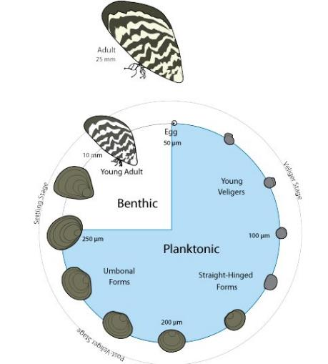
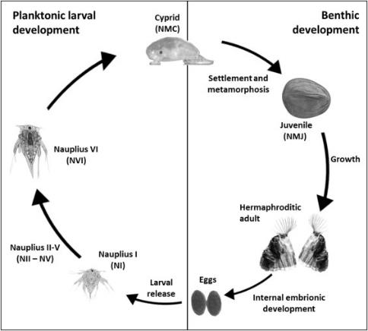

Slide 4
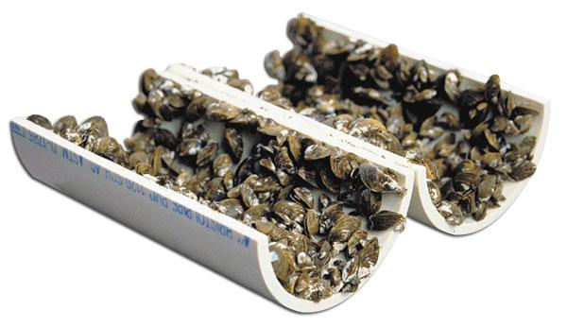
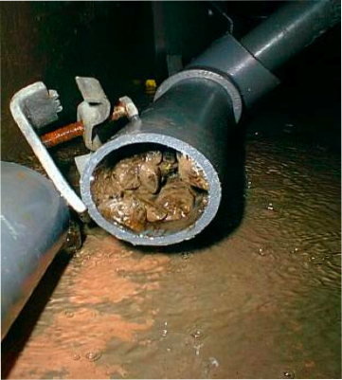
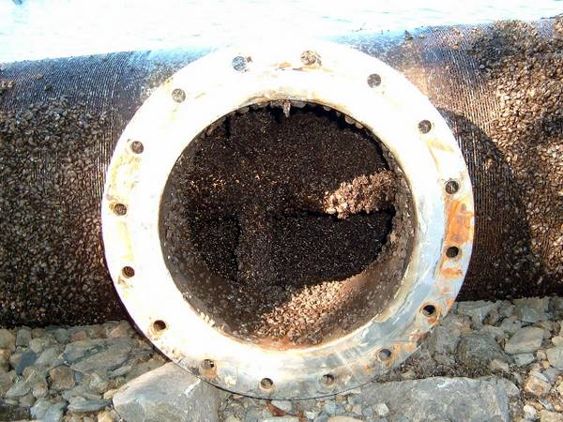
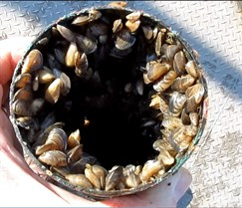
Controlling Zebra Mussels:
SUBSCRIBER CONTENT: Jul 22, 2011, 3:00am PDT
« Back to article

Slide 5
Common Control Strategies
Chemical
Oxidizing Chemicals
Non Oxidizing Chemicals
Physical
Strainers/filters
Antifouling Coatings
HOD UV

Slide 6
UV Based Control
Experimental studies carried out in the 1990’s with number of different UV sources have shown that a dose of approx. 100 mW‑s/cm²delivered by medium pressure lamps would prevent downstream settlement of dreissenid larvae

Slide 7
Quantification of minimum HOD- UV dose required for control of quagga mussel settlement – 2012 study sponsored by Atlantium Technologies
Medium pressure lamps
Raw Colorado River water with high density of live veligers; no in-line filter
Volume treated - 7m³/hr
Comparison of settlement before and after UV light treatment using different UV dose

Slide 8
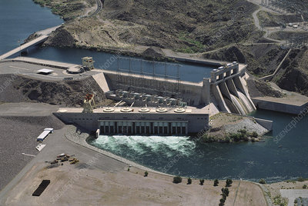
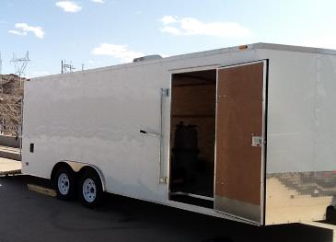

Slide 9
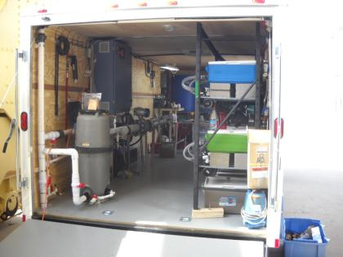
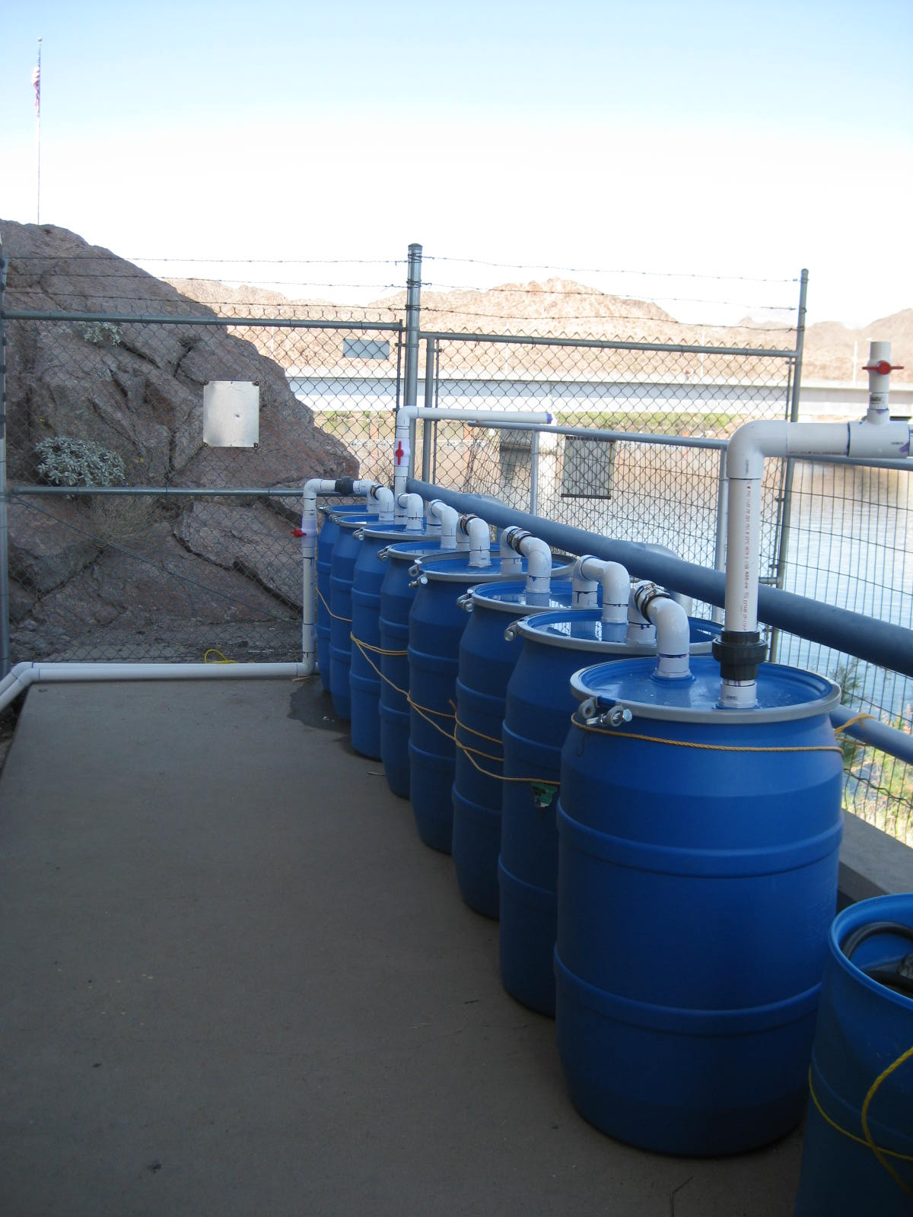

Slide 11
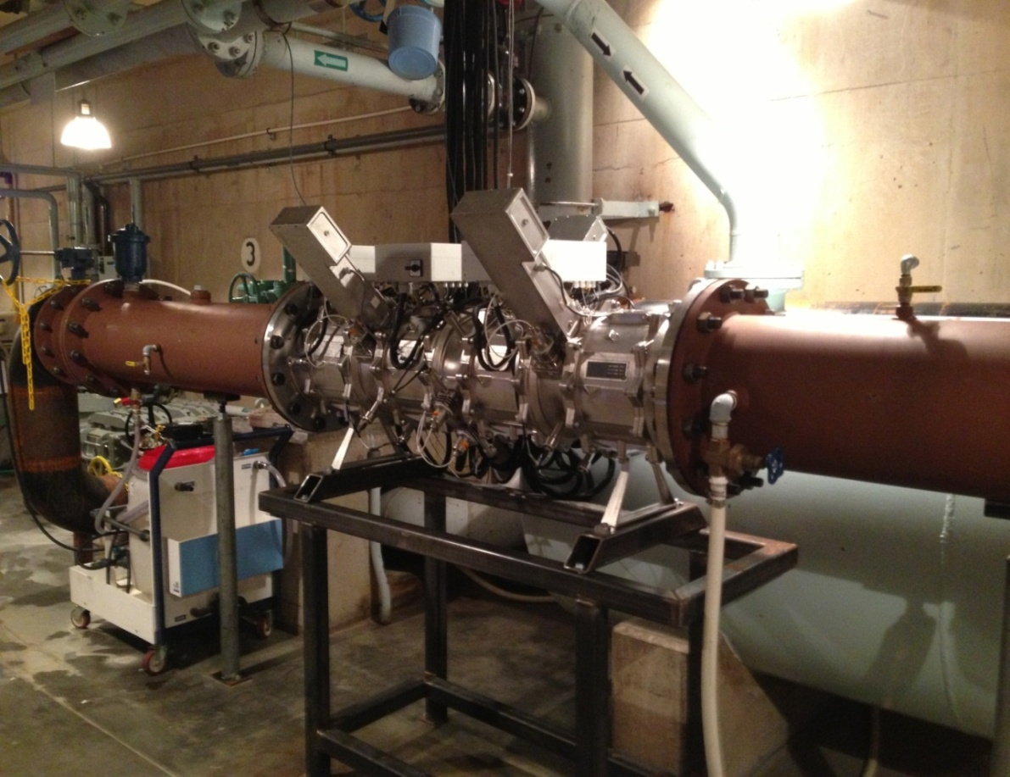
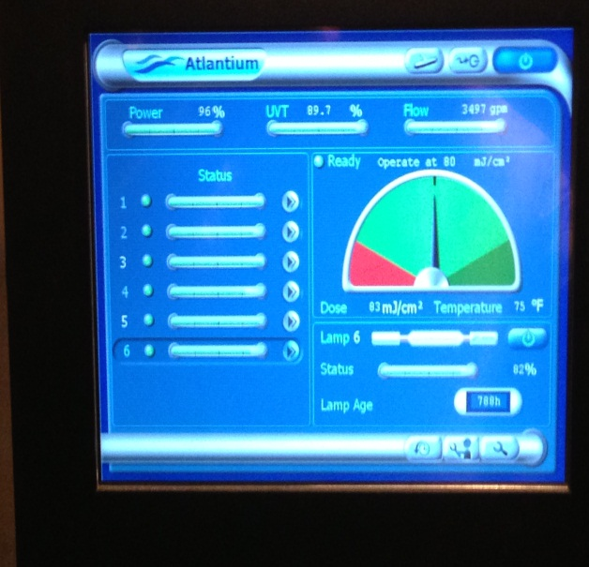
Full Sized Atlantium UV Based Power Plant Cooling Water Mussel Control System
Installed July 2013 on a 4000 GPM system

Slide 12
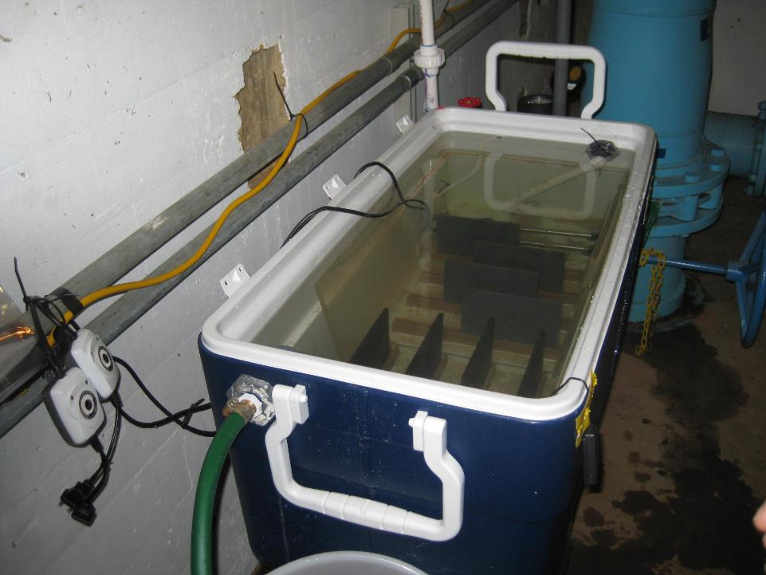

Slide 13
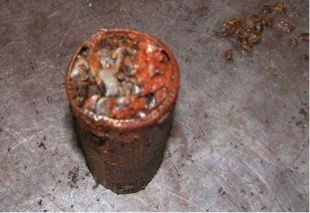
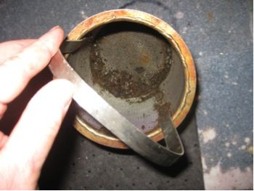
Settlement; Control (blue) vs. Treated under different UV dose levels

Slide 14
Major finding
HOD UV prevented majority of mussel settlement even at the low dose of 20 mW/cm2
Instantaneous mortality of veligers was not required to prevent settlement
Veligers exposed to HOD UV reached mortality after 3 to 4 days

Slide 15
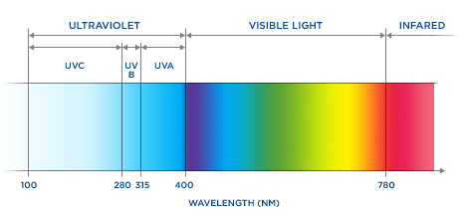
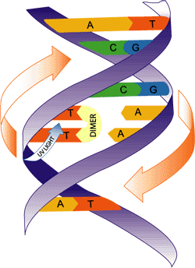
UV Dose
(mJ/cm²)
UVT (%)
Flow (gpm)
Lamp Power
UV
Apparatus
  UV ➔ Electricity ➔ Germicidal Power + Photochemistry Power
Penetrates Cell Membrane
For chemical treatment Dose = Concentration X Time [CT]
Notes:
Ultra violet light is well known because of its germicidal and photochemistry ability to disinfect water
Its mode of action comes from its ability to penetrate the DNA and inactivate bacteria
In the world of Ultraviolet treatment there exists low pressure treatment technology which emits energy at a single wave length 254 nm and Hydro Optic Disinfection UV, which is a medium pressure UV, that emits energy in a much broader energy spectrum of 200 to 415 nm which is able to cause a lot more damage to target organisms by inactivating cell repair mechanisms
In multicellular organisms like Zebra and Quagga mussel veligers, we are not sure what damage takes place, but our research has shown that HOD UV with its broader spectrum of treatment does a better job of killing veligers with a lower dose than low pressure lamps at a higher dose.

Slide 16
Aspects of HOD UV System not shared by other Medium Pressure systems
Atlantium HOD UV has total internal reflection inside the chamber which allows for energy to bounce around in the chamber and achieve a uniform dose throughout the chamber compared to other types of medium pressure systems without this feature
As the lamps age, dose pacing adjusts the lamp output to maintain the correct dose
As water quality (UVT- UV transmissibility) changes over time, two sensors per lamp can adjust the dose to maintain the effective dose

Slide 17
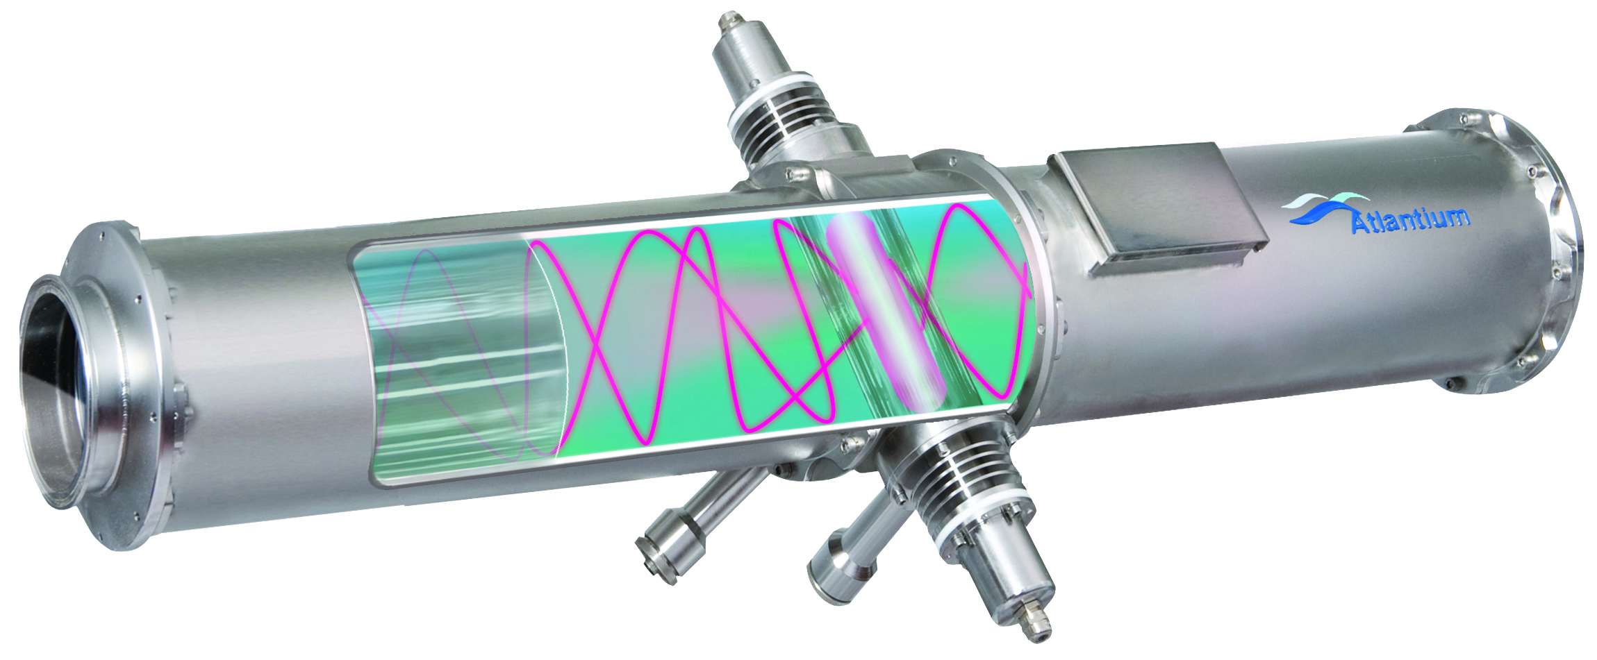
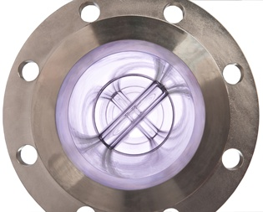
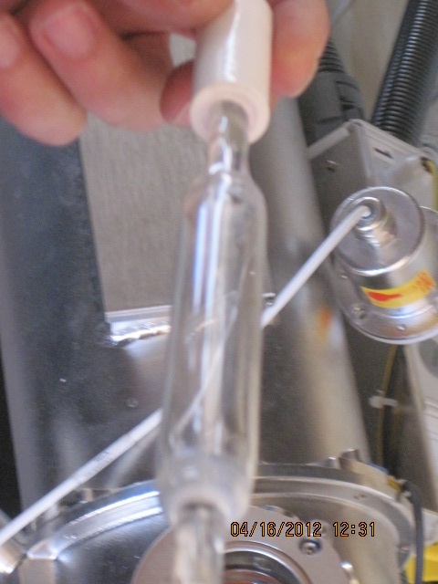
Atlantium Technologies HOD UV System
1

Slide 18
HOD UV Treatment of Mussels in Low UVT Water

Slide 19
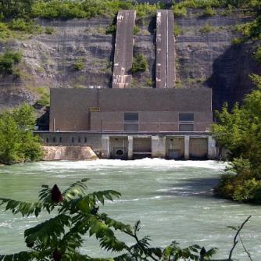
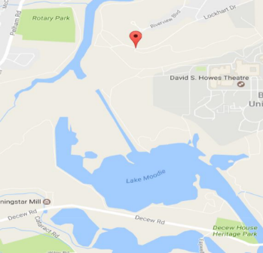

OPG Decew NF23 Generating Station full-scale study low UVT%
OPG Study
Number of generating units – 2
Nameplate capacity total: 140mW
Cooling water flow rate –
1,895gpm / 430m³/h

Slide 20
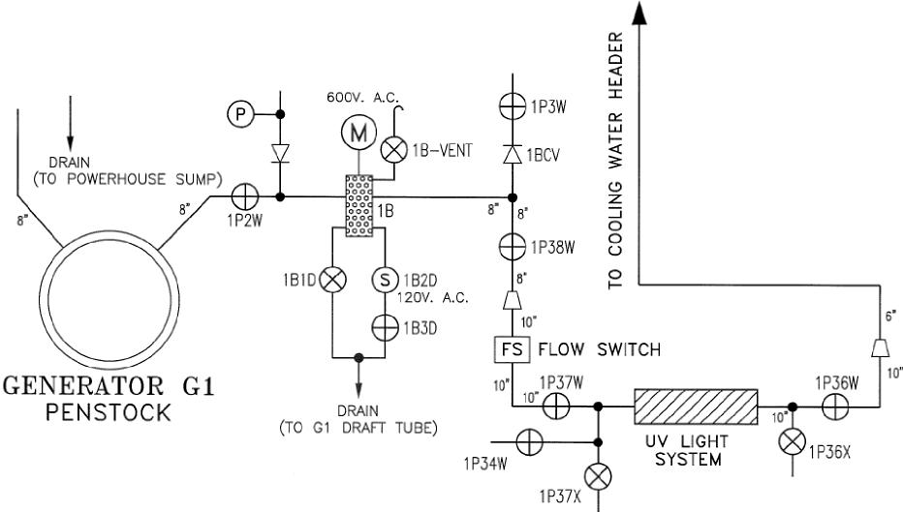
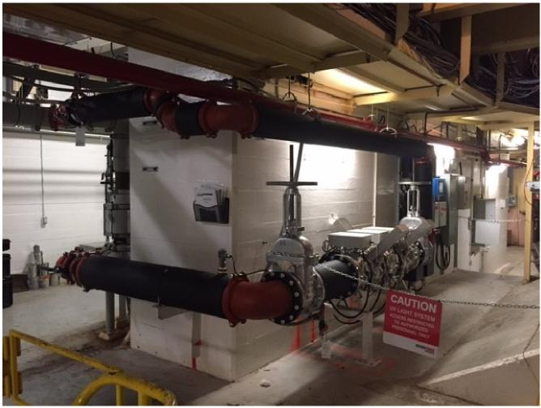
%UVT Temperature Flow Rate | 49.79 % – 98.99 %
 | 8 – 30 ºC 430 m³/h (1,895 gpm)

Slide 21
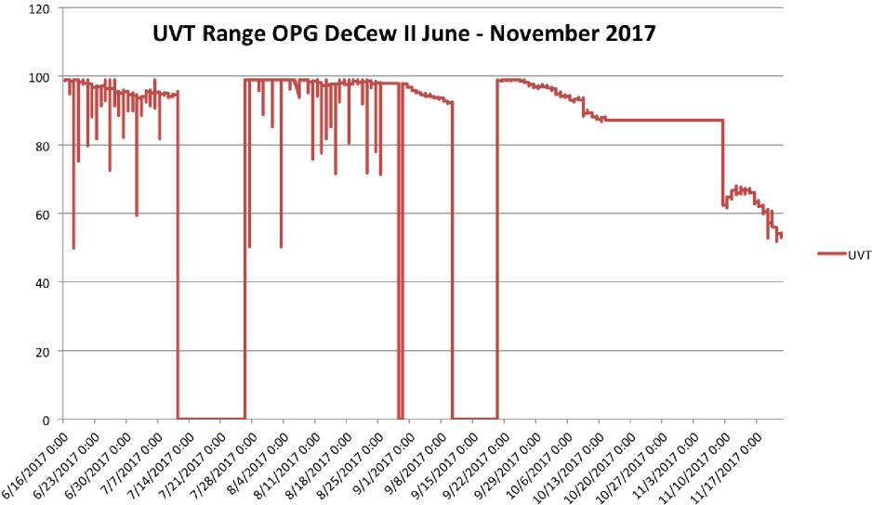

Slide 22
Some settled pediveligers were detected on the sampling plates in the test biobox. These individuals, although attached, did not grow over time and eventually sloughed off.

Slide 23
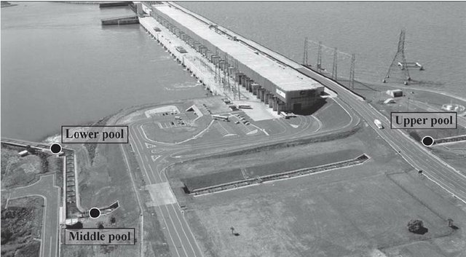
Test with Golden Mussel in Brazil
Test done at Sergio Mota-CESP hydropower plant, Parana River, Porto Primavera, 2013

Slide 24
Evaluation of Golden Mussel Treatment with HOD UV in Brazil
UVT - 82
A portion of incoming water was treated with dose of 80mW/cm2
After 90 days, mussel accumulation was reduced by 98-100% on settlement plates in the treated stream vs. settlement in the non- treated stream

Slide 25
Evaluation of HOD UV for Quagga Mussel Treatment in the Missouri River

Slide 26
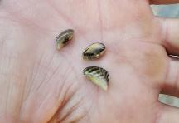
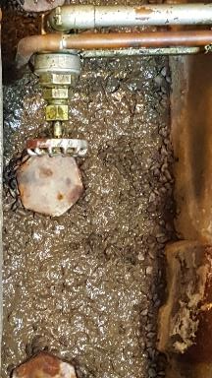
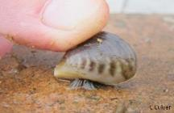
History of Mussels at Missouri River Hydroelectric Power Plant
Mussels first found in 2014
Found on spillway stop logs and boat ramps
Found in many places in 2015
Firmly established infestation by 2016
Notes:
Sources on the first found location of mussels at Gavin’s Point and in Lewis and Clark Lake vary.
If you were to ask the rangers they would say the first zebra mussel was found on a boat dock at midway in November of 2014.
Those in the powerhouse would tell you the Contractors were finding them on the stop logs when doing spillway gate rehab in April 2014.
Never the less we had a firmly established infestation by 2015.

Slide 27
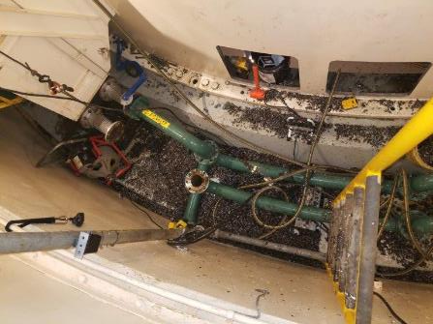

Plant Raw Water System
The most impacted system
Clogged Air Coolers
Clogged Thrust Bearing Coolers
Clogged Packing Gland Strainers
Severely Reduced flows
Overheating units
Unit outages

Slide 28
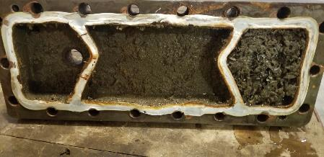
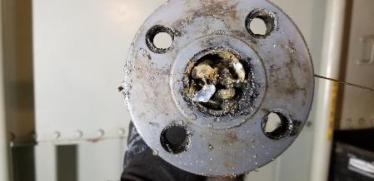
Thrust Bearing coolers
Cooler Cover June 2018
Cooler Supply Clogged June 2018

Slide 29
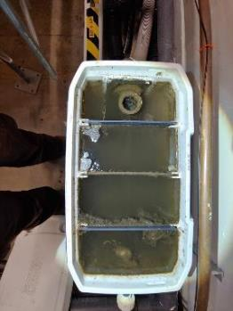
Mitigation- HOD UV Lights
Main source of mitigation is the Raw Water Strainers and HOD UV
Monitoring/Validation started in October 2018 finished in December 2020
2 units, North and South
Bio box study to validate the effectiveness of the HOD UV
Notes:
We have also talked about trying a Zequanox treatment or something of the sort but no move has been made forward in these discussions.

Slide 30
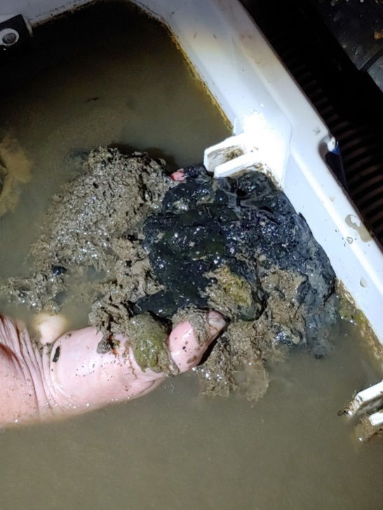
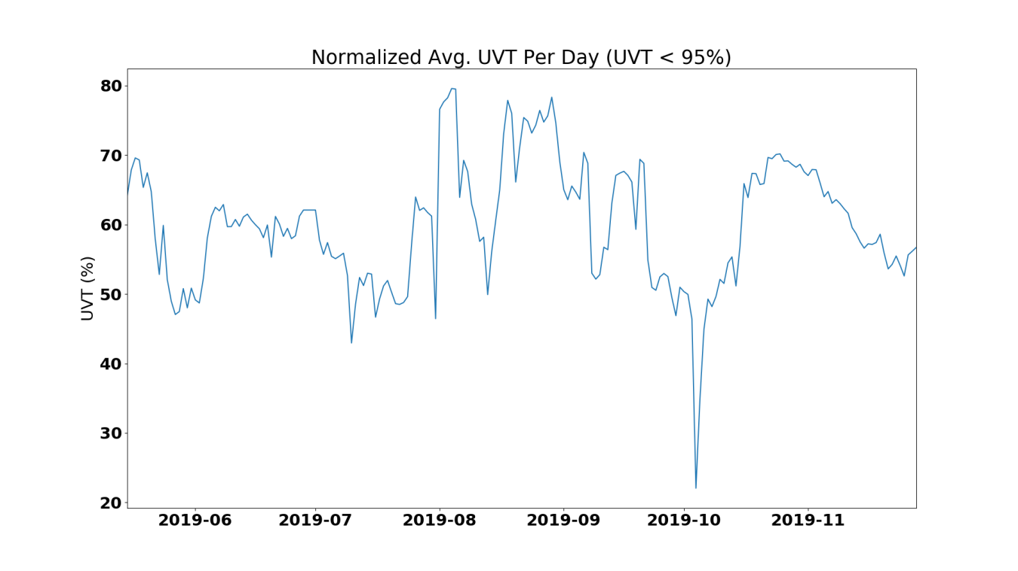
2019 Biobox Validation
400 mussels settled in the unprotected biobox versus 3 adults found in the biobox protected by HOD UV system <99% reduction.
In 2019 UVT was below 50% transmissibility for 25.7 days out of 120 days

Slide 31
2020 Biobox Validation
UVT below 50% transmissibility for 68 days out of 120 days
Date | Before Biobox | After Biobox
July 20,2020 | 6 | 0
September 3,2020 | 31 | 0
November 16,2020 | 16 +151 + 676 | 0
Total settlement | 880 | 0

Slide 32
Questions?

