Slide 1
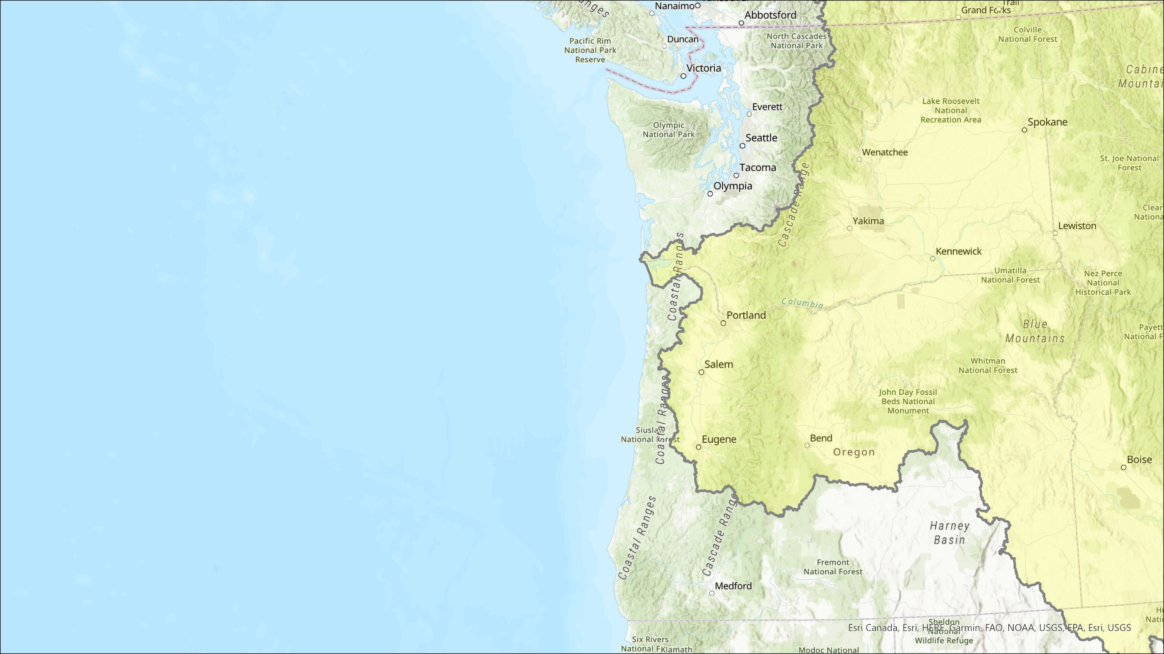







2021 Dreissinid mussel Monitoring results and 2022 Plans
Rich Miller, Catherine de Rivera, and Mark Sytsma
Columbia River Basin Dreissinid Mussel Monitoring Forum January 11, 2022

Slide 2
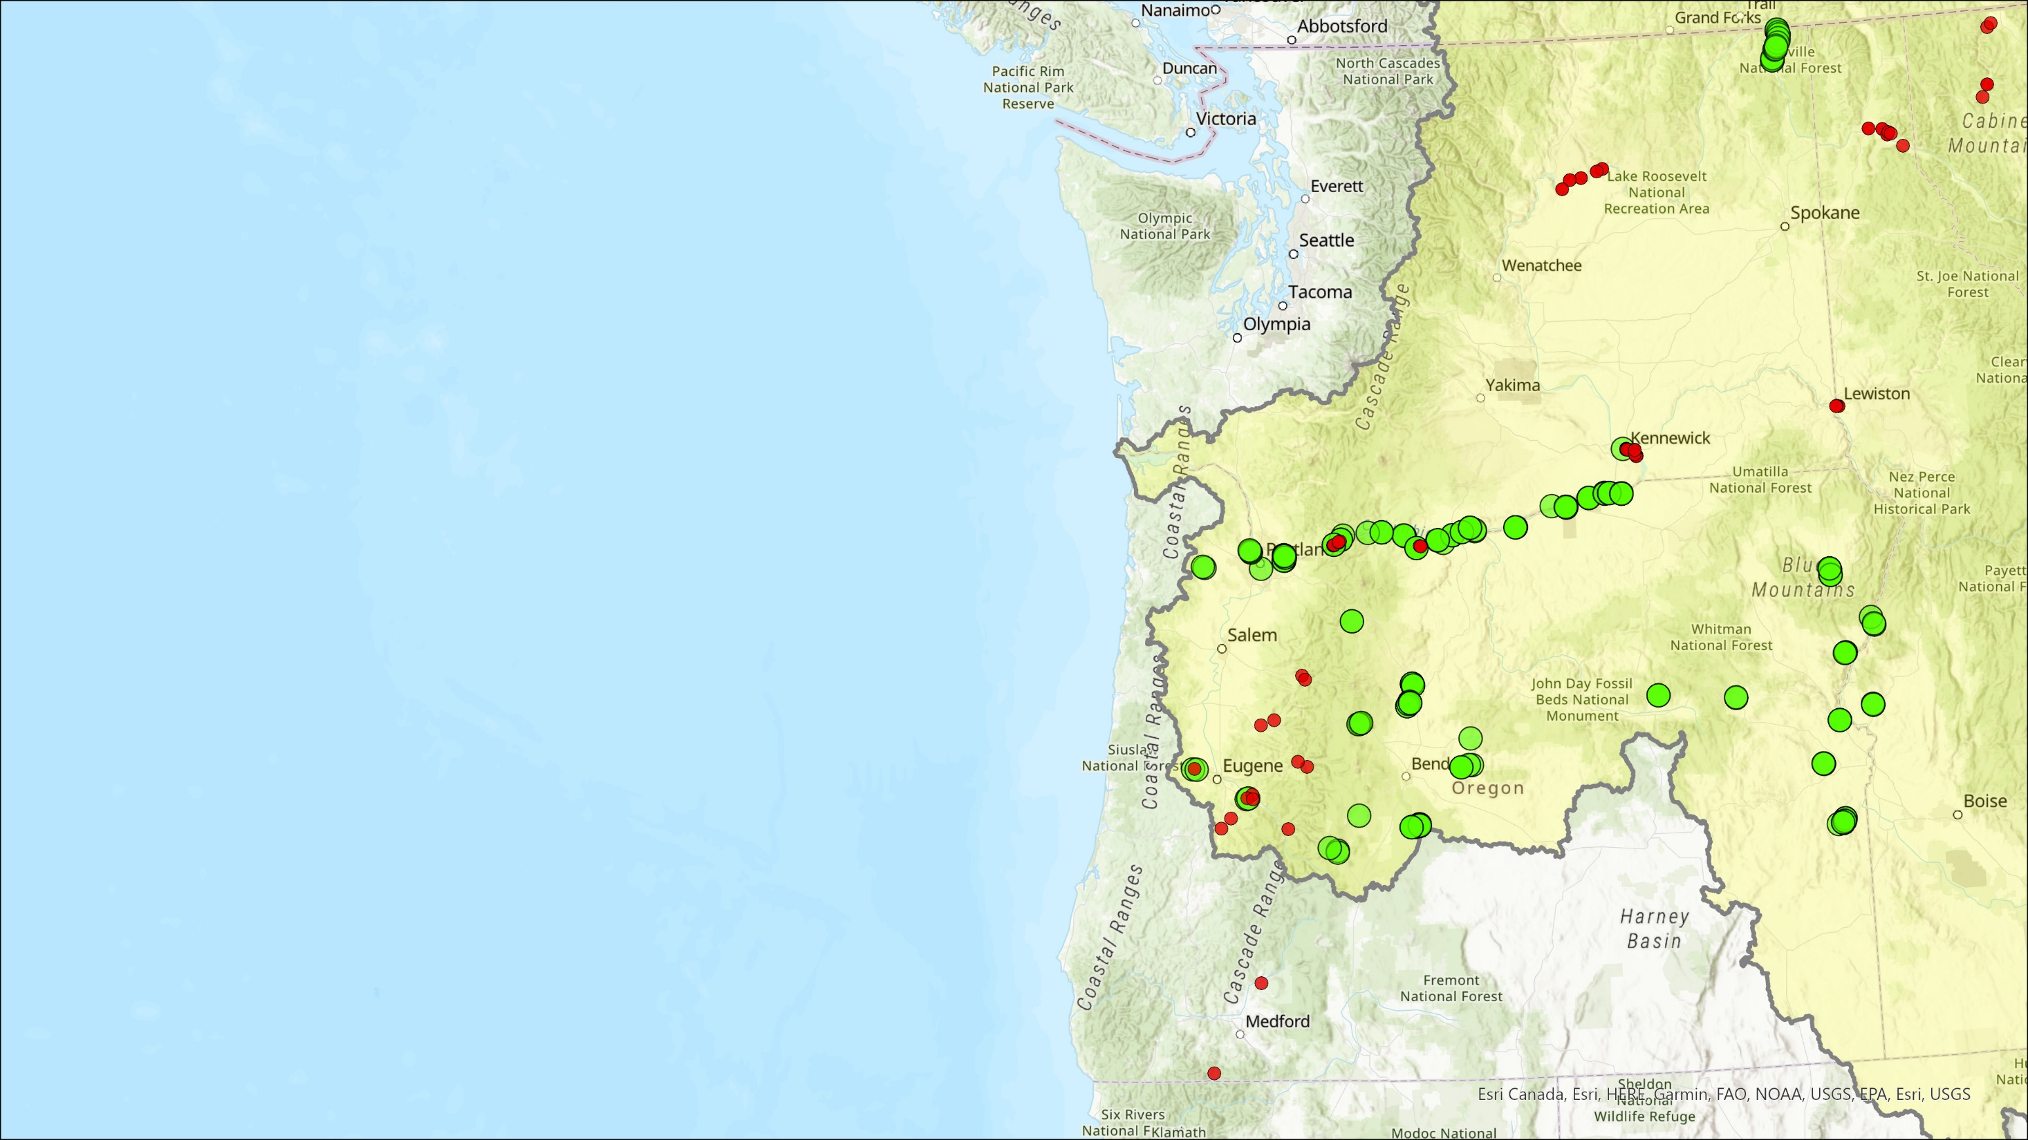
PSU 2021 Monitoring Results
Veliger Surveys
Mostly high- to medium-risk waterbodies (Wells et al. 2011)
Two high-risk waterbodies not sampled due to low water (Malheur Reservoir, Warm Springs Reservoir)
Three medium-risk waterbodies not sampled due to low water or access issues (Buckeye Lake, Hart Lake, Mann Lake)
Samples collected from 50 waterbodies using 64 µM mesh, 30 cm diameter nets using horizontal, vertical, and stationary collection methods
Up to four sampling events per waterbody per year
248 total veliger samples collected
4,003 m³ total tow volume collected
No Dreissinid veliger detections using cross-polarized light microscopy (Aquaticus LLC)
Juvenile Corbicula fluminea in Boundary Reservoir, Columbia River and reservoirs, Snake River Reservoirs, and Willamette River and reservoirs.
PSU Monitoring Sites
USACE Monitoring Sites
2

Slide 3
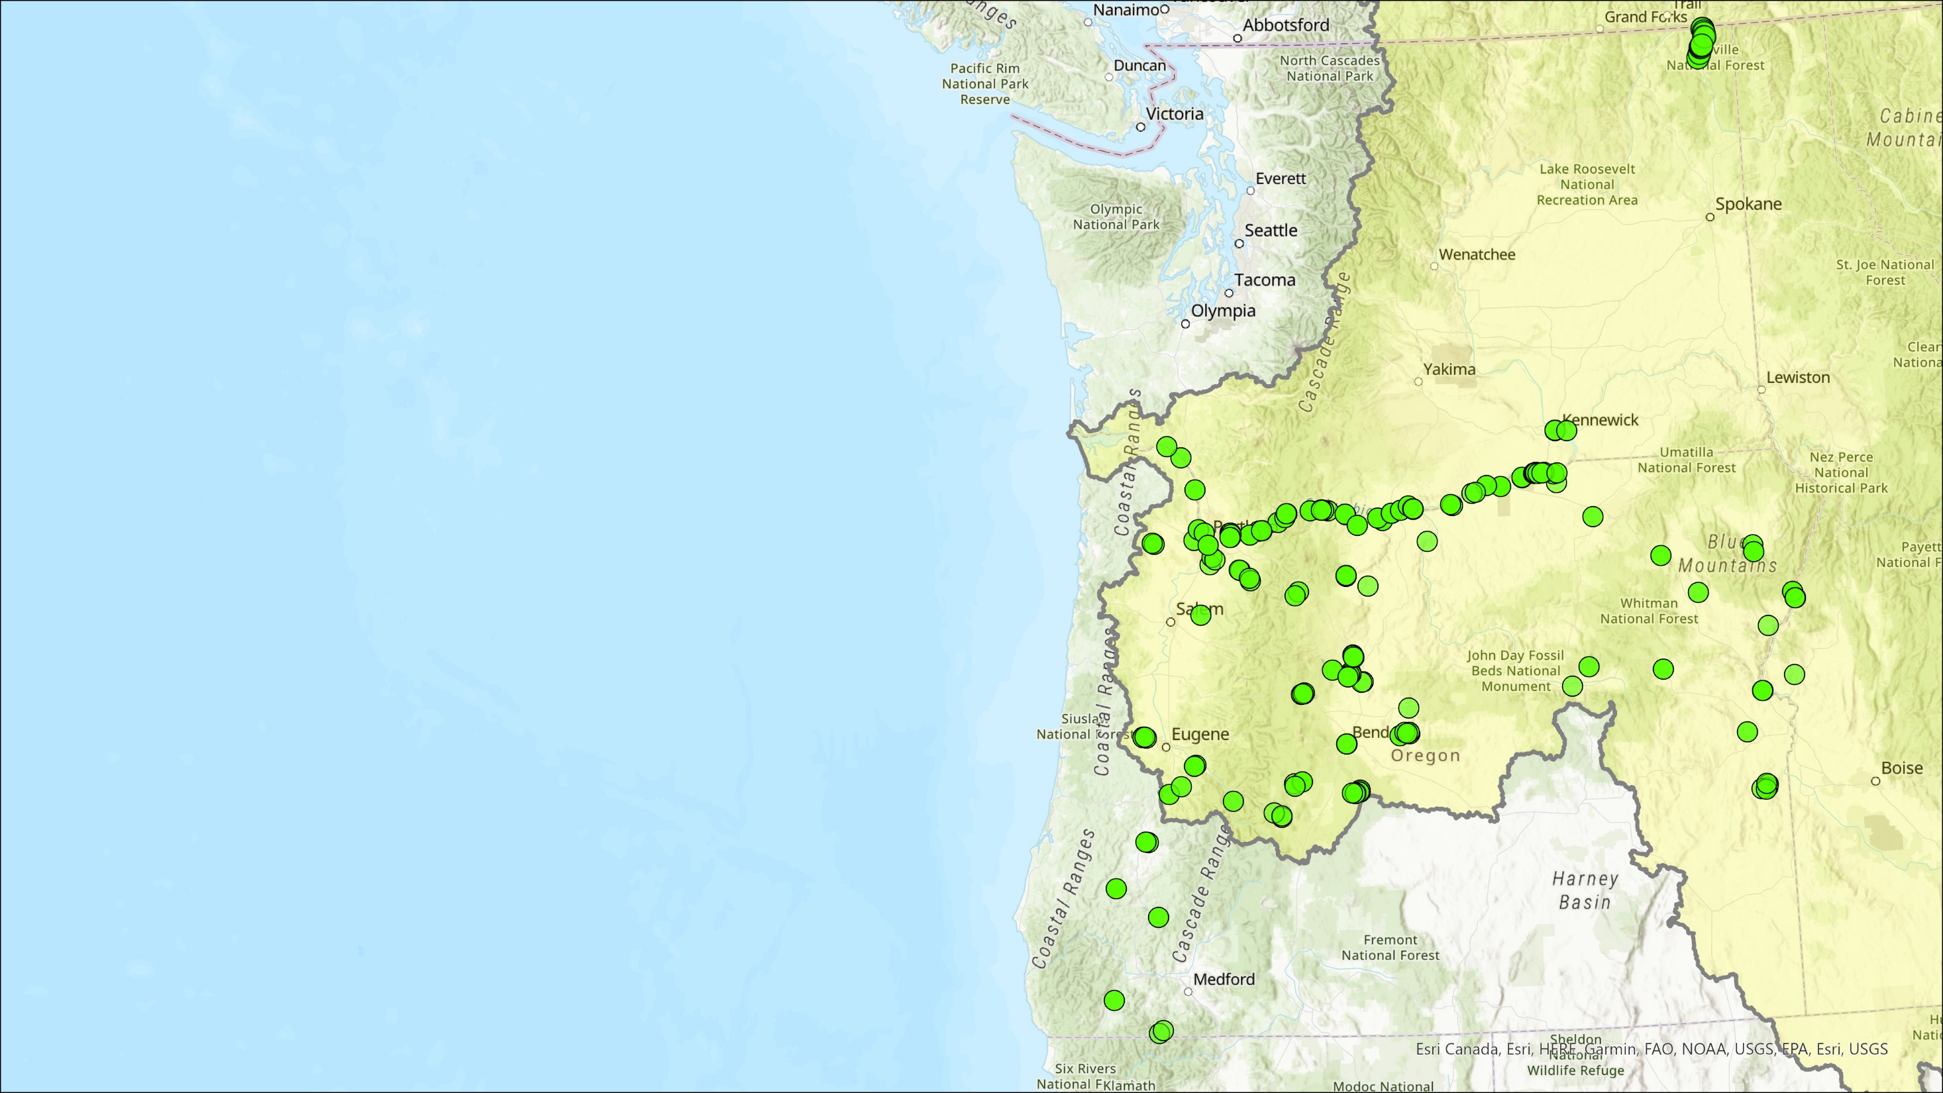
PSU 2021 Monitoring Results
Adult Surveys
57 waterbodies surveyed
139 sampling areas
193 dock pat-downs (6048 m total)
188 shoreline surveys (5382 m total)
172 rakes grab/bucket rinse samples
48 ponar grab samples
No adult Dreissinid mussels found
New Zealand mudsnails found in Lake Wallula and Lake Umatilla
PSU Monitoring Sites
3

Slide 4
PSU Dreissinid Monitoring
Plans for 2022
Continue veliger and adult Dreissinid mussel monitoring:
Seattle City Light – funded. Continue with similar effort as 2021
USBR – funded though 2023. Monitoring start in June, and hope for more water in USBR reservoirs
USFWS – funded. Oregon State Plan will be used to fill in monitoring funding gaps
WRDA – submitted proposal. Lower funding request due to limited match availability.
BPA – will submit proposal and hope to continue work with USACE partners
Continued emphasis on high- and medium-risk waterbodies
Coordination to compliment efforts of others in Oregon (e.g., Oregon Dept. of Fish and Wildlife)
No plans for eDNA sampling
4

Slide 5
PSU Dreissinid Monitoring
Questions
Rich Miller | richm@pdx.edu | 971-506-7594
Catherine de Rivera | derivera@pdx.edu
5

